Slide 1
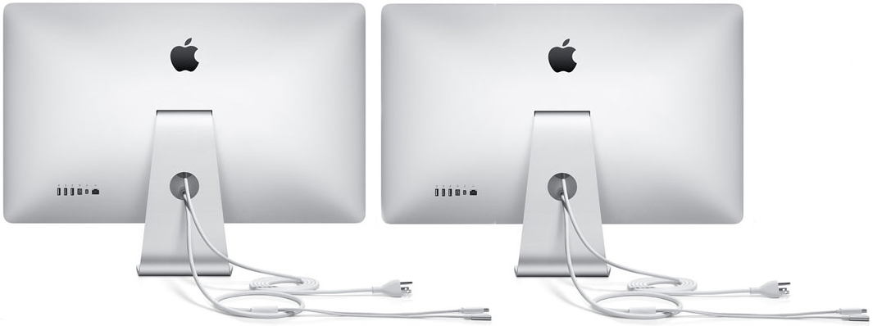
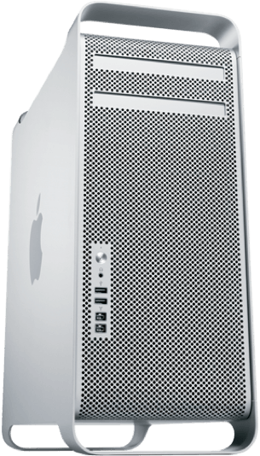
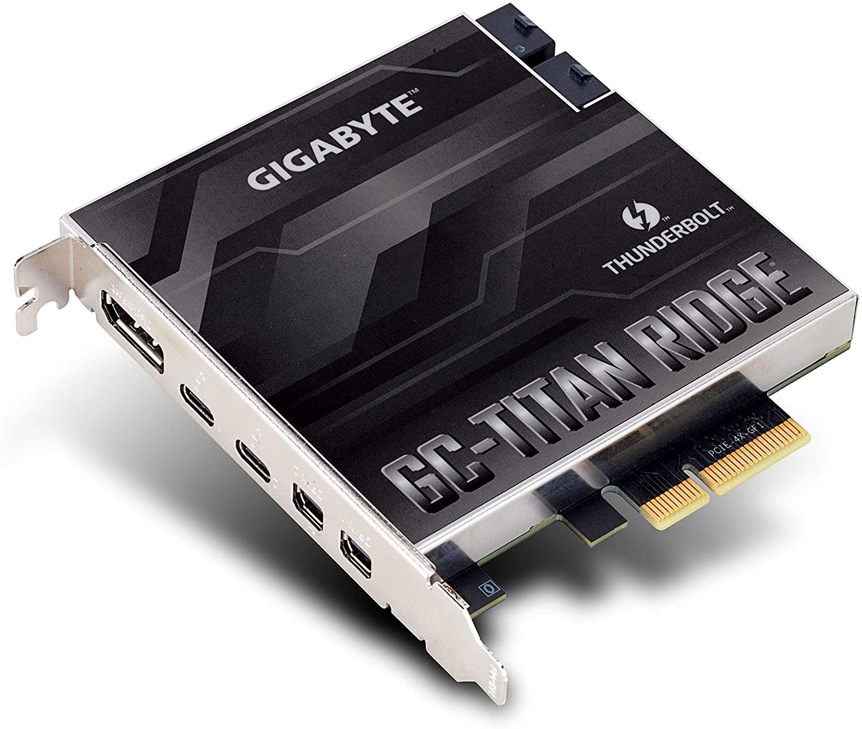
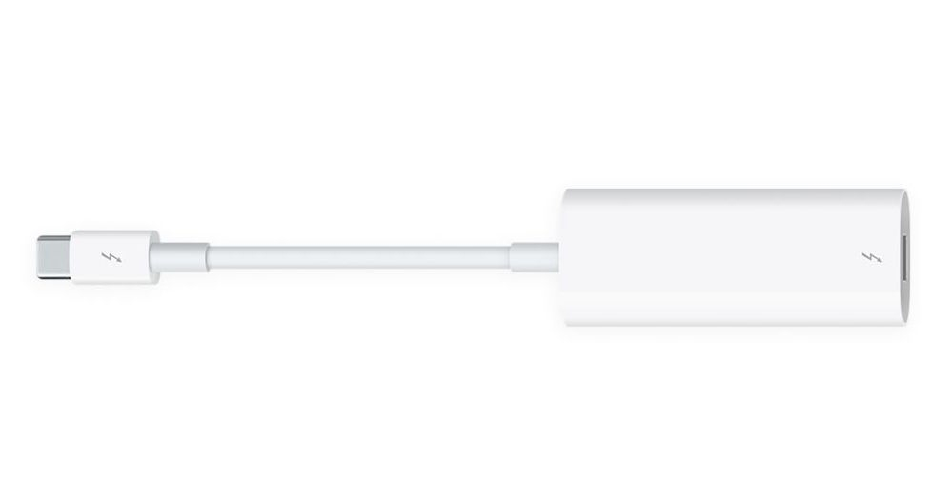
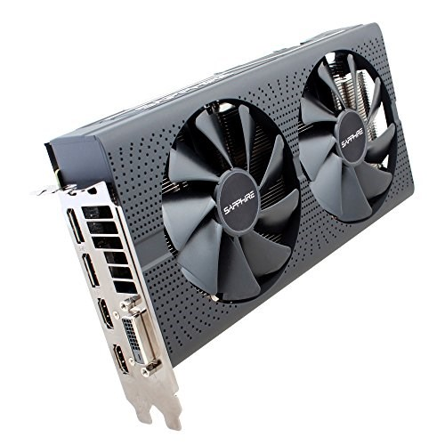
5
4
3
PCI Slot 4
1
2
Connect Display Port to the Mini Display Port Using the provided cables
3
Connect Thunderbolt 2 to 3 adapter to any of the thunderbolt 3 ports
4
Connect the Thunderbolt cable from monitor to the adapter
1
5
Connect second Thunderbolt cable from monitor to first thunderbolt display thunderbolt port at the back
2
PCI Slot 1

