Slide 1
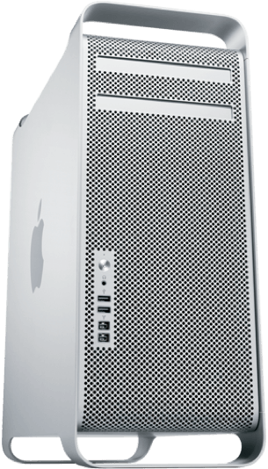
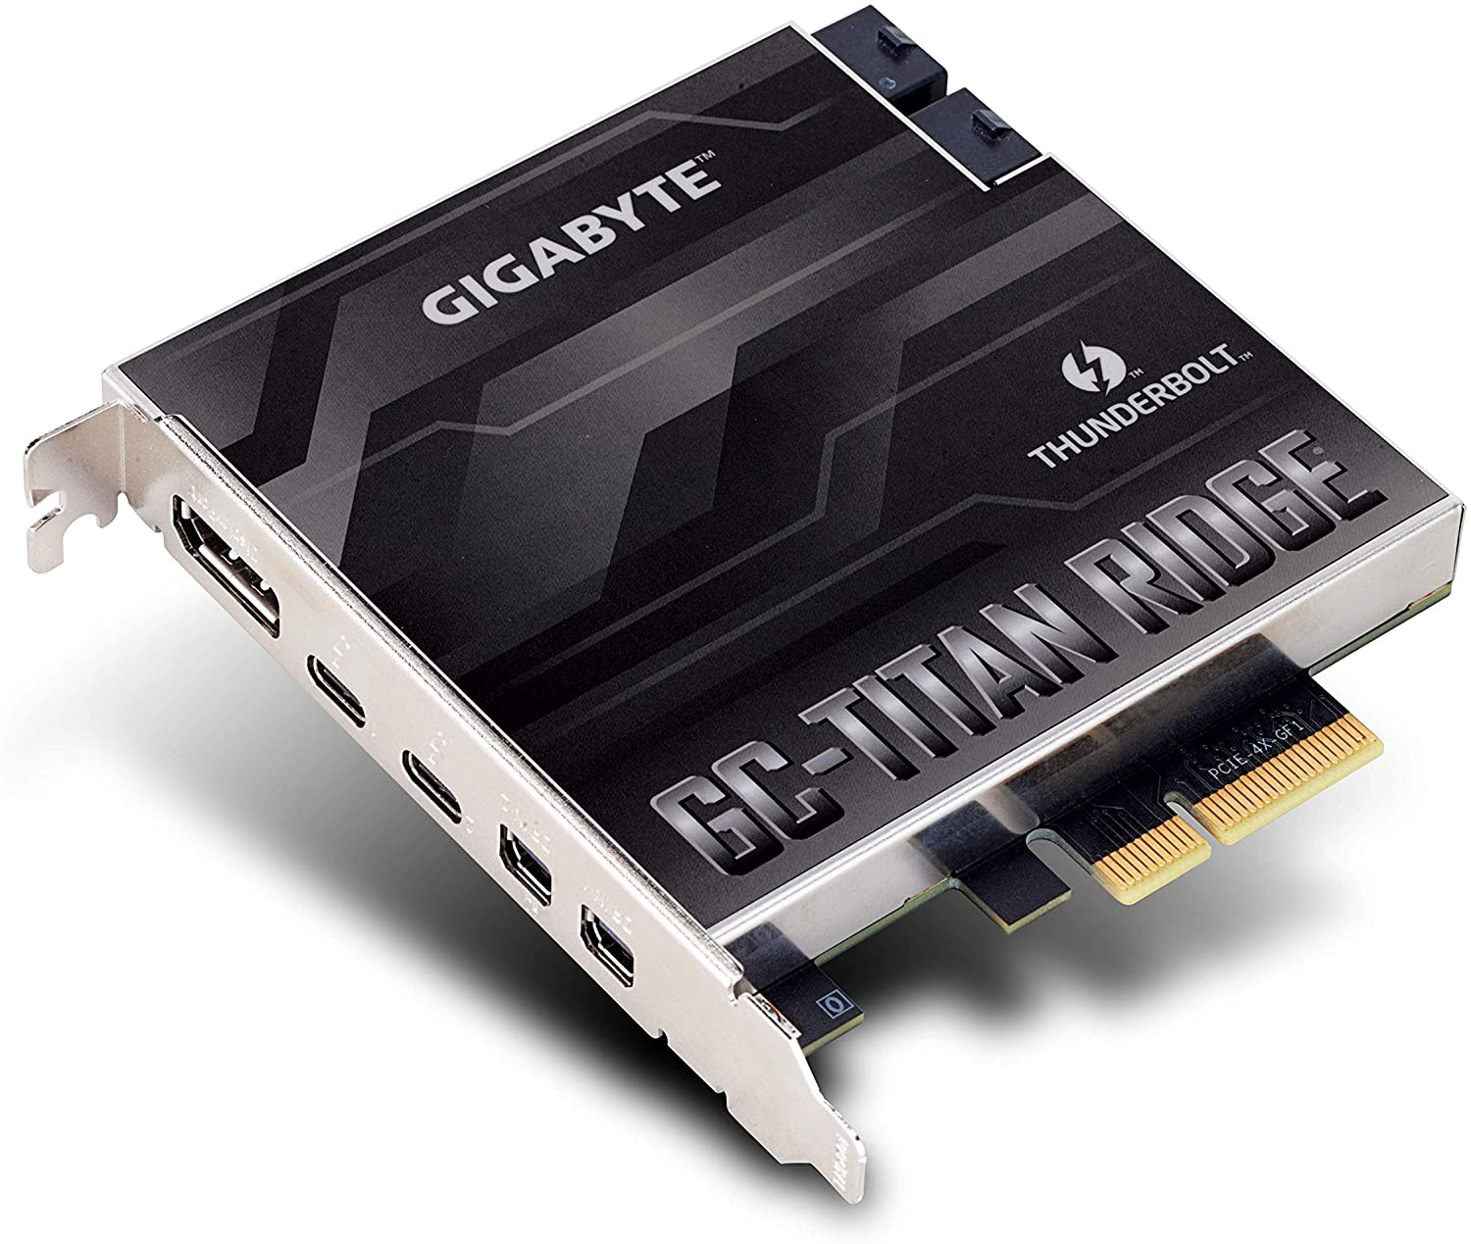
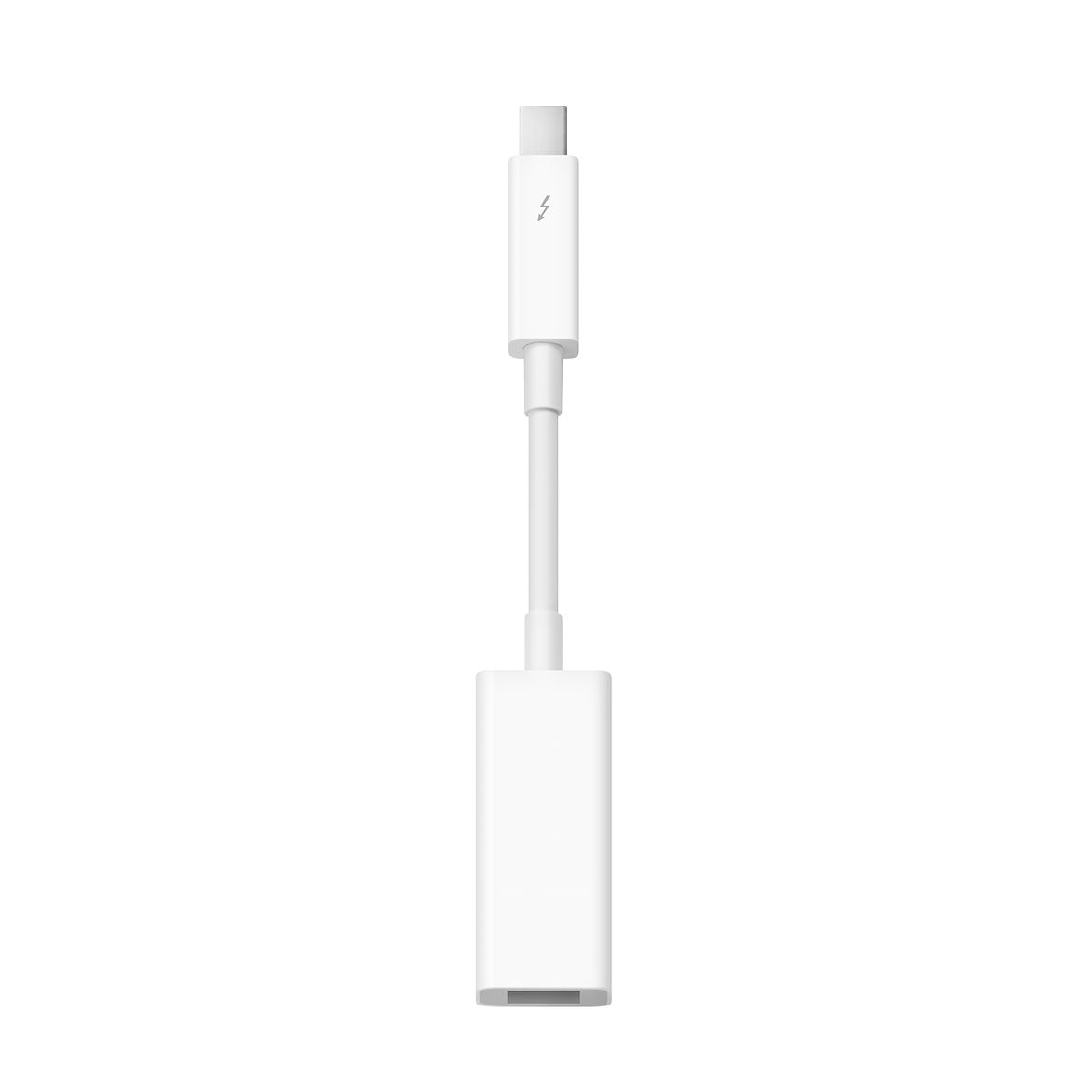
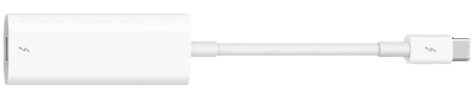
MOTU 828mk2
Front
MOTU 828mk2 Back
3
2
1
PCI Slot 4
1
Connect Thunderbolt 2 to 3 adapter to any of the Thunderbolt ports
on the GC-Titan Ridge card
2
Connect Thunderbolt to Firewire adapter to Thunderbolt 2 to 3 adapter
3
Connect the Firewire cable from the Thunderbolt to Firewire adapter to the
Firewire port at the back of the MOTU 828mk2

