Slide 1
Sign Language Interpreter
(leveraging computer vision)
Team: Tech Transofmers Date of Presentation -28th April 2025
Lasya - Facilitation, backend & Integration
Varshini - Design, Data acquisition and backend
Mounika - Testing
Darsani - Debugging
Saanvi - Design Event -Second Evaluation
Shritha - Frontend
Harini - Bug fix and regression
Institution : CR RAO AIMSCS

Slide 2
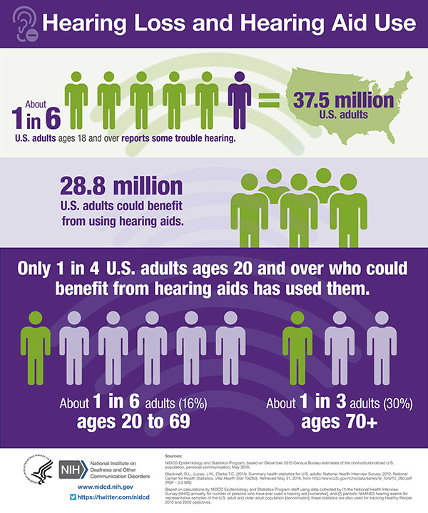
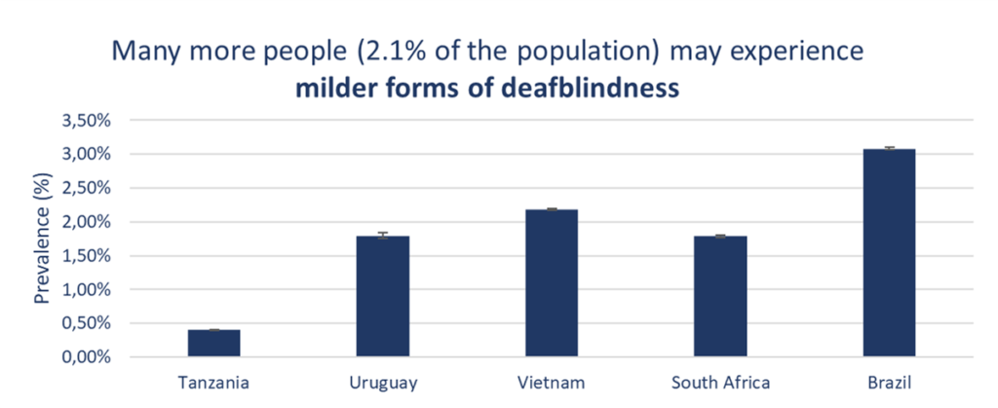
PROBLEM STATEMENT:
                People with hearing impairment might face challenges to interpret sign language. Visual impairment makes the problem even more worse.
                Human interpreter or text based communications may not be adequate enough in terms of accessibility, efficiency or affordability.

Slide 3
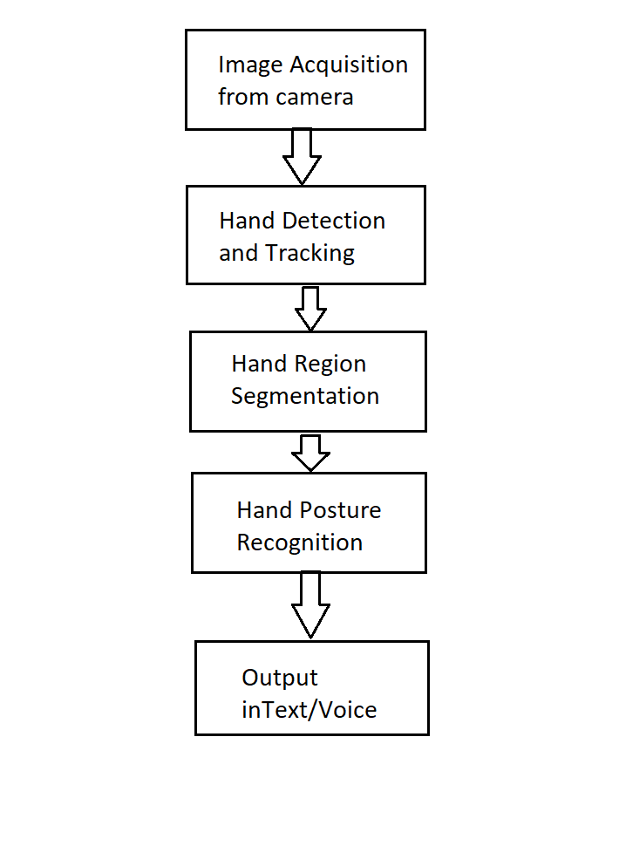
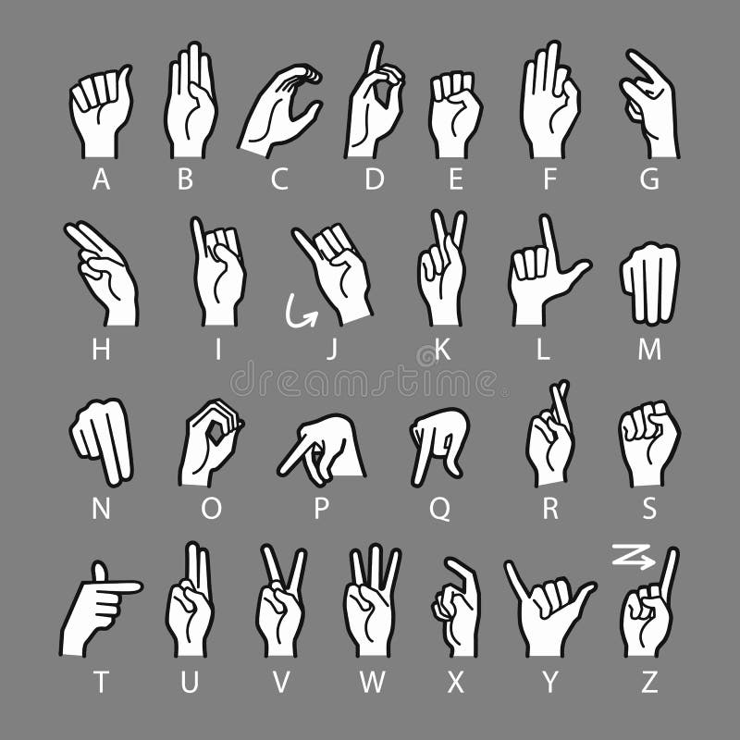
Proposed Solution
To facilitate hard-of-hearing individuals with an ML driven system that translates sign language gestures into text and speech.
Functionalities to be implemented
Convert recognized gestures into text and display.
Use text to speech API’s to fetch audio output.

Slide 4
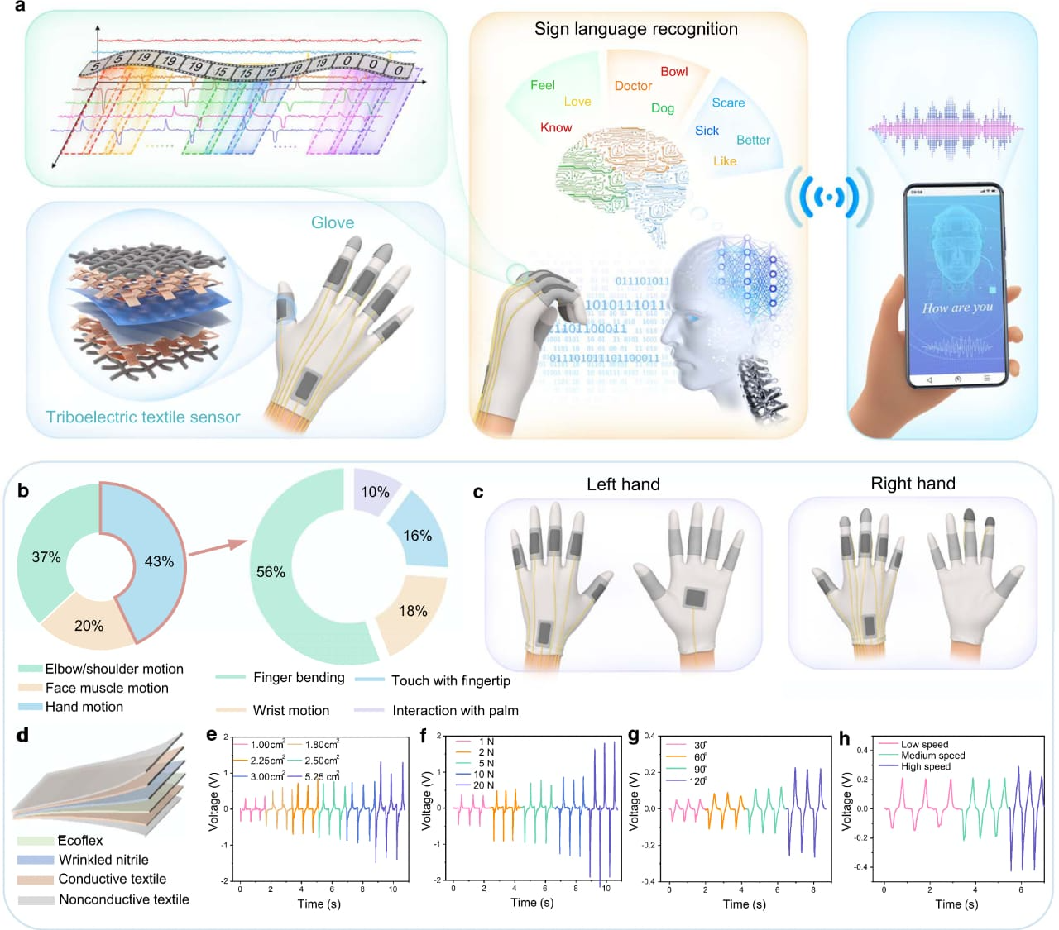
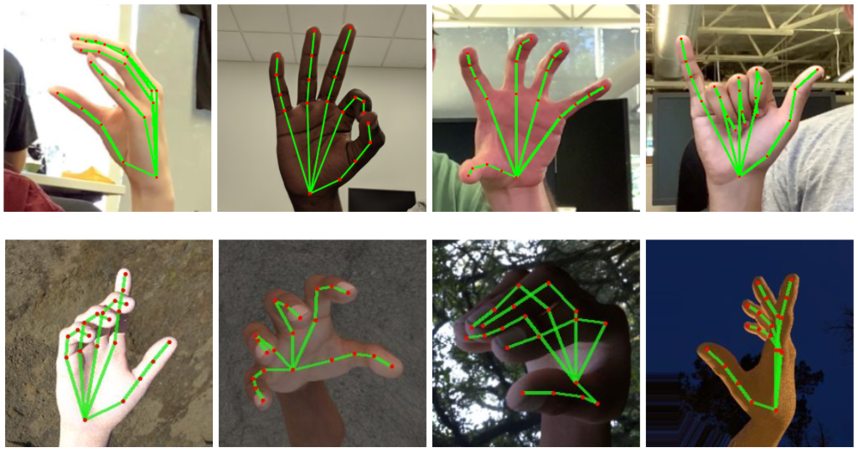
Opportunities & Innovation
Benefits to Society: Supports both visually and hearing impaired.
Exploit computer vision and ML techniques to make the job easy.
Supports multiple devices and platforms.
Train the model extensively for improved accuracy.

Slide 5
Features of the solution
Key Functionalities:
                1. SLI has a provision to prompt for language
                User can choose language of their choice for SL to text conversion.
                2. SLI preserves co-ordinates of acquired images and develops a model to distinguish among various gestures.
                3. Trains the Model in a rigorous way to attain utmost accuracy
Usability & Benefits:
                1. Cost effective and User friendly
                2. Can act as a bridge between the impaired and the rest of the world.
                3. Once the application is live, it can be extended to multiple platforms.

Slide 6
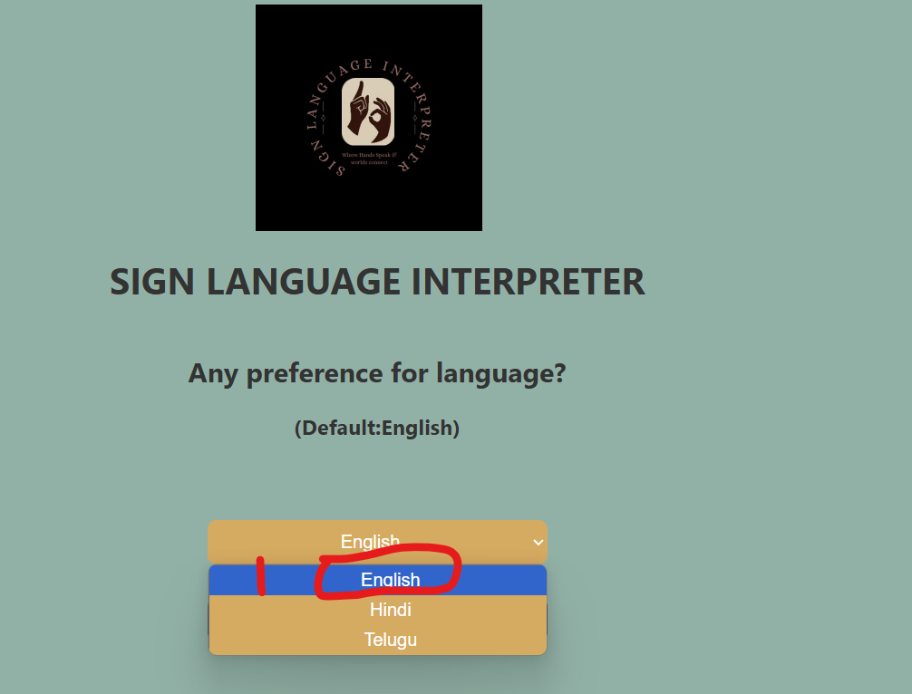
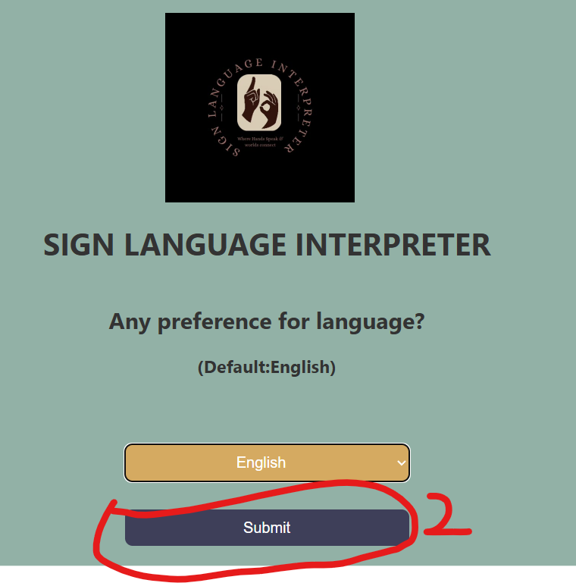
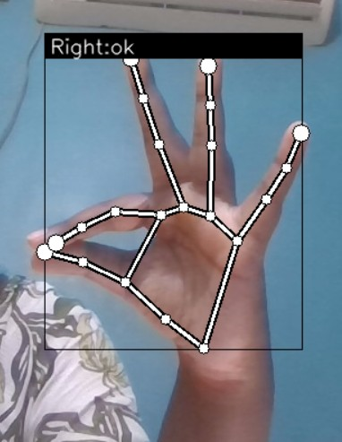
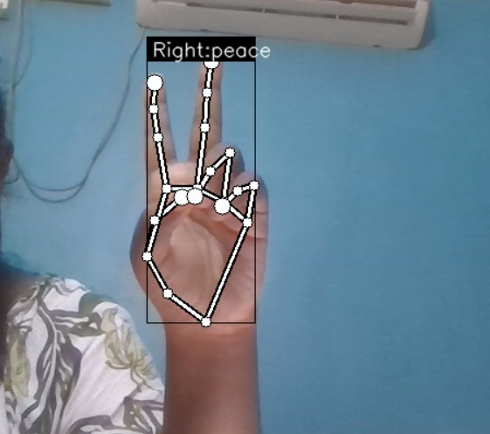
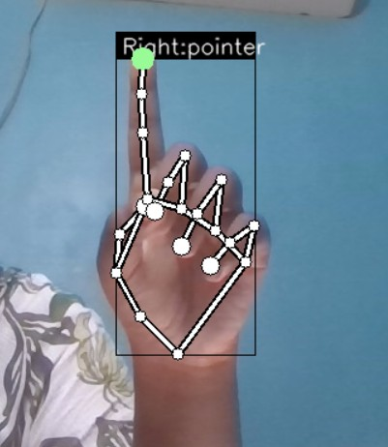
Current Status of the Work
Glimpses of the work so far:
What’s been done so far?:
                Proof of concept is implemented to recognize few gestures.
                Front-end is developed with minimal requirements.

Slide 7
Flow diagram
Flask application
SignLanguage interpreter(back end)
1. Sets up capture device
2. Initiates keypoint classifier – Module responsible for hand gesture points acquisition and ML model creation
3. Initiates points history classifier – Module responsible for model training
4. Runs the application in a relentless mode to identify the gestures on the fly.
Frontend
Acquire Language option
Click submit

Slide 8
Tech stack
Programming languages:
                Front end: HTML, CSS
                Back end : Python
Framework : Flask
Packages :
    TensorFlow – ML model creation and training
    OpenCV – Capture images
    Mediapipe – process video/image files
    Numpy - Large data processing
    Tools: Pycharm, Jupyter notebook(Anaconda)

Slide 9
Development Journey
Milestones:
  Design – Tremendous progress on identifying the requisite technologies and algorithms to be leveraged.
  Considerable progress on front-end
  Flask application is completely functional.
  Backend application - Sign language Interpreter module works for few of the gestures.
Next Steps
Improvise the front-end part. Leverage advanced frontend frameworks.
Expand the functionality to cover regional audio output as well.
Need to do some research on API’s that can convert text to regional languages.

Slide 10
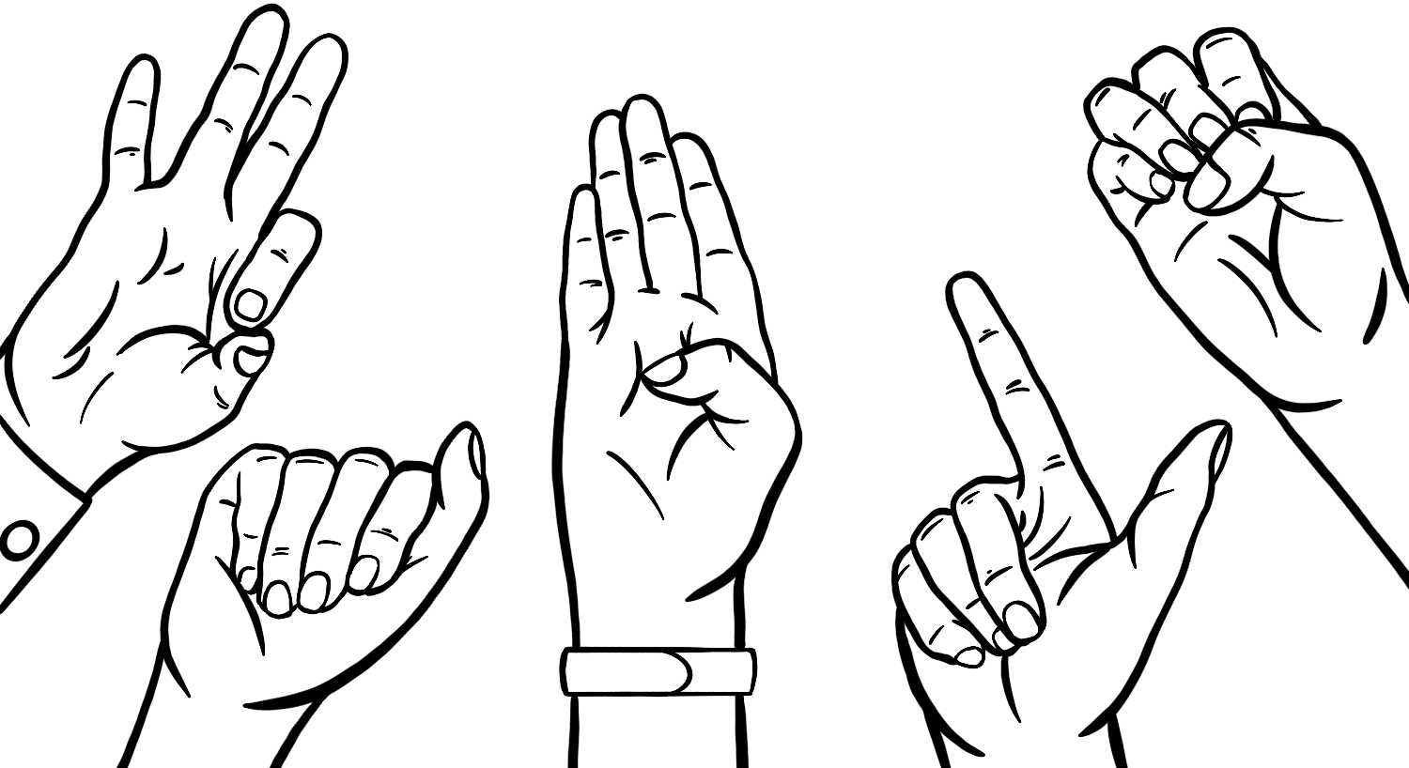
Thank you

