Slide 1


CYBER HELP BUTTON AND SOS
One Tap to Outsmart AI Scams!

Slide 2

Problem Statement
AI-driven scams, deep fake fraud, and cyber threats are rising, making people vulnerable to impersonation, financial fraud, and misinformation. At the same time, emergency response systems are fragmented, causing delays in critical situations. CyberHelp is an AI-powered security assistant that detects deep fake scams in real-time and provides a one-tap smart SOS system protecting users from cyber threats while ensuring instant access to the right emergency services.

Slide 3
Solution
The CyberHelp Button detects deep fake scams, prevents fraud, and enables instant emergency response. It analyzes voice and video in real-time, identifying AI-generated threats. A long-press triggers an SOS, sharing location, recorded evidence, and risk analysis with emergency contacts. With silent distress signals, live tracking, and tamper-proof evidence storage, CyberHelp ensures rapid, reliable protection against AI-driven deception.
CyberHelp is not just a button—it’s a defense system, built to outsmart AI deception and protect lives.

Slide 4

How it works
Smart Detection: If you receive a suspicious call, CyberHelp analyzes the voice in real-time to detect deep fake scams.
Instant SOS: A long-press on the button silently alerts your emergency contacts.
Secure Evidence: The app records and encrypts the conversation for proof and verification.
Quick Response: Your trusted contacts or authorities are notified immediately for fast action.
Alerts emergency contacts with real-time location tracking.

Slide 5
Technologies used
For deepfake detection, you can use:
SOS Signal (Kotlin) - to alert trusted contacts.
Pre-Trained AI Models (Deepware) – Analyze and compare voiceprints for real-time verification. Identifies synthetic voices based on frequency patterns.
Deepfake Detection Models (DeepFace, FaceForensics++) – Detect manipulated video and AI-generated facial movements.
Python (Flask/FastAPI) + OpenCV/TensorFlow – Process and analyze video for deepfake characteristics.

Slide 6
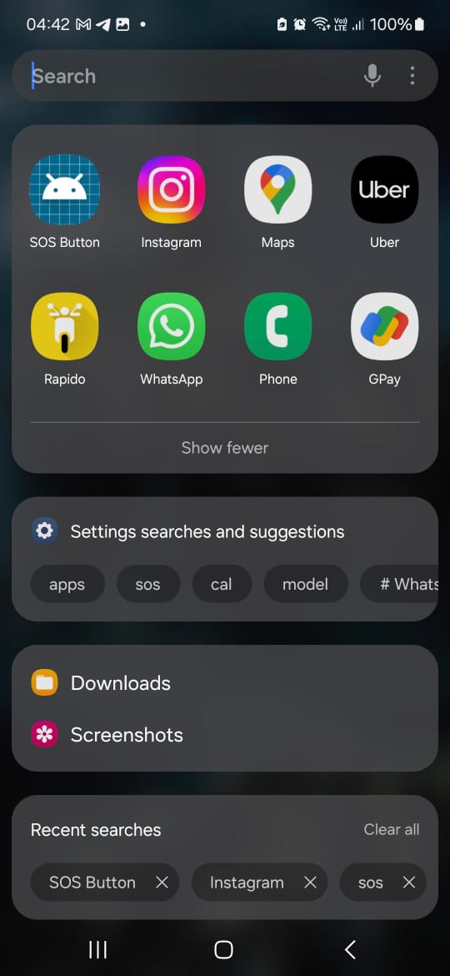

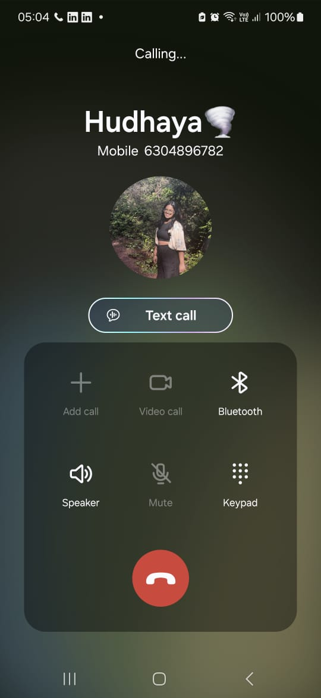
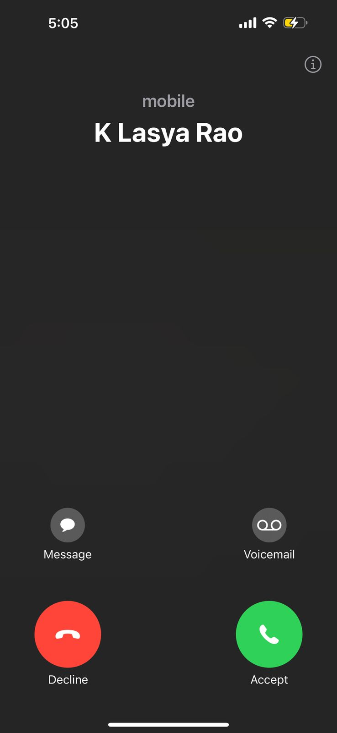

Prototype
Locating the App
Long press the button
Calling
Receiving call

Slide 7
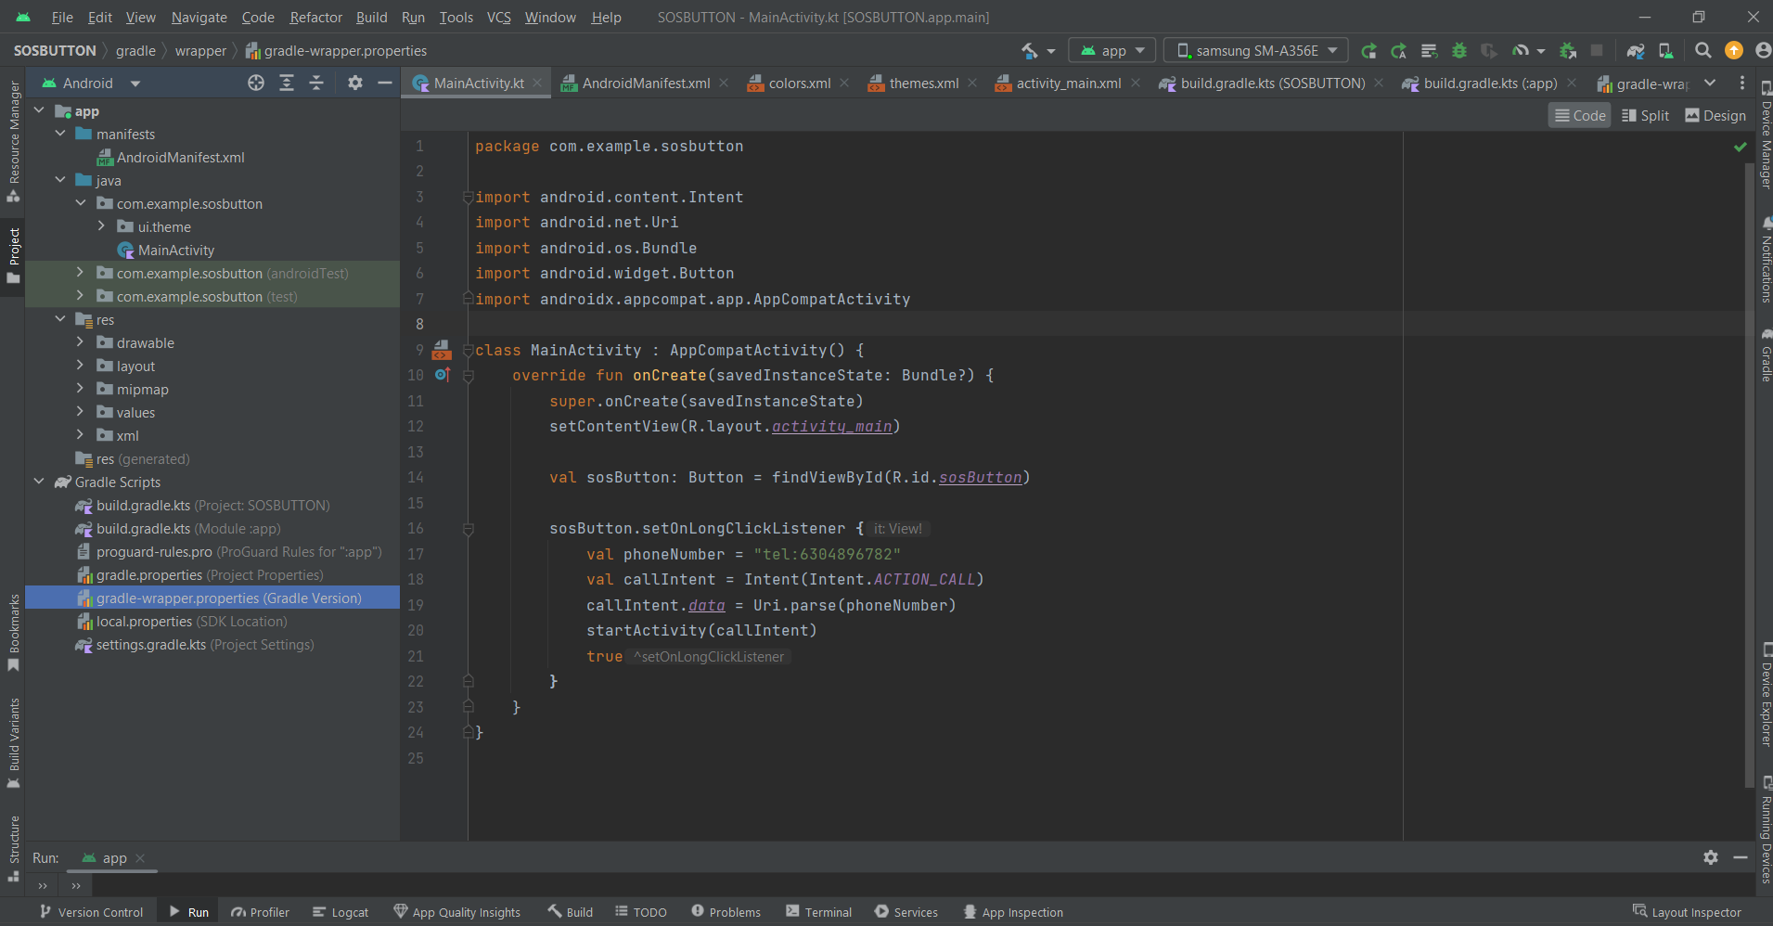
SOS SIGNAL CODE

Slide 8
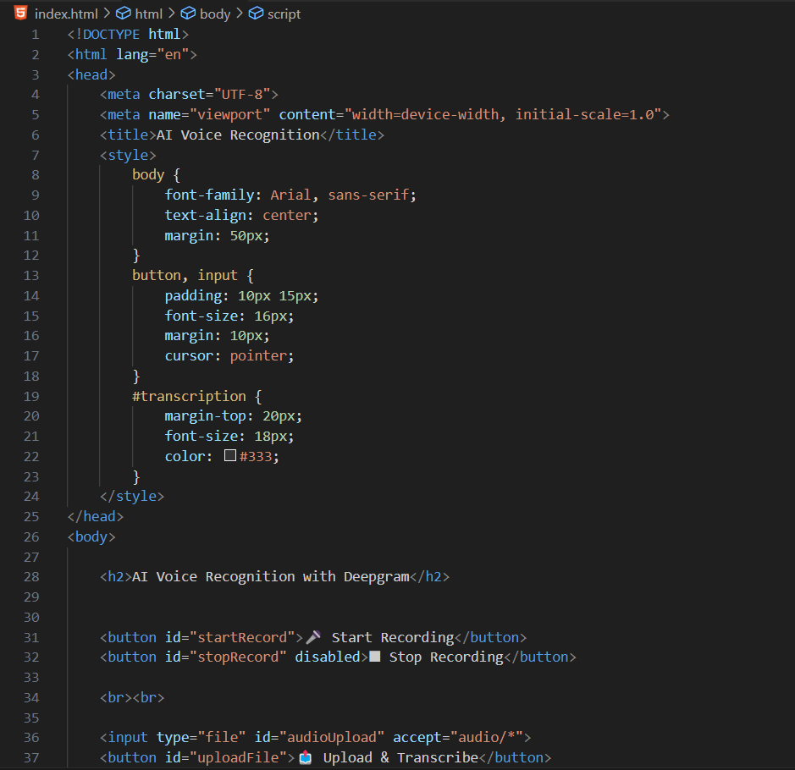
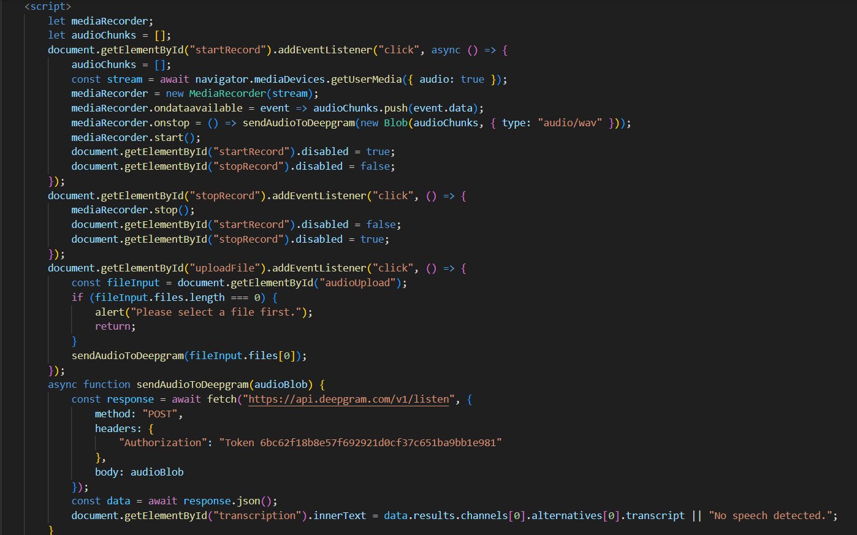
SOS SIGNAL CODE

Slide 9
Why it stands out?
Why CyberHelp Stands Out
Dual Protection: Combines AI scam detection with a smart SOS system.
Real-Time Alerts: Instantly detects deep fake fraud and impersonation.
One-Tap Emergency Access: Replaces multiple helplines with a single, fast SOS function.
Seamless Integration: Works on smartphones, wearables, and smart devices.
Privacy & Security: Uses blockchain and AI to ensure data protection.

Slide 10
Revenue Model
Subscription Model (Freemium) -
Basic Free Version: Allows SOS functionality and limited AI deepfake detection.
Premium Subscription: Offers enhanced deep fake detection, AI voice authentication, and additional emergency features (e.g., auto-recording threats, cloud backup).
Government & Corporate Partnerships -
Law Enforcement: Partner with police or cybersecurity agencies for rapid response integration.
Enterprises & Financial Institutions: Sell AI impersonation detection services to banks and businesses prone to fraud.
In-App Purchases -
Advanced Security Features: Purchase options for advanced AI voice authentication or VPN security.
Personalized Alerts: Users pay to customize emergency contacts or set automated messages.
API Licensing - Offer AI deep fake detection as an API for other apps (e.g., social media, banking apps, or legal tech) to integrate.
Ads & Affiliate Marketing - Cybersecurity Product Ads: Promote VPNs, antivirus software, or secure communication apps. Emergency Services Referrals: Partner with ambulance/hospital networks for premium placement.

Slide 11
Scalability
AI-Driven Architecture – Uses advanced AI models for deepfake detection and fraud prevention.
Cloud Infrastructure – Leverages cloud-based AI for scalable deepfake detection.
Edge Computing – Enables on-device fraud prevention without heavy cloud reliance.
Modular Backend – Built on FastAPI, PostgreSQL, and TensorFlow, allowing easy expansion.
Continuous AI Updates – Regular model improvements for enhanced security.
Regulatory Compliance – Adheres to cybersecurity standards for wider adoption.

Slide 12
Potential/Scalability
Cloud Integration – Utilize AWS or Google Cloud for handling large-scale deepfake detection and SOS alerts.
Edge AI Optimization – Optimize AI models to run directly on mobile devices, reducing reliance on cloud processing for faster real-time detection.
Multi-Platform Expansion – Extend beyond mobile apps to web platforms, wearables, and smart home devices for wider accessibility.
Global Threat Database – Continuously update deepfake patterns and voiceprints to improve detection accuracy over time.
API as a Service – Offer deepfake detection and SOS features as an API for businesses, law enforcement, and financial institutions.

Slide 13




Team Members and closing statement
Team Members and Closing Statement
K.Lasya Rao
Ch.Nia Rachel
CyberHelp represents the future of AI-driven cybersecurity, seamlessly blending real-time threat detection with rapid emergency response. Its scalable architecture, powered by advanced AI and cloud integration, ensures proactive protection against evolving cyber threats. By bridging the gap between security and emergency services, CyberHelp is poised to redefine digital safety, empowering users with intelligent, instant defense in an increasingly complex digital world.
R.Hudhayasri
A.Praneetha

Slide 14
THANK YOU!

