Slide 1
ABSTRACT
E-Business Mart is a leading B2B marketplace that assists buyers and sellers to trade with each other at a common, reliable & transparent platform.
The project is a web portal providing a marketplace to generate business leads, find suppliers, post trade offers, test market products, promote their brand and conduct business.
Project helps business people providing online catalogs, active products, business enhancements, mailing and communication between business people, b2b market places, trade enquiries, trade shows, online new business management, online survey for products and tenders information. In addition to business directory, online catalog, trade leads and tenders, we offer personalized assistance to buyers and sellers for almost everything they need to buy/sell using mart process. Business people can perform B2B marketplace through the country or world.
The project provides an interaction between the business people around the country. It helps businessman in providing information of any product their required.

Slide 2
Existing System
The project entitled “e-Business Mart” provides entire information of a business online. e-Business Mart project provides information related to products, business, industries, factories, tenders and various other information related to business. The project gives many benefits to buyers and sellers.

Slide 3
Dis advantages
The existed system is b2b is through business weekly magazines, news papers advertisements and marketing executives marketing.
The existing is costly and covers only certain regions because giving advertisements, appointing marketing executives and processing the business in costly factor.
The businessmen cannot also find competitive business market so the buyers and sellers will be in a static process.

Slide 4
Proposed System
In the proposed project e-Business Mart interacts buyers and sellers to trade with each other at a common, reliable & transparent platform.
The project is a web portal providing a marketplace to generate business leads, find suppliers, post trade offers, test market, business news, tenders information, mail communication, trade enquiries, export and import companies information, products information, company information etc.,

Slide 5
Advantages
We design a reliable and transparent platform for providing all the facilities. When the web portal is designed, businessmen all over country will have fast and best interaction and communication.

Slide 6
Hardware and software
Software Specification:
Programming : java
Database : oracle
Hardware Specification:
Processor : Pentium-IV
Hard Disc : 40GB
RAM : 512GB

Slide 11
SEQUENCE DIAGRAM FOR USER
:user
:login
:view
:businessmen
check
1.enter
username
and password
2.check
details
3.provides
screen
4.view
business information and
process trade
enquriy
5.mail
to the administrator to clarify doubts
6.clear
user doubts and provide requested information
Buy SmartDra
!
-
purchased copies print this
Visit www
.
.
com or call
1
-
800
-
.
768
-
39
.

Slide 15
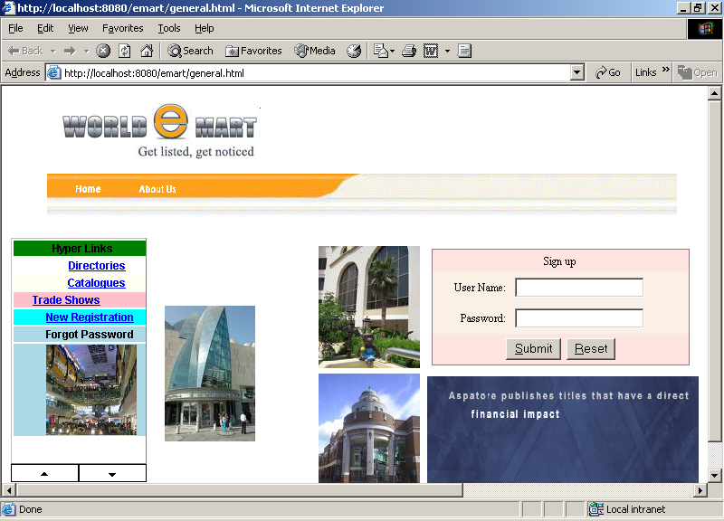

Slide 16
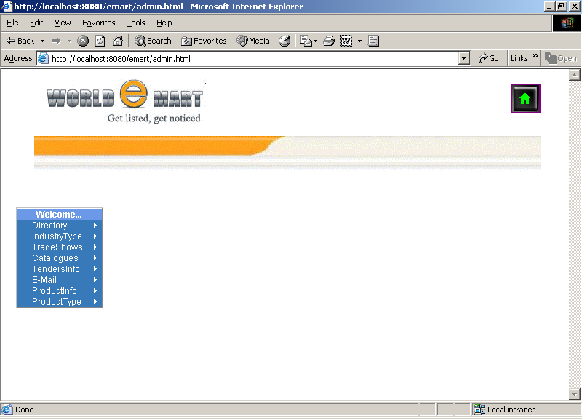

Slide 17
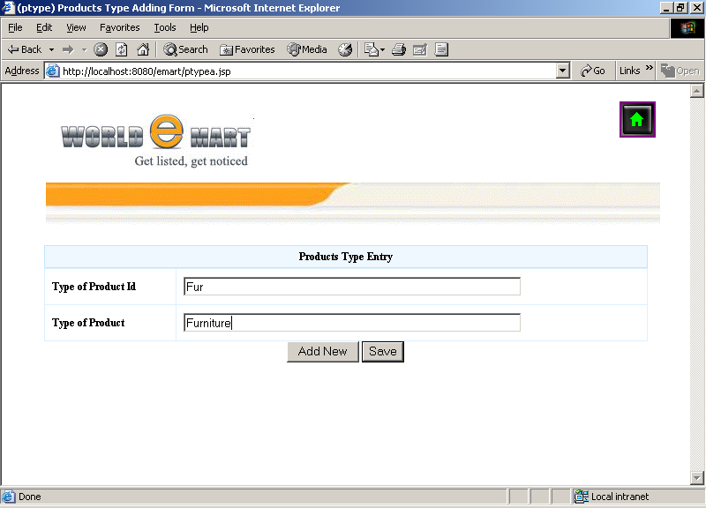

Slide 18
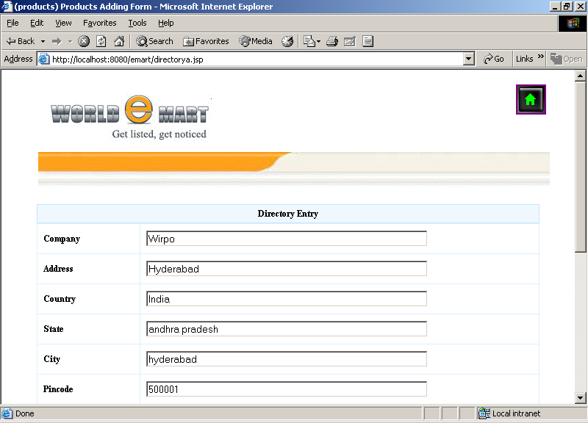

Slide 19
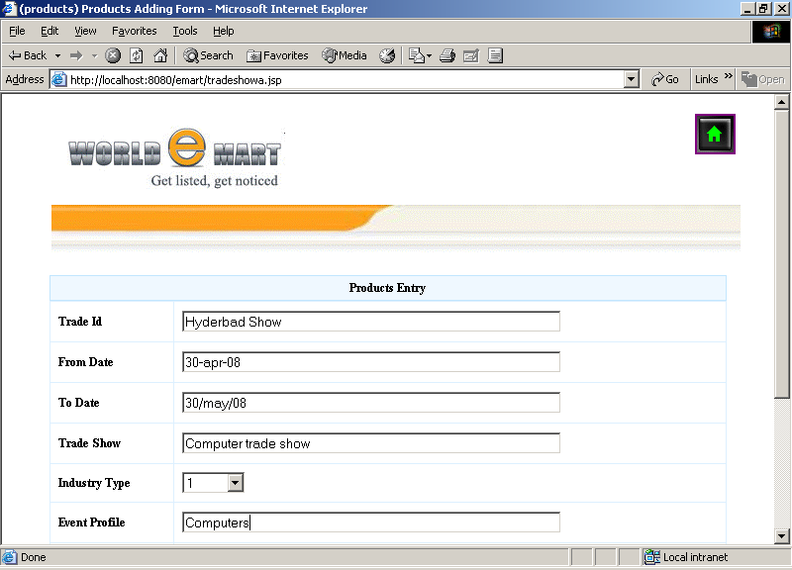

Slide 20
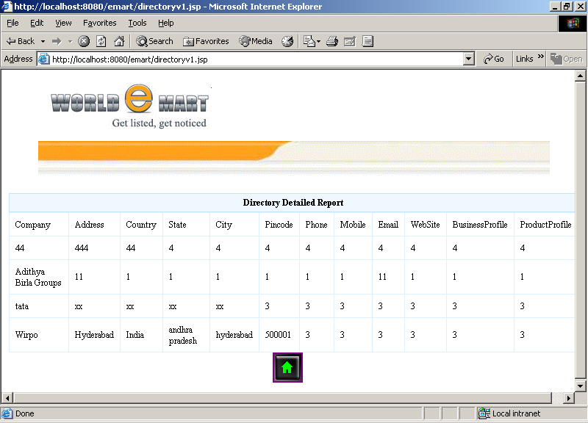

Slide 21
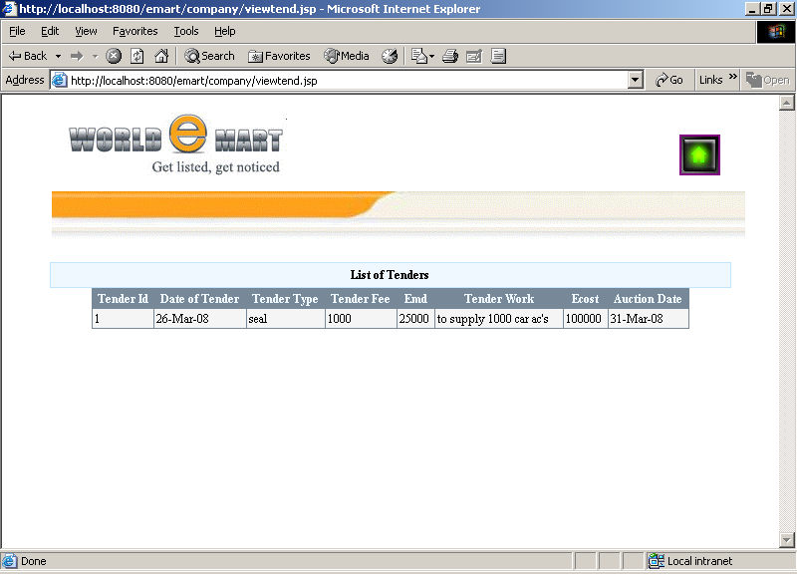

Slide 22
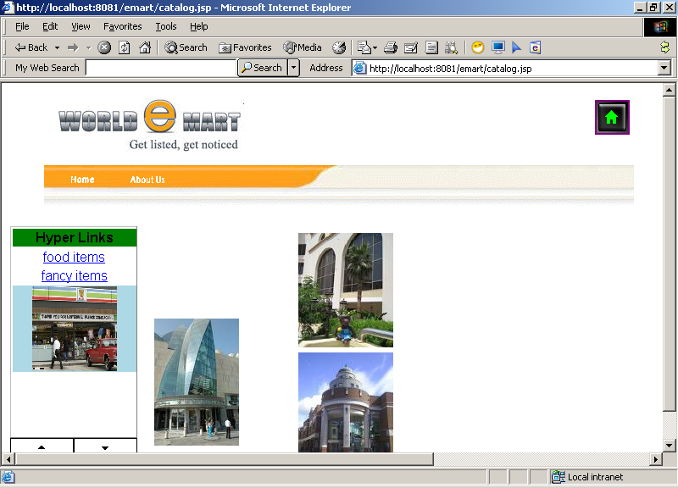

Slide 23
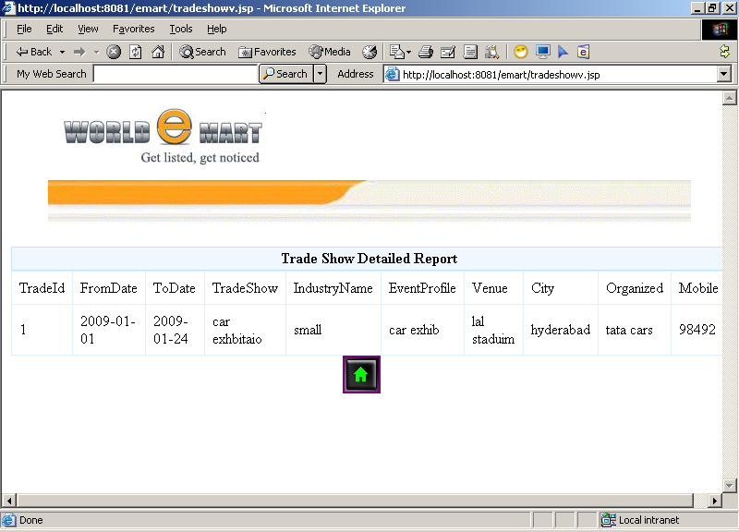

Slide 24
conclusion
The On Line Emart Solutions can be further developed into a separate, automated system with the following enhancements:
A mail server can be implemented to send mails directly from the system to the inbox of the recipient. The code needed for the same is being implemented except the mail server.
Help file can be included. The system, as of now, does not support any help facility for the users of the system. A help menu can be provided with a special function key and help command in the main page itself. Help can be either introduced as a separate window, a reference to a printed manual or as one or two line suggestion produced in a fixed screen location.

