Slide 1
AccrediVault
NAAC & NBA Accreditation Evidence Management Platform
A Paperless Accreditation Evidence Repository with Digital Signature Simulation, QR Verification and SHA-256 Tamper-Evident Audit Trail
PROJECT PRESENTATION — B.TECH CSE (ARTIFICIAL INTELLIGENCE & MACHINE LEARNING)
Student Name: [Student Name] | Roll / Register No: [Roll Number / Register No.]
Project Guide: [Guide Name / Supervisor] | Department: Computer Science & Engineering (AI & ML)
Institution: [College / Institution Name] | Academic Year: 2025–26

Slide 2
ACCREDIVAULT PROJECT PRESENTATION
Introduction to AccrediVault Platform
NAAC & NBA Accreditation Standards
Higher Education Institutions in India are periodically evaluated by NAAC and NBA accreditation bodies, requiring thousands of verified evidence documents spanning academic, research, and governance domains.
Multi-Departmental Evidence Aggregation
Accreditation evidence originates from diverse university departments (CSE, AIML, ECE, EEE), individual faculty members, placement cells, and IQAC quality assurance coordinators.
Challenges of Manual Evidence Management
Traditional physical filing and unmonitored digital storage lead to misplaced documents, approval delays, lack of verifiability, and vulnerability to undetected record tampering.
The AccrediVault Solution
AccrediVault provides a centralized, paperless accreditation repository featuring role-authenticated approval workflows, digital signature simulation, public QR verification, and SHA-256 tamper-evident audit trails.
Institutional Impact
Streamlines audit preparation, guarantees complete document chain-of-custody accountability, and enables instant accreditation readiness tracking for NAAC 7-Criteria peer team reviews.
AccrediVault — NAAC & NBA Accreditation Evidence Repository | B.Tech CSE (AI & ML) Project
Slide 2

Slide 3
ACCREDIVAULT PROJECT PRESENTATION
Problem Statement: Challenges in Traditional Accreditation Management
❌ Scattered & Unstructured Evidence
Accreditation documents are stored across isolated personal drives, physical cabinets, and unmonitored servers without uniform indexing.
❌ Slow Manual Approval Workflows
Physical paper routing between Faculty, HODs, and Principals introduces severe bottlenecks and risk of document loss during review.
❌ Lack of Status Transparency
Faculty members and IQAC coordinators lack real-time visibility into whether evidence is uploaded, pending review, approved, or rejected.
❌ Vulnerability of Database Audit Logs
Standard database logs can be altered directly by administrators or bad actors without leaving a cryptographic trace of unauthorized modification.
❌ Difficulty in External Verification
External NAAC/NBA peer teams face difficulty verifying document authenticity, sign-off timestamps, and exact approval sequence.
❌ Unmonitored Accreditation Readiness
Institutions lack automated criteria-wise readiness metrics (NAAC Criteria I–VII) to identify missing evidence before formal inspection.
AccrediVault — NAAC & NBA Accreditation Evidence Repository | B.Tech CSE (AI & ML) Project
Slide 3

Slide 4
ACCREDIVAULT PROJECT PRESENTATION
Project Objectives
🎯 1. Centralized Evidence Repository
Establish an organized digital archive indexing academic evidence by department, academic year, NAAC criterion, and document type.
🎯 2. Role-Based Access Control (RBAC)
Implement secure authentication and role-specific workspaces for Faculty, HOD, Principal, NAAC/NBA Coordinator, and Admin.
🎯 3. Paperless Approval Workflow
Build a multi-stage approval chain (Faculty Upload → HOD Review → Principal Approval) with mandatory rejection reasons.
🎯 4. Digital Signature Simulation
Provide simulated institutional Principal sign-off capturing signer identity, signature ref ID, timestamp, and simulation reference ID.
🎯 5. SHA-256 Tamper-Evident Audit Trail
Construct a cryptographic hash chain linking all workflow events to detect record modification and maintain chain-of-custody.
🎯 6. QR / Verification ID Portal
Provide a public verification portal supporting QR codes and Verification IDs to instantly validate authentic documents.
🎯 7. Accreditation Readiness Monitoring
Enable real-time executive monitoring of NAAC 7-Criteria compliance matrix, department readiness scores, and document stats.
AccrediVault — NAAC & NBA Accreditation Evidence Repository | B.Tech CSE (AI & ML) Project
Slide 4

Slide 5
ACCREDIVAULT PROJECT PRESENTATION
Role-Based Access Control (RBAC) Matrix
User Role | Demo User | Authorized Responsibilities & Workspace | Sidebar Menu Items
Faculty | Prof. Rajesh Kumar (faculty@demo.com) | Upload new accreditation evidence files; track personal submission approval status; view personal evidence archive. | Executive Dashboard, Upload Evidence, My Approval Status, My Evidence, QR Verification
HOD | Dr. Sunita Rao (hod@demo.com) | Review departmental evidence; approve or reject submissions with mandatory remarks; view department evidence index. | Executive Dashboard, Approval Workflow, Department Evidence, Evidence Repository, QR, Audit Trail
Principal | Dr. A. K. Sharma (principal@demo.com) | Final institutional approval; reject with reason; execute simulated digital signature sign-off with metadata. | Executive Dashboard, Approval Workflow, Evidence Repository, Audit Trail, QR Verification
NAAC/NBA Coordinator | Prof. Meena Reddy (coordinator@demo.com) | Executive readiness monitoring; NAAC 7-Criteria matrix tracking; audit trail review; public QR verifier (Read-Only). | Executive Dashboard, Evidence Repository, Accreditation Status, Audit Trail, QR Verification
Admin | System Administrator (admin@demo.com) | User management (create users); department configuration; system health monitoring and log oversight. | Admin Dashboard, Admin Management, Evidence Repository, Audit Trail, QR Verification
🔒 Security Note: Each authenticated role receives a dedicated workspace with role-filtered sidebar items. Backend API endpoints enforce HTTP header role authorization (x-user-role) to prevent unauthorized action execution.
AccrediVault — NAAC & NBA Accreditation Evidence Repository | B.Tech CSE (AI & ML) Project
Slide 5

Slide 6
ACCREDIVAULT PROJECT PRESENTATION
Accreditation Evidence Workflow & Chain of Custody
Step 1: Faculty Upload → Faculty uploads evidence with title, department, academic year, NAAC criterion, & file attachment.
System Outcome: Status: Pending HOD Review
Step 2: HOD Review → HOD inspects departmental evidence. Approves to forward or rejects with mandatory remarks.
System Outcome: Status: Pending Principal Review
Step 3: Principal Approval → Principal conducts final institutional review. Approves for digital signature or rejects with reason.
System Outcome: Status: Pending Digital Signature
Step 4: Digital Signature → Simulated Class-3 Principal Digital Signature attached with Ref ID, timestamp, & serial.
System Outcome: Status: Digitally Signed / Approved
Step 5: Central Repository → Approved document indexed in central repository with permanent Document ID & Verification ID.
System Outcome: Search & Filter Ready
Step 6: QR Verification → Public QR Verifier resolves Verification ID or scanned QR code to authentic metadata & audit history.
System Outcome: ✓ Document Verified
Step 7: SHA-256 Audit Trail → Cryptographic SHA-256 hash chain links previous & current hashes for complete audit integrity.
System Outcome: Tamper-Evident Chain
AccrediVault — NAAC & NBA Accreditation Evidence Repository | B.Tech CSE (AI & ML) Project
Slide 6

Slide 7
ACCREDIVAULT PROJECT PRESENTATION
Major System Modules
1. Authentication & RBAC
Role-authenticated login with session persistence, role identification, and route protection.
2. Evidence Submission
Faculty upload form supporting multi-criterion, department, academic year, and document type metadata.
3. Approval Workflow
Multi-stage approval chain (Faculty → HOD → Principal) with stage tracking steppers and rejection remarks.
4. Digital Signature Simulation
Simulated Class-3 Principal sign-off generating signature ref IDs, timestamps, and certificate serials.
5. Evidence Repository
Centralized searchable document archive supporting multi-filtering (department, criterion, year, status).
6. Accreditation Monitoring
Executive dashboard tracking overall readiness score (%), 7-Criteria matrix, and department index.
7. SHA-256 Audit Trail
Cryptographic hash chain linking event hashes with tamper detection and log restoration features.
8. QR Document Verification
Public document verification portal resolving Verification IDs and QR codes to authentic details.
9. Admin Management
System administration console for user account creation, department setup, and database stats.
AccrediVault — NAAC & NBA Accreditation Evidence Repository | B.Tech CSE (AI & ML) Project
Slide 7

Slide 8
ACCREDIVAULT PROJECT PRESENTATION
System Architecture
PRESENTATION & WORKSPACE LAYER (React 18 + Tailwind CSS + Lucide Icons)
Faculty Workspace | HOD Approval Queue | Principal Sign-off | Coordinator Monitor | Admin Management
APPLICATION LOGIC LAYER (Node.js + Express.js REST API Services)
• Authentication & RBAC Middleware (x-user-role validation)
• Document Upload Service (Multer multipart handling)
• Multi-Stage Workflow Approval Engine (HOD & Principal approval status state machine)
• Simulated Digital Signature Execution Service (Class-3 DSC metadata stamp generator)
SECURITY, VERIFICATION & AUDIT LAYER (SHA-256 & QR Engine)
• Node.js Crypto SHA-256 Tamper-Evident Hash Chain Engine (prev_hash | timestamp | action | current_hash)
• Audit Integrity Verification Service & Tamper Detection Engine
• Public QR & Verification ID Resolution Engine (QRCodeSVG + REST verifier)
DATABASE & STORAGE LAYER (SQLite3 + Local File System)
Relational Tables: users, departments, documents, audit_trail | Local Storage: /server/uploads/ (PDF/Docs)
AccrediVault — NAAC & NBA Accreditation Evidence Repository | B.Tech CSE (AI & ML) Project
Slide 8

Slide 9
ACCREDIVAULT PROJECT PRESENTATION
Technology Stack (Implementation Verified)
Frontend Framework
React 18, Vite, Javascript (ES6+)
Component-driven SPA architecture
Styling & UI Components
Tailwind CSS, Lucide React Icons
Glassmorphic modern responsive UI
Backend Runtime
Node.js, Express.js (REST API)
Asynchronous server logic & HTTP routing
Database Engine
SQLite3 (`accreditation.db`)
Embedded relational DB with promisified queries
File Upload Handling
Multer Middleware
Multipart evidence document upload storage
Security & Hashing
Node.js `crypto` (SHA-256)
Cryptographic hash chain computation
QR Code Generation
QRCodeSVG (`qrcode.react`)
Dynamic QR code rendering for verification
Data Visualization
Recharts Library
Interactive bar charts & pie charts for metrics
UI Feedback
Canvas Confetti (`canvas-confetti`)
Celebration feedback on digital signing
AccrediVault — NAAC & NBA Accreditation Evidence Repository | B.Tech CSE (AI & ML) Project
Slide 9

Slide 10
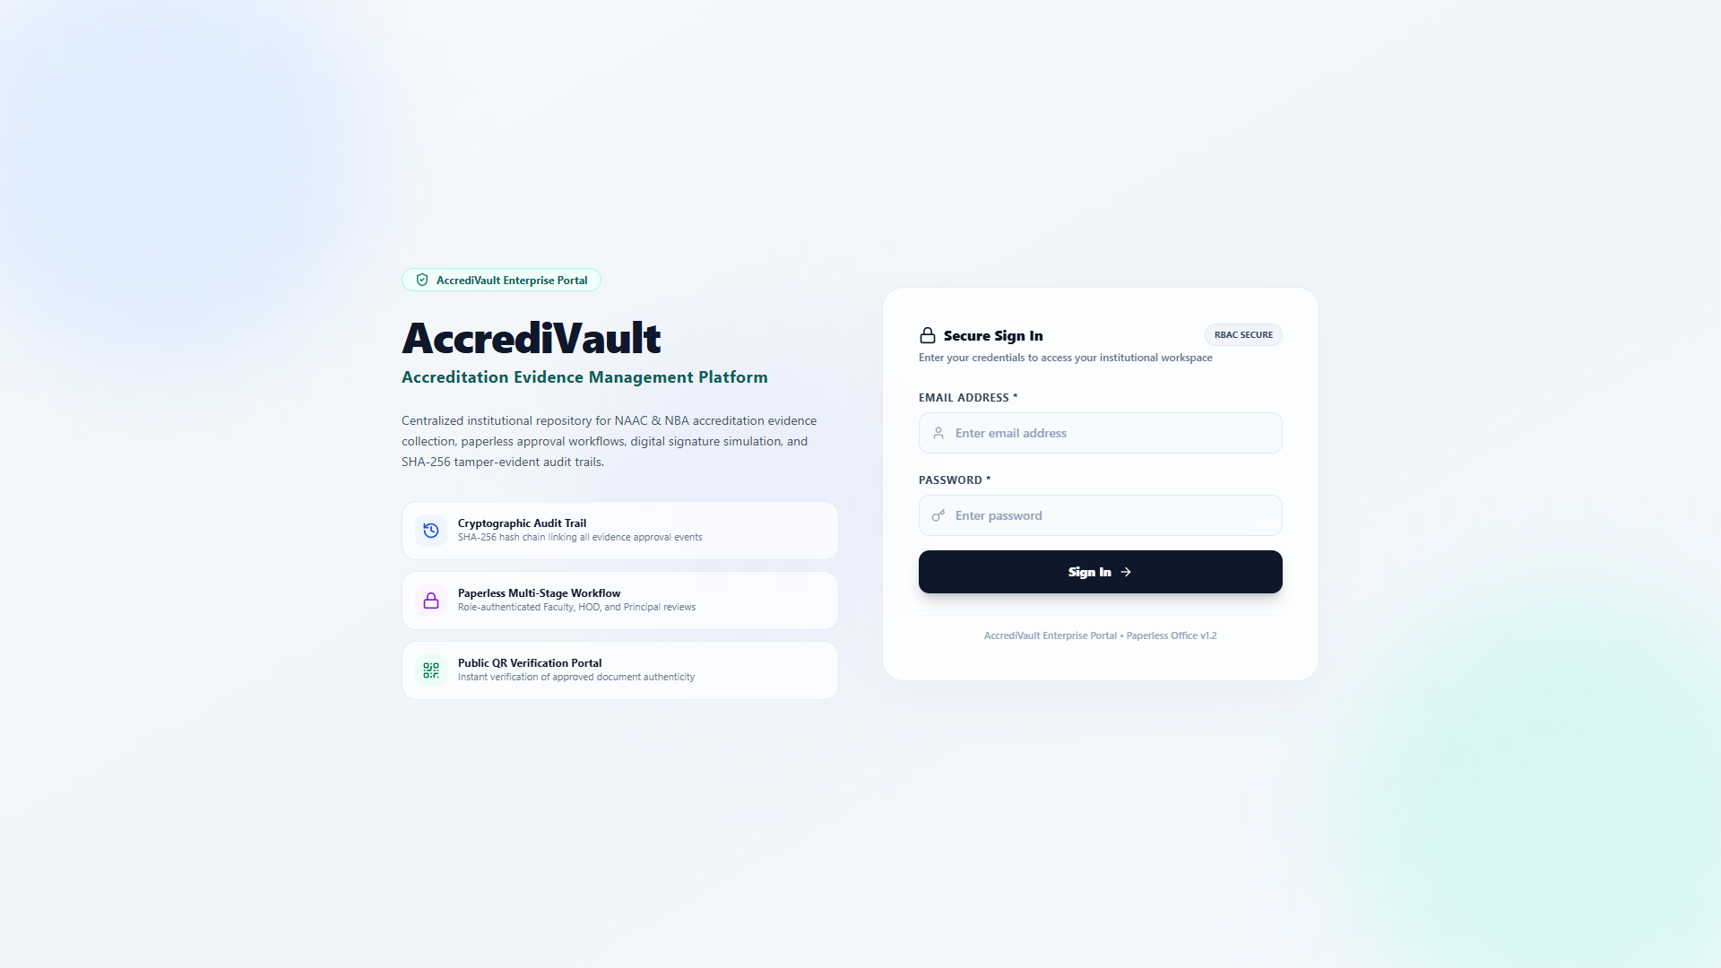
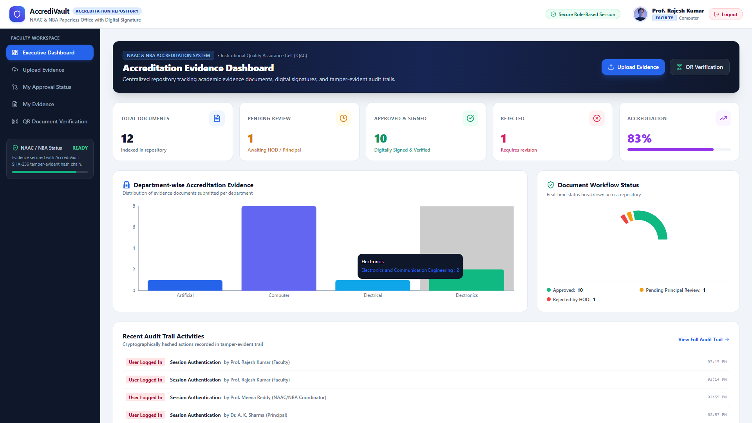


ACCREDIVAULT PROJECT PRESENTATION
System Outputs: Core Application User Interfaces
1. Glassmorphism Login Page
Role-authenticated sign-in interface
2. Faculty Executive Dashboard
Metrics cards, department charts, & status pie
3. HOD Approval Workflow Queue
Departmental evidence review & approval queue
4. Principal Approval & Signature
Principal final sign-off & Digital Signature
5. Coordinator Accreditation Monitor
NAAC 7-Criteria readiness matrix & completion
AccrediVault — NAAC & NBA Accreditation Evidence Repository | B.Tech CSE (AI & ML) Project
Slide 10

Slide 11
ACCREDIVAULT PROJECT PRESENTATION
Security, Audit & Document Verification System
SHA-256 Tamper-Evident Audit Trail
Audit log entries linked via cryptographic SHA-256 hashes. verifyAuditIntegrity() verifies chain continuity across all records.
Tamper Detection & Log Restoration
Simulated record alteration triggers hash mismatch (brokenIndex). System detects tamper & enables 1-click log restoration.
Public QR & Verification ID Portal
Public verifier resolves Verification IDs or scanned QR codes, displaying document status, approved metadata, & audit sequence.
💡 Digital Signature Clarification: The digital signature workflow is implemented as an institutional prototype simulation (Class-3 DSC metadata stamp) for demonstration purposes.
AccrediVault — NAAC & NBA Accreditation Evidence Repository | B.Tech CSE (AI & ML) Project
Slide 11

Slide 12
ACCREDIVAULT PROJECT PRESENTATION
Conclusion & Future Enhancements
PROJECT CONCLUSION
✓ Centralized Evidence Archive:
Successfully replaces fragmented physical files with a unified NAAC/NBA evidence repository.
✓ Paperless Multi-Stage Workflow:
Eliminates physical routing bottlenecks through automated Faculty → HOD → Principal review queues.
✓ Cryptographic Audit Chain:
Ensures 100% audit accountability via SHA-256 tamper-evident hash linking.
✓ Public Document Verification:
Provides transparent verification of approved evidence using QR codes & Verification IDs.
✓ Executive Readiness Visibility:
Enables real-time monitoring of NAAC 7-Criteria compliance and department readiness scores.
FUTURE ENHANCEMENTS & SCOPE
🚀 Real eSign / DSC Integration:
Integrate legally binding eSign API / Class-3 USB Token signing services (eMudhra / C-DAC).
🚀 Cloud Deployment & Encrypted Storage:
Deploy on AWS / Azure with S3 encrypted blob storage & CDN distribution.
🚀 Institutional ERP Integration:
Connect with college ERP systems (e.g. CollPoll, Fedena) for automated faculty data sync.
🚀 Automated Queue Notifications:
Implement email and WhatsApp notifications for pending HOD & Principal review queues.
🚀 AI-Powered Evidence Analytics:
Incorporate LLM-based evidence quality check & automated criterion classification.
AccrediVault — NAAC & NBA Accreditation Evidence Repository | B.Tech CSE (AI & ML) Project
Slide 12

