Slide 1

ACCREDIVAULT ENTERPRISE PORTAL
AccrediVault
NAAC & NBA Accreditation Evidence Management Platform
A centralized platform for the digital collection, review, approval, storage,
verification and monitoring of institutional accreditation evidence.
B.TECH CSE (AI & ML)
TEAM MEMBERS
PROJECT GUIDE
Lasya Devulapalli
Mr. E. Sankar
Vyasa Mayuri
Assistant Professor

Slide 2
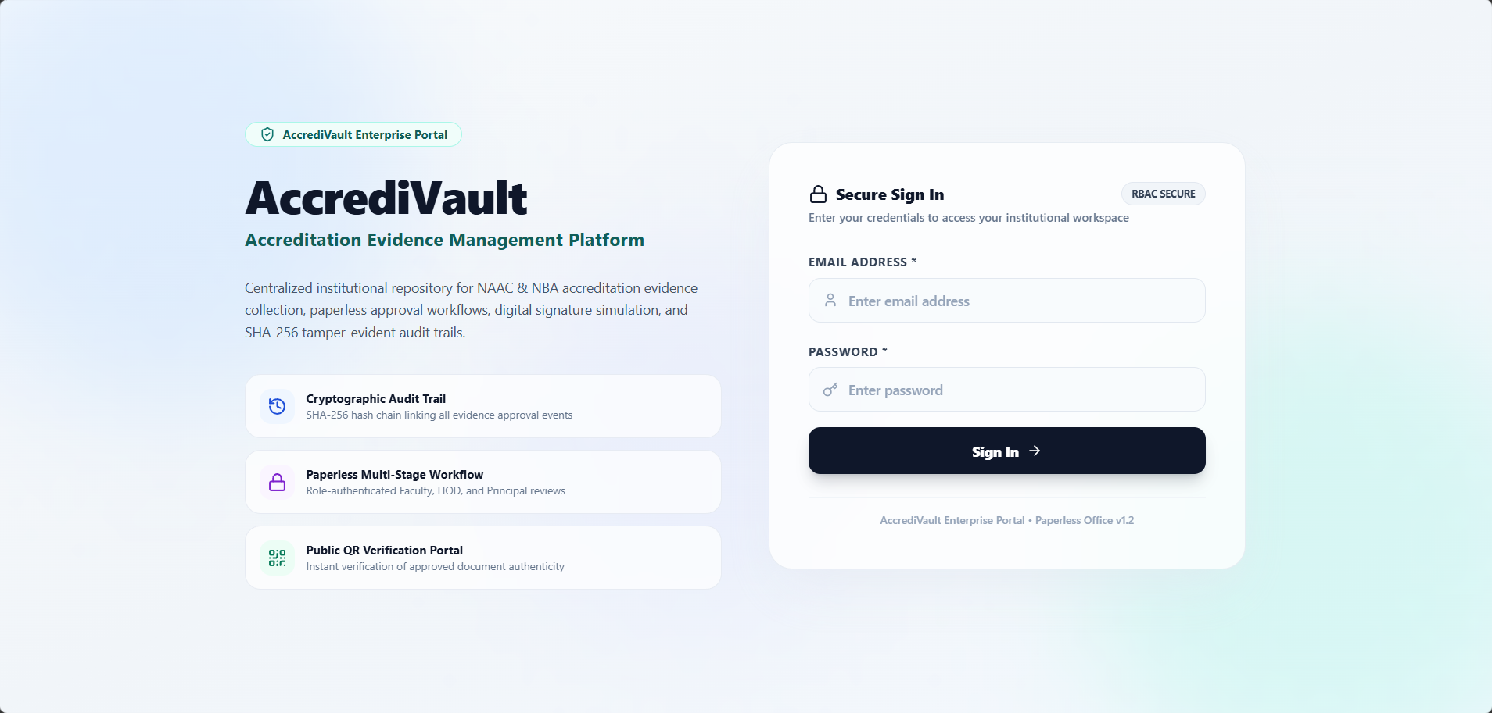



INTRODUCTION
Digitizing Institutional Accreditation Evidence
NAAC and NBA accreditation requires institutions to continuously collect, organize, and present documentary evidence of academic and institutional activity. AccrediVault is a centralized, role-based web platform built to digitize this entire evidence lifecycle — from faculty submission through multi-level approval, digital sign-off, secure storage, and tamper-evident audit tracking.
Role-Based Access
Five distinct institutional roles, each with a dedicated workspace
Paperless Workflow
Secure Role-Based Login
Multi-stage digital review and approval replacing manual files
Tamper-Evident Trail
WHAT THE PROTOTYPE COVERS
SHA-256 hash-chained audit log for every recorded action
Evidence submission, HOD & Principal approval, simulated digital signature, central repository, QR/ID document verification, SHA-256 audit trail, and accreditation readiness monitoring — implemented and demonstrable end-to-end.
AccrediVault | NAAC & NBA Accreditation Evidence Management Platform
2

Slide 3






PROBLEM STATEMENT
Why Institutions Need a Centralized Solution
Scattered Evidence
Slow Manual Approvals
Poor Status Visibility
Accreditation evidence remains spread across departments, folders and individual systems.
Paper-based, multi-level approval processes are time-consuming and hard to coordinate.
Tracking where a document stands in the approval chain is difficult without a central system.
Incomplete Audit History
Undetectable Tampering
Hard to Verify Authenticity
Maintaining a complete, chronological record of institutional actions is hard to guarantee manually.
Unauthorized modification of audit or approval records can go unnoticed in file-based systems.
Confirming that a document is genuine and unaltered is difficult without a verification mechanism.
In short: accreditation readiness lacks a single, centralized, trustworthy source of truth.
AccrediVault | NAAC & NBA Accreditation Evidence Management Platform
3

Slide 4







OBJECTIVES
What the Prototype Sets Out to Achieve
1
Centralized Evidence Repository
2
Role-Based Access
Develop a single institutional repository for all accreditation evidence.
Implement role-based access control for every category of institutional user.
3
Paperless Approval Workflow
4
Simulated Digital Signature
Provide a paperless, multi-stage approval workflow for evidence sign-off.
Implement a simulated digital signature for institutional-level sign-off.
5
Tamper-Evident Audit Trail
6
Document Verification
Maintain a SHA-256 tamper-evident audit trail across recorded actions.
Provide QR / verification-ID based document authenticity verification.
7
Readiness Monitoring
Monitor accreditation evidence completeness and institutional readiness status.
AccrediVault | NAAC & NBA Accreditation Evidence Management Platform
4

Slide 5
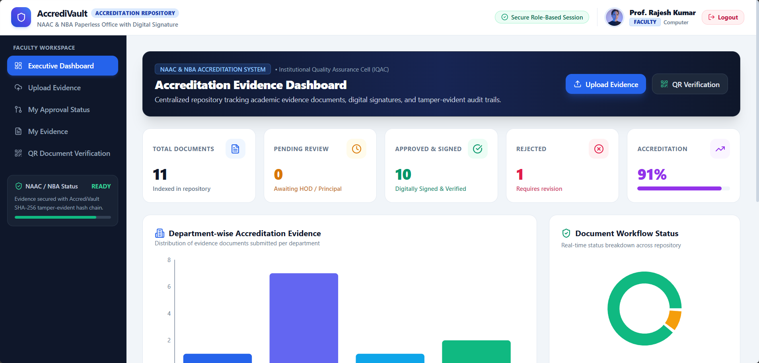




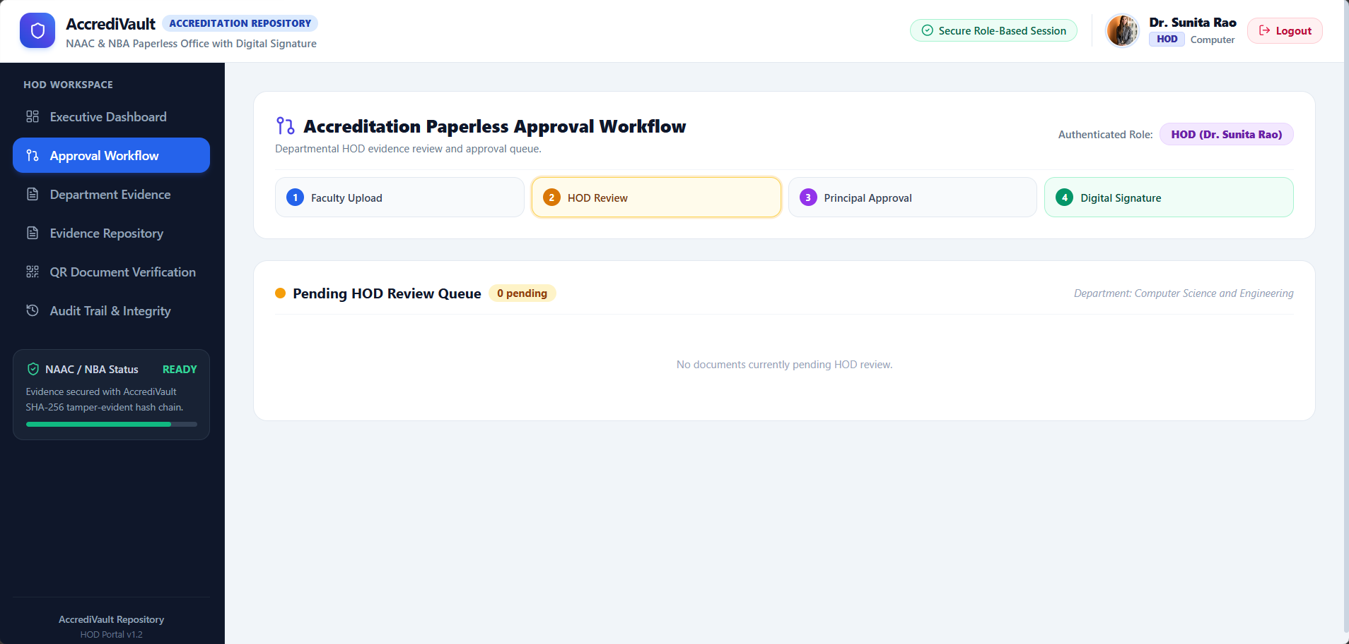

ROLE-BASED ACCESS CONTROL
Five Institutional Roles, Five Dedicated Workspaces
ROLE
RESPONSIBILITY
Faculty
Evidence submission and tracking
HOD
Departmental evidence review and approval
Principal
Final approval and simulated digital sign-off
NAAC/NBA Coordinator
Accreditation readiness and evidence monitoring
Faculty Role-Based Workspace
Admin
System and administrative management
Each role authenticates into a distinct workspace with role-specific sidebar navigation and permissions.
HOD Approval Workspace
AccrediVault | NAAC & NBA Accreditation Evidence Management Platform
5

Slide 6




ACCREDITATION EVIDENCE WORKFLOW
The Complete Evidence Lifecycle
1
2
3
4
5
6
7
Faculty Upload
HOD Review
Principal Approval
Digital Signature
Evidence Repository
QR / ID Verification
Audit Trail
Evidence submitted with metadata
Departmental review & approval
Final institutional approval
Simulated signature applied
Stored in central repository
Authenticity check available
SHA-256 hash chain logged
EVIDENCE LIFECYCLE, END TO END
Every step in this flow — from the moment Faculty upload evidence to the point it is signed, stored, verifiable, and logged — is recorded as a discrete, timestamped action inside the SHA-256 audit trail, giving the institution a traceable and tamper-evident record of the entire approval journey.
AccrediVault | NAAC & NBA Accreditation Evidence Management Platform
6

Slide 7





MAJOR SYSTEM MODULES
Eight Functional Modules in the Prototype
Authentication & RBAC
Evidence Submission
Approval Workflow
Evidence Repository
Secure login with role-based workspace & navigation
Metadata-tagged evidence upload by Faculty
Faculty → HOD → Principal multi-stage review
Centralized, searchable, filterable document listing
Digital Signature Simulation
SHA-256 Audit Trail
QR / Document Verification
Accreditation Status
Simulated signer, reference ID & signed date metadata
Hash-chained log with integrity verification
Verification-ID based authenticity check
Readiness score & NAAC 7-criteria matrix
AccrediVault | NAAC & NBA Accreditation Evidence Management Platform
7

Slide 8


SYSTEM ARCHITECTURE
Conceptual System Architecture
ACCREDIVAULT PLATFORM
Authentication & Role-Based Access Control
Evidence
Management
Approval
Workflow
Accreditation
Monitoring
Admin
Module
Simulated Digital Signature
SHA-256 Audit Trail
QR / Verification System
Central Evidence Repository
Conceptual architecture — reflects functional layering of the implemented prototype.
AccrediVault | NAAC & NBA Accreditation Evidence Management Platform
8

Slide 9






TECHNOLOGY STACK
Platform Delivery Overview
The prototype runs as a browser-based web application. The frontend stack confirmed below reflects what is implemented in the current build; backend, database, and hosting details will be added once finalized.
Delivery Model
Local Dev Environment
Access Control Model
Client-server web application, accessed via a standard browser
Served from a local development host (seen as localhost:3000)
Session-based, role-authenticated access confirmed in-app
IMPLEMENTED PROTOTYPE STACK
FRONTEND
APPLICATION MODEL
Next.js
Browser-based web application
React
Role-based authenticated workspaces
TypeScript
Role-specific navigation and permissions
Tailwind CSS
AccrediVault | NAAC & NBA Accreditation Evidence Management Platform
9

Slide 10
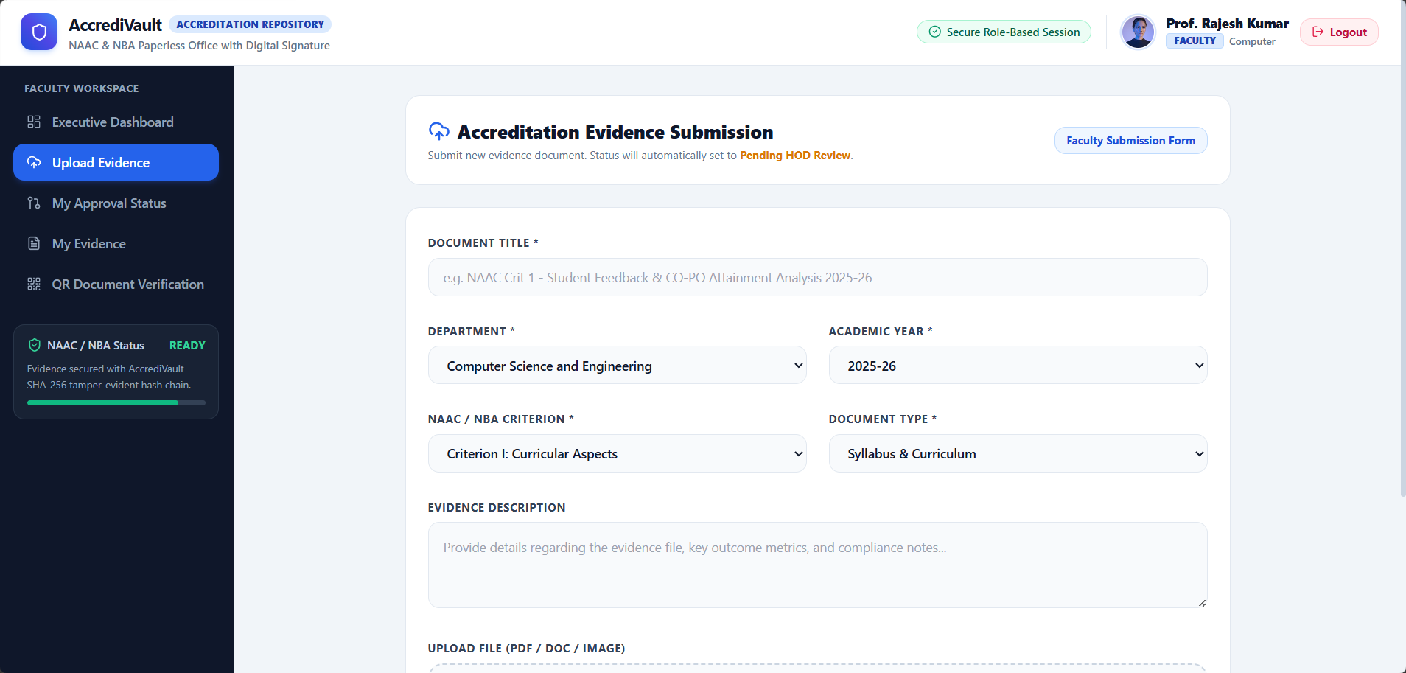
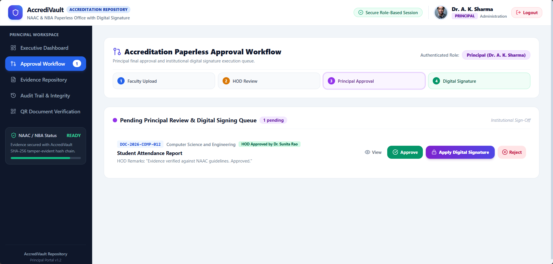
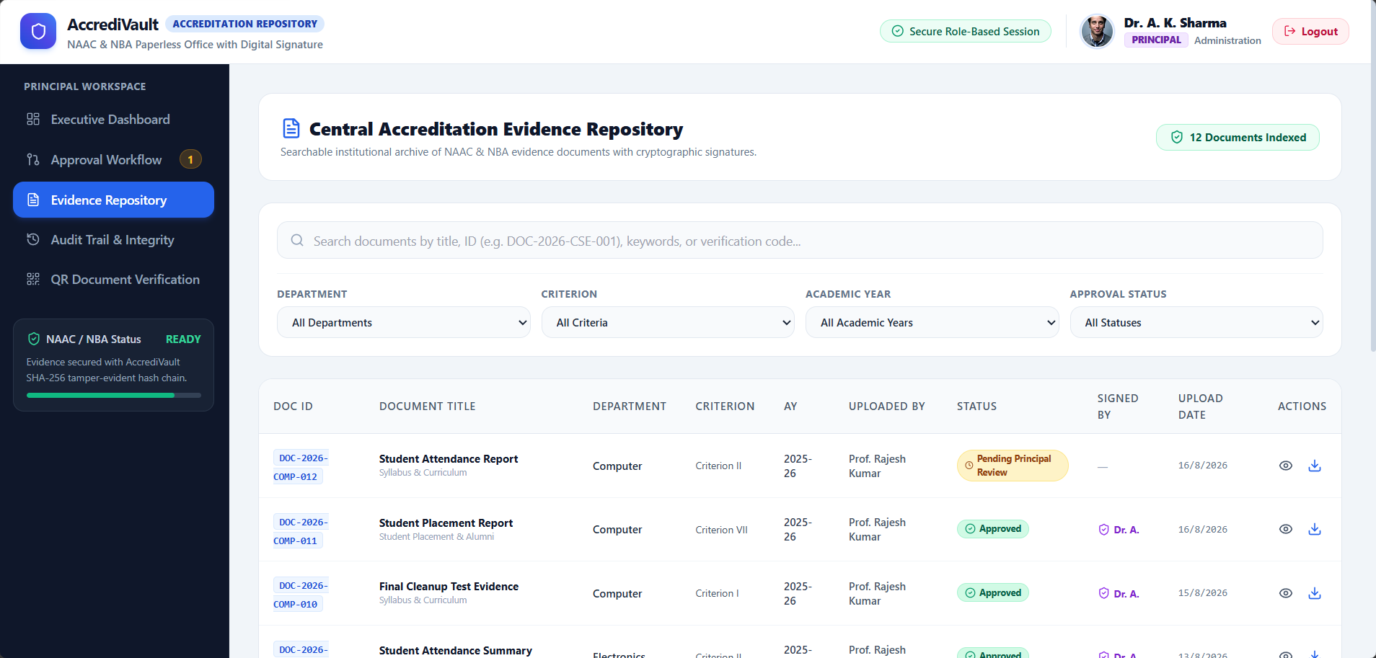
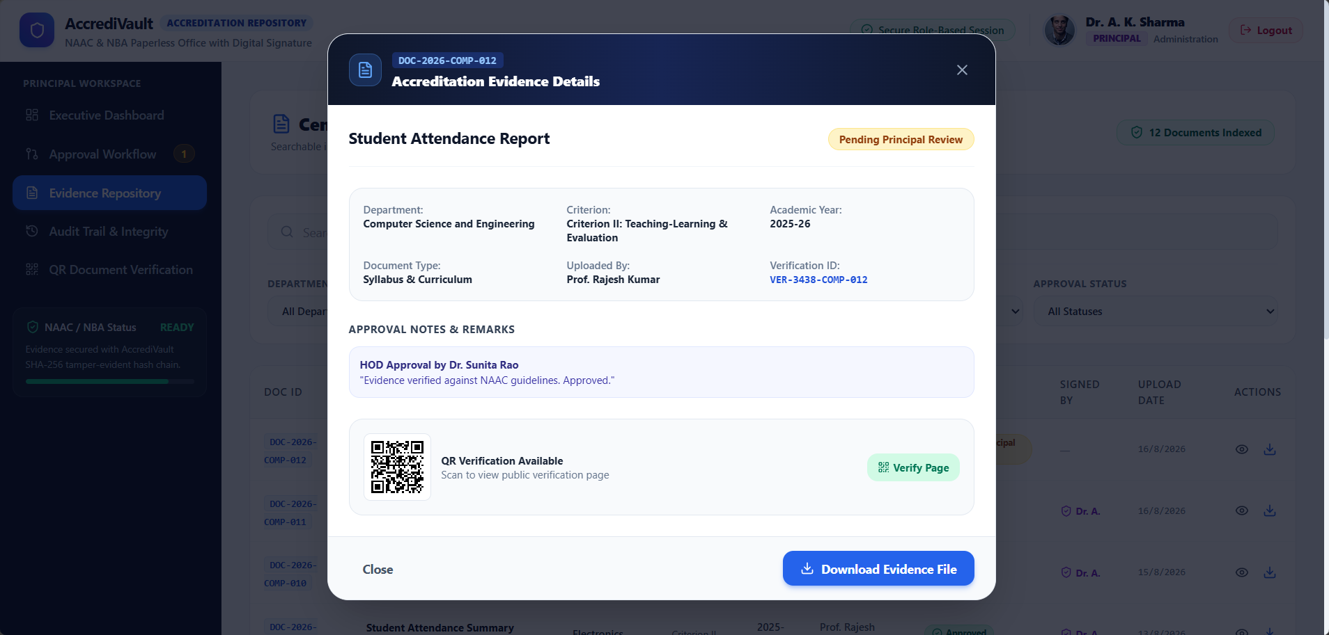
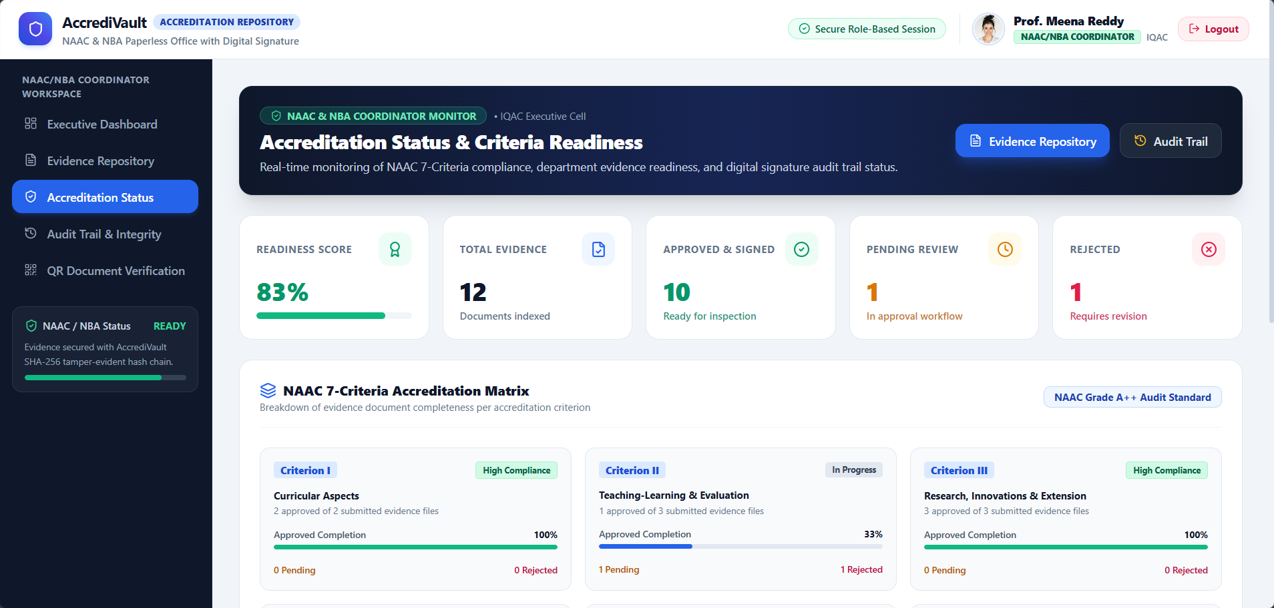
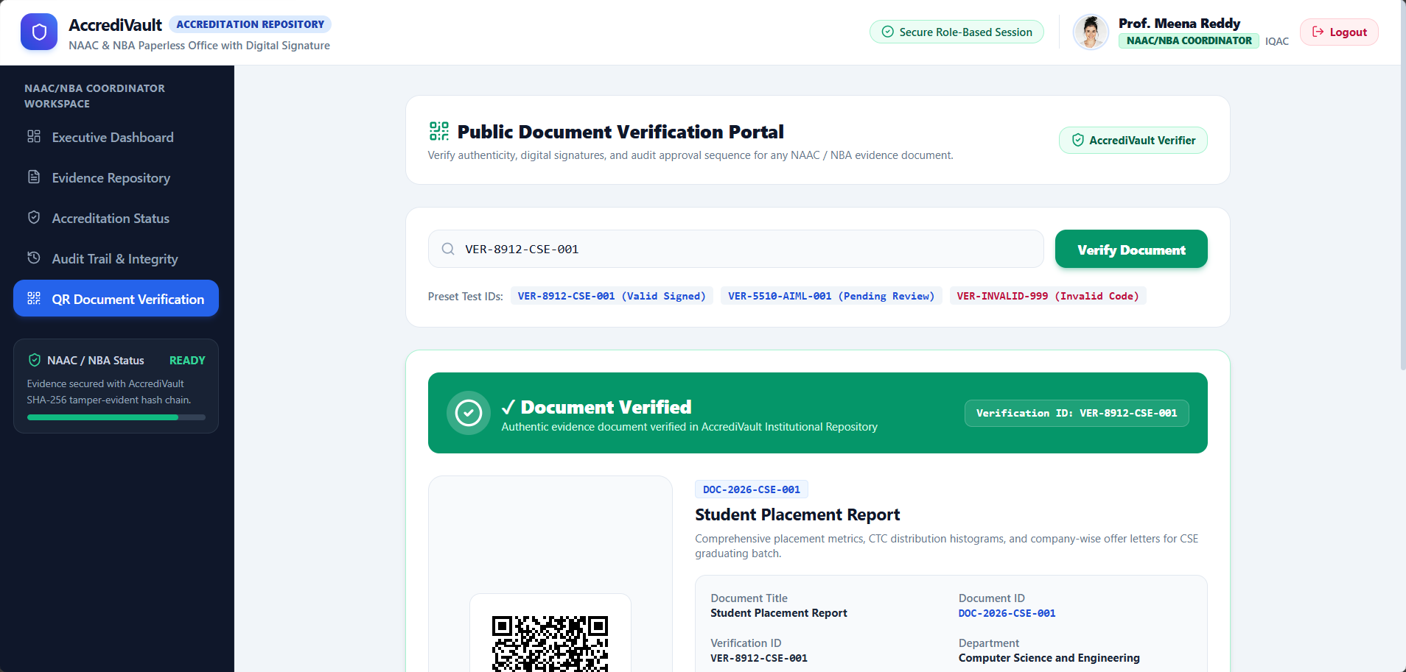
SYSTEM OUTPUTS
Working Prototype — Screen Gallery
Evidence Submission
Principal Approval Queue
Evidence Repository
Evidence Details & QR
Accreditation Status
Document Verification
AccrediVault | NAAC & NBA Accreditation Evidence Management Platform
10

Slide 11

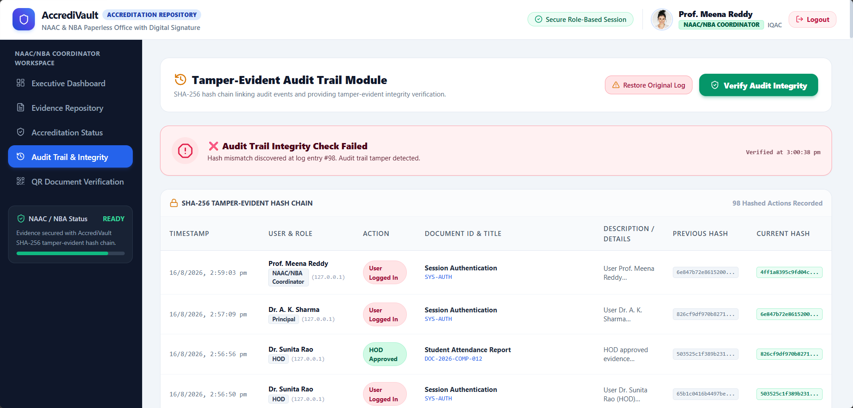
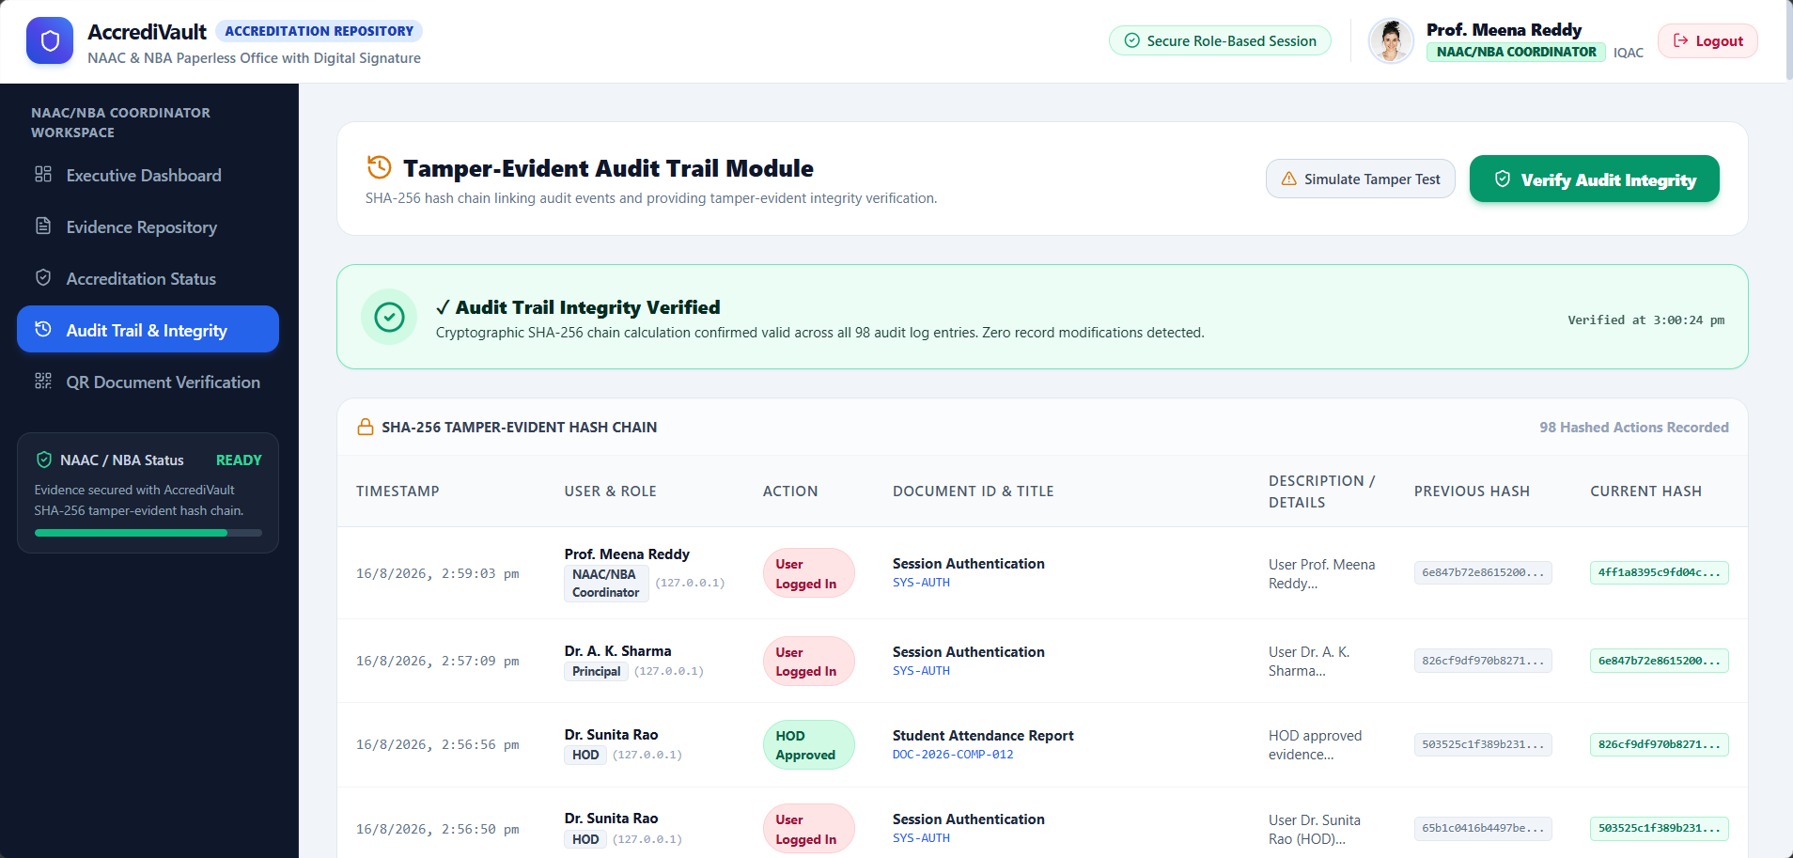
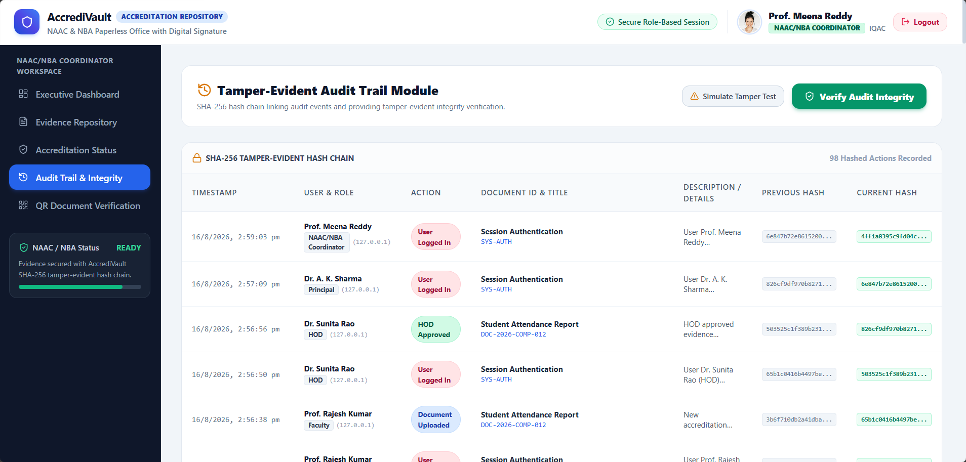
SECURITY, AUDIT & VERIFICATION
Tamper-Evidence, Detection & Document Trust
SHA-256 Tamper-Evident Audit Trail
Tamper Detection
Document Verification
Digital Signature
Links audit events using previous/current hash values
Simulated tampering produces a hash mismatch
QR / verification-ID based lookup
Currently a simulated signature only
Helps detect any modification of audit records
System detects and reports the mismatch
Valid document → verification succeeds
Stores signer & signature metadata
Provides on-demand integrity verification
Original log can be restored on demand
Invalid ID → verification correctly fails
Real eSign / DSC integration is future scope
Simulated Tamper Detection
Audit Integrity Verified
SHA-256 Audit Trail
AccrediVault | NAAC & NBA Accreditation Evidence Management Platform
11

Slide 12



CONCLUSION & FUTURE SCOPE
From Working Prototype to Institutional Readiness
CURRENT PROTOTYPE
FUTURE SCOPE
Centralizes accreditation evidence management
Real digital signature / eSign / DSC integration
Reduces paper-based, manual processes
Cloud deployment for institution-wide access
Provides role-specific access for five roles
Automated notifications and reminders
Supports a multi-stage digital approval workflow
Advanced accreditation analytics & reporting
Provides traceable, hash-chained audit records
Integration with institutional ERP systems
Supports QR / ID based document verification
Enhanced security, backup and compliance
Provides accreditation readiness monitoring
Thank You
12

