Slide 1

DIAMOND PRICE PREDICTION
Predicting Diamond Prices with Machine Learning
Problem Statement
Diamonds are priced using the “Four Cs” — Carat, Cut, Colour, Clarity — alongside physical dimensions (depth, table, x, y, z), making manual valuation complex, inconsistent, and expert-dependent.
Buyers, sellers and jewellers need a fast, objective way to estimate a fair diamond price directly from its measurable characteristics, without relying solely on a gemmologist's judgement.
Goal: build a regression-based machine learning model that learns the relationship between a diamond's attributes and its market price, compare multiple algorithms, and deploy the best model as a usable web application.
01

Slide 2

INTRODUCTION
About the Dataset
53,940
Carat
Cut
Weight of the diamond — the primary driver of size and price.
Quality of shaping and faceting; affects brilliance and sparkle.
Diamonds recorded
10
Color
Clarity
Graded D (colourless) to Z (light yellow/brown).
Presence of inclusions/blemishes, from Flawless to Included.
Original attributes
9
Depth & Table
x, y, z
Height and top-facet size, each as a % of diameter.
Length, width and depth of the stone in millimetres.
Predictor features used
Target variable: Price (USD) • Source: classic Diamonds dataset (diamonds.csv), used in its original, unmodified form for this project.
02

Slide 3

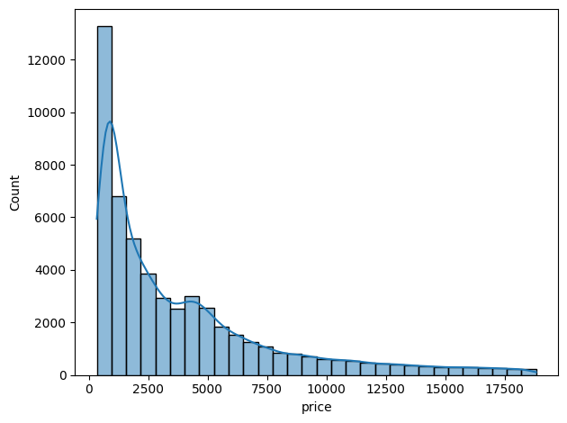
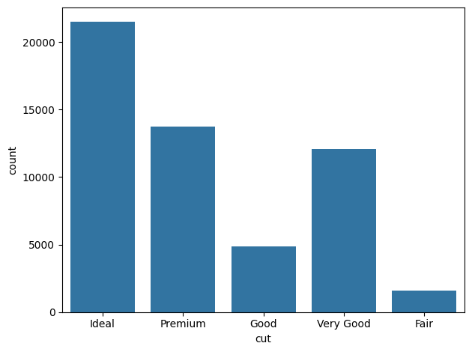
EXPLORATORY DATA ANALYSIS
Univariate Distributions & Data Cleaning
Cleaning: 146 duplicate rows removed; 0 missing values found.
Invalid records with x, y or z = 0 dropped (physically impossible dimensions).
Skewness: carat (1.11) and price (1.62) are highly skewed; y and z showed extreme outliers before cleaning.
Categorical check: cut, color and clarity contain only valid, standard grading values.
Cut: Ideal is the most common grade, followed by Premium and Very Good.
Price distribution — right-skewed (skew = 1.62)
Diamond count by Cut quality
After outlier trimming (y, z < 20), skewness for y and z fell to ~0.39; log transformation (log1p) was applied to carat and price, reducing price skew from 1.62 to 0.12.
03

Slide 4

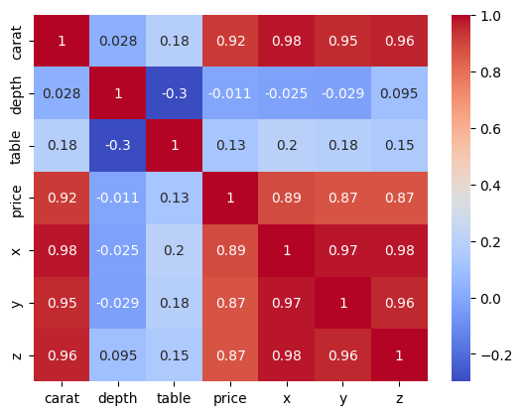
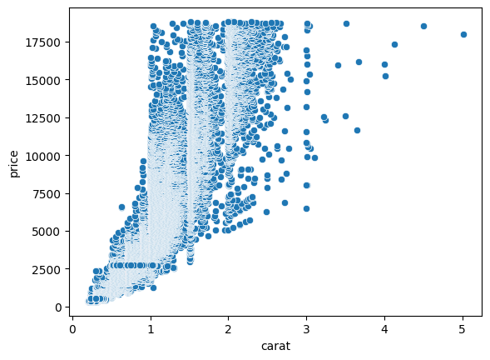
EXPLORATORY DATA ANALYSIS
Correlations & Relationships with Price
Price correlates strongly with carat, x, y and z (all ≈ 0.9+); these dimensions move almost identically with carat.
Depth and table show weak, scattered relationships with price — little standalone predictive power.
Median price is paradoxically lower for the Ideal cut than for Fair/Premium, since price is driven jointly by multiple features, not cut alone.
High correlation among carat, x, y, z signals multicollinearity — addressed later via VIF and regularisation.
Carat vs. Price — strong positive trend
Correlation heatmap (numeric features)
Outlier check (IQR method): carat, depth, table and price have many outliers, but these are valid — diamonds legitimately span that range. Only unrealistic x/y/z dimension values were removed.
04

Slide 5

MODELING
Preprocessing Pipeline & Models Used
1
Ordinal encoding of cut, color, clarity (using their natural quality order, not alphabetical)
Decision Tree
Linear Regression
2
Log transform (log1p) of carat & price to correct skewness
Random Forest
Gradient Boosting
3
VIF check for multicollinearity among carat, x, y, z, depth, table
XGBoost
CatBoost
4
80 / 20 train-test split; StandardScaler applied for Linear Regression
Linear Regression assumptions — linearity, normality, homoscedasticity, independence, multicollinearity — were formally validated (see Results).
05

Slide 6

MODELING
Model Comparison After Hyperparameter Tuning
Model | Train R² | Test R² | MAE | MSE | RMSE
CatBoost | 0.9865 | 0.9825 | 278.79 | 275,156.09 | 524.55
Gradient Boosting | 0.9860 | 0.9817 | 283.45 | 286,690.98 | 535.44
Random Forest | 0.9959 | 0.9810 | 269.75 | 297,554.28 | 545.49
XGBoost | 0.9984 | 0.9805 | 268.16 | 305,308.34 | 552.55
Decision Tree | 0.9819 | 0.9742 | 339.48 | 405,053.12 | 636.44
WINNER
CatBoost
Regressor
Highest Test R² (98.25%)
Lowest RMSE (524.55)
Best generalisation gap vs. train score
Handles categorical + numeric features natively
Tuned via RandomizedSearchCV (5-fold CV, 10 candidates per model). CatBoost's best parameters: depth = 7, learning rate = 0.1, iterations = 300.
06

Slide 7

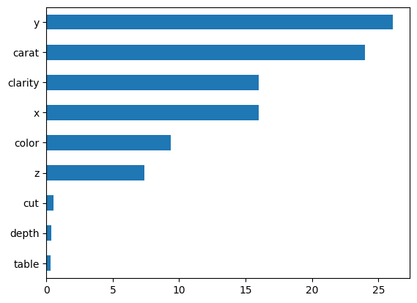
RESULTS
Final Model Performance & Feature Importance
98.25%
98.26%
524.55
278.79
Test R²
Mean CV R² (5-fold)
RMSE (USD)
MAE (USD)
Tuned CatBoost was validated using 5-fold shuffled K-Fold cross-validation: mean R² = 98.26%, std. dev. = 0.0005 — confirming stability across data splits.
Feature importance shows y (width) and carat as the two dominant predictors, followed by clarity and color.
This differs slightly from the untuned Decision Tree, where carat ranked first — importance is model-dependent.
Depth, table, x, z and cut contribute comparatively little once carat and y are accounted for.
CatBoost feature importance
07

Slide 8

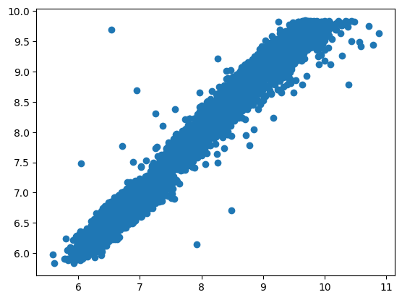
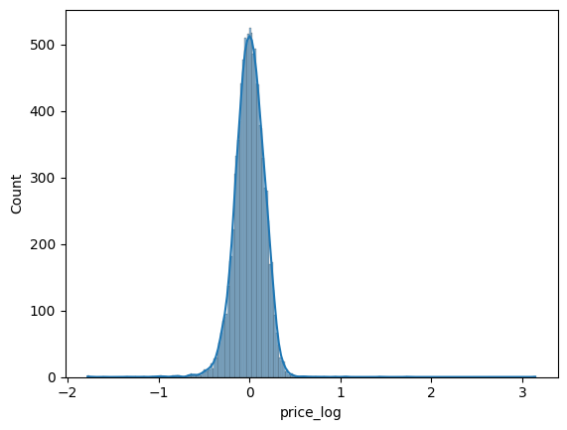
RESULTS
Regression Assumption Checks (Log-Linear Model)
Linearity: predictions closely track actual values; only a few outliers show larger error.
Normality: residuals are bell-shaped and centred at zero.
Homoscedasticity: residual spread is broadly constant, with a mild trend at higher predictions.
Independence: Durbin-Watson statistic = 2.01 (within the 1.5-2.5 acceptable band).
Actual vs. Predicted (log price)
Residual distribution
With log-transformed carat & price, Linear Regression reached Train R² = 97.41% and Test R² = 97.28% (up from ~90% before transformation) — all core assumptions reasonably satisfied. However, the tuned CatBoost model still outperforms it (Test R² = 98.25%) and was selected as the final production model.
08

Slide 9

WHAT'S NEXT
Future Enhancements
Richer feature set
Deep learning models
Explainability (SHAP)
Incorporate fluorescence, symmetry, polish and certificate lab (GIA/IGI) grades for finer-grained pricing.
Explore neural network regressors and stacked/blended ensembles to push accuracy beyond CatBoost.
Add SHAP-based explanations so users see why a specific price was predicted, not just the number.
Live market recalibration
Image-based grading
API & bulk pricing
Periodically retrain on fresh market data so predictions track real-world price drift over time.
Use computer vision on diamond images/certificates to auto-fill cut, color and clarity inputs.
Expose a REST API for jewellers/e-commerce platforms to price entire inventories programmatically.
09

Slide 10


DEPLOYMENT
Live Web Application on Streamlit
The final tuned CatBoost model is deployed as an interactive Streamlit web app — no installation or code required.
Users enter a diamond's carat, cut, color, clarity, depth, table and x/y/z dimensions through simple form inputs.
The app returns an instant predicted price, making the model directly usable by buyers, sellers and jewellers.
Built entirely in Python: pandas & scikit-learn/CatBoost for modeling, Streamlit for the front end, hosted on Streamlit Community Cloud.
SCAN TO TRY IT LIVE
diamond-price-prediction-
rplveaqu2q3azbdmzqwwvq
.streamlit.app
Deployed • Live • Interactive
10

