Slide 1







5
4
4
5
2
1
2
1
4.5
1.5

Slide 2
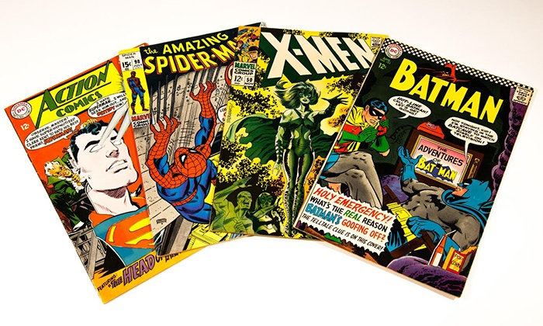
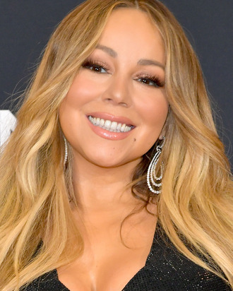


5
4
4
5
2
1
2
1
3.75
4.5
1.5
2.25

Slide 3

A B C
5 | 4 | 2
4 | 4 | 1
1 | 2 | 4

Slide 4
A B C
A B C
5 | 4 | 2
4 | 4 | 1
1 | 2 | 4
5 | 4 | 2
4 | 4 | 1
1 | 2 | 4

Slide 5
?
?
?
1.2 | 1.3 | 0.2
1.1 | 1.2 | 0.3
0.2 | 0.3 | 1.5
A B C
5 | 4 | 2
4 | 4 | 1
1 | 2 | 4
?
?
?
A
B
C
1.3 | 1.1 | 0.4
1.4 | 0.9 | 0.5
0.3 | 0.4 | 1.7

Slide 6
1.2 | 1.3 | 0.2
1.1 | 1.2 | 0.3
0.2 | 0.3 | 1.5
0.4 | 0.3 | 1.4
A B C
5 | 4 | 2
4 | 4 | 1
1 | 2 | 4
? | 1 | 5
?
?
?
A
B
C
1.3 | 1.1 | 0.4
1.4 | 0.9 | 0.5
0.3 | 0.4 | 1.7

