Slide 1
„Tic Tac Toe” reloaded
Team »PPM« (PingPongMasters)

Slide 2
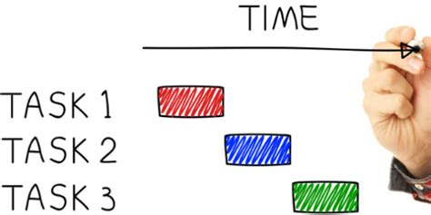


Our goals
AI
Expendable table
Colored

Slide 3
Used skills
GitHub
Searching solutions +
Last week skills
Communications

Slide 4
GitHub

