Slide 1
Agent 365
Third-party agent registry demo
A local LangGraph agent registered in Microsoft Entra Agent ID, instrumented with the Agent 365 Observability SDK and protected by the Purview SDK.
1
Entra integration
2
Observability SDK
3
Purview SDK
A365 CLI setup + MSAL OBO
OpenTelemetry to Agent 365
processContent DLP verdicts
Agents: DemoAgent1 (:8000) · DemoAgent2 (:8001) · DemoAgent3 (proposed :8002)
Notes:
Agent 365 third-party agent registry demo. Build order: 1 Entra integration, 2 Observability SDK, 3 Purview SDK.

Slide 2
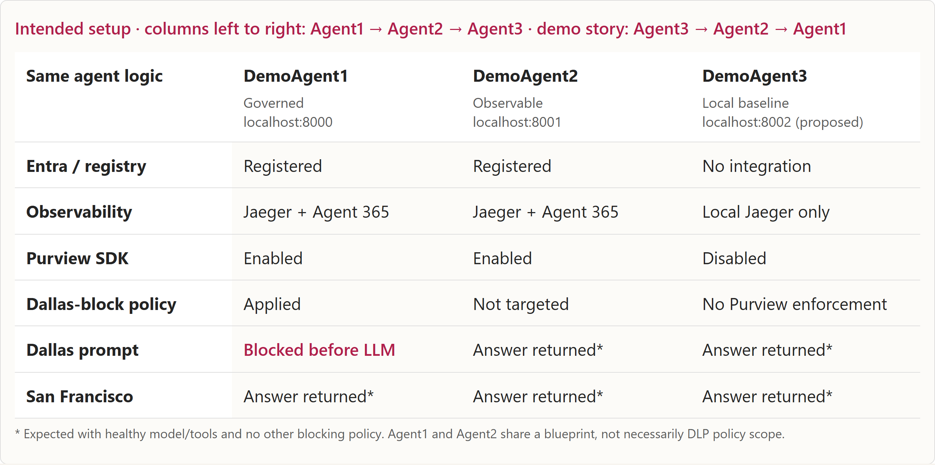
11
Three agents: local, observable, governed
Source: presenter-script.md · intended comparison setup
Notes:
start with Agent3: a working local agent without Agent 365 integration. Move to Agent2: registered and observable, with the Purview SDK still enabled but outside the Dallas-block policy. Finish with Agent1: the same Dallas prompt is blocked by Purview before the model runs. San Francisco works in all three. Permissions enable the integration; policy targeting determines enforcement.
Preparation required: Agent3 has not been created. The current DLP setup script targets both registered instances. Scope the Dallas-block policy to Agent1 only and verify Agent2 is not blocked before presenting this comparison. A separate collection policy can capture Agent2 prompt/response content without applying the Dallas-block rule.
Source: presenter-script.md · intended comparison setup

Slide 3
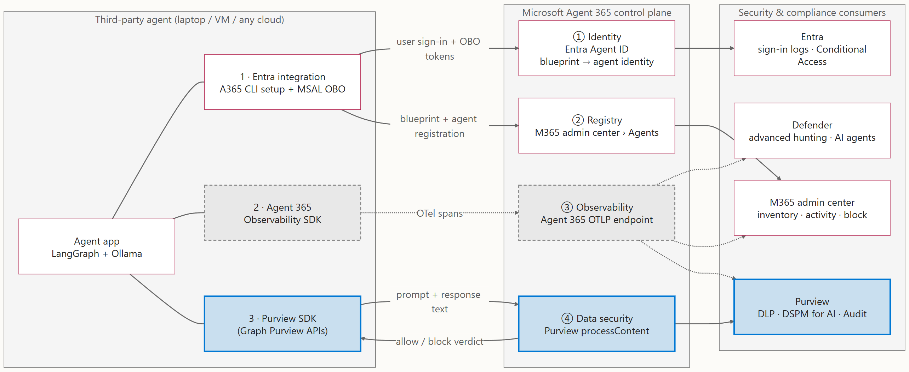
1
High‑level architecture: Agent 365 integration points
■ Purview SDK: prompt/response text, policy verdicts □ OpenTelemetry: activity telemetry, no policy enforcement
Talk track
Four integration points: ① an identity in Entra, ② an entry in the registry, ③ telemetry through the Observability SDK, and ④ data security through the Purview SDK. The agent keeps running where it is. Only identity, telemetry and the Purview API calls go to Microsoft.
Build order (left column, top to bottom): 1 Entra integration comes first (the A365 CLI creates the blueprint, agent identity and registry entry, and the app uses MSAL OBO at runtime), then 2 the Observability SDK, and 3 the Purview SDK last.
Source: README.md, 02-register.md
Notes:
Four integration points: ① an identity in Entra, ② an entry in the registry, ③ telemetry through the Observability SDK, and ④ data security through the Purview SDK. The agent keeps running where it is. Only identity, telemetry and the Purview API calls go to Microsoft.
Build order (left column, top to bottom): 1 Entra integration comes first (the A365 CLI creates the blueprint, agent identity and registry entry, and the app uses MSAL OBO at runtime), then 2 the Observability SDK, and 3 the Purview SDK last.
Purview SDK: prompt/response text, policy verdicts
OpenTelemetry: activity telemetry, no policy enforcement
Source: README.md, 02-register.md

Slide 4
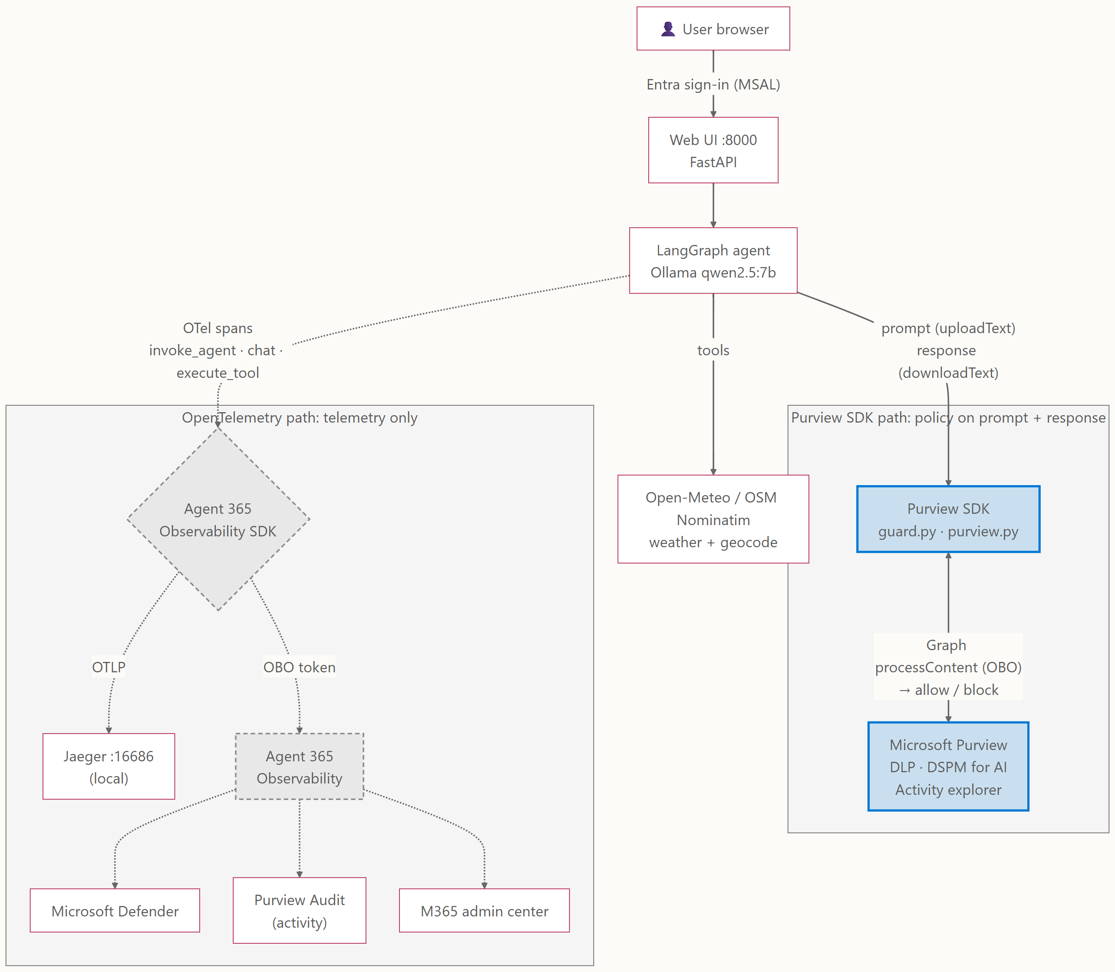
2
Solution architecture
Talk track
the prompt and the response go from LangGraph to Purview through the Purview SDK (processContent), before the LLM runs and before the answer is shown. That's where DLP decides allow or block. OpenTelemetry carries activity telemetry to Defender, Purview Audit and the admin center, but it does not evaluate or enforce prompt/response policies.
■ Purview SDK path: prompt and response go to Purview for policy
□ OpenTelemetry path: telemetry only
Source: README.md · code: agent/app.py, agent/guard.py, agent/purview.py, agent/telemetry.py
Notes:
the prompt and the response go from LangGraph to Purview through the Purview SDK (processContent), before the LLM runs and before the answer is shown. That's where DLP decides allow or block. OpenTelemetry carries activity telemetry to Defender, Purview Audit and the admin center, but it does not evaluate or enforce prompt/response policies.
Purview SDK path: prompt and response go to Purview for policy
OpenTelemetry path: telemetry only
Source: README.md · code: agent/app.py, agent/guard.py, agent/purview.py, agent/telemetry.py

Slide 5
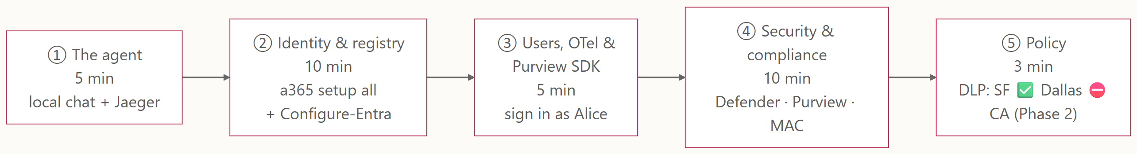
3
Demo storyline
Source: presenter-script.md (≈35 min)
Notes:
Source: presenter-script.md (≈35 min)

Slide 6
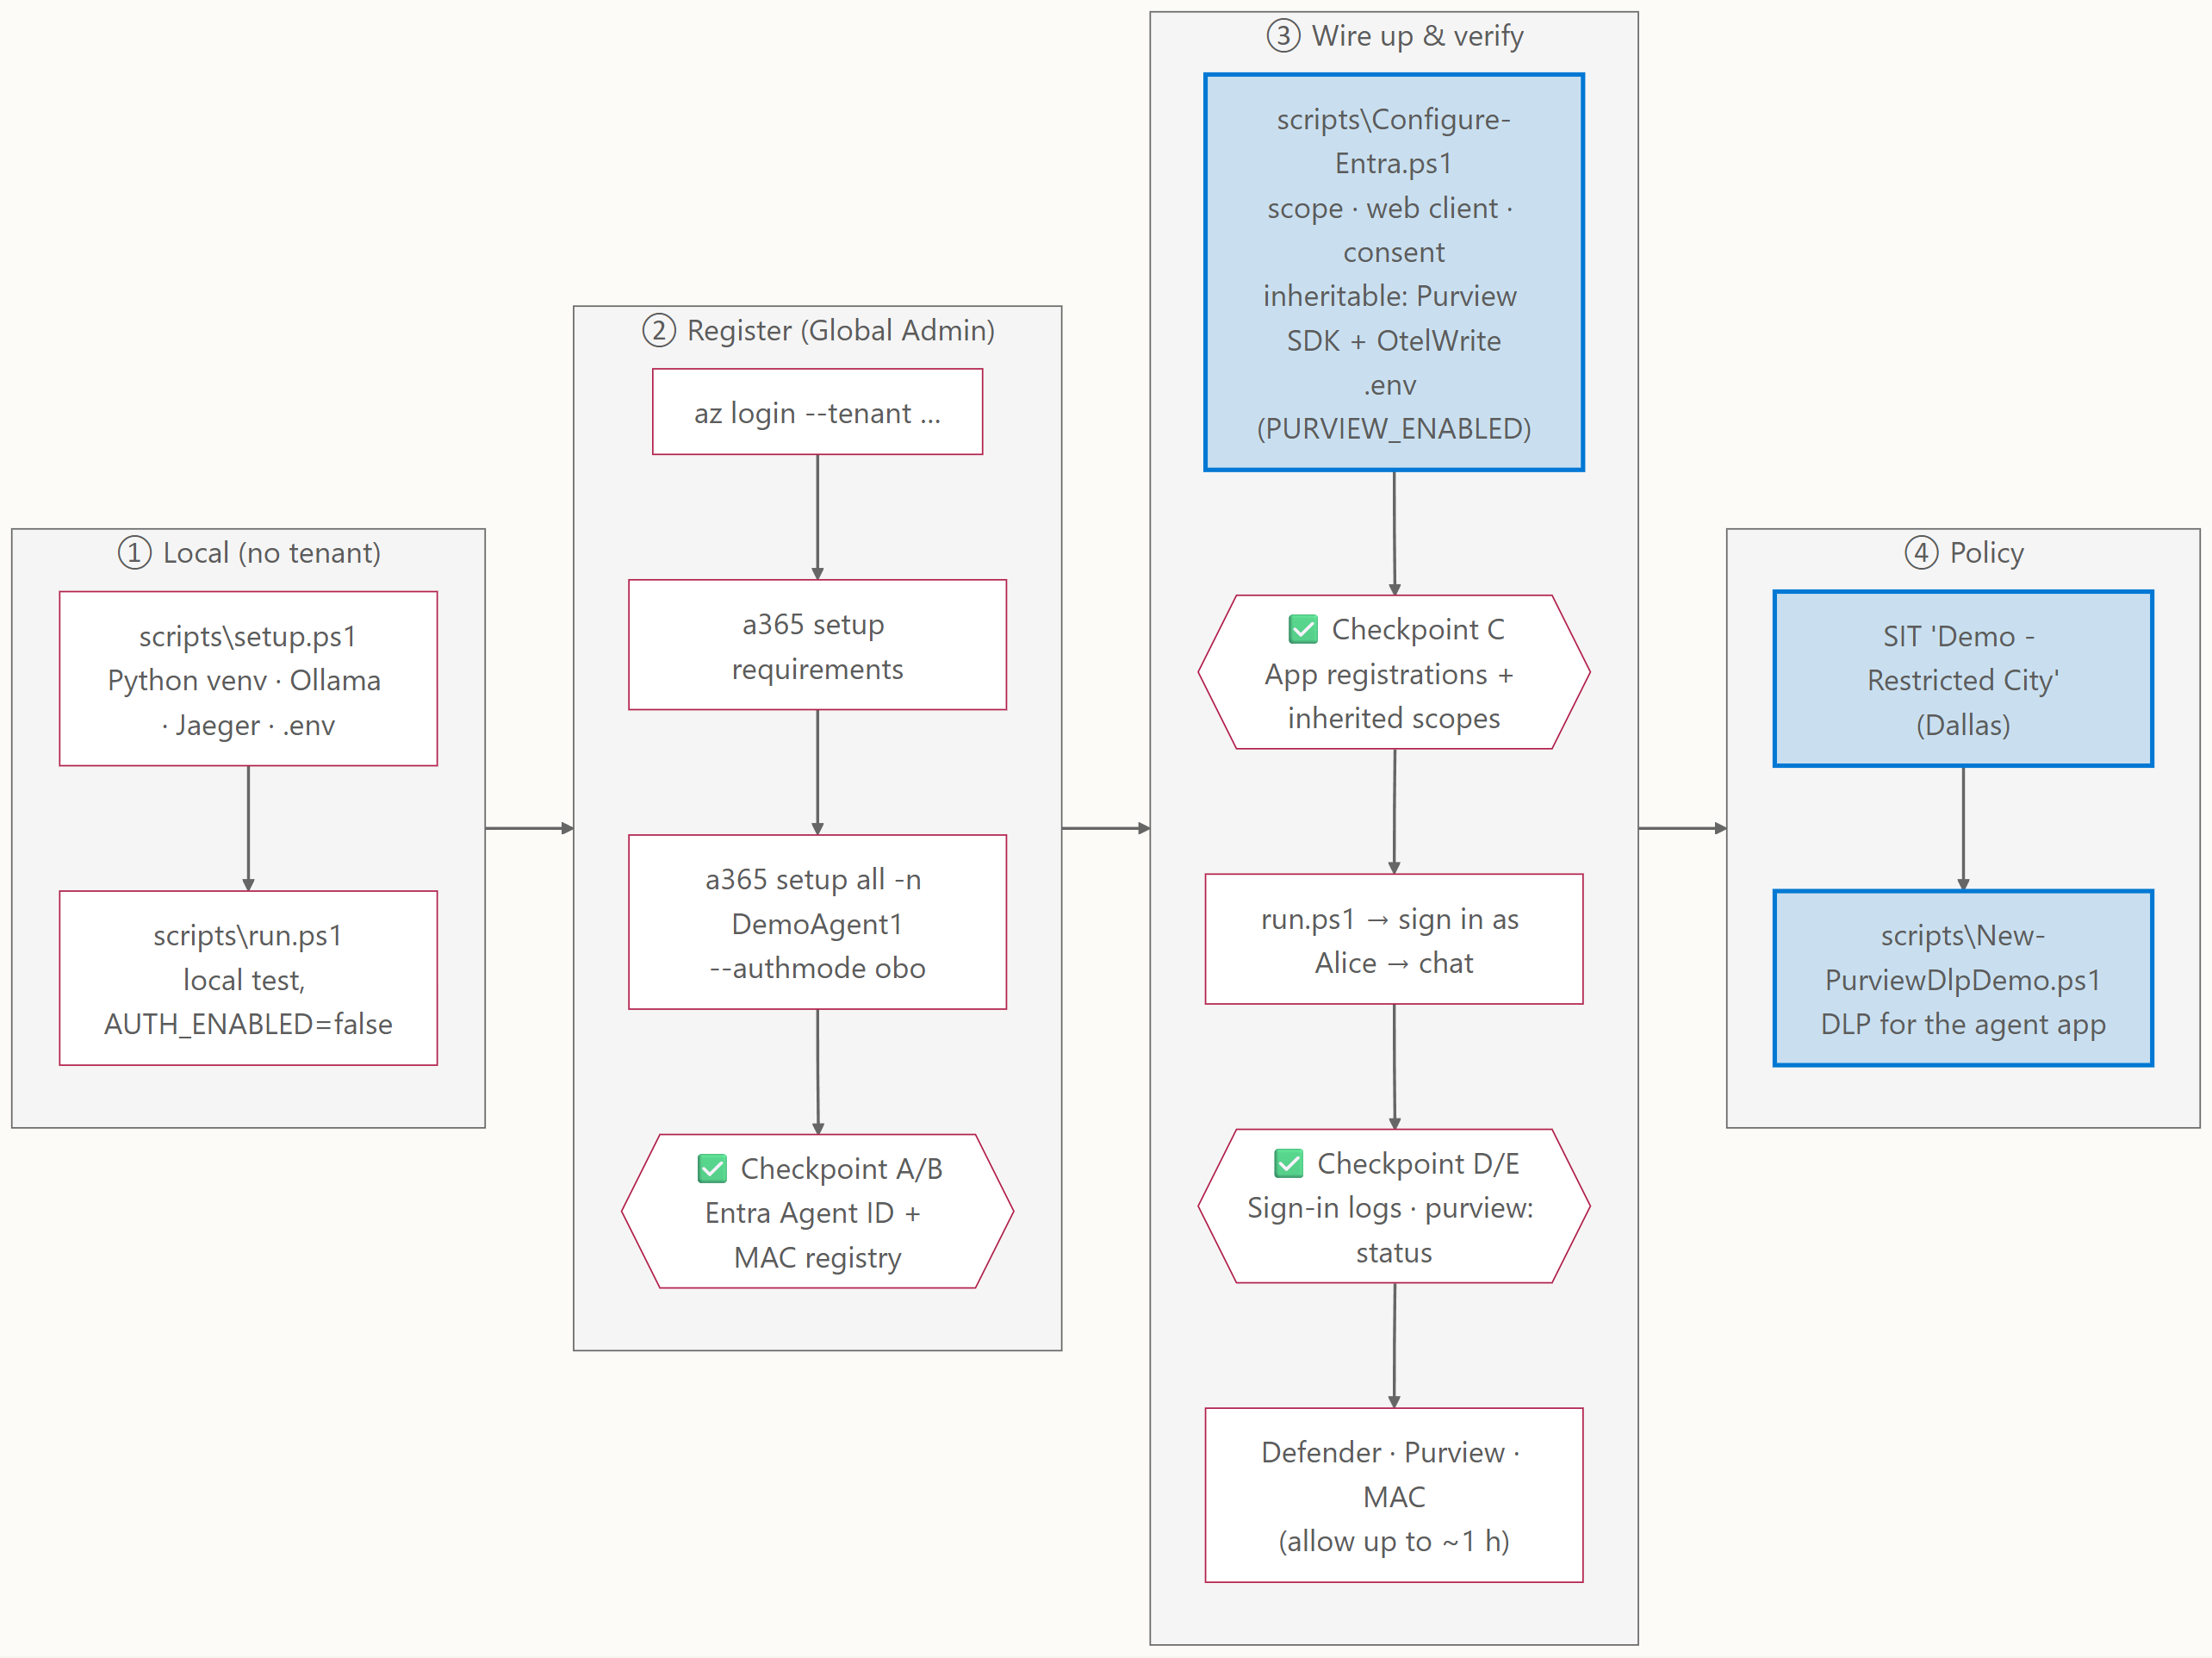
4
Setup & registration steps
Source: 01-run-agent.md, 02-register.md, 05-phase2-dlp-ca.md
Notes:
Source: 01-run-agent.md, 02-register.md, 05-phase2-dlp-ca.md

Slide 7
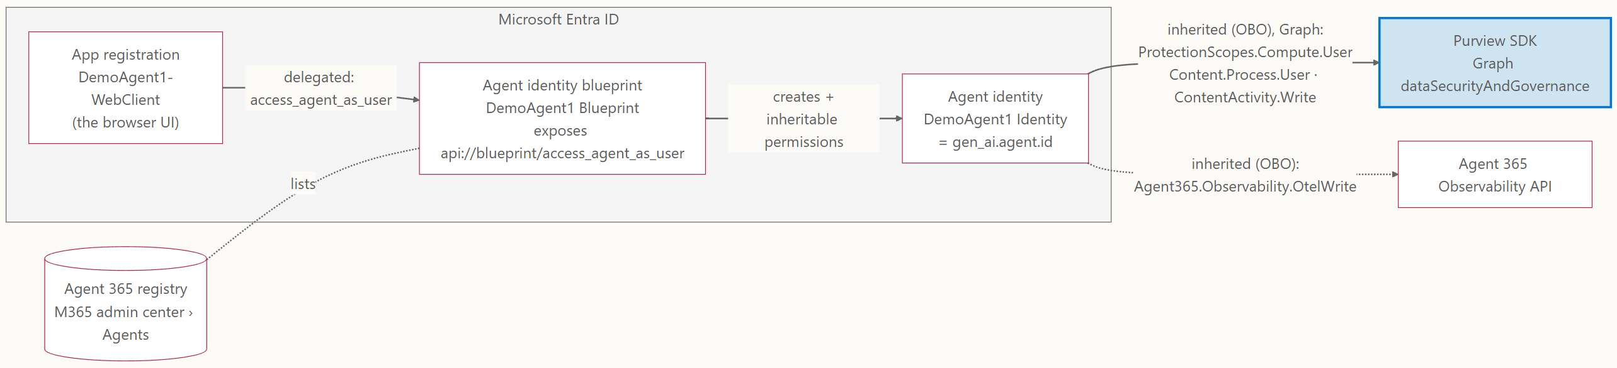
5
Entra objects and permissions
Talk track
Why three objects? The blueprint is the template and credential holder, and it carries the inheritable permissions (Purview SDK and Observability scopes) that every agent identity gets. The agent identity is the runtime principal. Blueprints can't do interactive sign‑in, so a normal app registration signs the user in.
Source: 02-register.md
Notes:
Why three objects? The blueprint is the template and credential holder, and it carries the inheritable permissions (Purview SDK and Observability scopes) that every agent identity gets. The agent identity is the runtime principal. Blueprints can't do interactive sign‑in, so a normal app registration signs the user in.
Source: 02-register.md

Slide 8
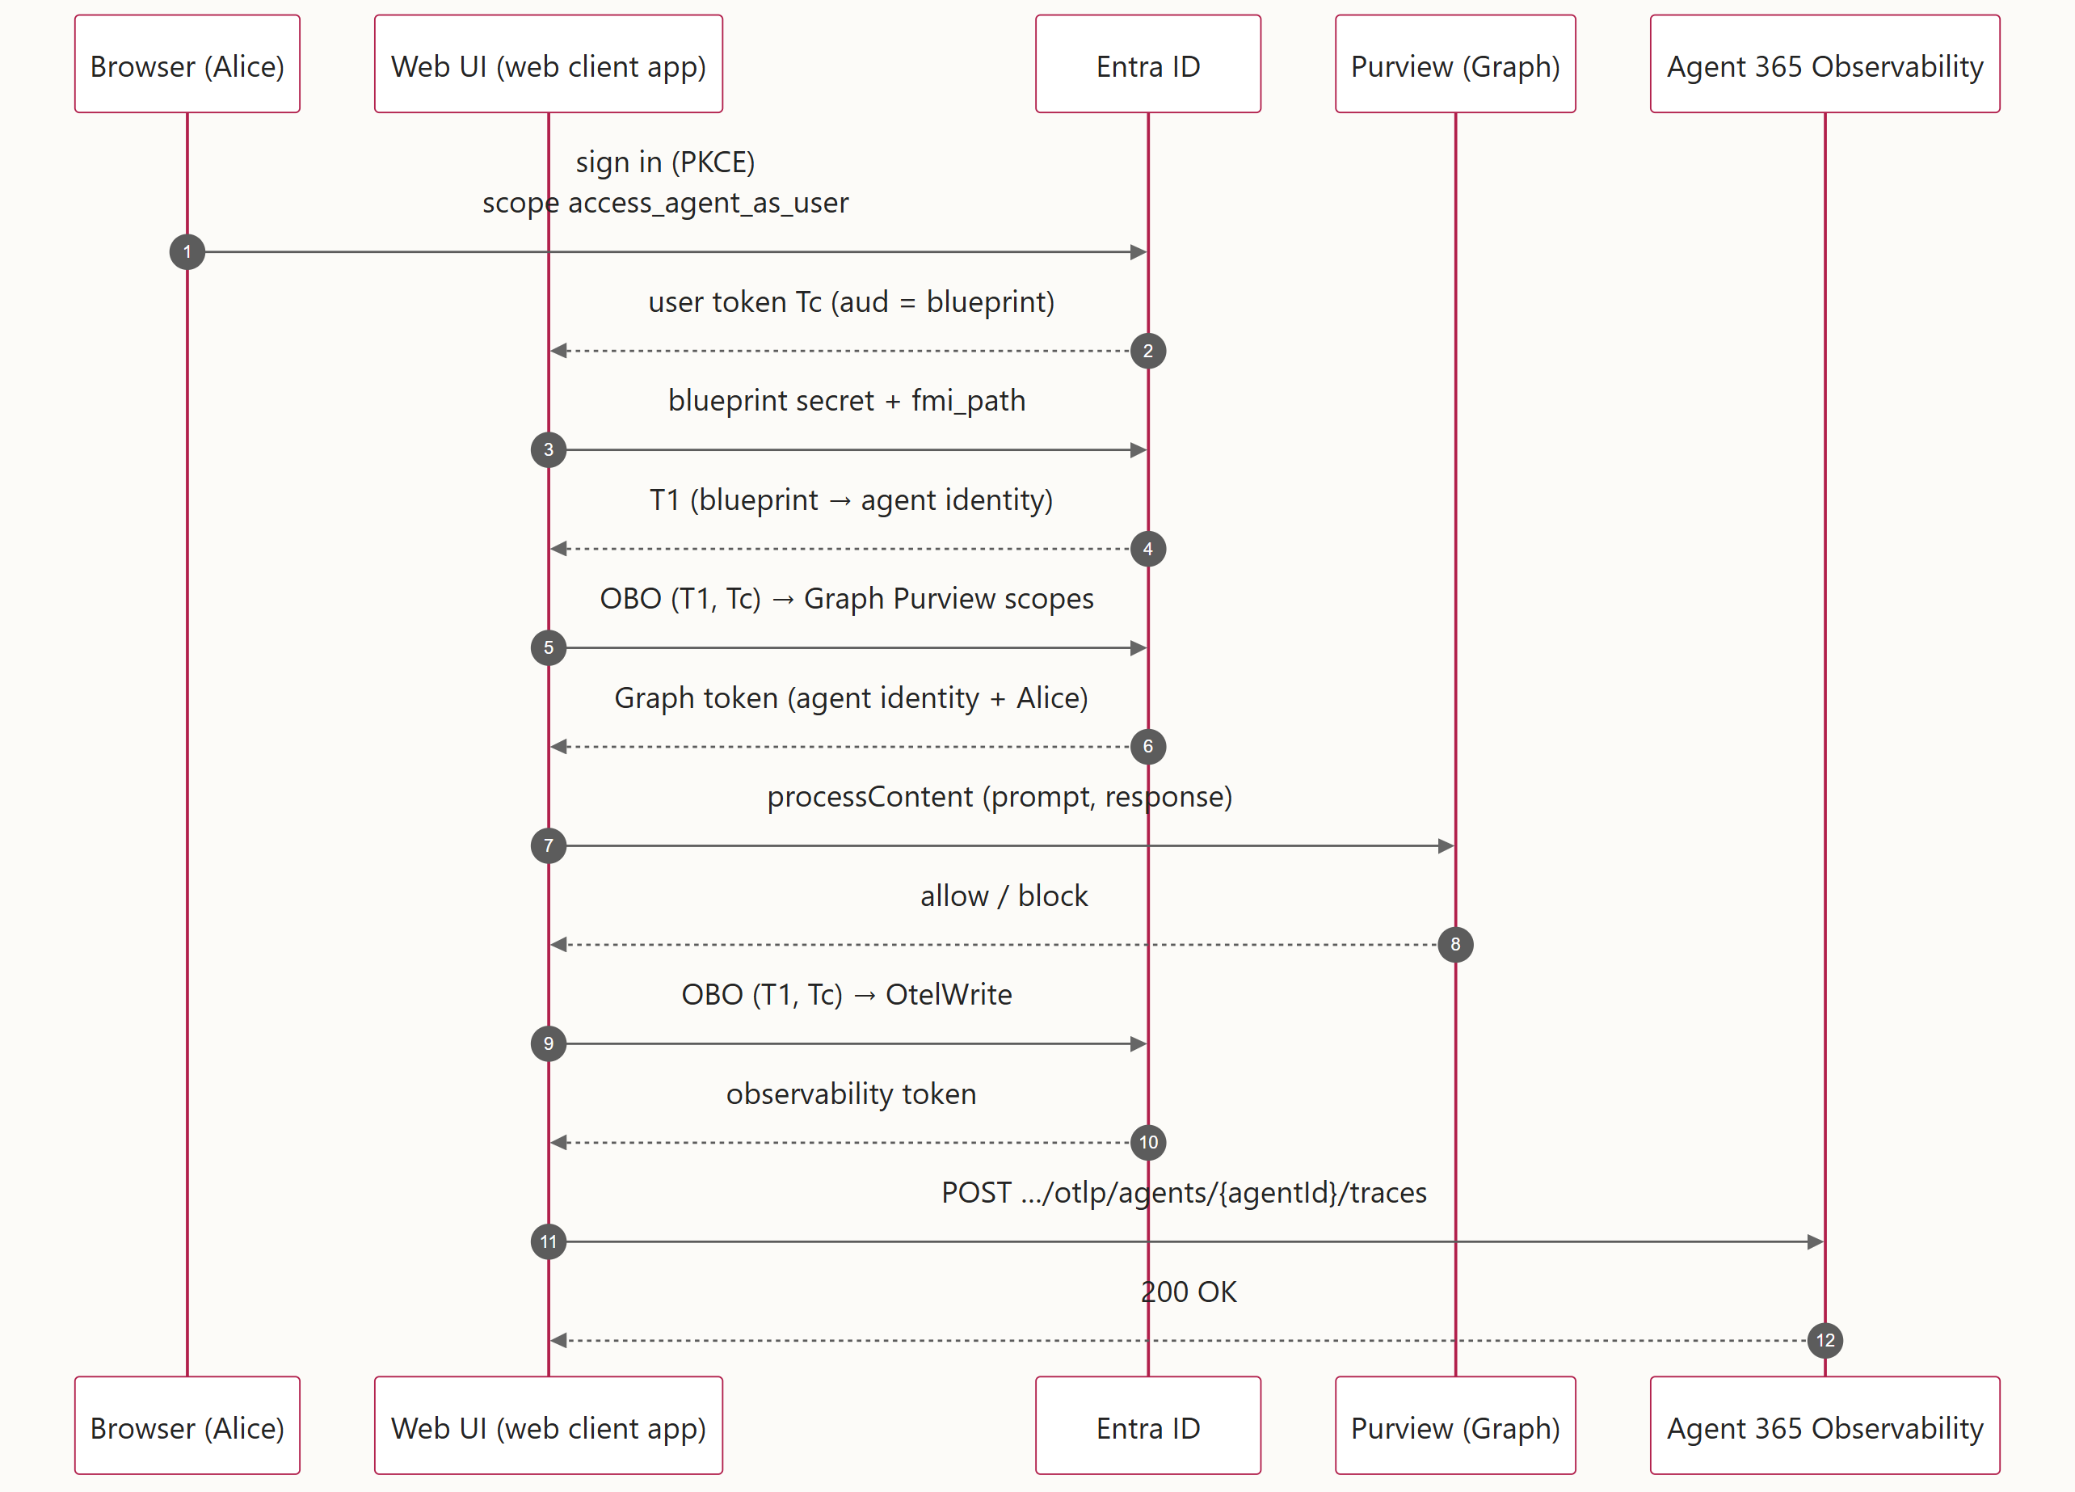
6
User sign‑in and on‑behalf‑of token chain
Source: 02-register.md · code: agent/auth.py
Notes:
Source: 02-register.md · code: agent/auth.py

Slide 9
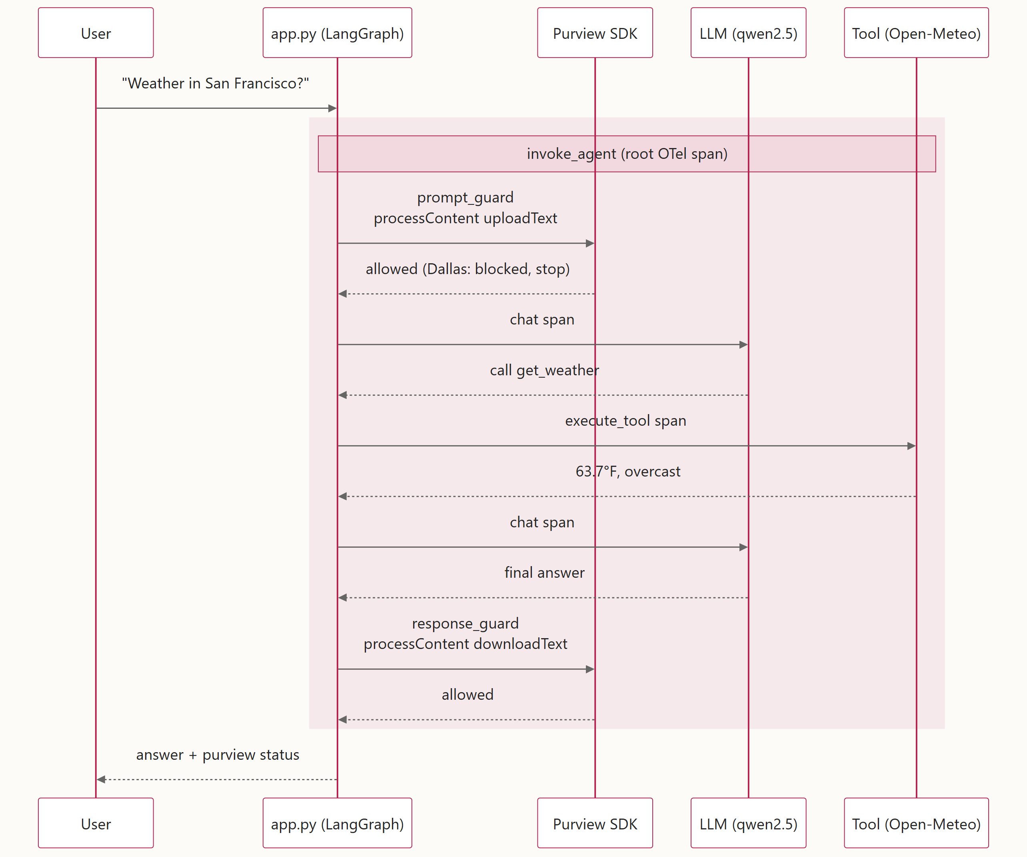
7
One chat turn: Purview SDK checks and the spans it produces
Talk track
Two separate channels: the Purview SDK calls carry the prompt and answer text and return a verdict. The OTel spans (invoke_agent, chat, execute_tool) carry gen_ai.agent.id, gen_ai.conversation.id, microsoft.tenant.id, user.id / user.email and client.address for Defender, Purview Audit and the admin center.
Source: 01-run-agent.md, 05-phase2-dlp-ca.md · code: agent/app.py, agent/guard.py, agent/purview.py
Notes:
Two separate channels: the Purview SDK calls carry the prompt and answer text and return a verdict. The OTel spans (invoke_agent, chat, execute_tool) carry gen_ai.agent.id, gen_ai.conversation.id, microsoft.tenant.id, user.id / user.email and client.address for Defender, Purview Audit and the admin center.
Source: 01-run-agent.md, 05-phase2-dlp-ca.md · code: agent/app.py, agent/guard.py, agent/purview.py

Slide 10
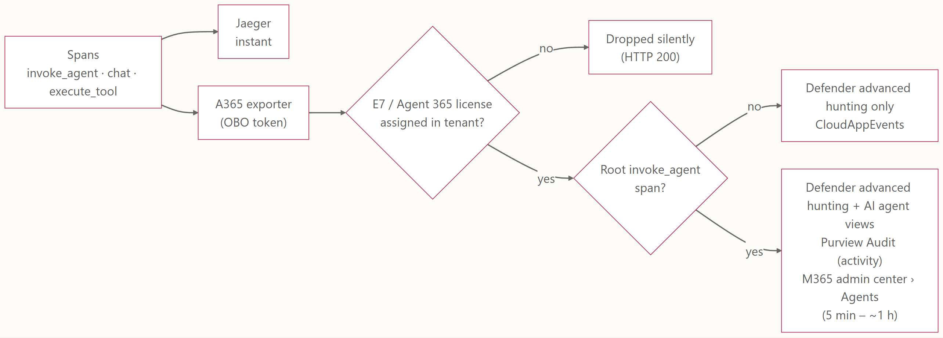
8
Where the OpenTelemetry shows up
Talk track
Not on this path: prompt/response policy evaluation. DLP verdicts and the prompt/response text in Activity explorer come from the Purview SDK (processContent), slide 9.
Source: 03-observability.md
Notes:
Not on this path: prompt/response policy evaluation. DLP verdicts and the prompt/response text in Activity explorer come from the Purview SDK (processContent), slide 9.
Source: 03-observability.md

Slide 11
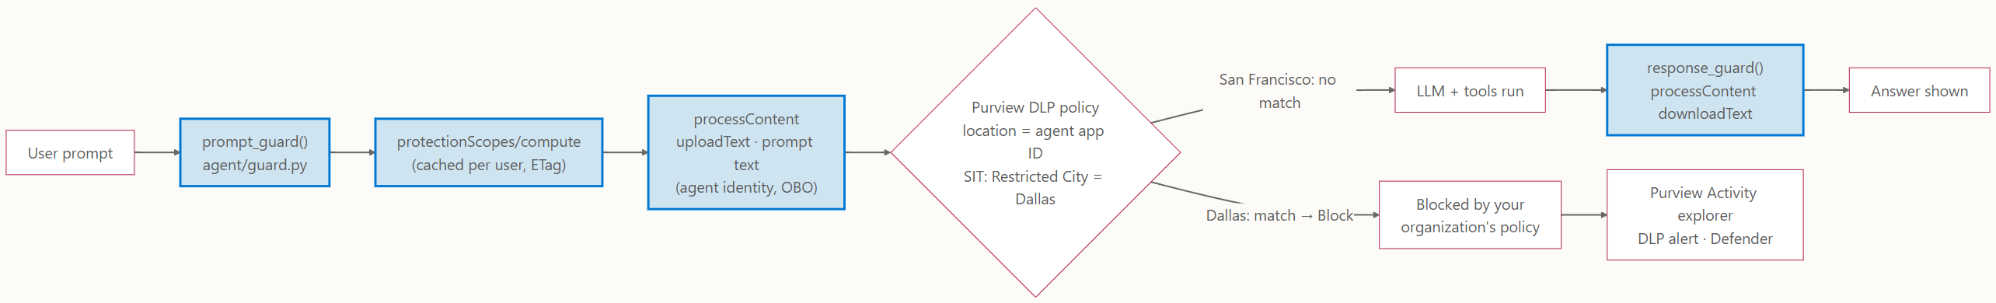
9
DLP via the Purview SDK: San Francisco allowed, Dallas blocked
Source: 05-phase2-dlp-ca.md · script: scripts/New-PurviewDlpDemo.ps1
Notes:
Source: 05-phase2-dlp-ca.md · script: scripts/New-PurviewDlpDemo.ps1

Slide 12
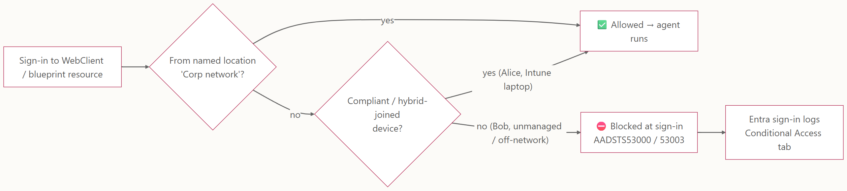
10
Phase 2 (planned): Conditional Access, Alice allowed, Bob blocked
Source: 05-phase2-dlp-ca.md
Notes:
Source: 05-phase2-dlp-ca.md

