Slide 1

Weather Prediction Machine Learning Model
UofT Data Analytics Bootcamp July 2020 - Final Project

Slide 2

Agenda Style
01
Summary & sources of information
02
Process Summary
03
Contents
04
Contents

Slide 3

Project Summary
Build a weather forecasting model using existing daily temperature data
Time is an important factor to be considered when selecting an appropriate model for the data
Some questions we asked:
Is the data stationary?
Is the data seasonal?
Is it auto correlated?
Decided to run the analysis on two types of models and then compare the results to see which model provides more accurate predictions.
Autoregressive integrated moving average (ARIMA)
Long short-term memory (LSTM) neural network model

Slide 4
Summary & sources of information
Build a weather forecasting model using existing daily temperature data
Time is an important factor to be considered when selecting an appropriate model for the data
Some questions we asked:
Is the data stationary?
Is the data seasonal?
Is it auto correlated?
Decided to run the analysis on two types of models and then compare the results to see which model provides more accurate predictions.
Autoregressive integrated moving average (ARIMA)
Long short-term memory (LSTM) neural network model
Notes:
DONE
For this project, we wanted to build a weather forecasting model focusing on daily temperature. Given that the data is in a time series format, we decided to run the analysis on two types of models and then compare the results to see which model provides more accurate predictions.
Autoregressive integrated moving average (ARIMA)
Long short-term memory (LSTM) neural network model

Slide 5

Sources Of Information
Data Source:
National Oceanic and Atmospheric Administration (NOAA):
https://www.ncdc.noaa.gov/cdo-web/
Reference Code:
ARIMA:
https://machinelearningmastery.com/arima-for-time-series-forecasting-with-python/
https://machinelearningmastery.com/time-series-data-stationary-python/
Neural Network (LSTM):
https://stackabuse.com/using-machine-learning-to-predict-the-weather-part-1, 2, 3
https://www.wunderground.com/
https://pdfs.semanticscholar.org/2761/8afb77c5081d942640333528943149a66edd.pdf
Notes:
ADDED TO TABLEAU

Slide 6
Process Summary
Extraction
Model Building
Visualisation
ARIMA model
LSTM Neural network models
Loaded the final data to Tableau dashboard
Data collection and processing
Notes:
ADDED TO TABLEAU

Slide 7
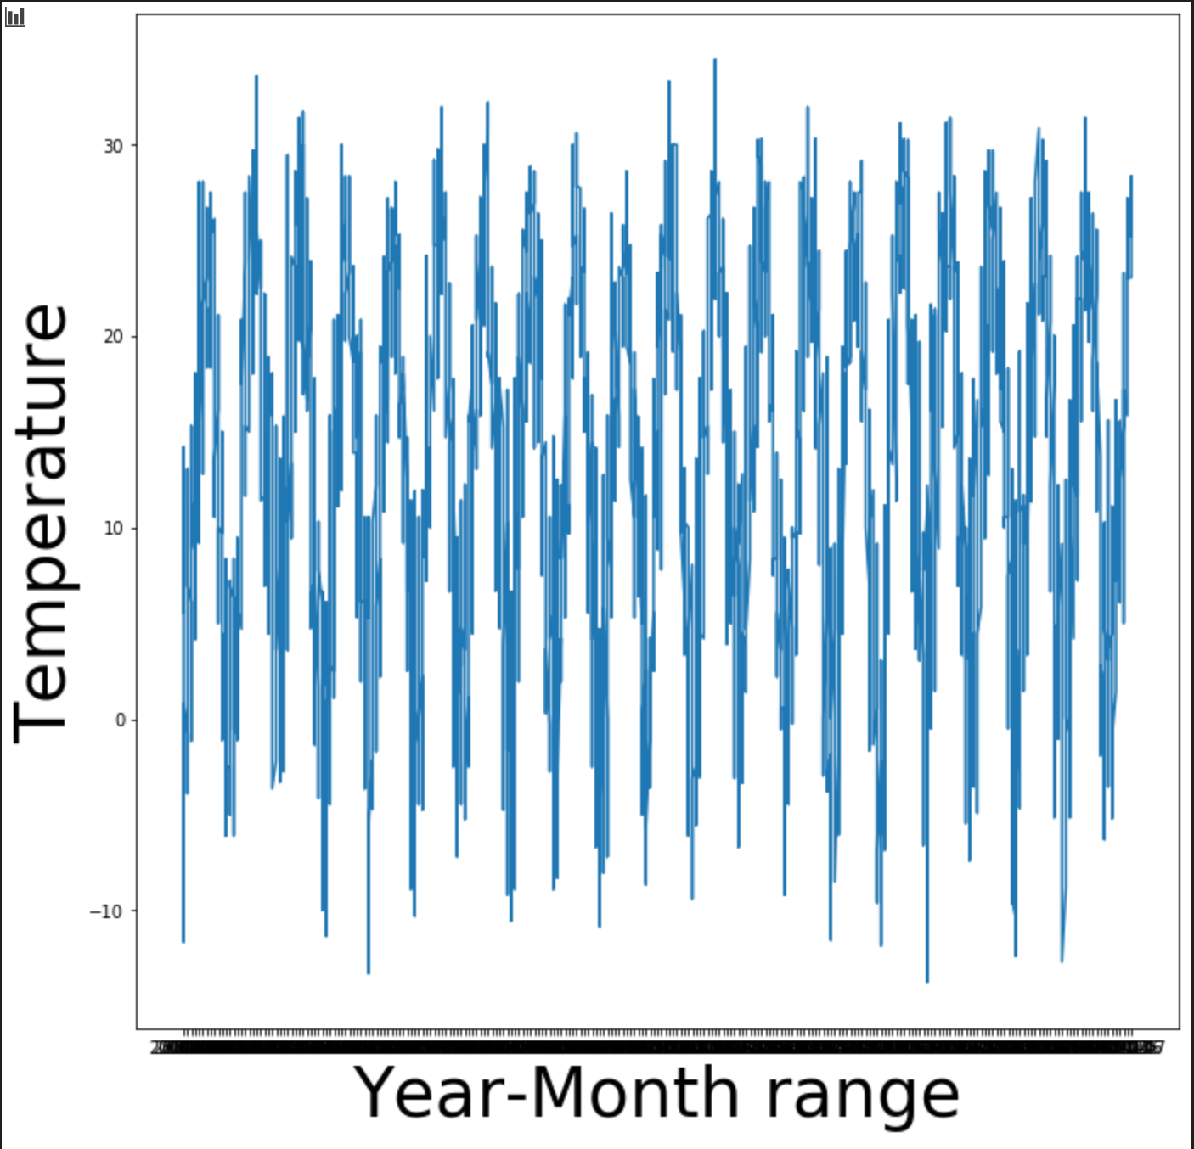
Time Series Assumptions
ARIMA model requires time series to be stationary
Augmented Dickey-Fuller test is a statistical tool to support this assumption.
Null hypothesis: Time series is non-stationary
ADF Statistic: -5.876
p = 3.14e-07
Reject null hypothesis (p< 0.05)→ Data is stationary
Data does not have a trend or seasonal effects
Notes:
ADD TO TABLEAU

Slide 8
Process summary
Process Summary
The following diagram provides a summary of the process:
Extraction
Data Cleanup
Data Exploration
Linear Regression
Data Gathering
Extracting the relevant data points and loading into a dataframe
Data Processing
Data Exploration
Linear Regression Model
Use the available data to build the relationship/linear regression model
Cleanse, standardize,
group, sort and validate the data
Understanding and analysing the data
Use SciKit-Learn to predict weather
Understanding Neural Networks
Application and Testing
Visualizations
SciKit-Learn
Use SciKit-Learn to create a prediction model and test it
Neural networks
Neural networks
Visualizations
Use Tableau to create interactive dashboards to present our findings
Understand the application of neural networks to the model
Application and testing
Notes:
ADDED TO TABLEAU

Slide 9
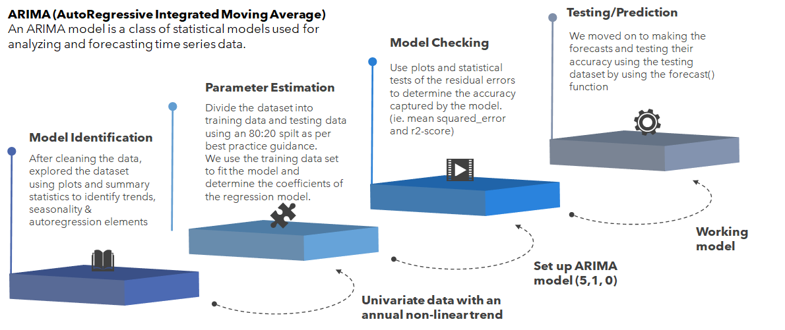
Deep Dive – ARIMA Model

Slide 10
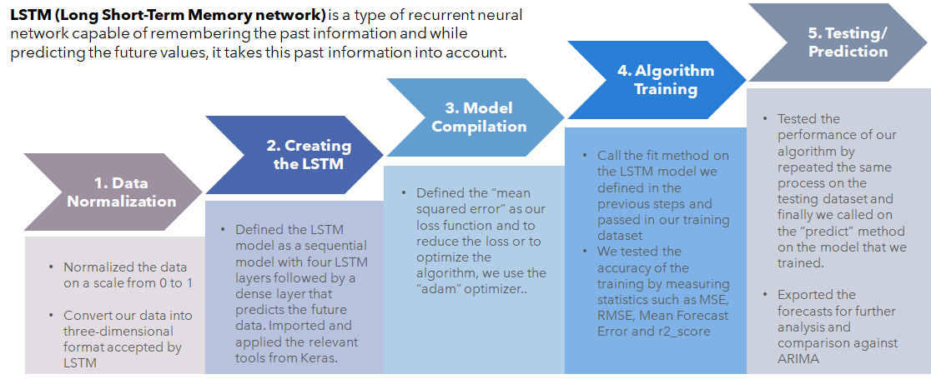
Deep Dive – LSTM Network

Slide 11
ARIMA vs LSTM
ARIMA Model
LSTM Model
No parameter tuning required
Faster run-time
Effectively handles multivariate data.
Better fit for large size data
No stationary data requirements
Model non-linear functions within neutral network.

Slide 12
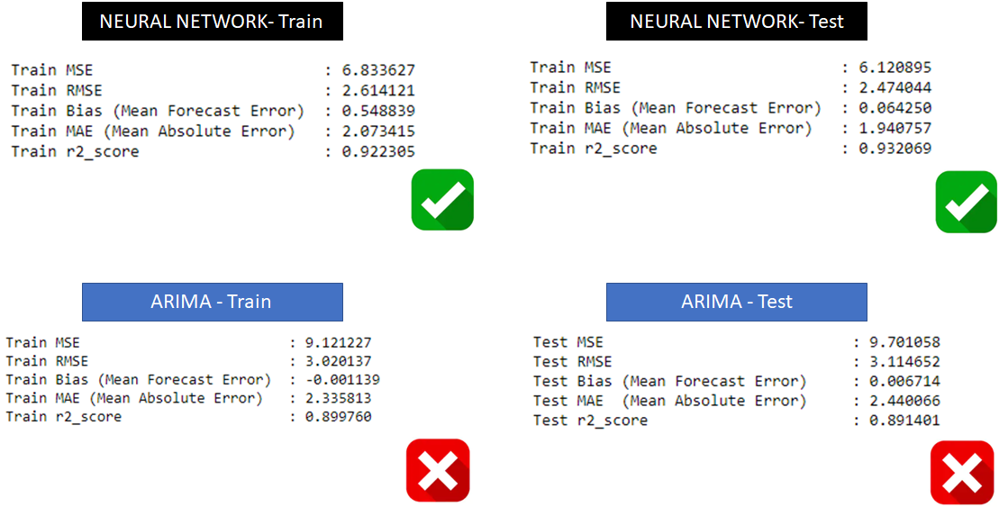
KPIs: ARIMA vs LSTM

Slide 13
Thank you ☺

