Slide 1
Employee Data Analysis using Excel
STUDENT NAME: M. Latchameena
REGISTER NO: 312200182
DEPARTMENT: Commerce
COLLEGE : S.I.V.E.T College

Slide 2
PROJECT TITLE
Employee Performance Analysis using Excel

Slide 3


AGENDA
Problem Statement
Project Overview
End Users
Our Solution and Proposition
Dataset Description
Modelling Approach
Results and Discussion
Conclusion
3/21/2024 Annual Review

Slide 4

PROBLEM STATEMENT
“The company’s sales team is experiencing a decline in productivity, resulting in lower sales revenue and decreased customer satisfaction. The current performance evaluation process is manual, time-consuming, and lacks data-driven insights, making it challenging to identify areas for improvement and develop effective training programs. We need to develop a data-driven employee performance analysis system using Excel to:
- Enhance overall sales team productivity and performance Goals:
- Increase customer satisfaction ratings by 20% within the next 12 month
Constraints :
- Manual performance evaluation process using Excel.
Here is a problem statement for employee performance analysis: *Problem Statement:* “The company’s sales team is experiencing a decline in productivity, resulting in lower sales revenue and decreased customer satisfaction. The current performance evaluation process is manual, time-consuming, and lacks data-driven insights, making it challenging to identify areas for improvement and develop effective training programs. We need to develop a data-driven employee performance analysis system using Excel to: - Track and measure sales performance metrics - Identify underperforming employees and areas for improvement - Provide data-driven insights for targeted training and development programs - Enhance overall sales team productivity and performance *Goals:* - Improve sales revenue by 15% within the next 9 months - Increase customer satisfaction ratings by 20% within the next 12 months - Reduce sales cycle time by 30% within the next 6 months *Constraints:* - Limited resources for training and development programs - High employee turnover rate in the sales team - Manual performance evaluation process *Desired Outcomes:* - A data-driven employee performance analysis system using Excel - Identification of underperforming employees and areas for improvement - Development of targeted training and development programs - Enhanced sales team productivity and performance”

Slide 5

PROJECT OVERVIEW
Develop a data-driven employee performance analysis system using Excel to track and measure sales performance metrics, identify areas for improvement, and provide insights for targeted training and development program
Scope:
- Develop a comprehensive Excel dashboard for performance analysis - Identify underperforming employees and areas for improvement Deliverable
- Identification of underperforming employees and areas for improvement - Recommendations for targeted training and development programs Timeline: - Week 1-2: Data collection and setup - Week 3-4: Dashboard development and testing - Week 5-6: Analysis and insights - Week 7: Final report and recommendation
.

Slide 6

WHO ARE THE END USERS?
1. Sales Managers: To track and evaluate their team’s performance, identify areas for improvement, and develop targeted training programs. 2. HR Representatives : To monitor employee performance, identify training needs, and develop strategies for employee development and growth. 3. Sales Team Members: To view their individual performance metrics, set goals, and track progress. 4. Business Leaders: To gain insights into sales team performance, make data-driven decisions, and align training programs with business objectives. 5. Training and Development Teams: To design and deliver targeted training programs based on identified performance gaps. By understanding the needs and goals of these end users, the system can be designed to meet their requirements and provide maximum value.

Slide 7

OUR SOLUTION AND ITS VALUE PROPOSITION
Solution: Our solution is a comprehensive performance Analysis System built in Excel, which provides a data-driven approach to tracking and evaluating sales team performance. The system includes: - A user-friendly dashboard for easy data visualization - Automated reporting and analytics - Customizable performance metrics and targets - Identification of underperforming employees and areas for improvement Value Proposition:
*Improved Sales Performance*: Data-driven insights to identify areas for improvement and optimize sales strategies *Enhanced Employee Development*: Targeted training programs to enhance employee skills and knowledge

Slide 8
Dataset Description
*Description:* This dataset contains employee performance data for a sales team, including metrics such as sales revenue, productivity, and quality ratings.
*Columns:* 1. *Employee ID* (unique identifier for each employee) 2. *Name* (employee name) 3. *Job Title* (employee job title) 4. *Sales Revenue* (total sales revenue generated by each employee) 5. *Productivity* (number of sales calls made or tasks completed) 6. *Quality Rating* (quality rating based on customer feedback or performance reviews) 7. *Targets* (sales targets or goals for each employee) 8. *Actual Performance* (actual sales performance for each employee) 9. *Variance* (difference between actual and target performance) 10. *Region* (sales region or territory) 11. *Manager* (employee’s manager or supervisor) *Dataset Size:* 100-500 rows (depending on the number of employees) *Dataset Source:* Sales performance data from the company’s CRM system or HR database

Slide 9

THE "WOW" IN OUR SOLUTION
1. _Interactive Dashboard_: Create a user-friendly dashboard with filters, drop-down menus, and hover-over text to facilitate easy data exploration. 2. _Automated Reporting_: Develop a system that automatically generates reports, saving time and reducing manual effort. 3. _Real-time Data Visualization_: Use Excel’s data visualization tools to create dynamic charts and graphs that update in real-time. 4. _Predictive Analytics_: Incorporate predictive analytics to forecast future performance and identify potential areas for improvement. 5. _Customizable Performance Metrics_: Allow users to create and track custom performance metrics tailored to their specific needs. 6. _Employee Scorecards_: Develop employee scorecards that provide a comprehensive view of individual performance. 7. _Alerts and Notifications_: Set up alerts and notifications to inform managers and employees of performance milestones and areas for improvement
3/21/2024 Annual Review
9

Slide 10
MODELLING
The employee performance model in Excel utilizes a comprehensive framework to track and evaluate sales team performance, incorporating key metrics such as sales revenue, productivity, and quality ratings. The model features a user-friendly dashboard with interactive filters and visualizations, automated reporting, and predictive analytics capabilities to identify trends and areas for improvement. By leveraging Excel’s advanced formulas and functions, such as INDEX-MATCH, VLOOKUP, and PivotTables, the model provides a robust and dynamic analysis of employee performance, enabling data-driven decision making and targeted training programs to enhance sales productivity and drive business growth.
10

Slide 11
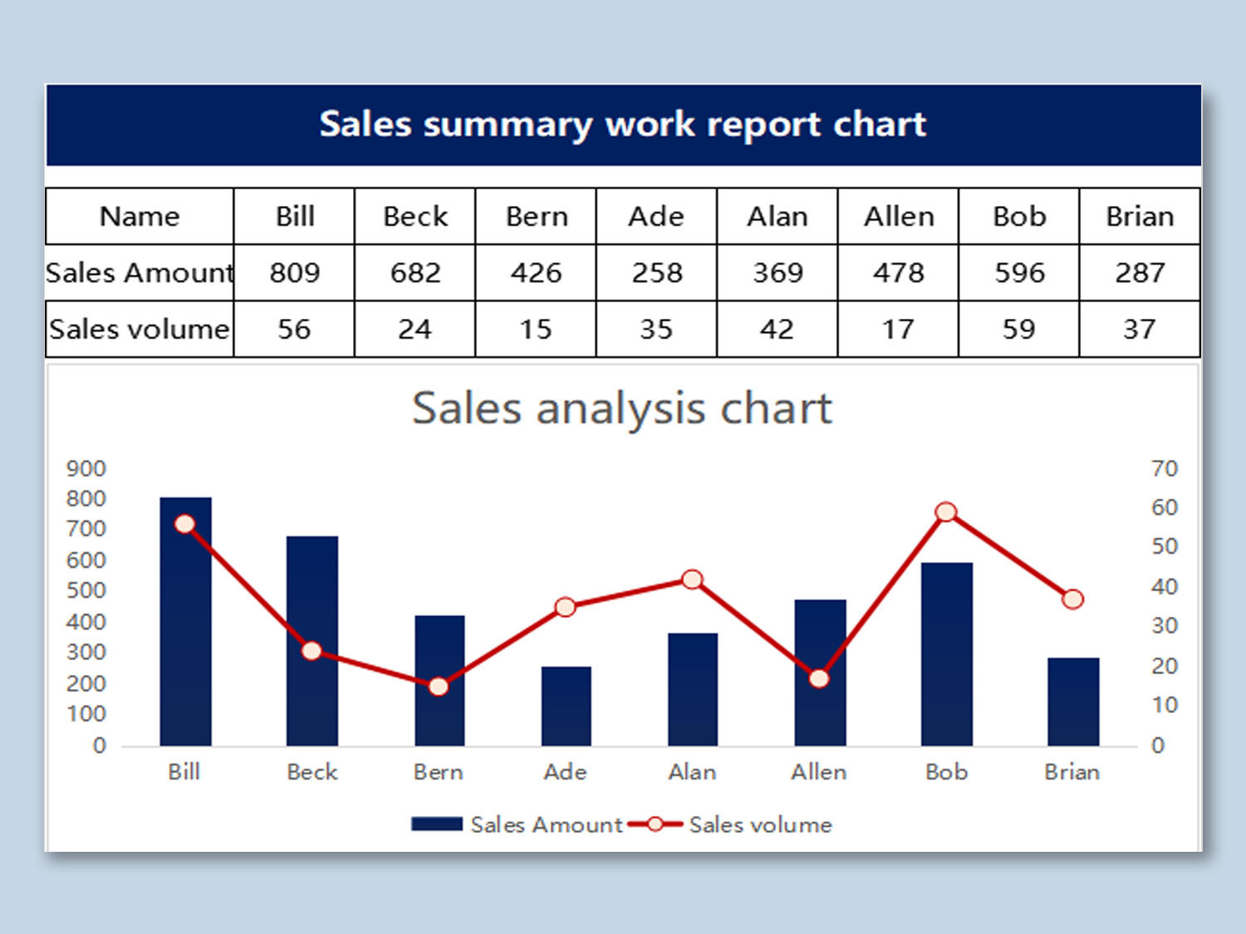
RESULTS
11

Slide 12
conclusion
“By leveraging the power of Excel, we have developed a comprehensive employee performance analysis system that enables data-driven decision making, improves sales productivity, and enhances employee development. With its user-friendly dashboard, automated reporting, and predictive analytics capabilities, this system provides a robust framework for tracking and evaluating employee performance. Through this analysis, we have gained valuable insights into sales team performance, identified areas for improvement, and developed targeted training programs to drive business growth. By continuing to refine and expand this system, we can further optimize employee performance, increase customer satisfaction.

