Slide 1
Agile- through Scrum

Slide 2
What is the scrum Agile Approach?
Scrum aims to complete a project as a team in small batches, “with continuous experimentation and feedback loops along the way to learn and improve”
Scrum is built of three principles:
Transparency
Inspection
Adaptation
Scrum success is dependent on the team that is assembled

Slide 3

The Scrum Team

Slide 4

The Product Owner
The line of communication between the development team and the client
Conducts interviews with client and gathers relevant information
Translates communications so that it is easily understood by all involved
Creates the Product Backlog and User Stories
Ensures user stories are attainable, easily understood, and ordered in a way to promote efficiency
Maximizes value of the product and the work of the development team
Provides direction and clarification
Has proficient business and technical knowledge

Slide 5

The Scrum Master
Ensures Scrum is understood and enacted.
Facilitates interactions between team members and outside individuals
Helps Product Owner curate Product Backlog for maximum values
Coaches team members as needed
Leads team and organization in Scrum Adoption
Leads the various Scrum events
Help organize scrum implementation on an organizational level and personal level
Removes impediments to development team’s progress

Slide 6

Developers
Create the deliverables that will be presented to the client.
Create the code that will be the backbone of the system
Complete user stories to the specifications lined out for them
Create code that is simple in design and iterable
Be self sustainable and manage their own work
Be willing to collaborate and reach out for clarification as need
Work as one entity
No titles or sub teams for developers
Regardless of skill level or area of focus, accountability applies to entire team

Slide 7

Testers
Ensures deliverables meet the client’s specifications
Create test cases to ensure program works as intended
Create conditions based on typical user actions
Create conditions that will ensure code works even under non typical circumstances
Test user stories based on test cases created
Look for additional areas where the code may need improvement

Slide 8
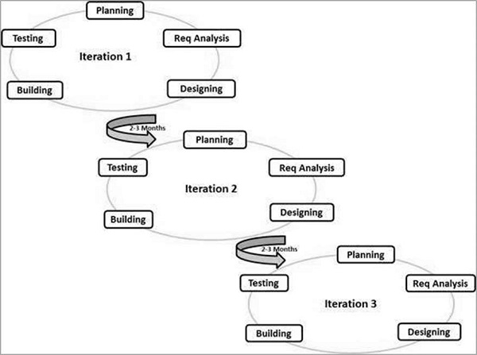
SDLC Through Agile
Rather than go through the software development life cycle once for the entire project, agile goes through each phase during each sprint.

Slide 9
Phases of SDLc in a sprint
PLANNING – User stories are selected for this sprint to determine the deliverables that are planned to be offered at the end of the sprint. Sets the course for the entire duration of the sprint.
ANALYSIS AND DESIGN – Through the daily sprint and regular communication, team members determine the finer details of how the various user stories need to be completed
BUILDING – Developers create the code based on the user story. Developers are often encouraged to collaborate, pair programming being an example, to use all resources available, increase speed of development, and create the strongest version of said user story. Developer also only build as much code as necessary, never overcomplicating in case changes need to be made.
TESTING – Testers, following test cases, ensure that the deliverables work as intended based on the current expected level of completion

Slide 10
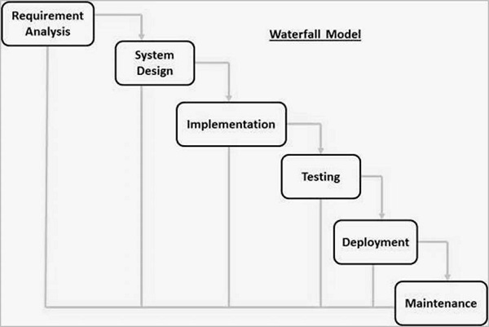
Waterfall vs Agile – Encountering Issues
In our sprint retrospective we talked at length of the values of Agile when there arises a need to pivot. What would have happened under a waterfall approach?
Each phase of waterfall must be completed before the next can occur. So…..
Customer wishes to pivot from a full page to a slideshow presentation during our implementation phase?
We must first return to the beginning, requirement analysis.
2. Customer wishes to move from Top 5 Destinations to Wellness focus during our testing phase?
We must first return to the beginning, the requirement analysis.
While Agile is able to adapt in the moment, most changes by the customer in Waterfall mean we must start again at the beginning.

Slide 11
Final takeaways – Agile or Waterfall
Choose Agile when:
Projects are large in scope
Changes in direction are likely to happen
Early working software is needed for review
Resource requirements are minimal or flexible
Choose Waterfall when:
Projects are smaller in scope
Predictability is important
Working software is not critical
Budgets and design are locked in from the beginning

Slide 12

Final takeaways - REflection
While new to us, our team quickly fell in love with agile development
Each team member felt empowered to bring their skills to the forefront
No one ever felt overworked because tasks were manageable, and we worked as a team throughout.
While unexpected, no changes brought to us forced us off path. We were able to still deliver on time and in budget.
We feel the flexibility of Agile allowed us to create the best version of SNHU Traver we could create.
We highly recommend that Agile methodology be introduced to more of the development teams here at Chada Tech

Slide 13
Sources
What is Scrum?. Scrum.org. (n.d.). https://www.scrum.org/resources/what-scrum-module
Schwaber, K., & Sutherland, J. (n.d.). The 2020 scrum GUIDETM. Scrum Guide | Scrum Guides. https://scrumguides.org/scrum-guide.html#events-review
Cobb, C. G. (2015). The project manager’s guide to mastering agile : principles and practices for an adaptive approach. John Wiley
Focusing on the agile team. Documentation. (n.d.). https://confluence.atlassian.com/jirasoftware/blog/2015/08/focusing-on-the-agile-team
SDLC - Agile Model. Tutorialspoint. (n.d.). https://www.tutorialspoint.com/sdlc/sdlc_agile_model.htm

