Slide 1

MALLA REDDY INSTITUTE OF ENGINEERING AND TECHNOLOGY
DEPARTMENT OF INFORMATION TECHNOLOGY
Courier Management System (A Web-Based Application to Track and Manage Couriers)
HEAD OF THE DEPARTMENT: Mr. V. RAMAKRISHNAN
TEAM LEAD : SHAIK LATEEF TEAM MEMBERS :
ESHA HARIDAS SHIVU KUMAR VADLA PRAVLEKA SAI SIDHARTHA ALETI
GUIDE: Mr. K. MAHENDAR

Slide 2
CONTENTS
ABSTRACT INTRODUCTION EXISTING SYSTEM EXISTING SYSTEM AND LIMITATIONS PROPOSED SYSTEM ADVANTAGES OF PROPOSED SYSTEM
SYSTEM ARCHITECTURE METHODOLOGY SYSTEM REQUIREMENTS
OUTPUT SCREENS FUTURE ENHANCEMENTS AND UPGRADES CONCLUSION

Slide 3
ABSTRACT
The Courier Management System is a web-based platform designed to streamline logistics and courier services by offering efficient real-time tracking of shipments. The system allows administrators to monitor deliveries, manage feedback, and ensure smooth coordination. Customers can easily track their couriers using unique IDs, with the added benefit of Google Maps API integration for accurate location tracking. Featuring a built-in user feedback mechanism, the system allows businesses to continuously improve service quality. Built with Python and Django for the backend and HTML, CSS, and JavaScript for the frontend, the system offers a scalable solution that grows with the needs of the business. This platform enhances operational transparency and customer satisfaction, providing a reliable tool for logistics companies in the growing demand for efficient, real-time courier services.
KEYWORDS:
Courier Management System,Logistics and Courier Services, Real-time Tracking, Google Maps API ,User Feedback Mechanism,Scalable

Slide 4
INTRODUCTION
The Courier Management System is a web-based application designed to streamline courier services by addressing the challenges of traditional systems. These challenges include inefficiencies, delays, and a lack of real-time parcel tracking. The system provides real-time tracking, automated updates, and centralized management, ensuring transparency and improving customer satisfaction .Built with a user-friendly interface and scalable architecture, the system allows administrators to efficiently manage operations, employees to update shipment statuses, and customers to track their parcels with ease. By modernizing courier services, this project aims to enhance operational efficiency, foster transparency, and deliver an exceptional user experience, meeting the growing demands of the logistics industry.

Slide 5
EXISTING SYSTEM
Traditional courier management systems rely on outdated processes and manual operations, causing errors and inefficiencies. They lack real-time tracking, making it hard for customers to monitor parcels and receive updates. Communication through phone calls and emails is slow and ineffective, leading to customer frustration and decreased trust. These systems also feature disjointed workflows, resulting in delays, poor resource utilization, and higher costs. With data stored in silos and no automation or advanced analytics, tasks like feedback collection, reporting, and tracking updates rely on manual input, increasing the risk of errors. As a result, existing systems struggle to meet the growing demand for faster, more efficient services.

Slide 6
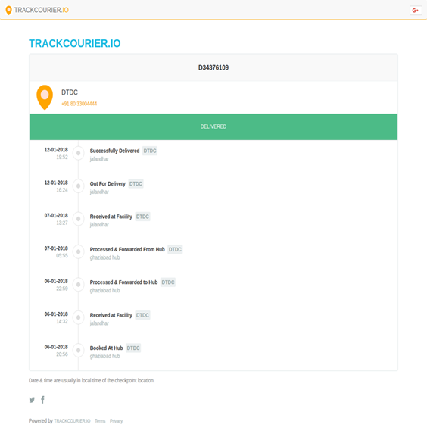

EXISTING SYSTEM LIMITATIONS
Lack of Real-Time Tracking
Poor Transparency
Lack of Feedback Mechanism
Inadequate Reporting and Analytics
Poor Customer Satisfaction

Slide 7
PROPOSED SYSTEM
The Courier Management System is a web-based application designed to improve traditional courier systems by providing efficient parcel tracking and management. It offers real-time tracking for customers, ensuring transparency and satisfaction. The system features a centralized admin dashboard for managing employee details, tracking parcels, and analyzing customer feedback. With a user-friendly interface, it facilitates smooth interactions between customers and employees. Built for scalability, the system can handle growing parcel volumes while ensuring data security to protect customer information.

Slide 8
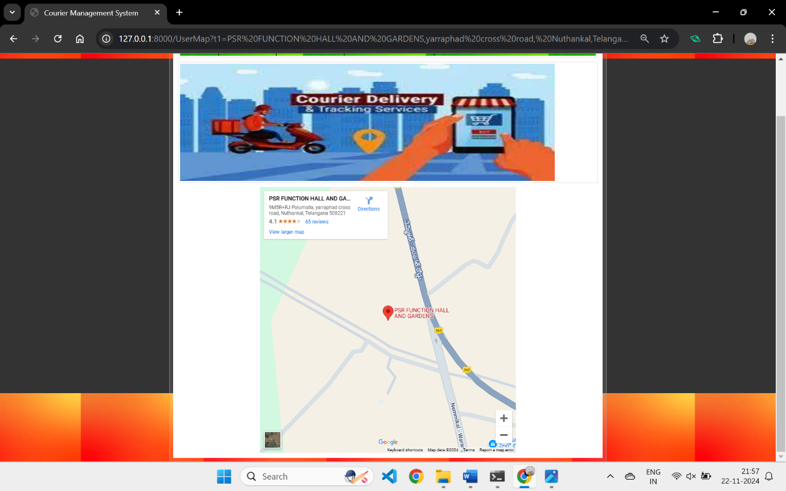
View Map Feature

Slide 9
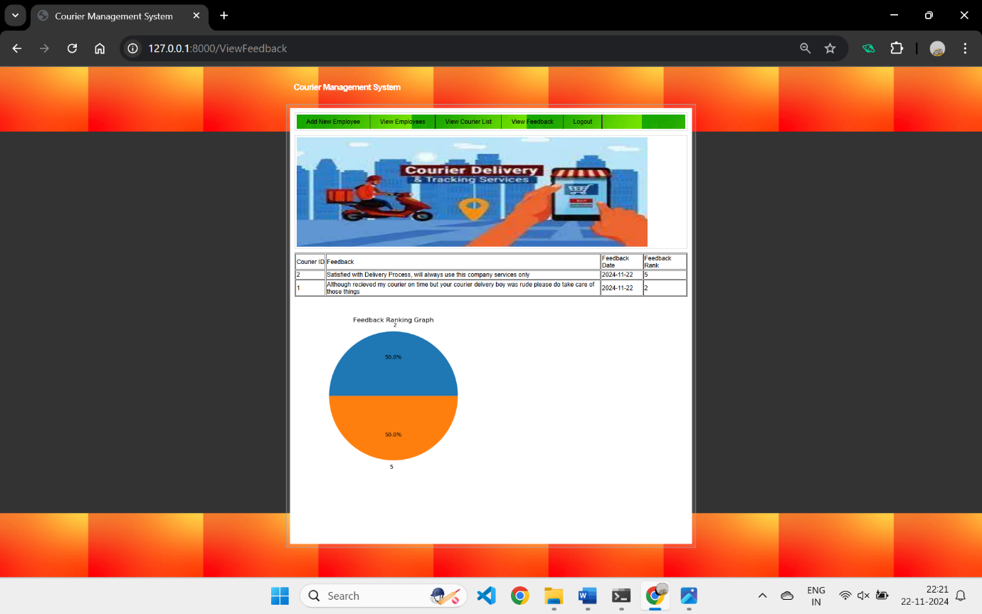

ADVANTAGES OF PROPOSED SYSTEM
Real-time tracking
Improved customer satisfaction
Increased efficiency and productivity
Continuous improvement through customer feedback
User Friendly Interface
Competitive Advantage

Slide 10
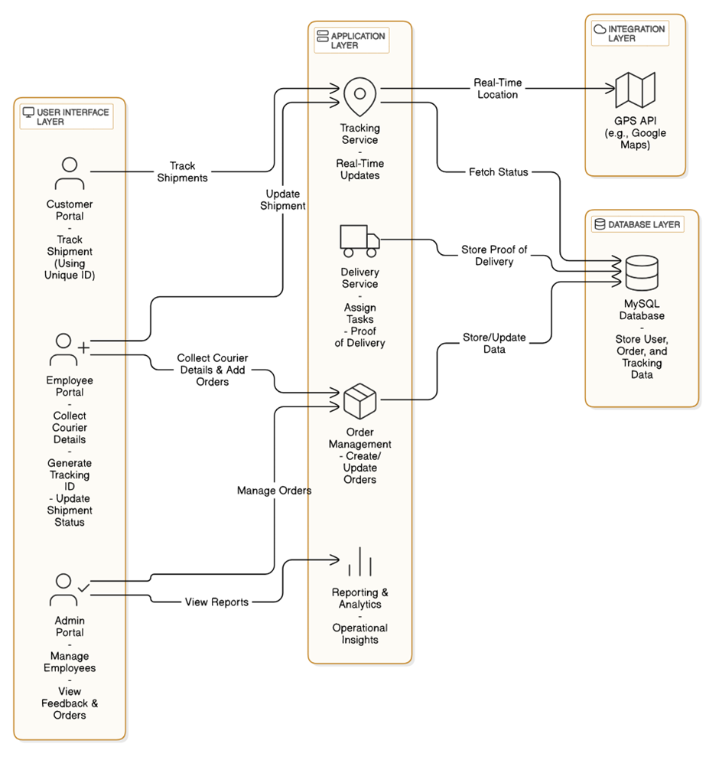
SYSTEM ARCHITECTURE

Slide 11
METHODOLOGY
Our project followed a structured methodology to ensure a scalable solution. We started with requirements gathering, analyzing the needs of admins, employees, and customers to design a system that meets both functional and non-functional requirements. We then designed the system architecture, database schema, and user interface, ensuring scalability and user-friendliness. Development was done using the Django framework and SQL for efficient data management. Comprehensive testing, including unit, integration, and system testing, ensured the system met specifications and was bug-free. Continuous feedback was incorporated throughout the development to improve system quality.

Slide 12
SYSTEM REQUIREMENTS
Processor : i3 or above Ram : 4 GB Hard Disk : 40GB
Operating System : Windows Browser : Any Browser

Slide 13
TECHNOLOGIES USED
Frontend:
HTML: Version 5
CSS: Version 3
JavaScript: ES6 or later
Backend:
Python: Version 3.7.0 or above
Django: Version 2.1.7
Database:
MySQL: Version 8.0

Slide 14
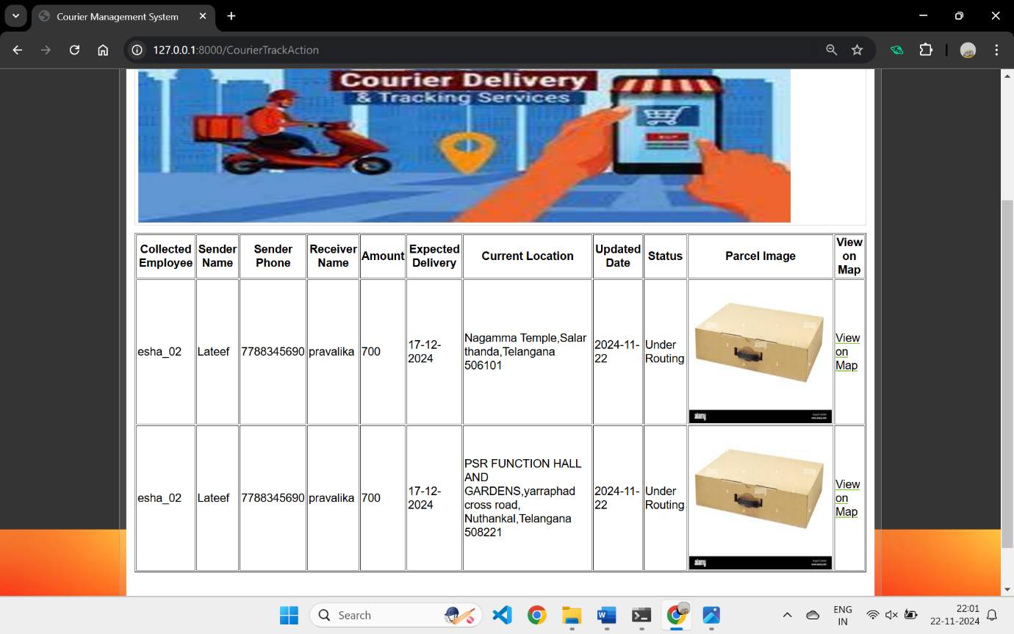
OUTPUT SCREENS
User Courier Tracking in Detail
View Map

Slide 15
Admin View Feedback

Slide 16
FUTURE ENHANCEMENTS AND UPGRADES
AI and ML Integration Intelligent customer service chatbots
IoT Integration Real-time package tracking with IoT sensor IoT-enabled vehicles for efficient delivery
Blockchain Integration Immutable records of package delivery and status
By integrating emerging technologies such as AI, IoT, blockchain, autonomous delivery, and augmented reality, our courier management system will continue to evolve and improve, providing even greater efficiency, transparency, and customer satisfaction.

Slide 17
CONCLUSION
The proposed web-based courier management system provides a solution to enhance operational efficiency, customer satisfaction, and business growth. With features like real-time tracking, automated processes, and data-driven decision-making, the system offers a competitive edge. Its scalability, flexibility, and user-friendly interface make it suitable for businesses of all sizes, leading to cost savings, increased customer loyalty, and higher profitability. This system has the potential to transform the courier industry and set a new standard in delivery services.

Slide 18
THANK YOU

