Slide 1

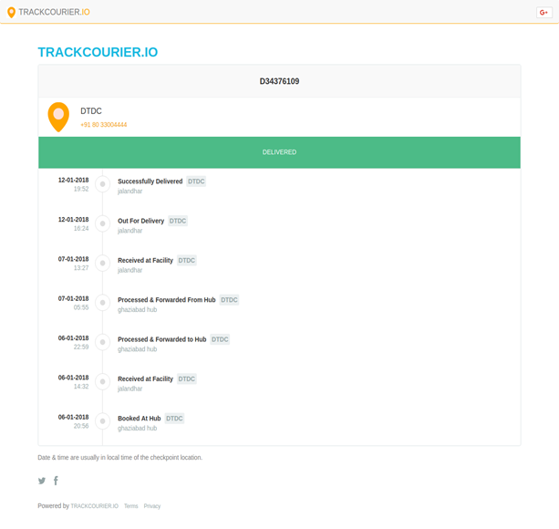
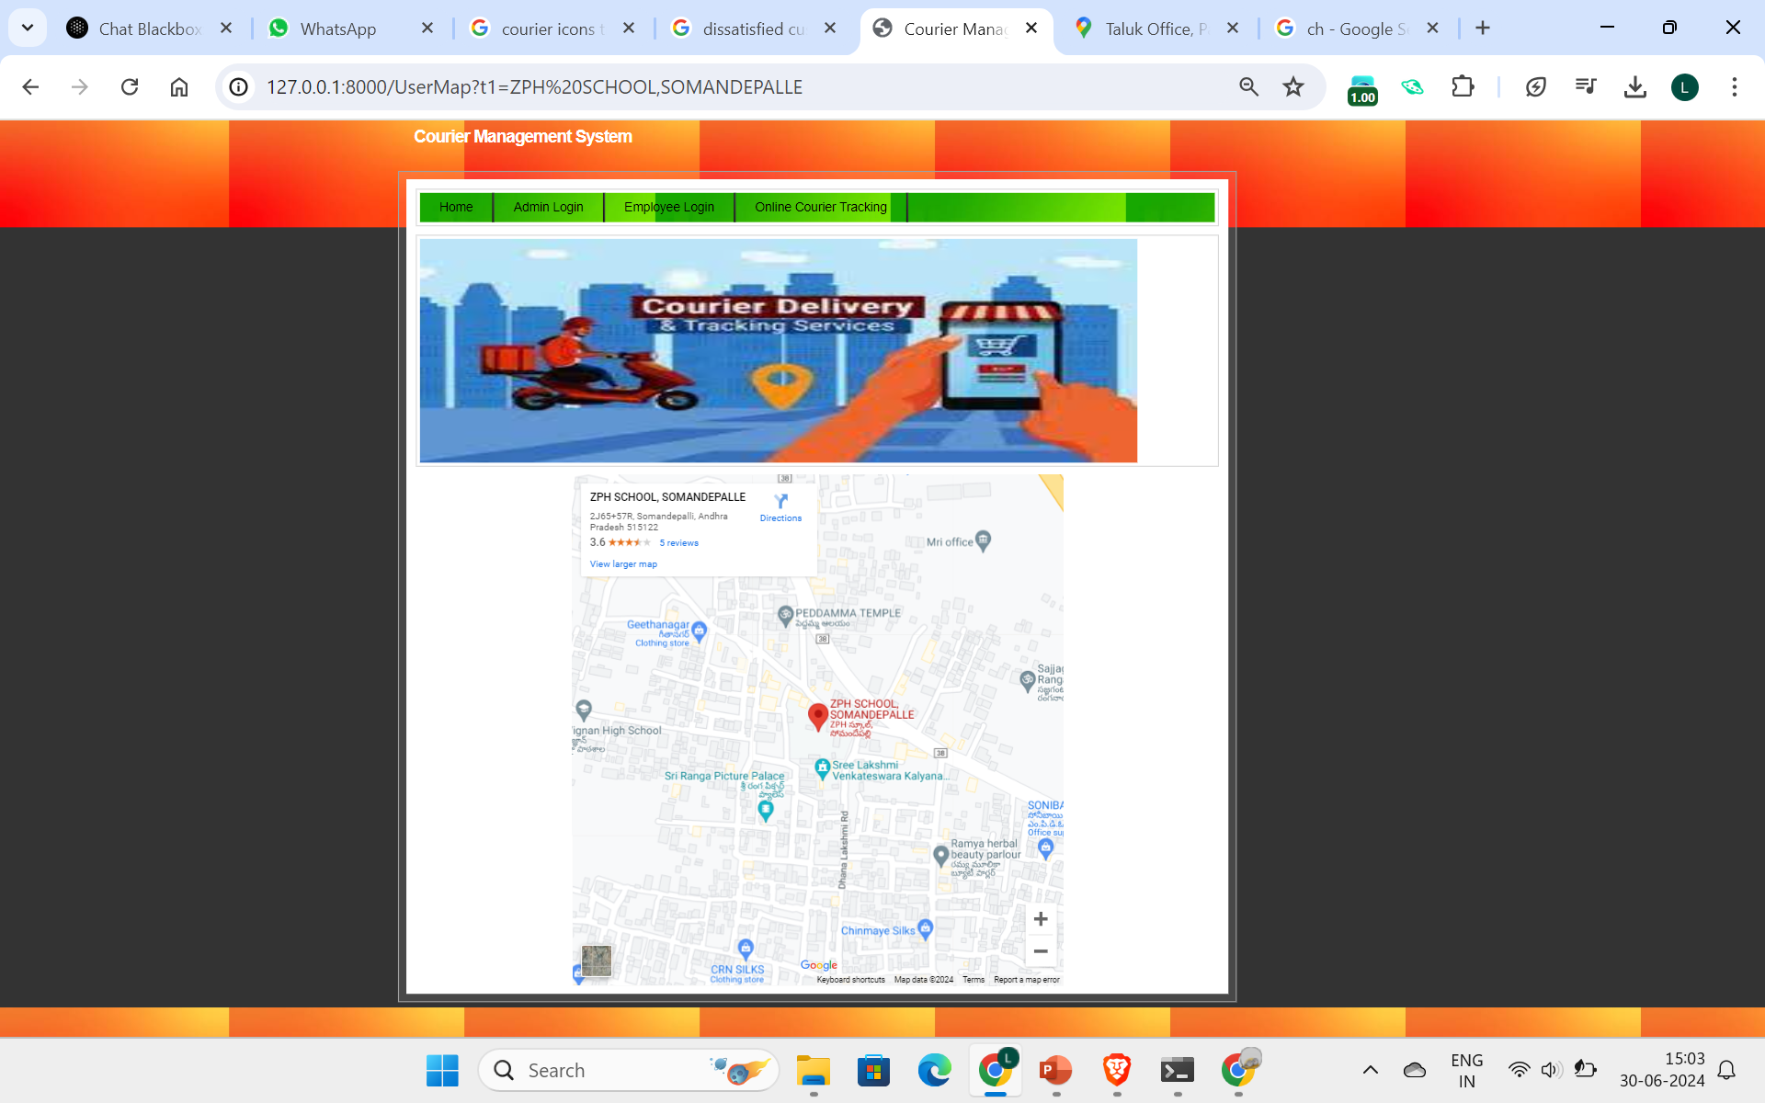
MALLA REDDY INSTITUTE OF ENGINEERING AND TECHNOLOGY
DEPARTMENT OF INFORMATION TECHNOLOGY
COURIER MANAGEMENT SYSTEM A WEB-BASED APPLICATION
FOR TRACKING AND MANAGING COURIERS
ABSTRACT
EXISTINGSYSTEM:
The Courier Management System is a web-based application that enhances logistics and courier services with Google Maps API and real-time tracking. Customers can monitor packages, rate, and review experiences. Courier companies get a centralized platform for operations. This scalable, secure, user-centric system aims to revolutionize the logistics industry.
INTRODUCTION
The logistics and courier services industry has rapidly grown due to increasing demand for fast, reliable delivery, especially with e-commerce. Efficient courier management systems are crucial as traditional systems relying on manual processes cause delays and lack transparency. The absence of real-time tracking makes it difficult for customers to stay informed about their packages.
PROPOSED SYSTEM
CONCLUSION
The proposed web-based courier management system boosts efficiency, customer satisfaction, and growth through real-time tracking and automation. Its scalable, flexible, and user-friendly design benefits all businesses, leading to cost savings, increased loyalty, and higher revenue, revolutionizing the courier industry.
HEAD OF THE DEPARTMENT:
MR V RAMAKRISHNAN GUIDE: MR K MAHENDAR
TEAM:
SHAIK LATEEF
ESHA HARIDAS V PRAVALEKA SHIVU KUMAR A SAI SIDHARTHA

