Slide 1
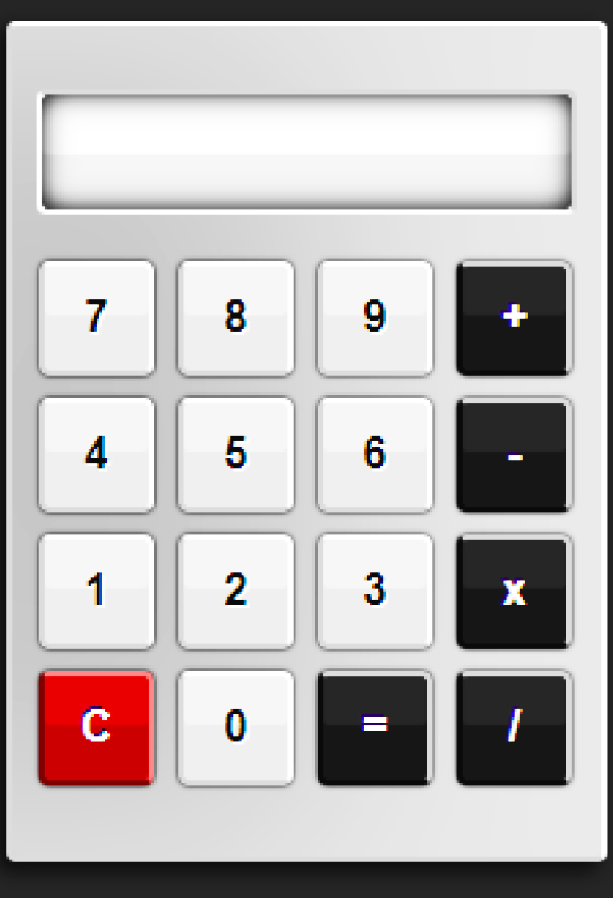


A Simple Calculator by Using Python Tkinter GUI
By Latha P

Slide 2
Introduction
Purpose of the Project
Tools and Technologies
A calculator is an electronic device or software used for performing mathematical calculations.
Common operations include addition, subtraction, multiplication, and division.
Used in daily life for quick computations.
Learn the basics of GUI programming with Python.
Understand how to link user inputs to backend logic.
Gain insights into event-driven programming.
Python: A versatile programming language.
Tkinter: A built-in Python library for GUI development.
Text Editor: Any Python-compatible editor like VS Code

Slide 3
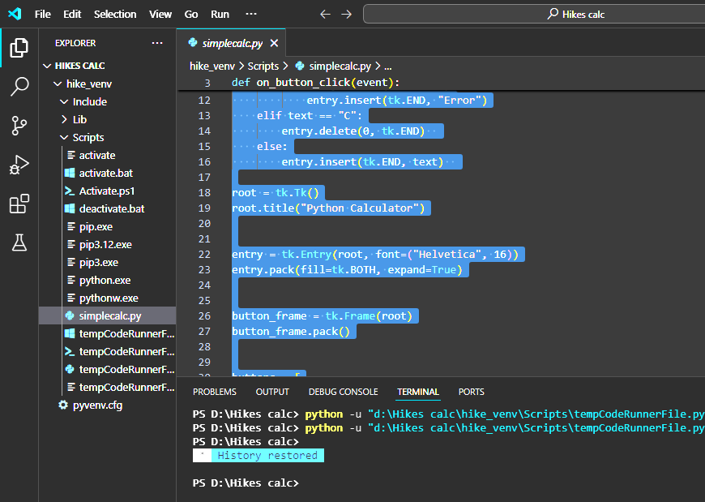
User-friendly graphical interface.
Support for basic arithmetic operations (+, -, *, /).
Clear button to reset the input field.
Real-time display of inputs and results.
Features of the Calculator
The calculator supports addition, subtraction, multiplication, and division.
It can perform calculations on both integers and floating-point numbers.
Implements basic error handling for division by zero
Function
ality
Users can enter numbers by clicking the corresponding buttons or typing on the keyboard.
The calculator displays the input and the result in the entry field.
Clear button resets the input and output
Input and Output

Slide 4
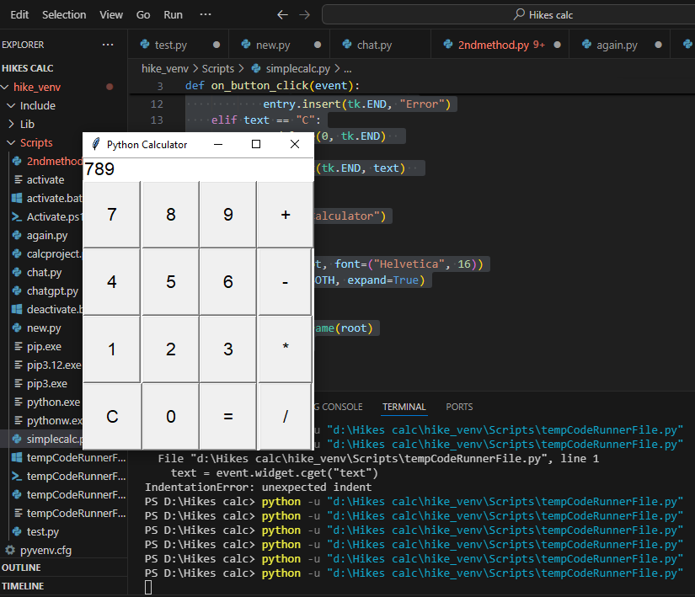
Code Structure
The program follows a modular approach with separate functions for different operations.
Uses the tkinter library for creating the graphical user interface.
Utilizes event-driven programming for handling button clicks.
Conclusion
A simple calculator program built with tkinter.
Provides basic arithmetic operations with a user-friendly interface.
Customizable and can be extended with additional features if desired.

Slide 5
Thank You!

