Slide 1

User Analytics in the Telecommunication Industry
By Latha Payani

Slide 2
Project Sub-Objectives
2. User Engagement Analysis
3. User Experience Analysis
4. User
Satisfaction Analysis
1. User Overview Analysis

Slide 3
Data Overview and Preparation Process
Data Collection
Gathered xDR records over for analysis
Data Cleaning
Handle missing values by replacing them with mean
Data Integrity
Ensure dataset integrity for accurate analysis
Exploratory Analysis
Conduct exploratory
analysis for insights into patterns.
Feature Identification
Identify key features
such as user engagement metrics.
1
2
3
4
5

Slide 4
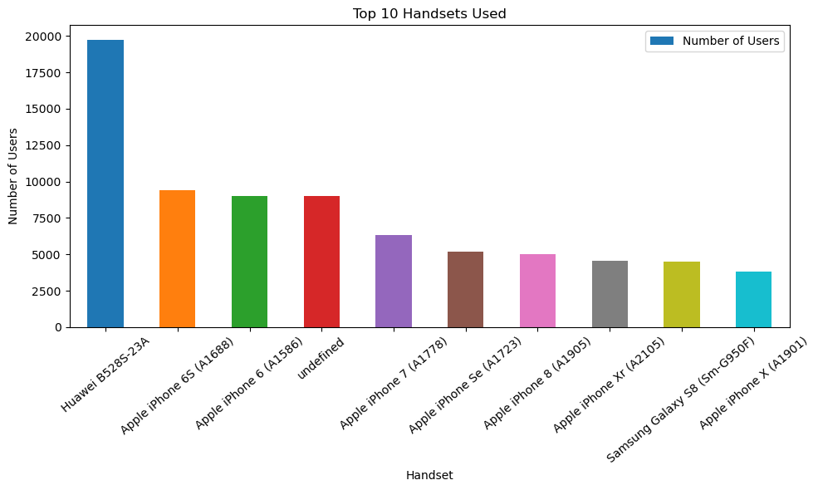
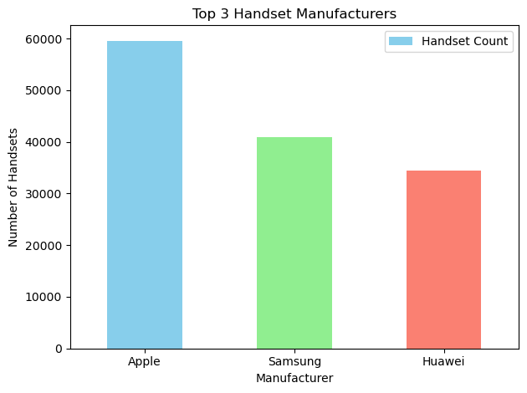
Task 1 - User Overview Analysis
Identified the top 10 handsets used by the customers
, Identified the top 3 handset manufacturers

Slide 5
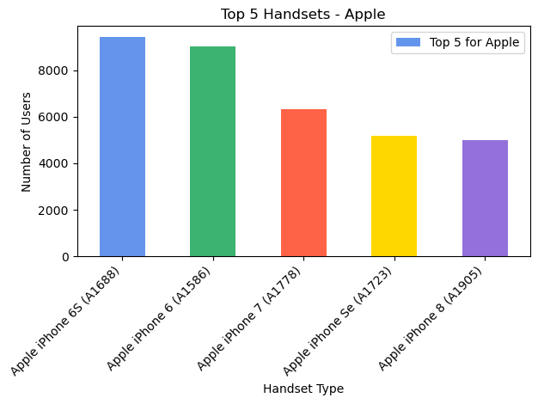
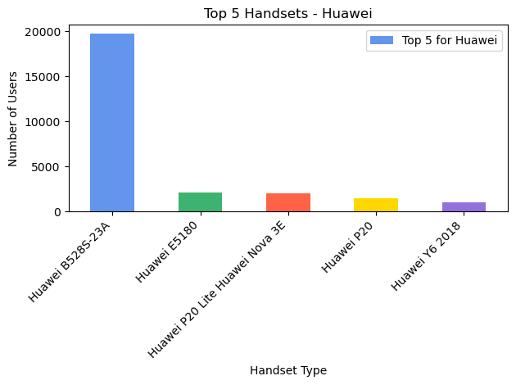
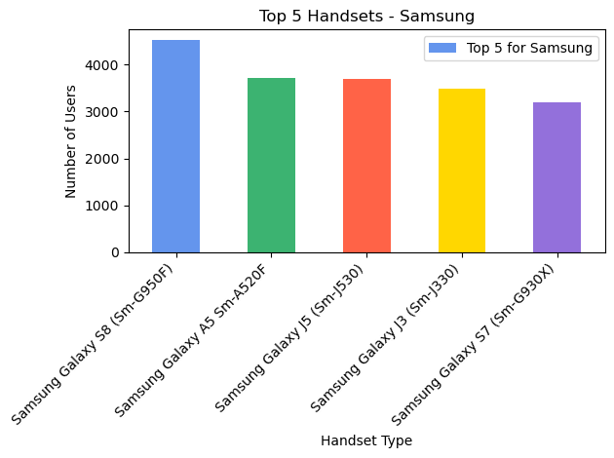
Identified the top 5 handsets per
top 3 handset manufacturer

Slide 6
Exploratory Data Analysis Techniques
Data Cleaning Uni/Bivariate Analysis
Handle missing values to ensure Explored relationships between
analysis robustness and integrity. different application usage metrics.
Descriptive Statistics Engagement Clustering
Compute mean, median, and mode Applied K-means clustering to
for insightful data summary. categorize users based on engagement.
Outlier Detection Performance Metrics
Identified and manage outliers to Assess network performance
improve overall data quality. parameters for enhanced user experience
Data Visualization Satisfaction Scoring
Used graphs to illustrate trends and Calculate scores to quantify
patterns in user behavior. customer satisfaction levels
1
5
2
6
3
7
4
8

Slide 7
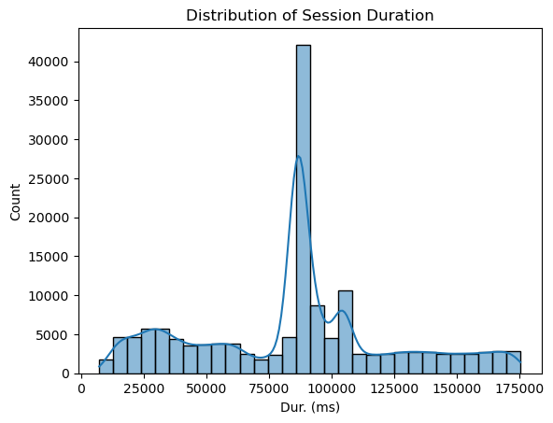
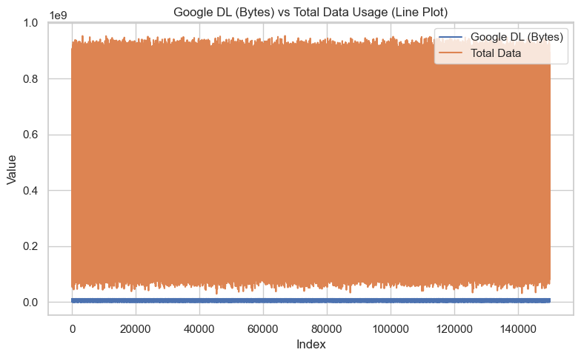
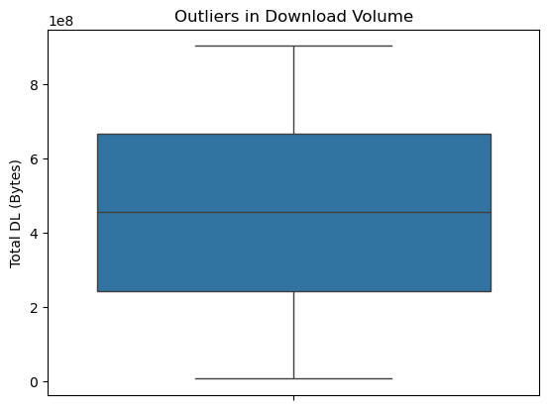
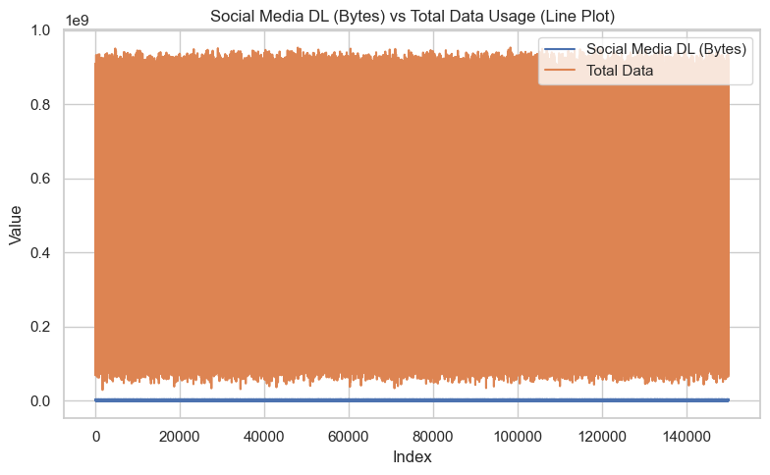
Univariate Analysis
Bivariate Analysis

Slide 8
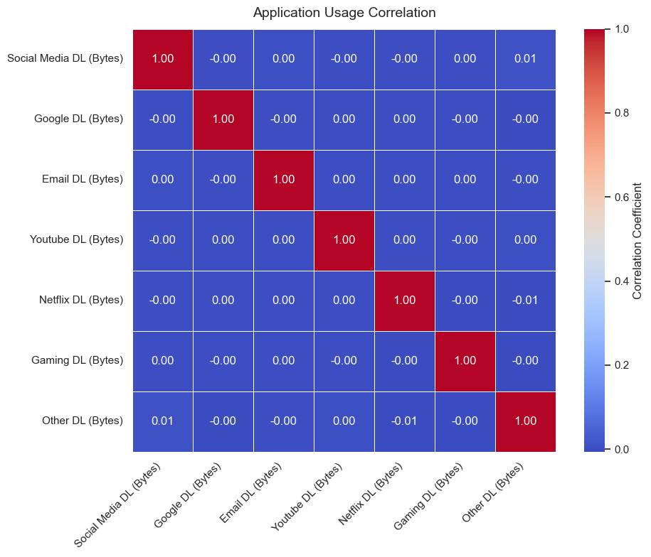
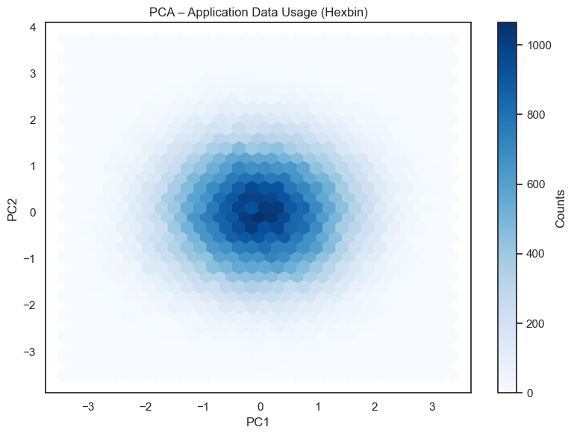
Correlation Analysis
Dimensionality Reduction

Slide 9
Task 2 - User Engagement Analysis
K-means Clustering
Utilized K-means clustering enables the segmentation of customers into
distinct engagement levels, identifying specific needs to optimize service
delivery effectively.
Engagement Metrics
Calculating session frequency and duration provides insights into user
interactions, assisting in the creation of targeted marketing strategies that
enhance customer retention and satisfaction.
Visual Analytics
Implementing visualizations of engagement data facilitates quick
understanding of user behaviour patterns, helping prioritize applications for
marketing efforts and infrastructural improvements

Slide 10
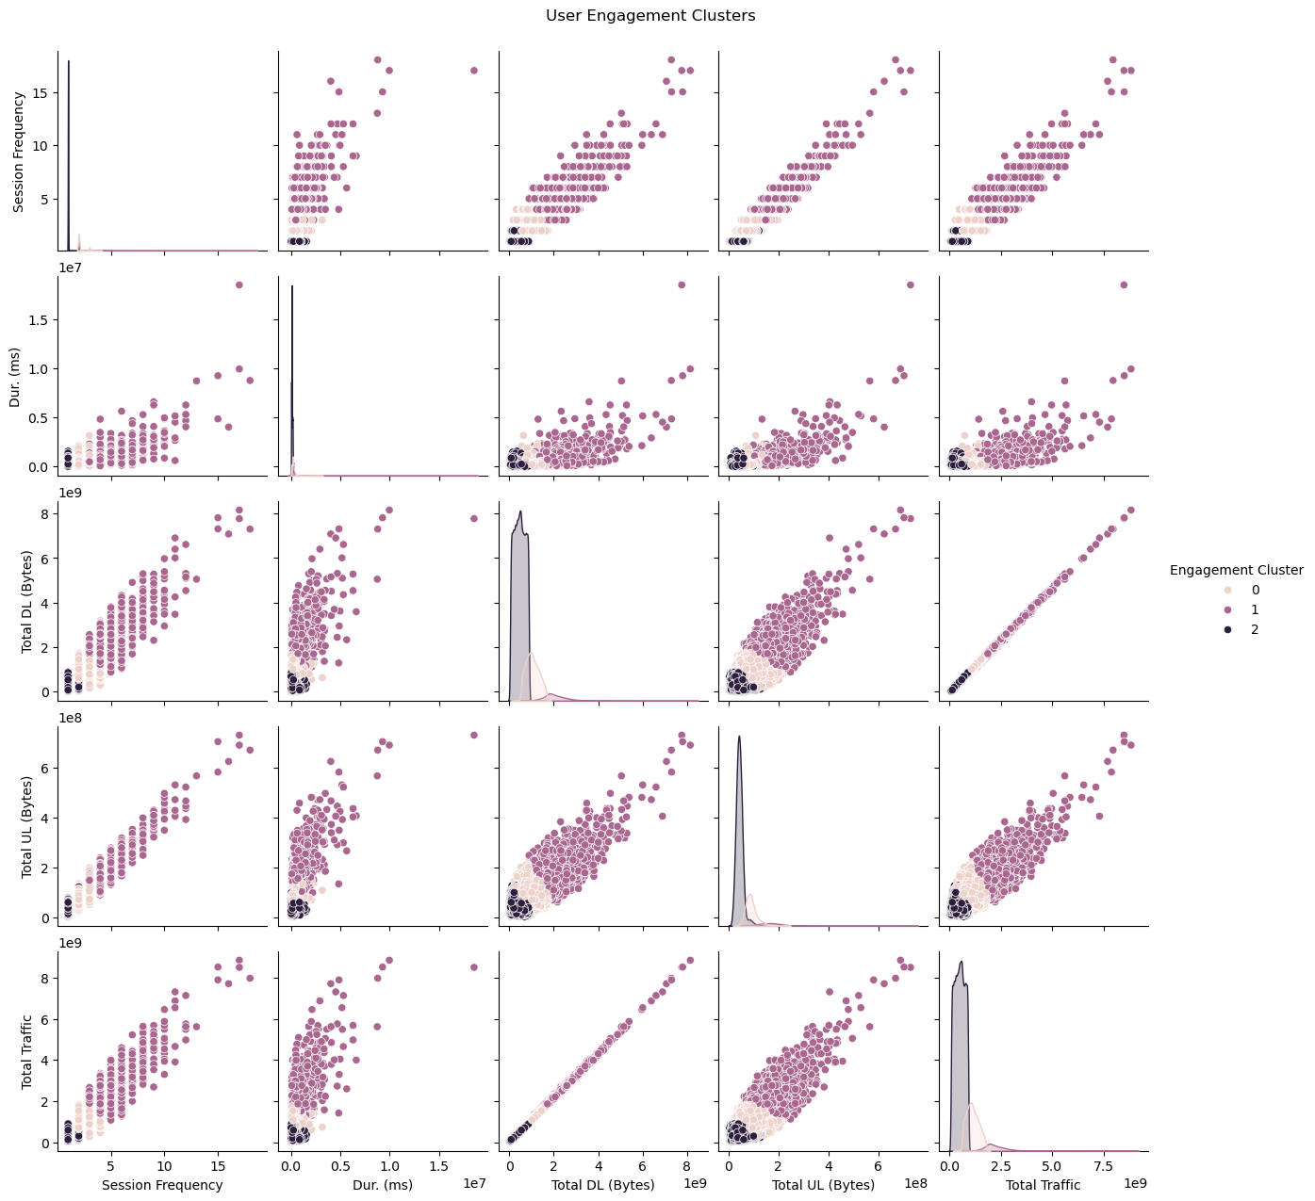
User’s Engagement Clusters

Slide 11
K-means Clustering for User Engagement
Data
Gather user engagement data for analysis.
Normalization
Normalize engagement metrics for consistency
across users
Clustering
Apply K-means algorithm to segment users
Analysis
Analyze extracted clusters for insights on behavior.
Implementation
Implement strategies based on engagement
findings

Slide 12
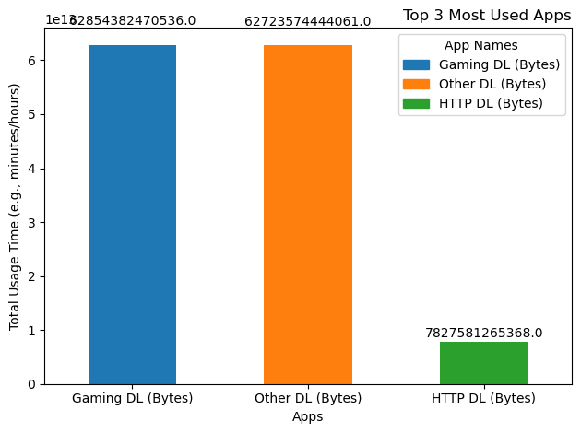
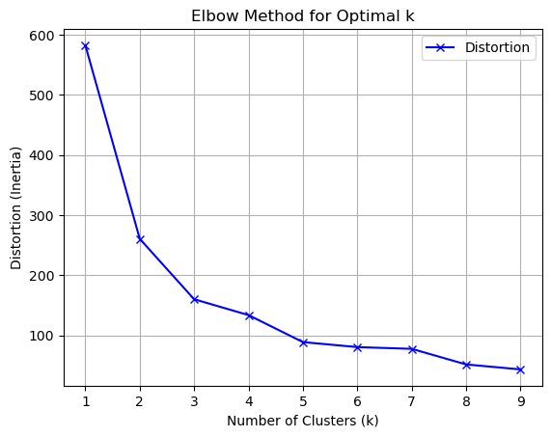
Top 3 most used applications
Elbow Method for Optimal k

Slide 13
Task 3 - Experience Analytics
TCP Retransmission
Measure TCP retransmission rates to evaluate network reliability and identify potential areas for performance enhancement.
Round Trip Time
Analyze RTT metrics to assess latency issues affecting user experience and improve service delivery efficiency.
Throughput Levels
Monitor average throughput across
handsets to ensure optimal performance and enhance customer satisfaction levels.
Device Performance
Evaluate the correlation between handset types and user experience metrics to provide targeted device recommendations

Slide 14
Network Performance Parameters Overview
TCP
Monitor TCP retransmissions to improve network efficiency
RTT
Analyze round trip time to enhance user experience
Throughput
Evaluate throughput per device to identify performance gaps
Latency
Minimize latency impacts on application performance for users
Network Congestion
Address congestion issues to ensure consistent service quality
Data Loss
Reduce data loss rates to boost customer satisfaction

Slide 15
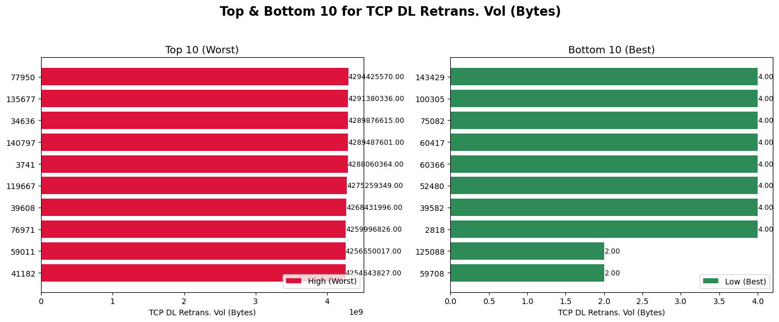
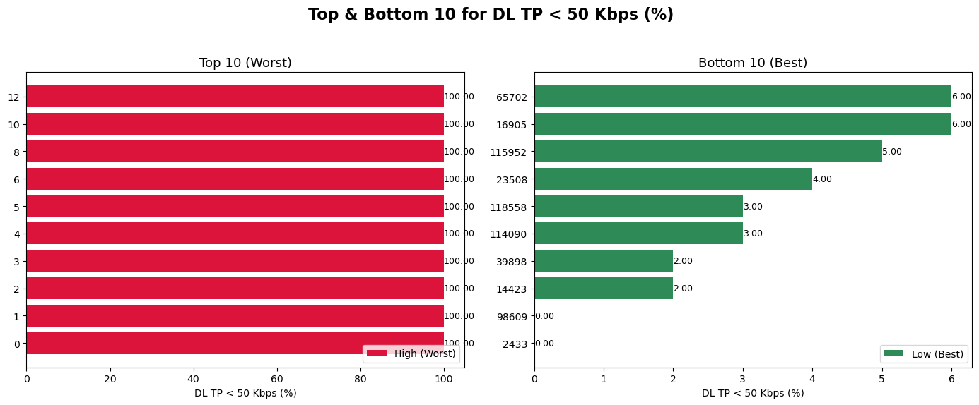

Slide 16
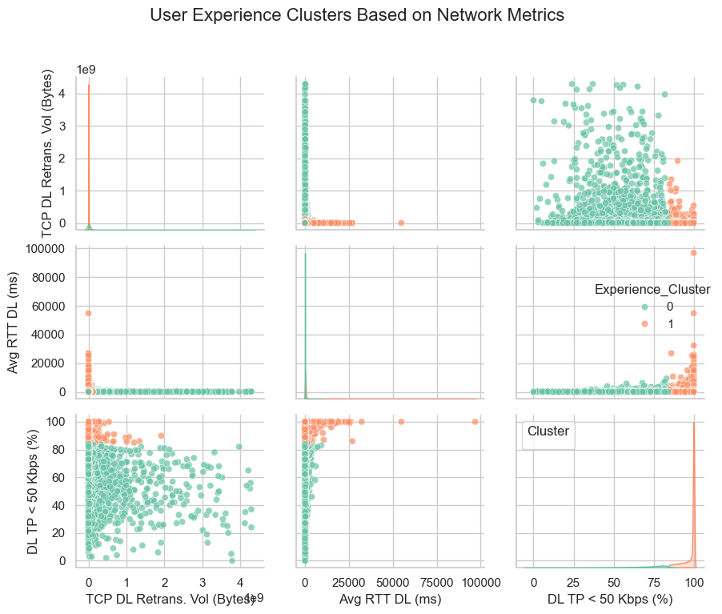
User the experience metrics

Slide 17
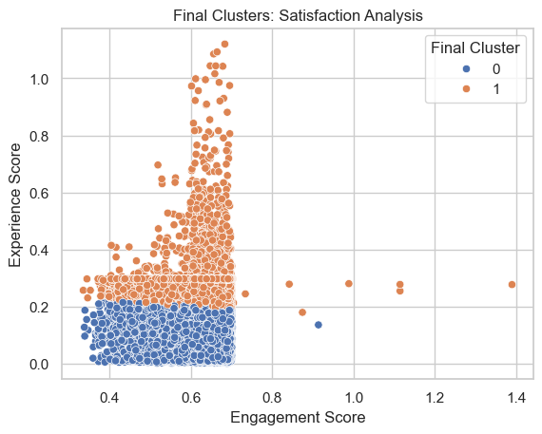
Task 4 - Satisfaction Analysis
Segmentation of Satisfaction Levels
Targeted Engagement
Focus on high satisfaction clusters for personalized marketing and service
enhancements to improve customer loyalty
Performance Monitoring
Regularly track satisfaction scores and adjust strategies based on cluster feedback
to ensure continuous improvement
Resource Allocation
Allocate resources towards high-value segments identified in satisfaction analysis
to maximize profitability and retention

Slide 18
Recommendations for Potential Acquisition
Enhance User Engagement
Target high-value users with personalized services to boost
profitability
Optimize Customer Experience
Focus on improving network performance based on user feedback
and data
Increase Marketing Focus
Utilize data insights to align marketing strategies with user
preferences
Implement Continuous Monitoring
Establish ongoing tracking of user satisfaction metrics for strategic
improvements

Slide 19
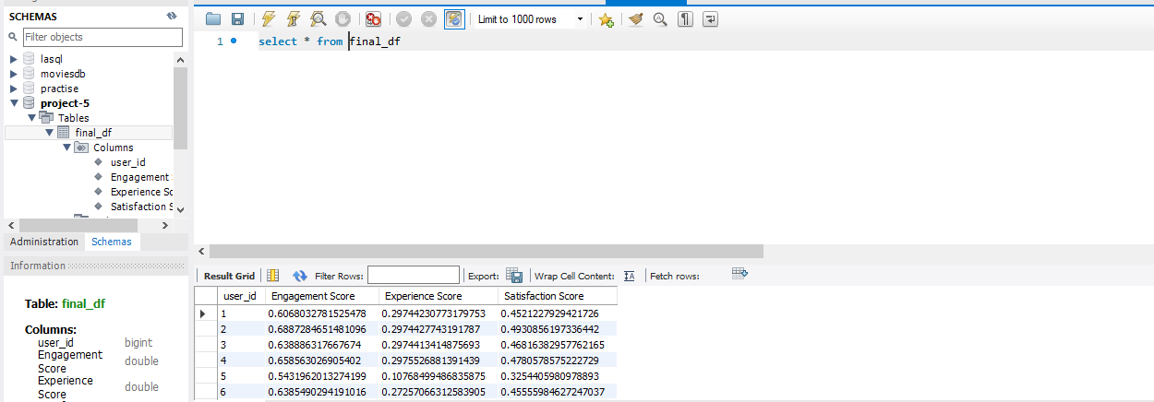
Exported final table containing all user ID + engagement, experience & satisfaction scores in local MySQL database.

Slide 20
Thank you

