Slide 1
Predicting House Prices using Machine Learning
Final Submission

Slide 2
Problem Statement
Background: You are tasked with building a machine learning model to predict house prices based on a dataset containing various features such as the size of the house, number of bedrooms, location, amenities, year built, and other relevant factors.
Objective: Develop a predictive model that accurately estimates the market value of a house given its features.
Data: You have a dataset that includes various attributes of houses and their corresponding sale prices. The dataset contains information on house size, number of bedrooms, number of bathrooms, location, proximity to amenities, age of the house, and other relevant details.

Slide 3
Tasks
Data Exploration : Analyze the dataset to understand the distributions of features, correlations, missing values, outliers, etc. Perform data cleaning, handle missing values, and preprocess the data as needed.
Feature Selection and Engineering: Identify important features that significantly impact house prices. Perform feature engineering if necessary (e.g., creating new features, transforming variables).
Model Building: Choose an appropriate machine learning algorithm (e.g., Linear Regression, Random Forest, Gradient Boosting) for house price prediction. Split the data into training and testing sets. Train the model on the training data and evaluate its performance using suitable metrics (e.g., Mean Squared Error, R-squared).

Slide 4
Tasks
Model Evaluation and Tuning: Validate the model using the test dataset to assess its predictive performance. Fine-tune the model parameters if necessary to improve its accuracy.
Deployment and Reporting: Deploy the trained model for house price prediction. Create a report summarizing the model's performance, key findings, important features, and any insights derived from the analysis.
Evaluation Metrics: Evaluate the model's performance using appropriate metrics such as Mean Absolute Error (MAE), Mean Squared Error (MSE), Root Mean Squared Error (RMSE), and R-squared.
Deliverables: A machine learning model capable of predicting house prices based on given features, along with a detailed report outlining the model's accuracy, key insights, and findings.

Slide 5

Data Source
Choose a dataset containing information about houses, including features like location, square footage, bedrooms, bathrooms, and price.
Dataset Link: https://www.kaggle.com/datasets/vedavyasv/usa-housing

Slide 6
Design Thinking
Empathize: Conduct interviews or surveys with real estate agents, homeowners, and potential buyers to understand their concerns and priorities when determining house prices. Gather insights into what factors are most important when estimating a house's value.
Define: Define the key features that could influence house prices based on user feedback and domain knowledge (e.g., size, location, amenities, age). Clearly outline the user expectations for the accuracy and usability of the house price prediction model.
Ideate: Brainstorm various machine learning techniques suitable for predicting house prices based on the identified features. Explore different algorithms (Linear Regression, Random Forest, Gradient Boosting) and their suitability for the task. Consider possible data preprocessing techniques and feature engineering methods to enhance model accuracy.

Slide 7
Design Thinking
Test: Test the preliminary model with a subset of the dataset to evaluate its accuracy and usability. Collect feedback from stakeholders (real estate agents, homeowners, buyers) on the model's predictions and user interface.
Refine and Iterate: Refine the model based on user feedback, adjusting features, and model parameters to enhance its accuracy and usability. Continue to test and gather feedback, iterating and refining the model based on insights gained.
Implement and Deliver: Deploy the refined model for house price prediction based on the insights gained during the iteration process. Create a user-friendly interface or platform to allow users to easily input house features and obtain predicted prices.

Slide 8
Data Preprocessing
Handling Missing Values
Handling Categorical Variables
Feature Scaling
Feature Engineering
Outlier Detection and Treatment
Handling Skewed Distributions
Splitting Data into Training and Testing Sets
Validation and Cross-Validation
Final Data Checks

Slide 9
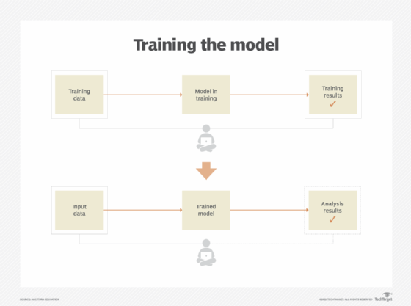
Model Training
As we have to train the model to determine the continuous values, so will be using these regression models.
SVM-Support vector machine
Random forest regressor
Linear regressor

Slide 10
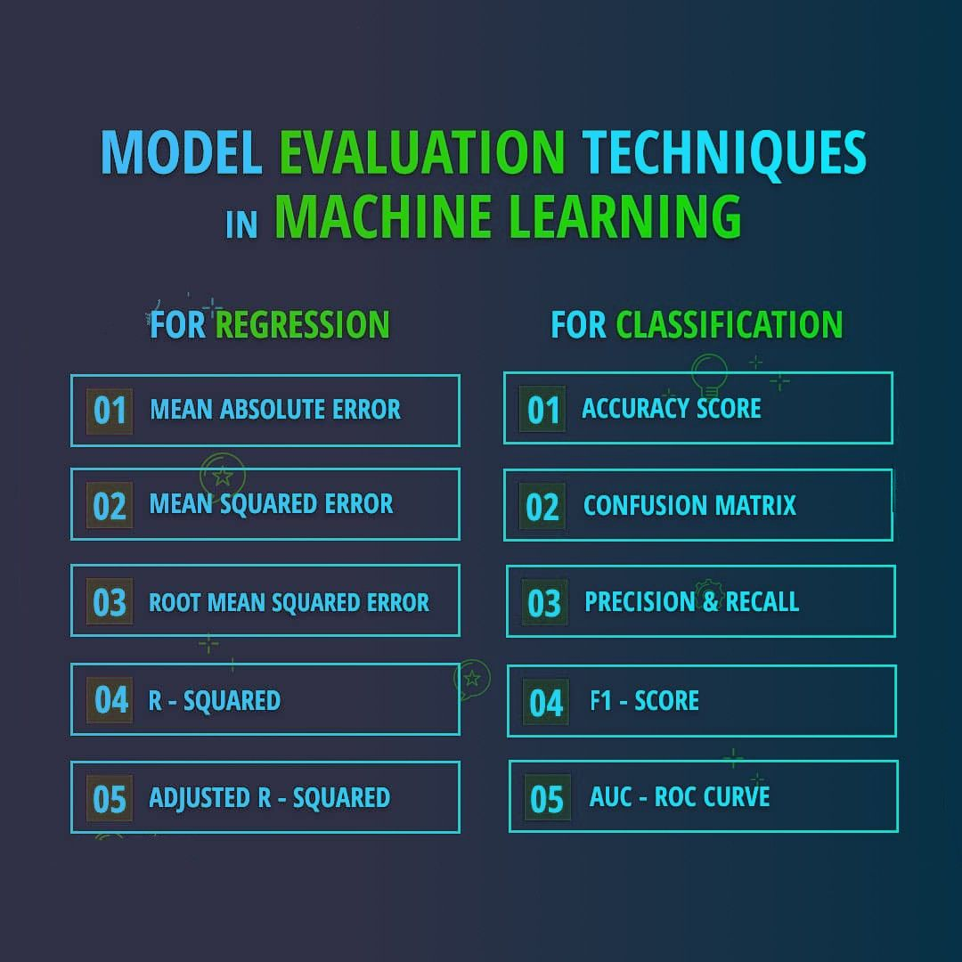
Model Evaluation

Slide 11
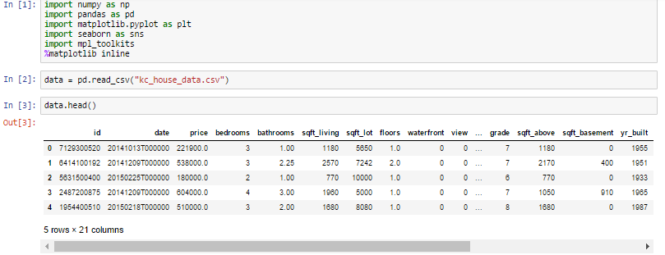
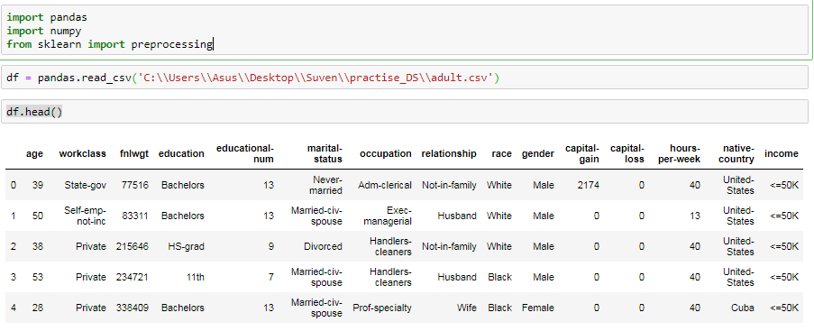

Slide 12
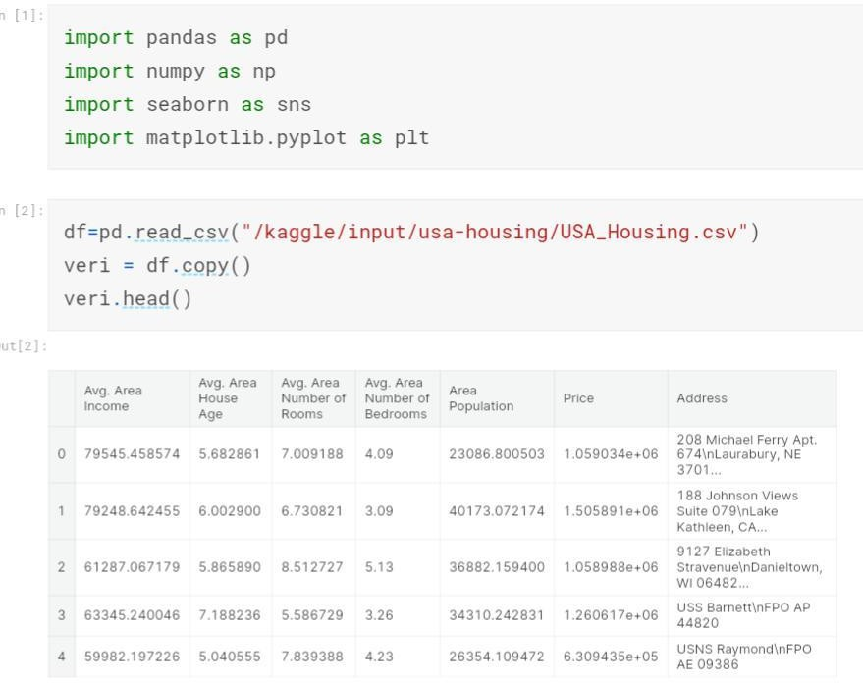

Slide 13
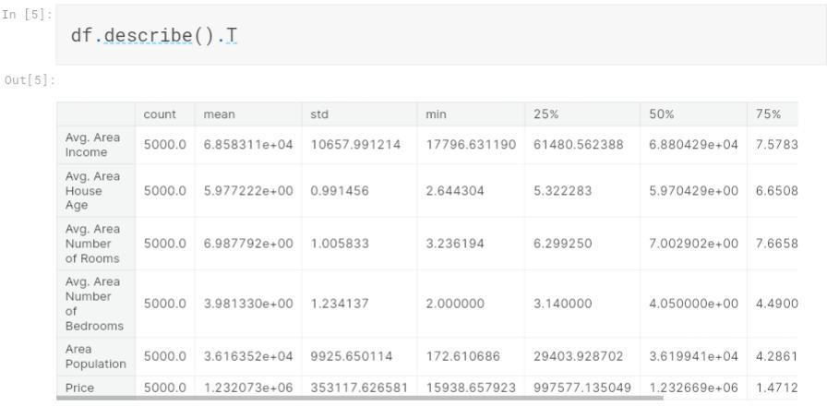

Slide 14
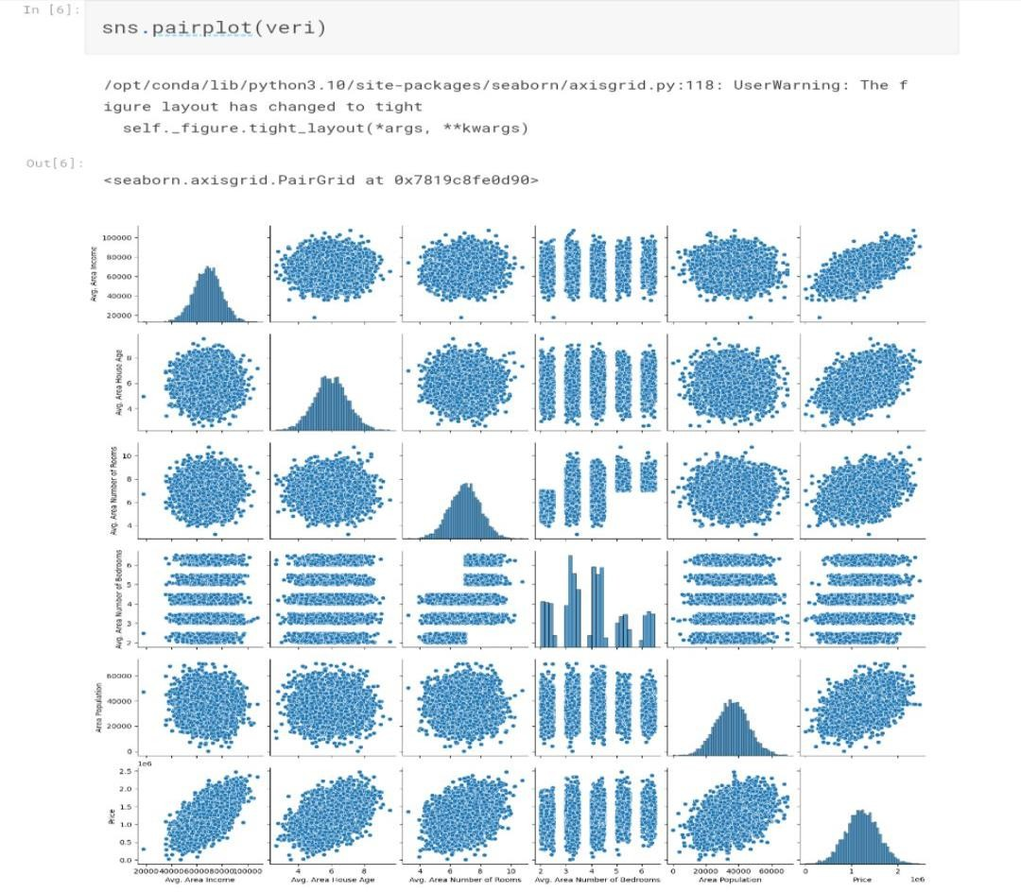

Slide 15
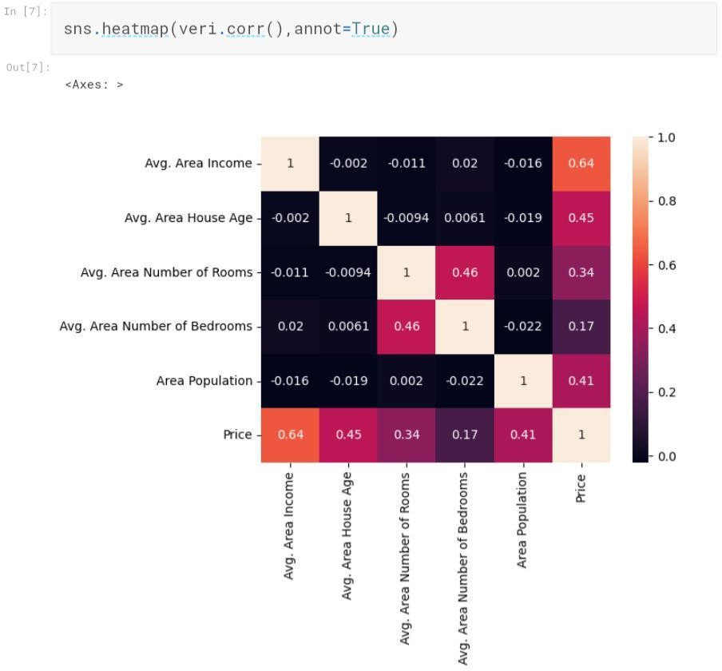

Slide 16
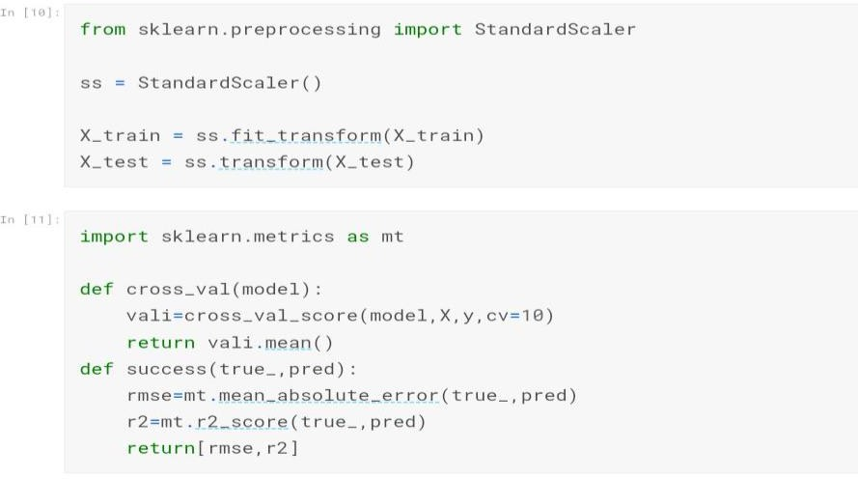

Slide 17
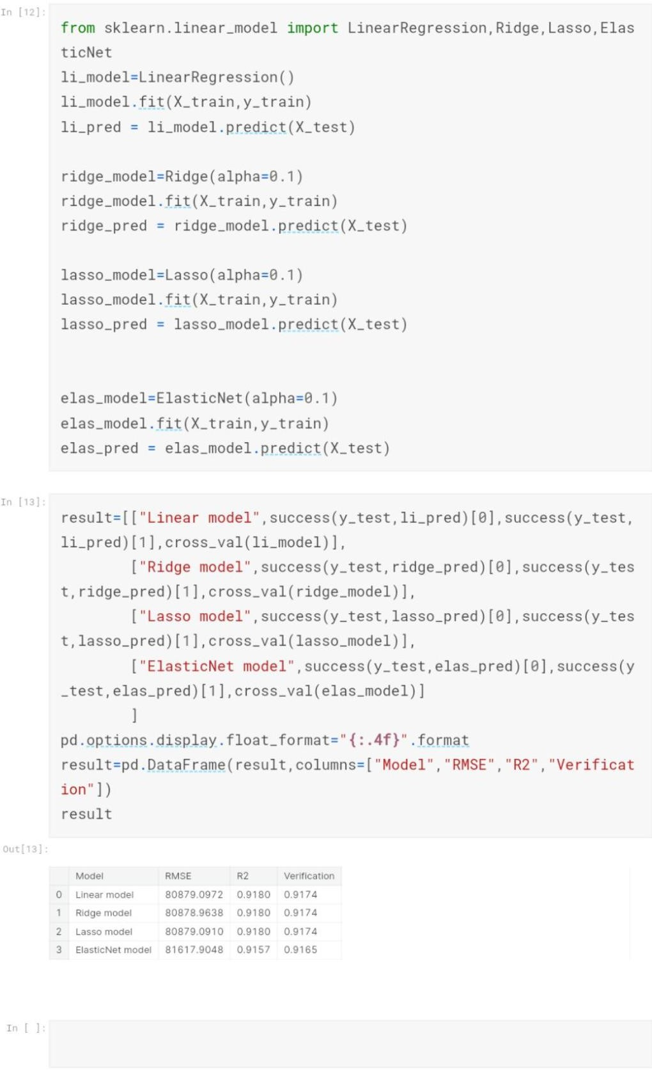

Slide 18
Conclusion
To predict the sale prices we are going to use the following linear regression algorithms: Ridge regression algorithm, Lasso regression algorithm, Elastic Net Model. These algorithms can be feasibly implemented in python with the use of the scikit-learn package.
Finally, we conclude which model is best suitable for the given case by evaluating each of them using the evaluation metrics provided by the scikit-learn package.

