Slide 1
AEGIS
Agentic Payment-Integrity Analyst
One AI agent that reasons across Treatment, Payment, and Operations — with governance in the loop.
Topic 2: Clinical Decision Making & Pattern Recognition in Health Care (TPO)
Name : Latha Boralingaiah
Email : latha.boralingaiah@sjsu.edu
Notes:
Hi, my name is [Name], and I’m a student at [University]. Today I want to show you a project I built called Aegis. It’s an AI system that reviews medical insurance claims and decides whether they should be paid. I’ll walk you through the problem it solves, how it works, a quick live demo, and where I’d take it next. Quick note on the name — Aegis means “a shield.” And that’s really the whole idea: there’s a safety layer that always keeps a human in control of the AI.

Slide 2
The Problem
WHY THIS MATTERS
$31.7B
$87.1B
~37,500
improper Medicare fee-for-service payments (FY2024)
improper payments across all CMS programs (FY2024)
claims manually sampled per year for error testing
Healthcare insurers process millions of claims a year. Manual review is slow, costly, and inconsistent, and most errors come from unsupported coding or missing documentation — exactly the work an agent can screen at scale.
Sources: CMS FY2024 Improper Payments; KFF (2025).

Slide 3
The Approach: Agentic AI for TPO
WHAT WE BUILT
An agent is given a goal and a set of tools; it decides which to call, reasons over the results, and reaches a decision. The same pattern serves all three sides of the business:
T
Treatment
P
Payment
O
Operations
Clinical decision support — is the ordered care consistent with guidelines?
Claim review & coding validation — should this claim be paid?
Provider analytics — clustering and anomaly detection across providers.

Slide 4
System Architecture
HOW THE PIECES CONNECT
Streamlit UI
6 interactive tabs
Orchestration
review_claim()
Agent
Demo rules · Live LLM
Tools
rule · ML · CDS · RAG
Governance
guardrails · audit log
Data & knowledge claims · policy rules · real CMS charges · trained models

Slide 5
How It Works
THE AGENT LOOP
1
2
3
4
Plan the checks
Call tools
Reason over results
Decide
!
Governance gate. A verdict — approve, deny, or route to a human — passes through guardrails first. Low confidence or a high-dollar denial is escalated to a human, and every step is written to an immutable audit log.
Demo mode runs a deterministic sequence for reliability; Live mode uses a real LLM that chooses its own tools.

Slide 6
What It Does
EVERY TECHNIQUE HAS A BUSINESS PURPOSE
Rule engine
RAG
ML risk model
Clustering
Validates NCCI, medical necessity, duplicates
Retrieves & cites the governing policy text
Predicts the probability a claim is problematic
Flags providers unlike their billing peers
Time-series
Clinical support
Governance
Chain reasoning
Detects abnormal billing spikes over time
Checks care against clinical guidelines
Human-in-the-loop guardrails + audit trail
Step-by-step, explainable decision trace

Slide 7
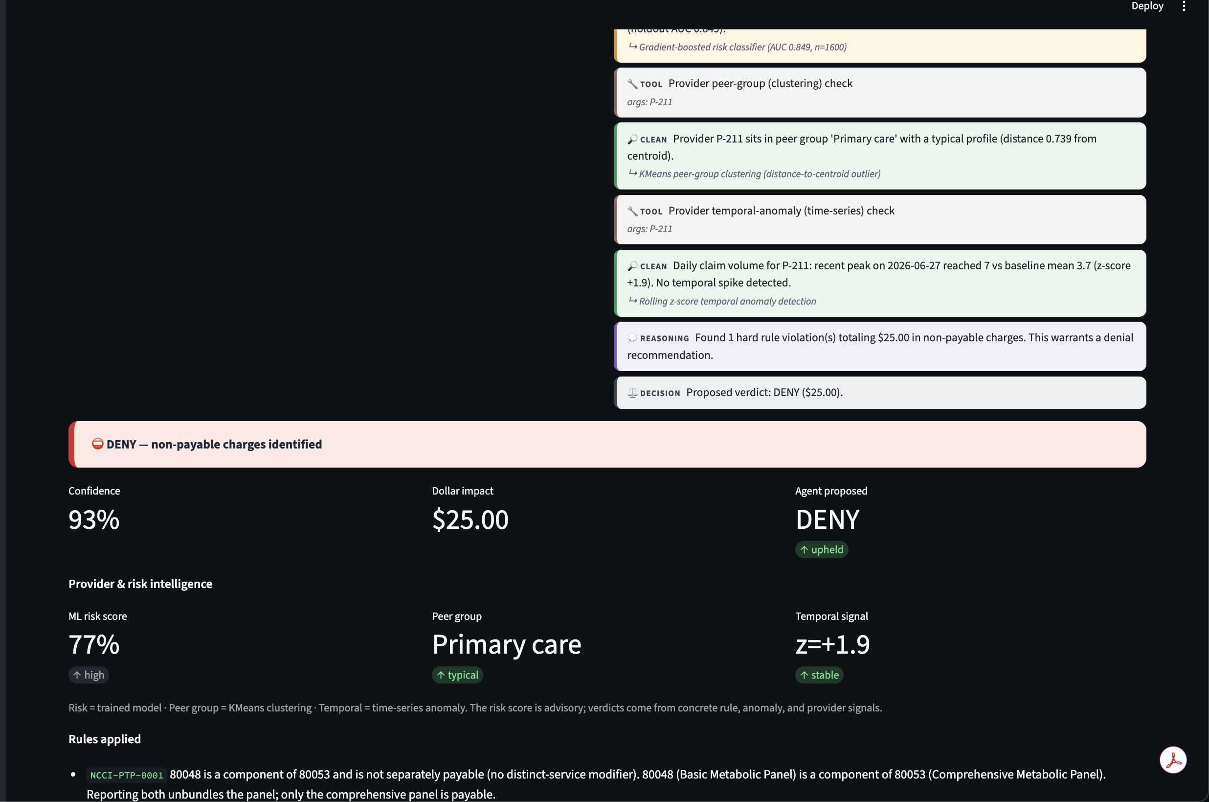
Inside One Decision
PAYMENT
The verdict
The agent denied an unbundled claim with 93% confidence, citing the exact NCCI rule.
Provider & risk intelligence
A trained risk model, KMeans peer group, and time-series signal appear alongside — the risk score is advisory, never the sole reason to deny.
Live screen: a claim reviewed end-to-end.

Slide 8
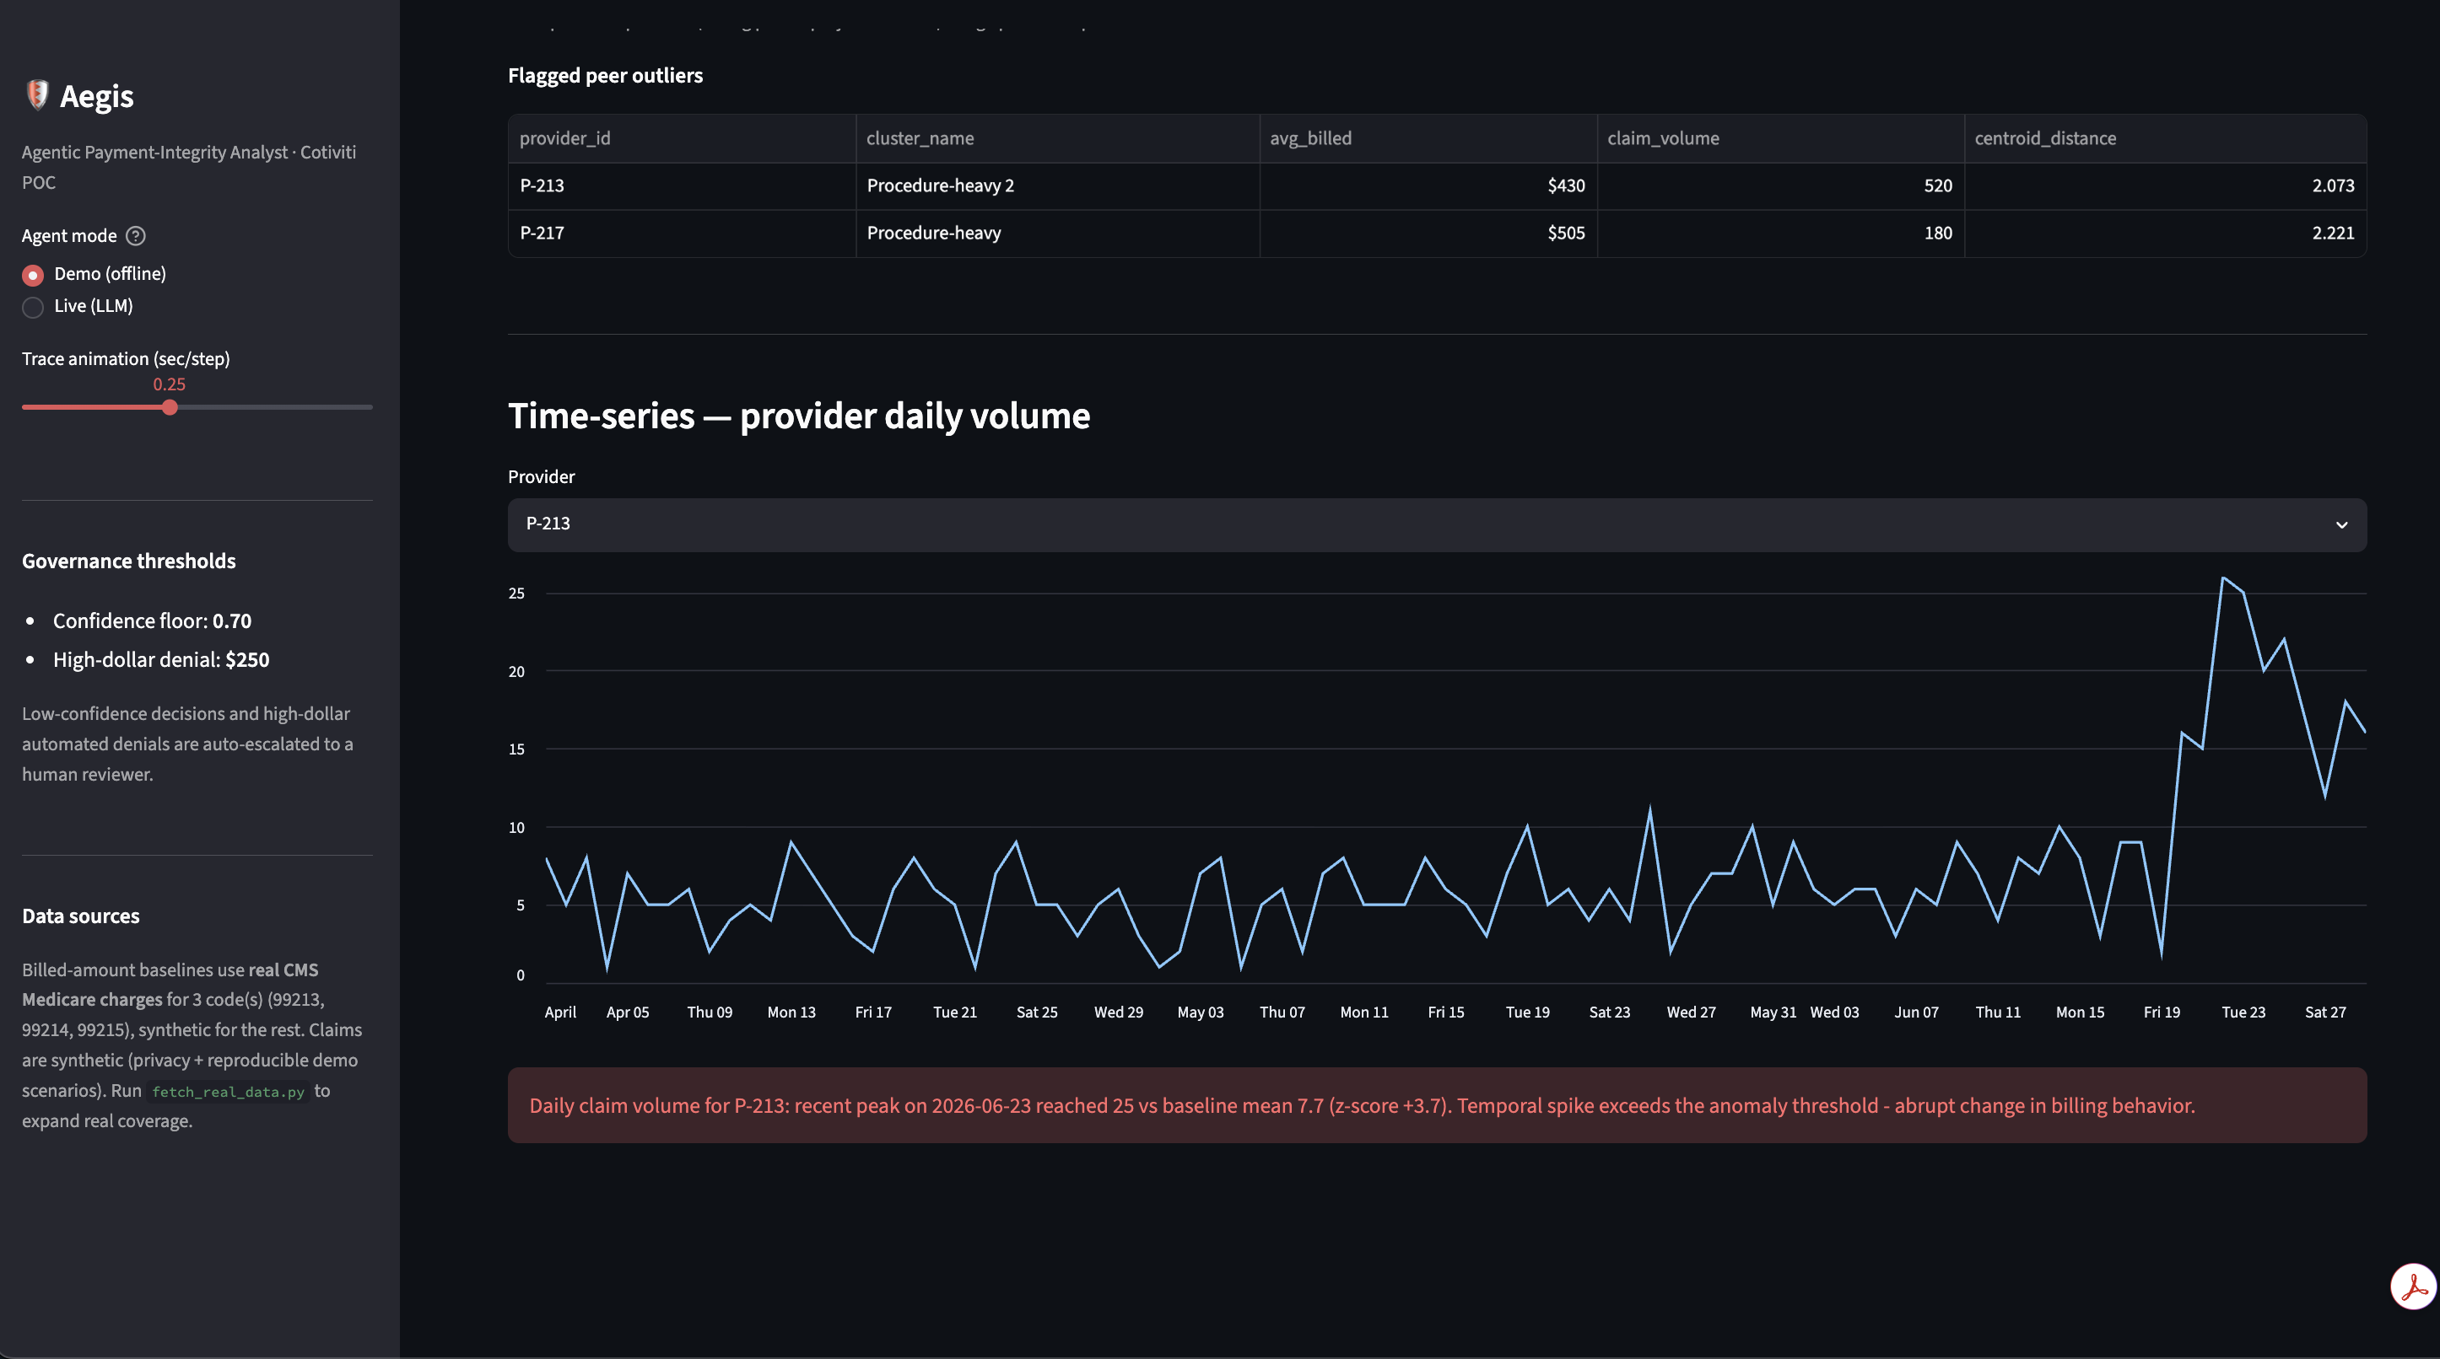
Provider Analytics
OPERATIONS
Clustering
Providers are grouped by billing behavior; those far from their peers are flagged as outliers (P-213, P-217).
Time-series anomaly
A rolling z-score catches an abrupt billing spike (z = +3.7) a single-claim check would miss.
Provider peer clusters + per-provider daily volume.

Slide 9
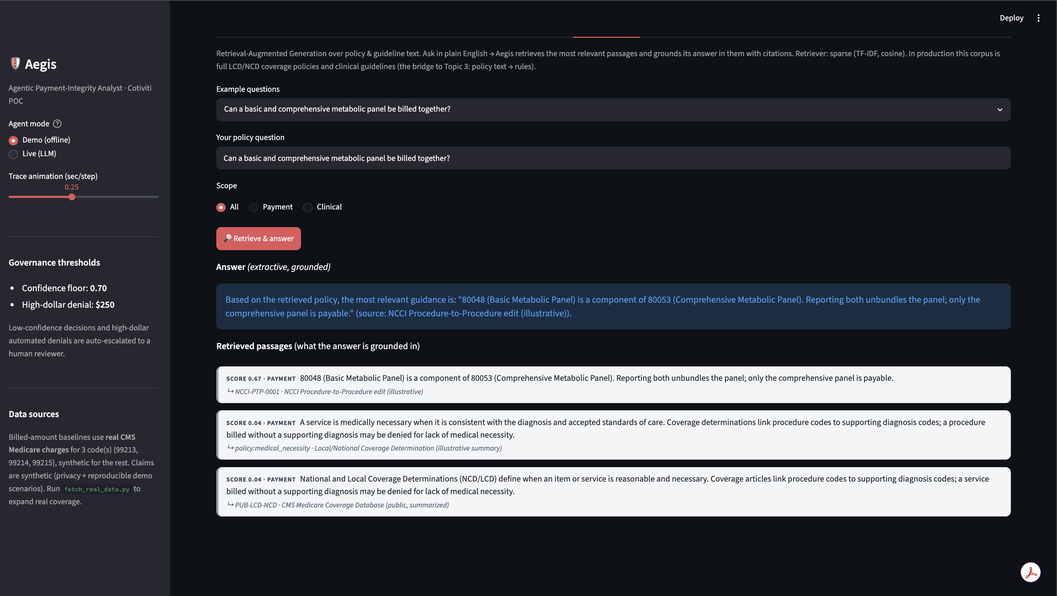
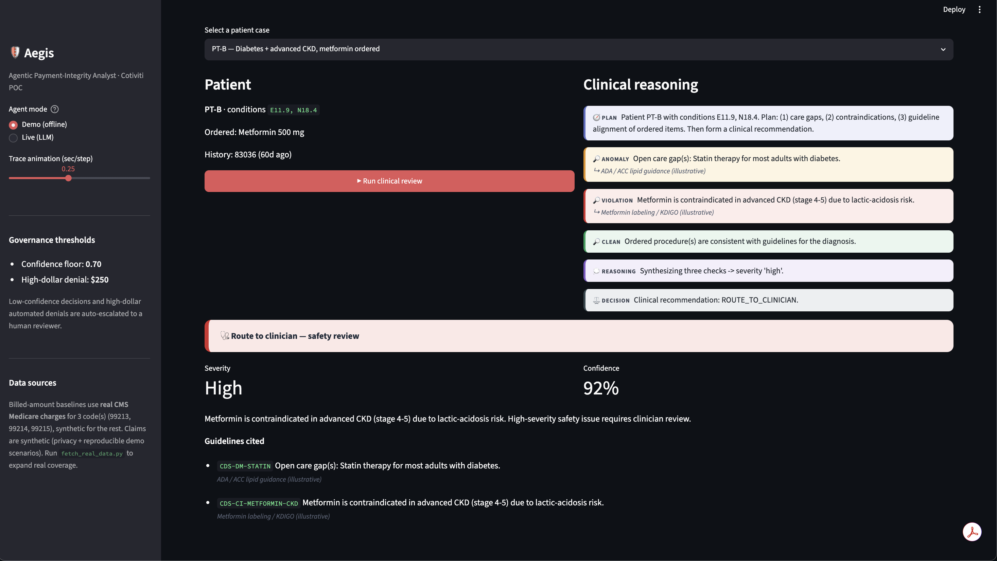
Grounded Answers & Clinical Safety
RAG + TREATMENT
RAG: retrieved passages + cited answer.
CDS: metformin contraindication → route to clinician.
RAG retrieves the governing policy and answers with a citation. Clinical decision support checks the care itself — here it catches a drug-safety issue and escalates it to a clinician rather than deciding alone.

Slide 10
Evaluation
MEASURED, NOT CLAIMED
87.7%
92.9%
82.9%
~4 ms
Accuracy
Recall
Precision
per claim
The full pipeline (rules + ML + governance) was run over 300 labeled synthetic claims. Metrics are intentionally imperfect — the labeled data includes noise — which is realistic for a claims-risk system and shows this is an engineering evaluation, not a cherry-picked demo. “Flagged” = any verdict other than approve.

Slide 11
Opportunities & Threats
THE HONEST VIEW
+
Opportunities
!
Threats
Review far more claims, consistently
One agent covers Treatment + Payment + Operations
Every decision is explainable and cited
Recovers dollars tied to each error
Wrong flags cause provider abrasion & appeals
Opaque denials invite regulatory risk
An agent can compound an early error downstream
HIPAA limits data; black-box over-reliance is risky

Slide 12
Recommendation for Cotiviti
A CLEAR POSITION
Keep the rules; add reasoning
1
Orchestrate deterministic edits (NCCI, coverage) with an agent, and add ML + provider analytics as supporting evidence — never the sole basis for a denial.
Make governance the product
2
Human-in-the-loop guardrails, immutable audit trails, and NIST-aligned documentation built in. In a market shifting to agentic AI, verifiable safety is a differentiator.
Ground policy in retrieval (RAG)
3
Retrieve and cite the actual coverage policies and guidelines behind each decision — a bridge toward converting written policy into executable rules.

Slide 13
Future Work
Ingest standard FHIR claim resources
Load the full real NCCI, MUE, and LCD/NCD policy tables
Split into specialized planning, payment, clinical, and governance agents
Continuous and federated learning from reviewer feedback
Thank you

