Slide 1


RAJEEV INSTITUTE OF TECGNOLOGY
DEPARTMENT OF COMPUTER SCIENCE AND ENGINEERING
INTERNSHIP (18CSI85)
ON
“MUSIC PLAYER”
Presented by
LATHA HN (4RA20CS047)
Internship Co-ordinator
Mr SANJAY M B.E, M.Tech
Assistant Professor
Dept.of CSE
RIT, HASSAN

Slide 2
Content
1
INTRODUCTION
6
FUTURE SCOPE
2
COMPANY PROFILE
7
CONCLUSION
3
8
OBJECTIVE
REFERENCES
4
TASK PERFORMED
5
PICTORIAL REPRESENTATION

Slide 3

INTRODUCTION
When talking about music players, it's like diving into a world where melodies and rhythms come to life. Music players are like our modern-day companions, allowing us to carry our favorite tunes with us wherever we go. They have evolved from the days of CDs and Walkmans to the digital wonders we have today. Music players not only provide entertainment but also create a personal soundtrack to our lives, shaping our moods and memories. They are the vessels that transport us to different emotional landscapes with just a click.
In this simple project i am using the powerful web Technologies i.e HTML , CSS , JAVASCRIPT

Slide 4

COMPANY PROFILE
Founded in 1967 and headquartered in Paris, France, the company has established itself as a global leader in its field, with operations spanning across more than 50 countries.
With a focus on sustainability and social responsibility, Capgemini is committed to creating a positive impact on society and the environment.
Capgemini, delving into a global leader in consulting, technology services, and digital transformation.

Slide 5


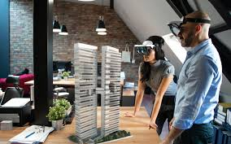
Capgemini is a global leader that leverages cutting-edge technologies like cloud computing, AI, and IoT to provide a wide range of services including consulting, technology, digital transformation, cybersecurity, and outsourcing. Their consistency in delivering innovative solutions and strategic guidance to clients across industries showcases their commitment to driving digital excellence and business success

Slide 6
OBJECTIVE
TEXT
Add the headline
Add the headline
The objective of using these technologies together in website development is to
create visually appealing, interactive, and user-friendly websites that provide a seamless and engaging experience for visitors.
Each of these languages complements the others to achieve a well-rounded and functional website.

Slide 7
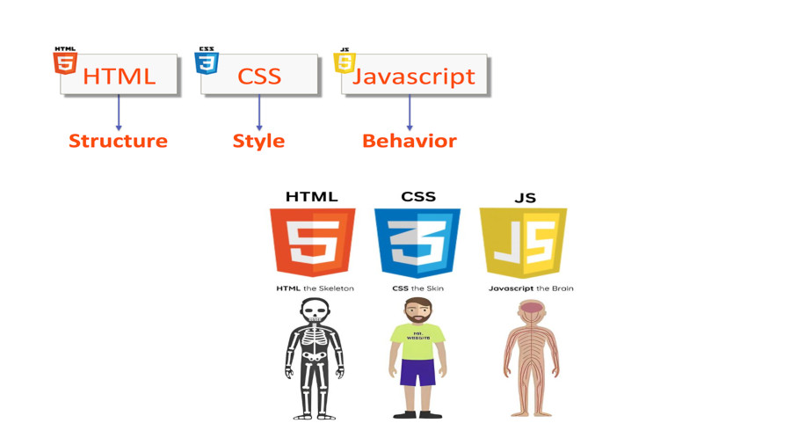
TASK PERFORMED

Slide 8

HTML
HTML stands for Hyper Text Markup Language
HTML is the standard markup language for creating Web pages
HTML describes the structure of a Web page
HTML consists of a series of elements
HTML elements tell the browser how to display the content
In Our Project , Start by creating the structure of the webpage using HTML. Elements like buttons for play, pause, next, previous, song progress bar, etc.
Include an audio element to play the music. We set the source of the audio element to our music files.

Slide 9

CSS
CSS stands for Cascading Style Sheets
CSS describes how HTML elements are to be displayed on screen, paper, or in other media
CSS saves a lot of work. It can control the layout of multiple web pages all at once
External stylesheets are stored in CSS files
We used CSS to style our webpage. To design the buttons, progress bars, background, and overall layout of the music player.
Make it visually appealing by adding colors, fonts, and layout styles to enhance the user experience.

Slide 10

JAVA
SCRIPT
JavaScript is a lightweight, cross-platform, single-threaded, and interpreted compiled programming language. It is also known as the scripting language for webpages.
JavaScript can be used for Client-side developments as well as Server-side developments. JavaScript is both an imperative and declarative type of language.
JavaScript contains a standard library of objects, like Array, Date, and Math, and a core set of language elements like operators, control structures, and statements.
We used JavaScript to add interactivity to our music player. You can write functions to play, pause, skip tracks, and update the progress bar.
Implement event listeners to handle user interactions like clicking buttons or dragging the progress bar

Slide 11
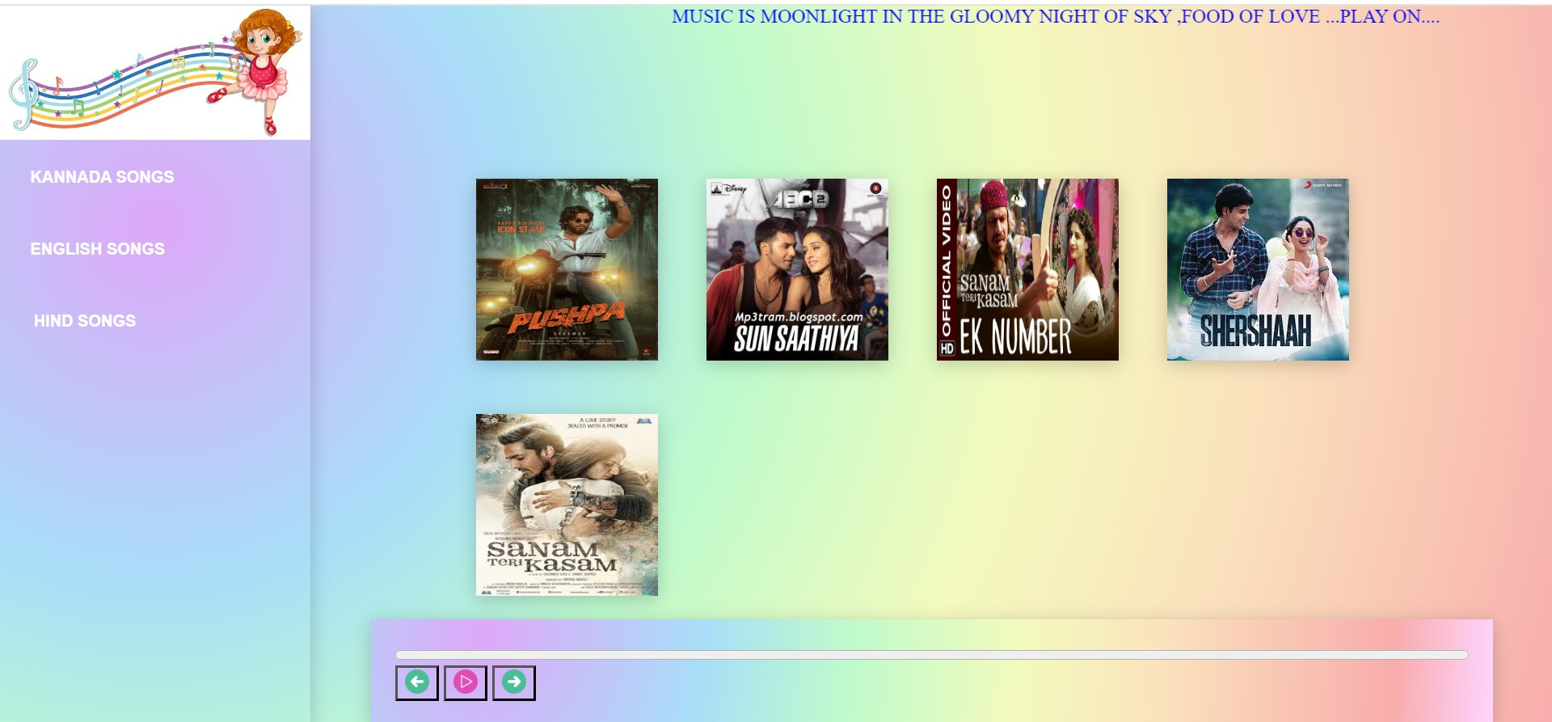
PICTORIAL REPRESENTATION
TEXT
Add the headline
Add the headline
FIG 1 : HOME PAGE ( Initially with kannada songs )

Slide 12
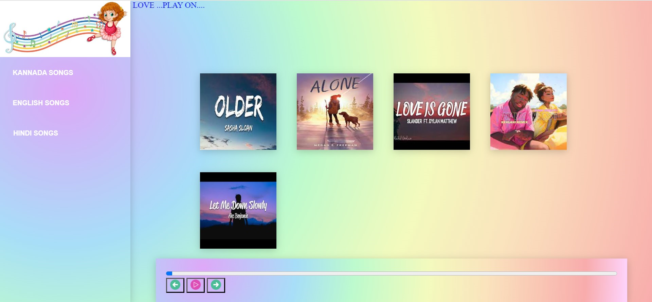
TEXT
Add the headline
Add the headline
FIG 2 : List of English songs

Slide 13
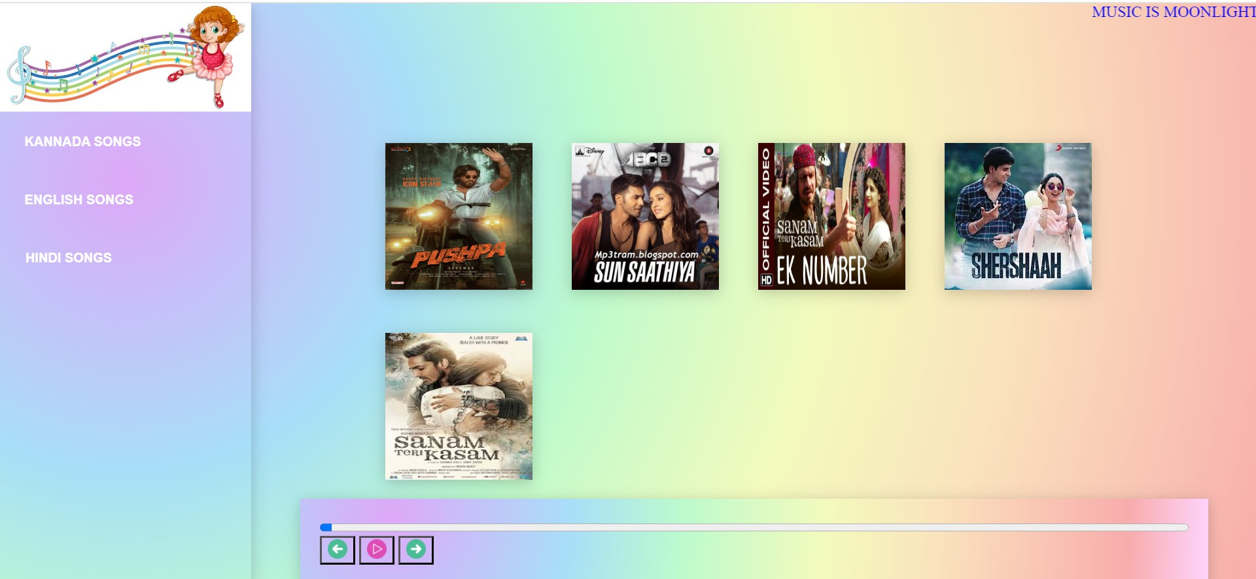
TEXT
Add the headline
Add the headline
FIG 3 : List of Hindi songs

Slide 14
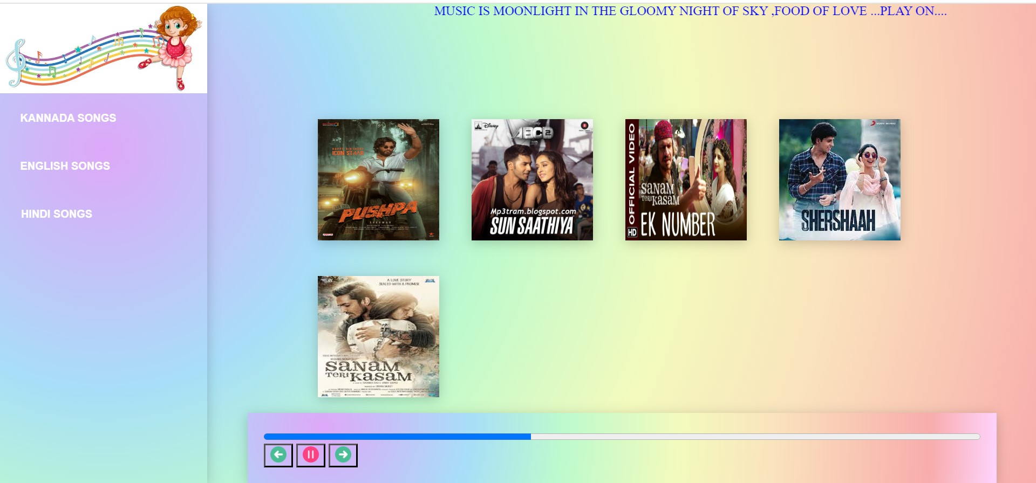
TEXT
Add the headline
Add the headline
FIG 4 : updating the progress bar

Slide 15
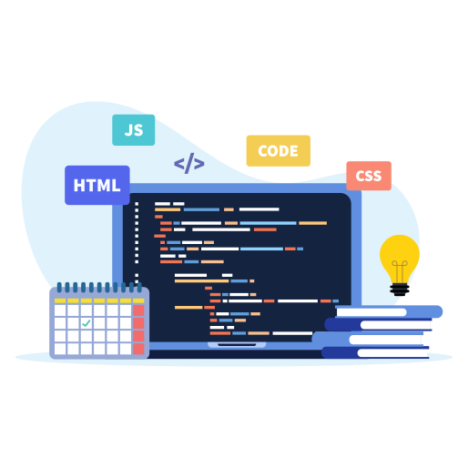
FUTURE SCOPE
In the future scope section of our music player website presentation regarding HTML, CSS, and JavaScript, Here are some ideas:
*Advanced UI/UX Features*: Implement more dynamic and interactive user interfaces using CSS animations and transitions to enhance the overall user experience.
*Responsive Design*: Focus on improving the website's responsiveness across different devices by utilizing advanced CSS techniques like media queries.
*Performance Optimization*: Explore ways to optimize website performance by leveraging JavaScript frameworks and libraries to streamline code and improve loading times.
*Accessibility*: Enhance accessibility features using HTML5 semantic elements and CSS techniques to ensure the website is usable for all users, including those with disabilities.

Slide 16
CONCLUSION
conclusion would emphasize the potential for growth and enhancement in utilizing HTML, CSS, and JavaScript to create a more engaging and user-friendly platform. By focusing on advanced UI/UX features, responsive design, performance optimization, and accessibility, your website can evolve to meet the changing needs and expectations of users. Emphasize how these technologies can be leveraged to create a dynamic and innovative music player website that stands out in the digital landscape.

Slide 17
REFERENCES
Visual Studio Code : https://vscode.dev
HTML, CSS, and JavaScript: Covering HTML5, CSS3, and ES6, Laura Lemay, Rafe Colburn, Jennifer Kyrnin, 3rd Edition, 2016, Sams.

Slide 18
THANKS FOR YOUR LISTENING

