Slide 1
InflationInsights
Nakka Bindu Latha P0 Project

Slide 2
Tech Stack:
Language: Python
Data Analysis: Numpy, Pandas
Code Editor: VSCode , SQLite
Purpose:
InflationInsights is a data collection and analysis platform that collects key inflation indicators across countries and years in a unified database.
The aim of this project is to provide an insights to make future trends.
Functionalities:
CRUD Operations:
Create: Ingest and process financial data feeds.
Read: Provide interactive dashboards, queries, and reports.
Update: Implement periodic dataset updates.
Delete: Manage outdated data for accuracy.

Slide 3
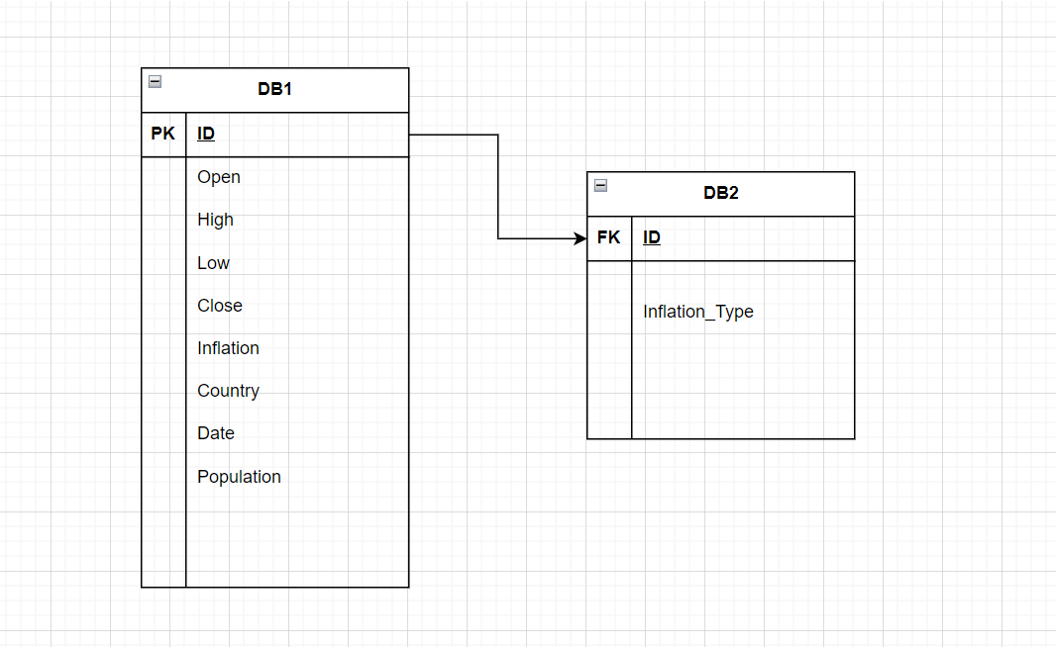
ER Diagram:

Slide 4
Github Repository :
https://github.com/Latha593/Revature.git

Slide 5
Challenges faced:
Data Accuracy and Completeness:
Ensuring the accuracy and completeness of the aggregated inflation data from diverse sources.
Database Integration:
Difficulties in handling large datasets, optimizing queries, and ensuring database performance.
Scalability:
Ensuring that the platform can scale effectively to handle an increasing volume of users and data.
Maintenance and Updates:
Challenge: Regularly updating and maintaining the platform to adapt to changing data sources and technologies.

Slide 6


