Slide 1

Any Guesses..What’s our our Project is about..??

Slide 2
SAMRIDHI NET BANKING
Team Members
S.BABY LATHA-17B01A05F6(CSE)
M.NAVYA BHARGAVI-17B01A0582(CSE)
BH.GAYATHRI-17B01A0508(CSE)
S.VARSHA-17B01A05F5(CSE)
K.V.S.JAHNAVI-17B01A0577(CSE)

Slide 3
Why This Project???
We have chosen this project because we felt that Net Banking is becoming more and more popular in this modern world.
As it is simple to open and easy to access for all the customers.
It is very convenient to the users that they can transfer money easily without standing in queues etc.
In little time we can complete the process of transaction and we can get updates easily.

Slide 4
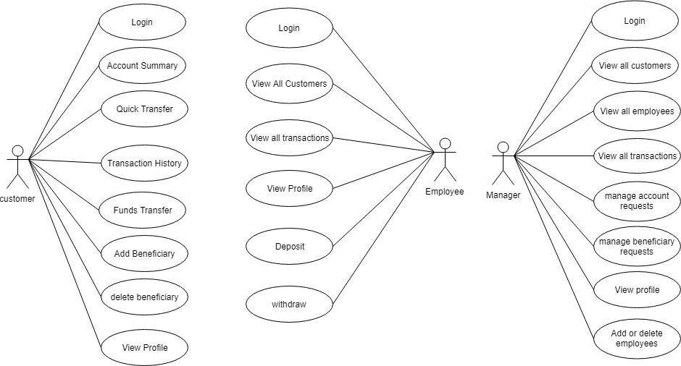
Use Case Diagram

Slide 5
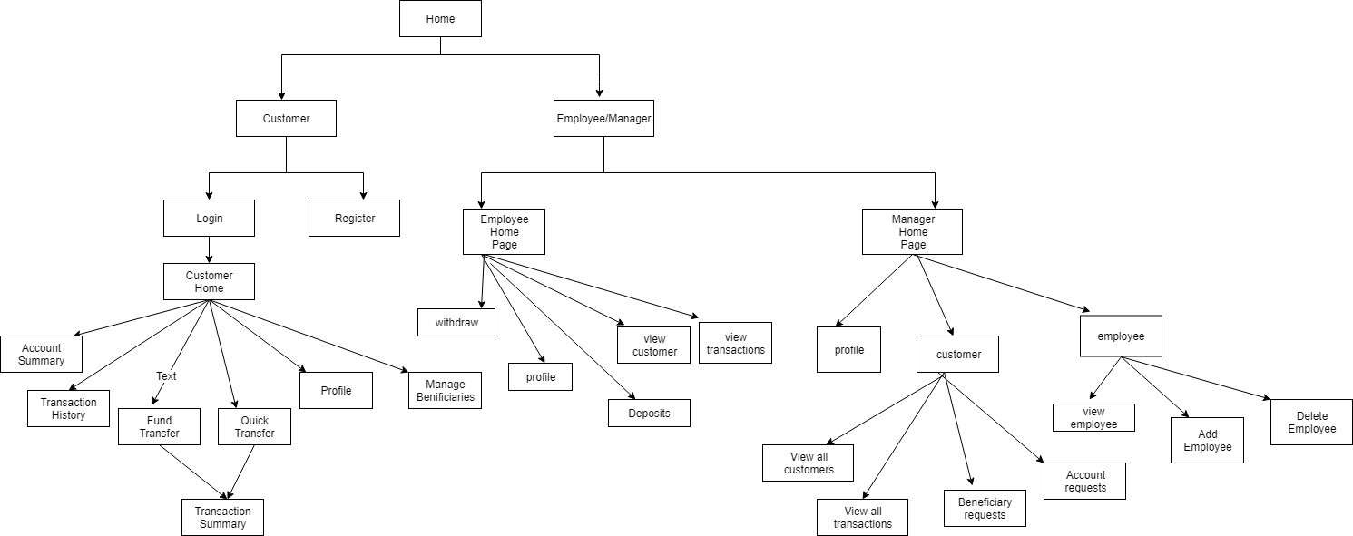
Application Flow Diagram

Slide 6
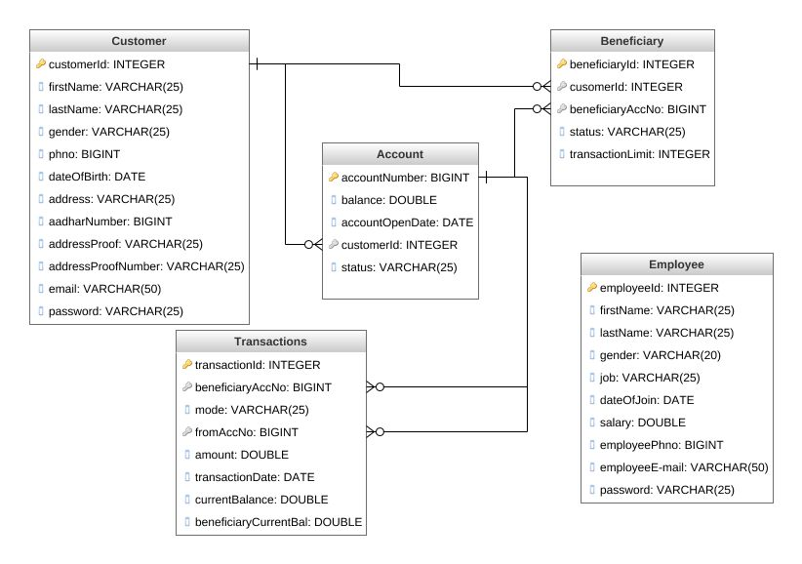
Database Schema

Slide 7
-Project Demo

