Slide 1
SMART WATER MANAGEMENT.
By using IOT (Internet of things) technology.

Slide 2
INTRODUCTION:
We are going to see IOT based water quality management.
In this project , the main applications are, we can use this project for may be
1) Water plant or
2)Other domestic purpose.
When it comes in hardware part,

Slide 3
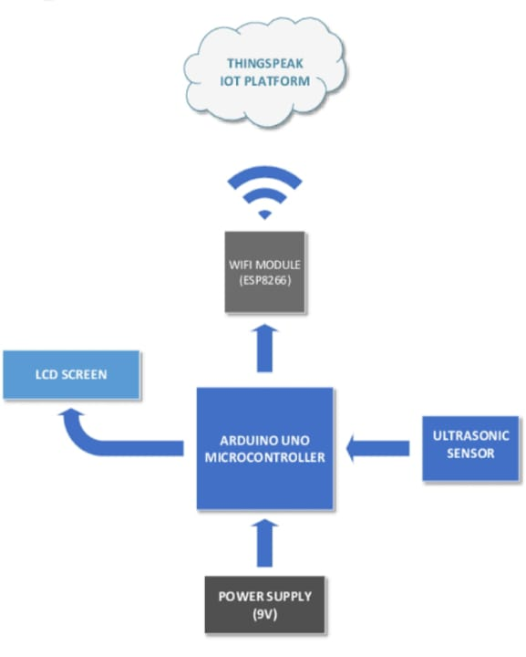
BLOCK DIAGRAM:
pH sensor

Slide 4
working
In our project , measure some quality parameters like pH , temperature, turbidity , level of water by using pH sensor, chlorine sensor , etc
Using controller , integrated sensor now we are going to monitor pH value of water , level of the water , temperature and purity of the water .
Integrated sensor , it has WIFI module.
In sensor all four parameters sense that controller. Controller will be continuously uploading the above parameters to our client website.
By using cloud page see all parameters

Slide 5
Steps:
How to connect Python script to Arduino ?
In general,
Connect the board to PC. Install and open the Arduino IDE . Configure the board settings . Write the code . Press a button on the IDE to upload the program to the board.
In another way using LCD or Buzzer for implement our project.
The python script coding can be written as,

Slide 6
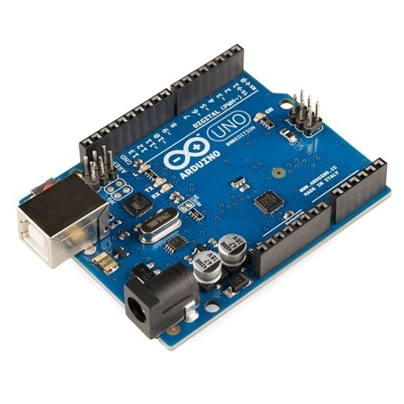
Coding for arduino:
(SINGLE CODING FOR BOTH ARDUINO AND LCD)
import RPi.GPIO as GPIO
import time
import smbus
# Define LCD column and row size for 16x2 LCD
lcd_columns = 16
lcd_rows = 2
# Define I2C address for LCD
lcd_address = 0x27
# Define GPIO pins for ultrasonic sensor
trig_pin = 9
echo_pin = 10
# Define analog pins for salinity and pH sensors
salinity_pin = 0
ph_pin = 1
# Initialize I2C bus
bus = smbus.SMBus(1)
# Define LCD commands
lcd_clear = 0x01
lcd_home = 0x02
lcd_entry_mode = 0x06
lcd_display_on = 0x0C
lcd_function_set = 0x28
# Define LCD line addresses
lcd_line1 = 0x80
lcd_line2 = 0xC0

Slide 7
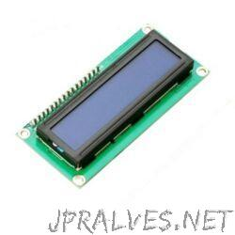
# Define LCD backlight control
lcd_backlight_on = 0x08
lcd_backlight_off = 0x00
# Initialize LCD
def lcd_init():
bus.write_byte(lcd_address, lcd_function_set)
time.sleep(0.1)
bus.write_byte(lcd_address, lcd_function_set)
time.sleep(0.1)
bus.write_byte(lcd_address, lcd_function_set)
time.sleep(0.1)
bus.write_byte(lcd_address, lcd_function_set | lcd_display_on) time.sleep(0.1)
bus.write_byte(lcd_address, lcd_clear)
time.sleep(0.1)
bus.write_byte(lcd_address, lcd_entry_mode)
time.sleep(0.1)
bus.write_byte(lcd_address, lcd_backlight_on)
time.sleep(0.1)

Slide 8
# Send command to LCD
def lcd_command(cmd):
bus.write_byte(lcd_address, cmd)
time.sleep(0.1)
# Send data to LCDdef lcd_write(data): bus.write_byte_data(lcd_address, 0x40, data)
time.sleep(0.1)
# Set cursor position on LCDdef lcd_set_cursor(row, col): address = lcd_line1 if row == 0 else lcd_line2
address += col
bus.write_byte(lcd_address, address)
time.sleep(0.1)
# Initialize GPIO
GPIO.setmode(GPIO.BCM)
GPIO.setup(trig_pin, GPIO.OUT)
GPIO.setup(echo_pin, GPIO.IN)
# Initialize LCD
lcd_init()
# Print initial messages on LCD
lcd_set_cursor(0, 0)
lcd_write(ord('Water Level:'))
lcd_set_cursor(1, 0)
lcd_write(ord('Salinity: pH:'))

Slide 9
# Main loop
while True:
# Measure distance using ultrasonic sensor
GPIO.output(trig_pin, GPIO.LOW)
time.sleep(0.2)
GPIO.output(trig_pin, GPIO.HIGH)
time.sleep(0.00001)
GPIO.output(trig_pin, GPIO.LOW)
while GPIO.input(echo_pin) == 0:
pulse_start = time.time()
while GPIO.input(echo_pin) == 1:
pulse_end = time.time()
pulse_duration = pulse_end - pulse_start
distance = pulse_duration * 17150
distance = round(distance, 2)
# Read analog values from salinity and pH sensors
salinity = bus.read_byte(salinity_pin) ph_value = bus.read_byte(ph_pin) # Print values on LCD
lcd_set_cursor(0, 12)
lcd_write(ord(str(distance)))
lcd_set_cursor(1, 11)
lcd_write(ord(str(salinity)))
lcd_set_cursor(1, 17)
lcd_write(ord(str(ph_value)))

Slide 10
# Print values on serial monitor print('Water Level:', distance, 'cm, Salinity:', salinity, ', pH:', ph_value)
time.sleep(1)

Slide 11
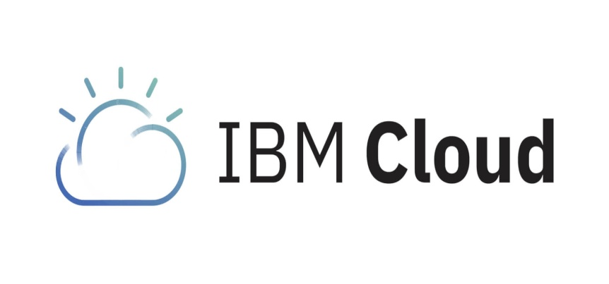
CAD:
Using IBM cloud foundry for building our project,
IBM cloud foundry is a open source(PaaS) platform for quickly create and deploy applications on cloud. Runs on softlayer infrastructure.
IBM Bluemix supports several programming languages and services as well as integrated DevOps to build, run , deploy , and manage applications on the cloud.

Slide 12


