Slide 1
Phase 2: Innovation
Smart Water Management is the activity of planning, developing, distributing and managing the use of water resources using an array of IoT technologies which are designed to increase transparency, and make more reasonable and sustainable usage of these water resources.

Slide 2
Components needed:
★Arduino Uno
★Ultrasonic Sensor (HC-SR04) for water level detection
★Salinity Sensor (e.g., Gravity: Analog Electrical Conductivity Sensor)
★pH Sensor (e.g., Gravity: Analog pH Sensor)
Jumper wires
★Breadboard (optional)

Slide 3
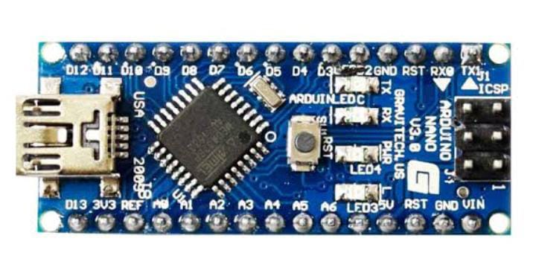
Audrino:

Slide 4
Uses of the sensor:
★It uses the lquidCrystal library to control the LCD for displaying readings.
★The Ultrasonic sensor measures the water level using the trig and echo pins.
★Salinity and pH sensors are read through analog pins.
★The readings are displayed on the LCD and printed to the Serial Monitor for debugging.
★The loop continuously updates the readings every second.

Slide 5
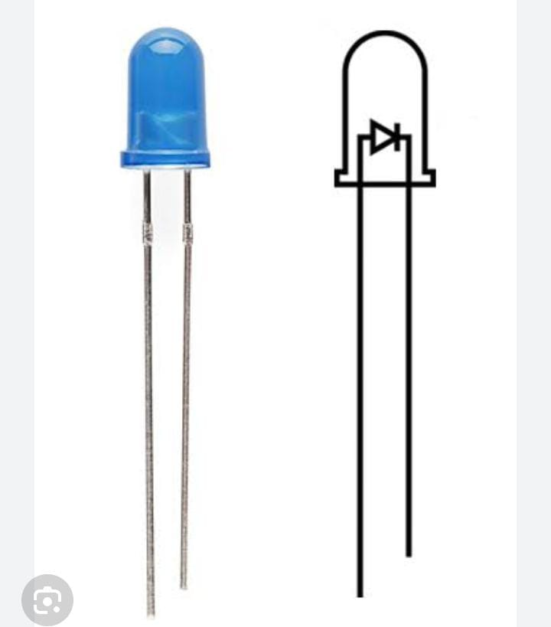
Display unit:
As the water level continues to rise and reaches half the tank, Yellow LED will glow. When the water in the tank rises to full an alarm is made by the buzzer as an indication that the tank is full.

