Slide 1
Products Analysis

Slide 2
INTRODUCION
In this project, we analyze a dataset containing detailed information about various products. The dataset includes essential attributes such as product IDs, categories, names, descriptions, pricing, URLs, and timestamps of creation and modification.

Slide 3
The dataset consists of the following columns:
ID: A unique identifier for each product.
SKU: Stock Keeping Unit, a unique code for identifying each product.
Categories: The categories to which the product belongs.
Name: The name of the product.
Description: A brief description of the product.
URL: The web address where the product can be found.
Image URL: The web address of the product's image.
Brand: The brand name of the product.
Created At: The date and time when the product entry was created.
Modified At: The date and time when the product entry was modified

Slide 4
Primary Objective
The primary objectives of this project are to perform data cleaning, exploratory data analysis (EDA), and derive meaningful insights from the dataset. Key tasks include handling missing values, converting data types, analyzing price distributions, and identifying trends over time.

Slide 5



Slide 6
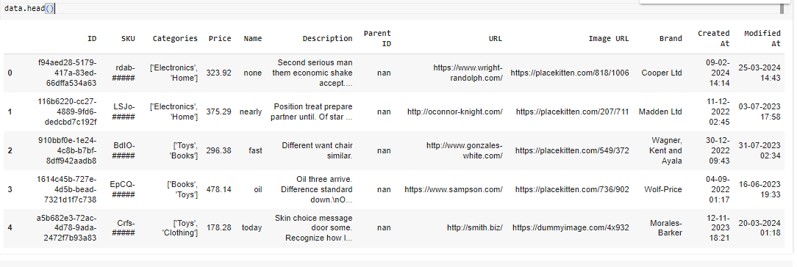

Slide 7
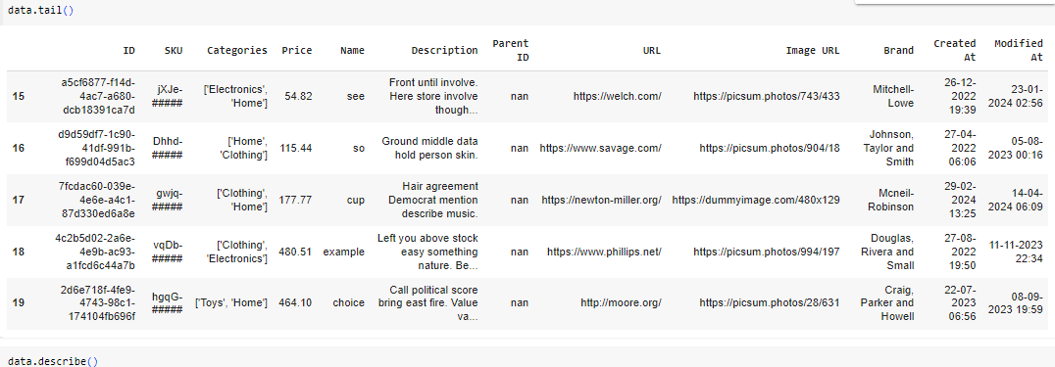

Slide 8
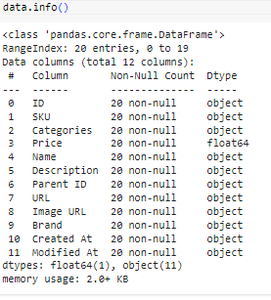
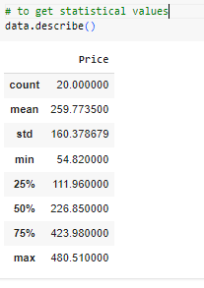

Slide 9
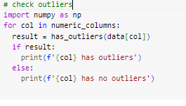



Slide 10



Slide 11
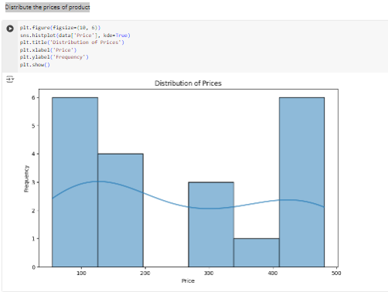

Slide 12
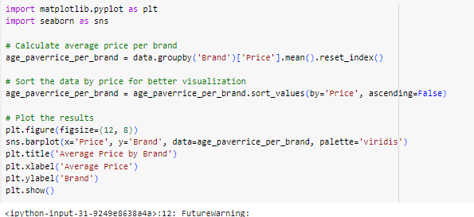
how brand affects prices of the products

Slide 13
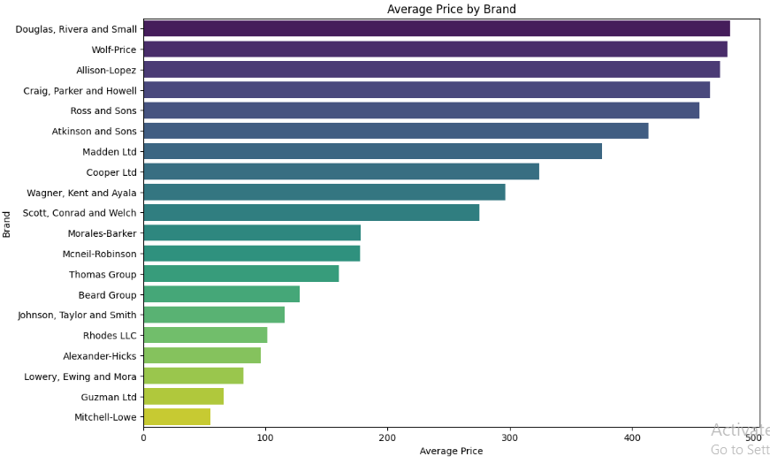

Slide 14

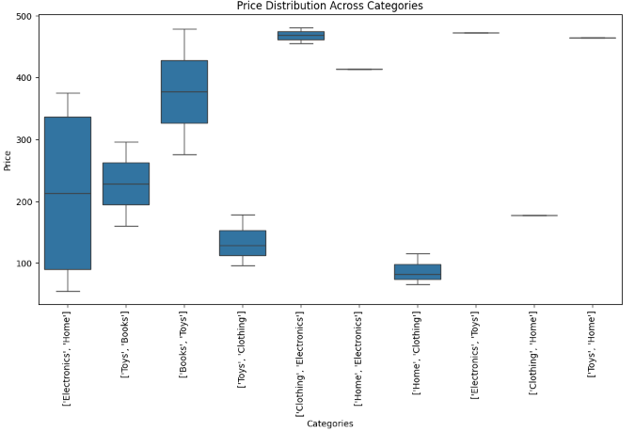
How do prices vary across different categories?

Slide 15
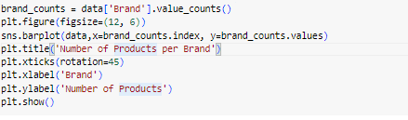
Find the number of products in each brand

Slide 16
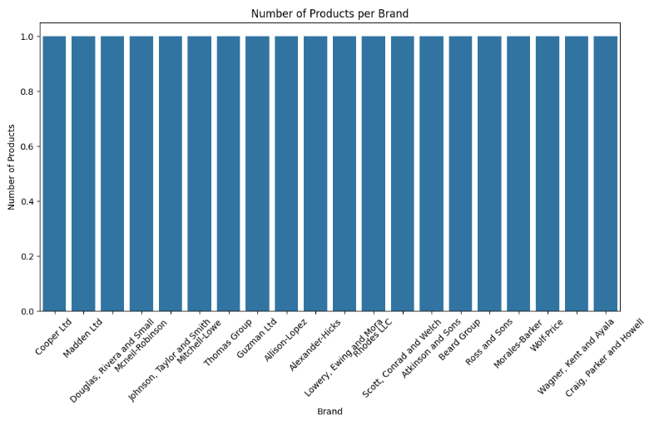

Slide 17
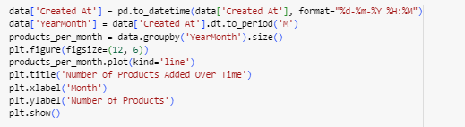
How has the number of products added changed over time?

Slide 18
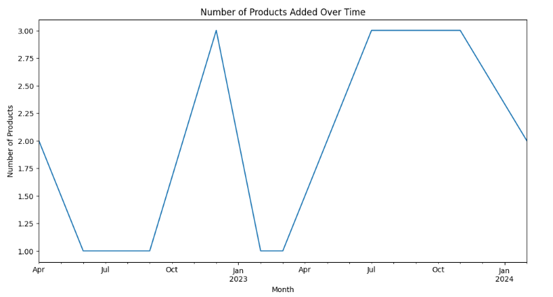

Slide 19
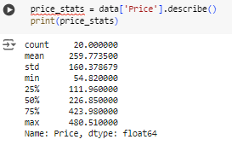
What are the basic statistics of product prices?

Slide 20
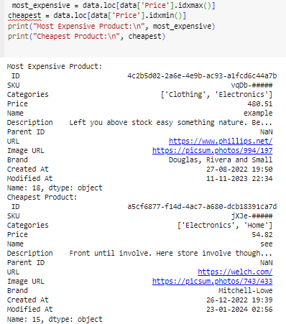
What are the most expensive and cheapest products?

Slide 21
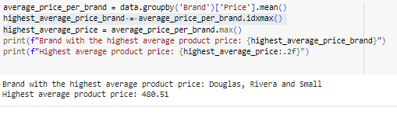
Which brand has the highest average product price?

Slide 22

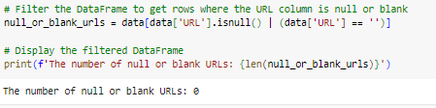
Number of unique product SKUs in the dataset
How many products have null or blank URLs?

Slide 23
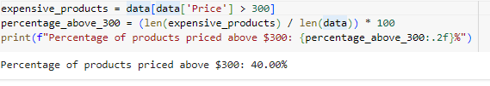
What percentage of products are priced above $300?

Slide 24
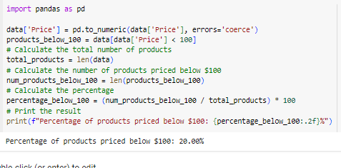
What percentage of products are priced below $100?

Slide 25
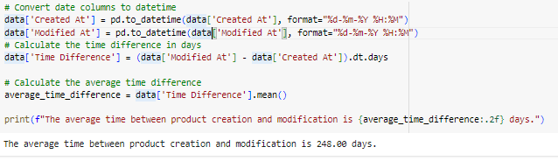
What is the average time between product creation and modification?

Slide 26
CONCLUSION
Through the analysis of the dataset, we have gained valuable insights into how different brands impact product pricing. We observed significant variations in average product prices across different brands. Some brands consistently command higher prices, suggesting a strong brand value and perceived quality among consumers. Analyzing the interplay between product categories and brands, we found that certain categories are dominated by specific brands.
This project has demonstrated the significant role that branding plays in product pricing. By leveraging these insights, businesses can make informed decisions that align with their strategic goals, enhance their competitive edge, and better meet the needs of their target customers.

