Slide 1
SAMPLE COMPANY
ID : EBEON0324891011
Batch : 2023-11258

Slide 2
Introduction
The topic of this project is sample company. This project have tree tables 1. ETHNICITY, 2. JOB ROLE, 3. LOCATION
In this project I used the following concepts of SQL. They are clauses , join function , window function, index, user define function .
By using these metioned cocepts I explained how to find the maximum value,which employee got the maximum salary ,how to join two tables and what are the outputs and how a user define function works.

Slide 3
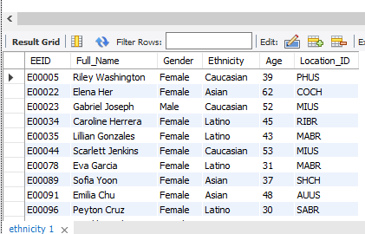
ETHNICITY

Slide 4
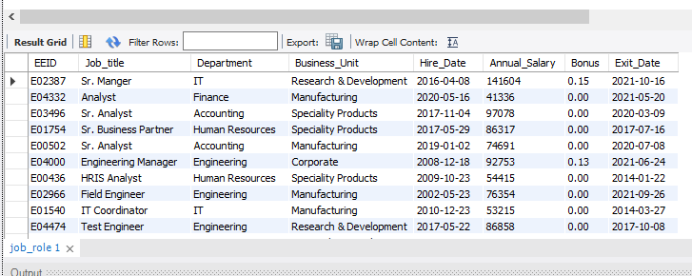
ROB ROLE

Slide 5
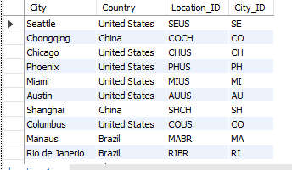
LOCATION

Slide 6
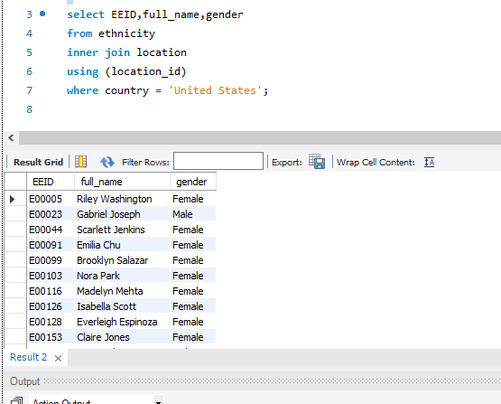
Write a SQL query to display the details of the employees who are from United States .

Slide 7
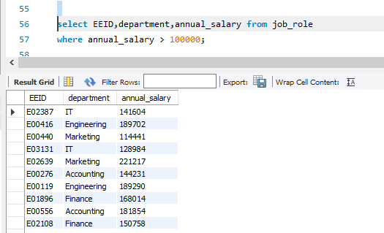
Write a query to find in which departments employees got the annual salary>100000.

Slide 8

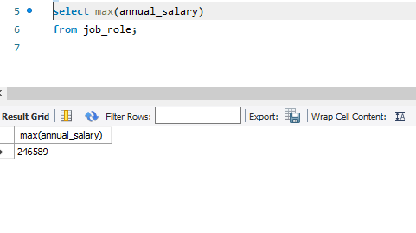
Write a query to calculate the maximum annual salary of the job role table.

Slide 9
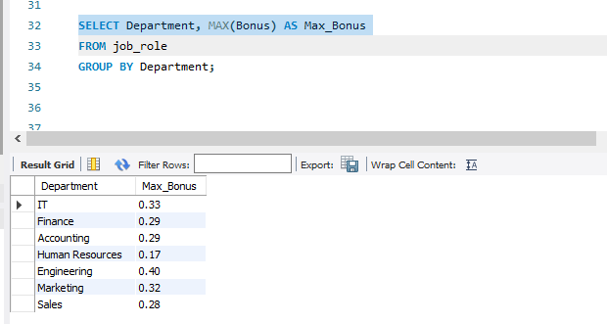
Write a query to find maximum bonus of employees by department wise.

Slide 10
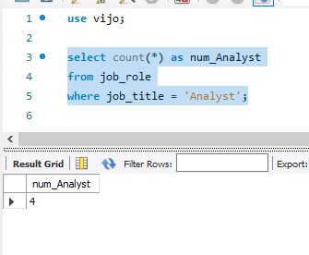
Write a query to find the number of Analyst in the company

Slide 11
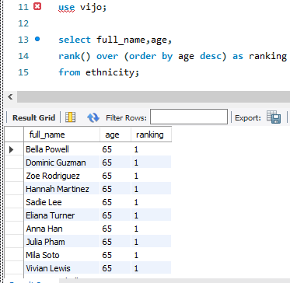
Write a SQL query to display the details of the employees by using rank based on their age?

Slide 12
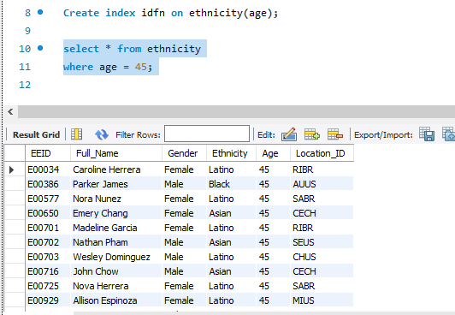
Write a SQL query to create an index function.

Slide 13
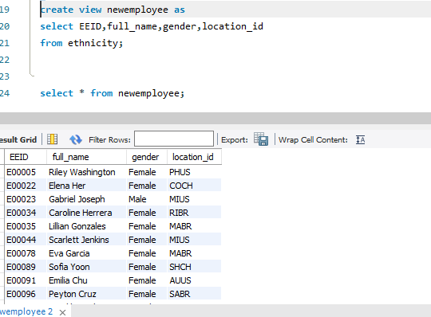
Create a view name newemployee that includes the following coloumns from ethnicity 1.EEID, 2.full_name, 3.gender, 4.location_id

Slide 14
Conclusion:
In this project we have known how SQL cocepts interfere in a company dataset and how it helps us to find the insights of the data.Like this we can get the required deatails from any dataset.

Slide 15
Thank you

