Slide 1

STUDENT DATA SCIENCE PROJECT
Automated Epileptic Seizure
Detection from EEG Signals
Turning raw brainwave signals into an automated, clinically-aware seizure detection pipeline — from signal to insight.
Pasumarthi Abhigna
Data Science • Machine Learning • Signal Processing

Slide 2




THE PROBLEM
Why seizure detection needs to be automated
Continuous EEG monitoring produces far more data than any clinician can watch live — and the moments that matter most are brief, subtle, and easy to miss.
Volume vs. attention span
Subtlety & disagreement
24+ hour continuous EEG recordings can't realistically be watched live by a human for the full duration.
Not every seizure is visually obvious — neurologists themselves disagree on borderline cases.
Recorded, not watched live
No one's watching at all
Most EEG is captured for later review rather than monitored in real time, delaying alerts.
In wearable / outpatient settings, there is no clinician observing the signal — automation is the only option.
02

Slide 3




PROJECT OBJECTIVES
What this project sets out to do
Engineer real signal features
Turn raw 178-point EEG windows into meaningful time-domain and frequency-domain features.
Compare two modelling paths
Classical ML on engineered features vs. deep learning directly on the raw signal.
Optimize for the right metric
Prioritize recall / sensitivity — missing a real seizure is costlier than a false alarm.
Explain the predictions
Identify which signal characteristics — amplitude, frequency bands — actually drive detection.
03

Slide 4
THE DATASET
Real EEG recordings, not summarized tables
Sourced from the widely-used Bonn University EEG benchmark — raw brain electrical activity captured across five recording conditions.
11,500
178
5
2,300
EEG samples
raw signal points
per 1-sec window
recording
conditions
samples per class
(perfectly balanced)
Five recording conditions: seizure activity, tumor-region tissue, the healthy hemisphere opposite a tumor, eyes-closed rest, and eyes-open rest — collapsible into a binary seizure / non-seizure task, or kept as 5-class.
04

Slide 5


APPROACH
Why raw signal, not pre-summarized data
Forces genuine feature engineering
Raw time-series signal, not ready-made tabular columns — real signal-processing work rather than plugging numbers into a model.
Openly accessible
No credentialing barrier, well documented, and widely used — straightforward to build and validate against.
Strong comparability
An established base of published results on this exact benchmark makes it possible to sanity-check this project's own numbers.
05

Slide 6
GROUNDED IN RESEARCH
Where this project fits in current work
Andrzejak et al., 2001
Kashefi Amiri et al., 2025
Cao et al., 2025
Moutonnet et al., 2024
Aziz et al., 2025
Defined the original 5 recording states this dataset still uses today.
DWT + 1D CNN-LSTM reached 97.24% on this exact benchmark — a target to compare against.
Feature selection (SVM-RFE) + CNN-BiLSTM — close match to this project's hybrid approach.
Warns that benchmark accuracy rarely translates to real clinical deployment.
Reviewed 67 wearable-AI epilepsy studies — detection at the edge is a fast-growing need.
06

Slide 7


FEATURE ENGINEERING
From 178 raw points to 21 engineered features
→
→
Raw EEG signal
Python extraction script
21-feature dataset
178 amplitude readings per 1-second window
Time + frequency domain feature computation
Ready for classical ML & feature selection
Time-domain features
Frequency-domain features (via FFT)
mean · std dev · variance · skewness · kurtosis · peak-to-peak · zero-crossing rate · RMS · mean absolute diff
power + relative power in delta · theta · alpha · beta · gamma bands · dominant frequency · spectral entropy
07

Slide 8


DATA PREPROCESSING
Getting the signal ready for modelling
Artifact & outlier checks
Normalization
Inspecting raw signal for movement / electrode-contact noise before feature extraction.
Scaling raw signal values so amplitude differences don't dominate downstream models unfairly.
Band decomposition
Label encoding
FFT-based extraction of delta / theta / alpha / beta / gamma frequency band power.
Binary seizure / non-seizure target, alongside the retained 5-class version.
08

Slide 9
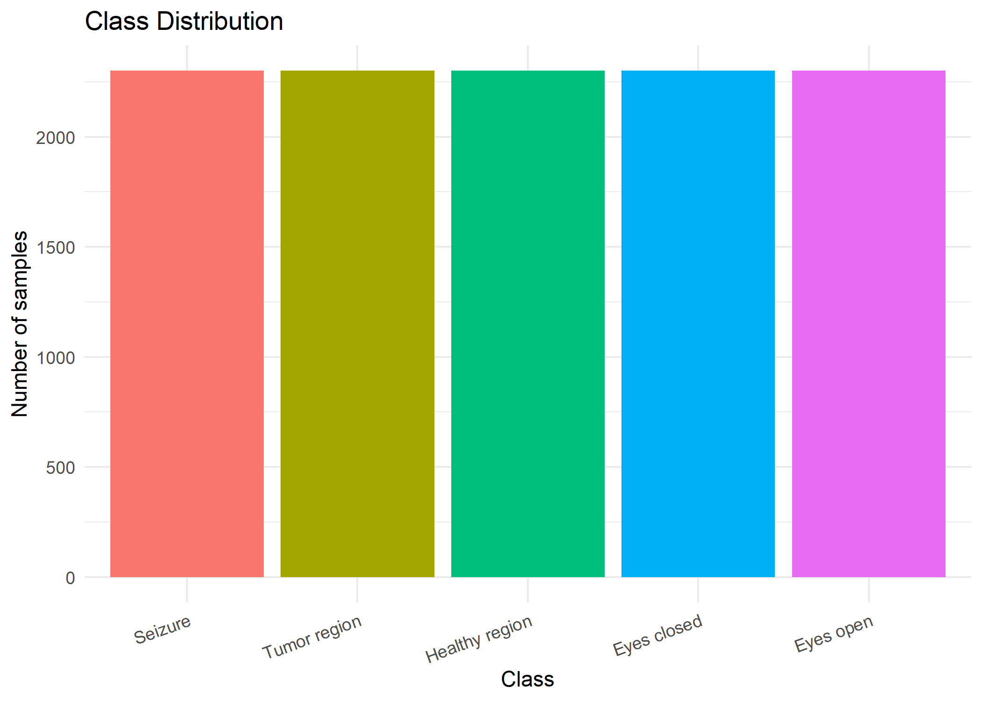
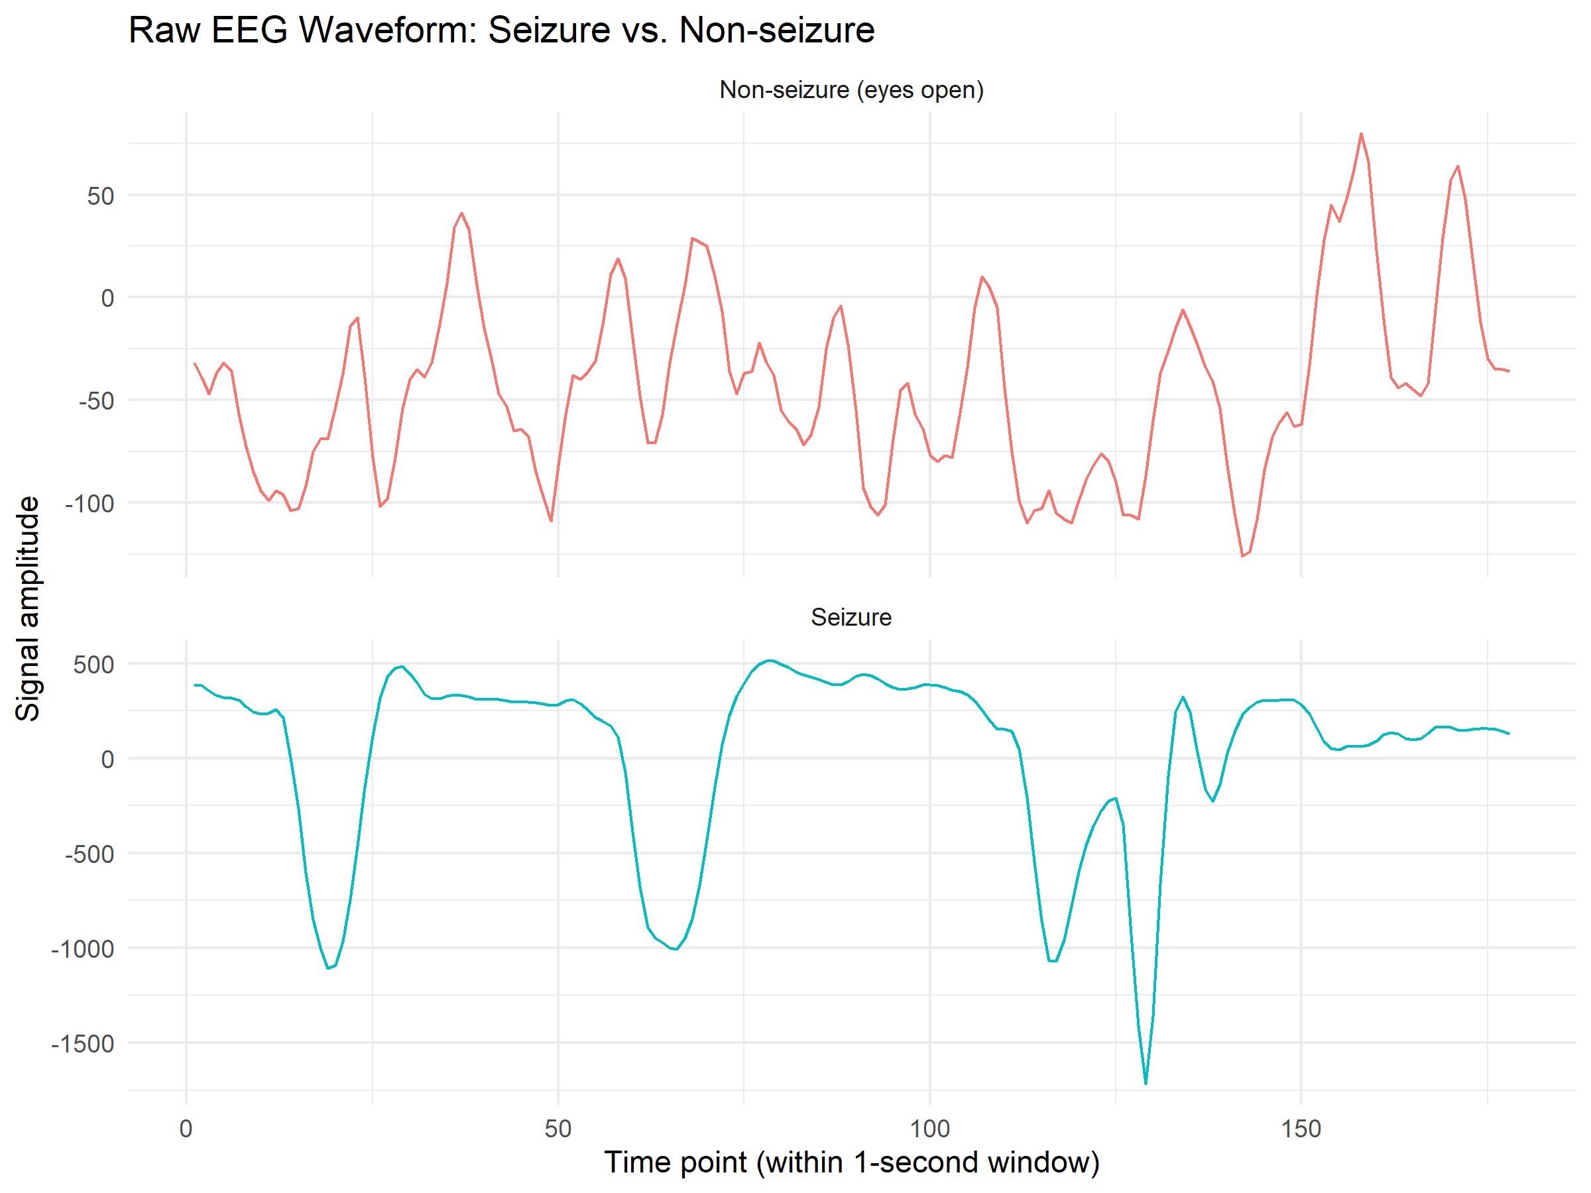
EXPLORATORY DATA ANALYSIS
First look at the data
Perfectly balanced — 2,300 samples in every class
No class-imbalance correction needed — a clean, balanced benchmark.
Seizure amplitude swings ~10–15× larger than non-seizure
09

Slide 10
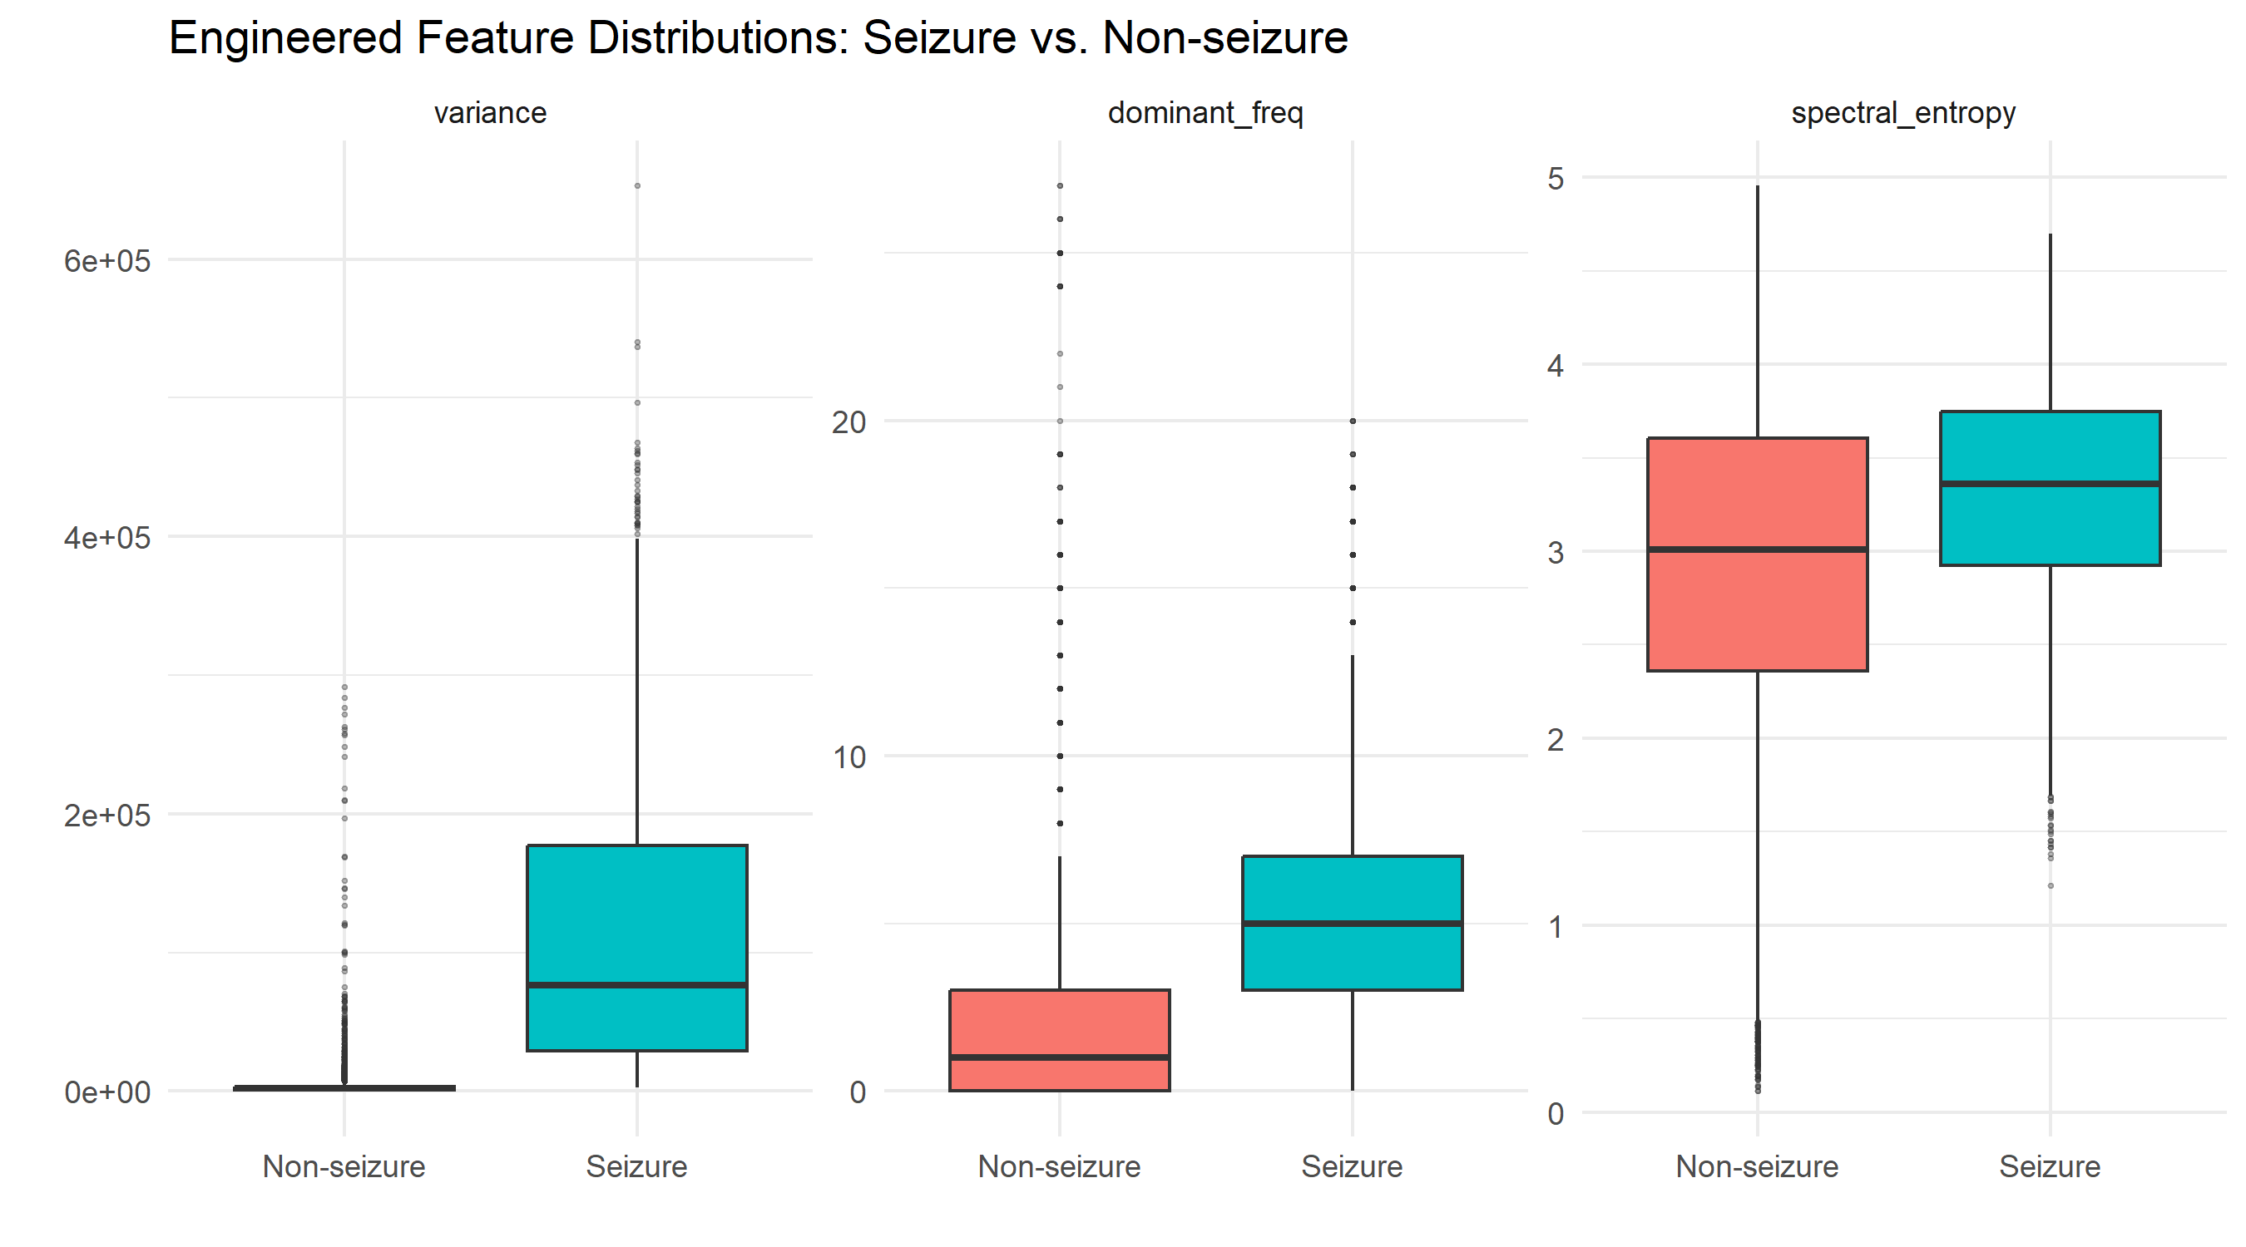
EXPLORATORY DATA ANALYSIS
Engineered features already separate the classes
~38×
higher median
variance in seizures
5 Hz
median dominant
freq. (vs. 1 Hz)
Variance, dominant frequency, and spectral entropy by class
10

Slide 11
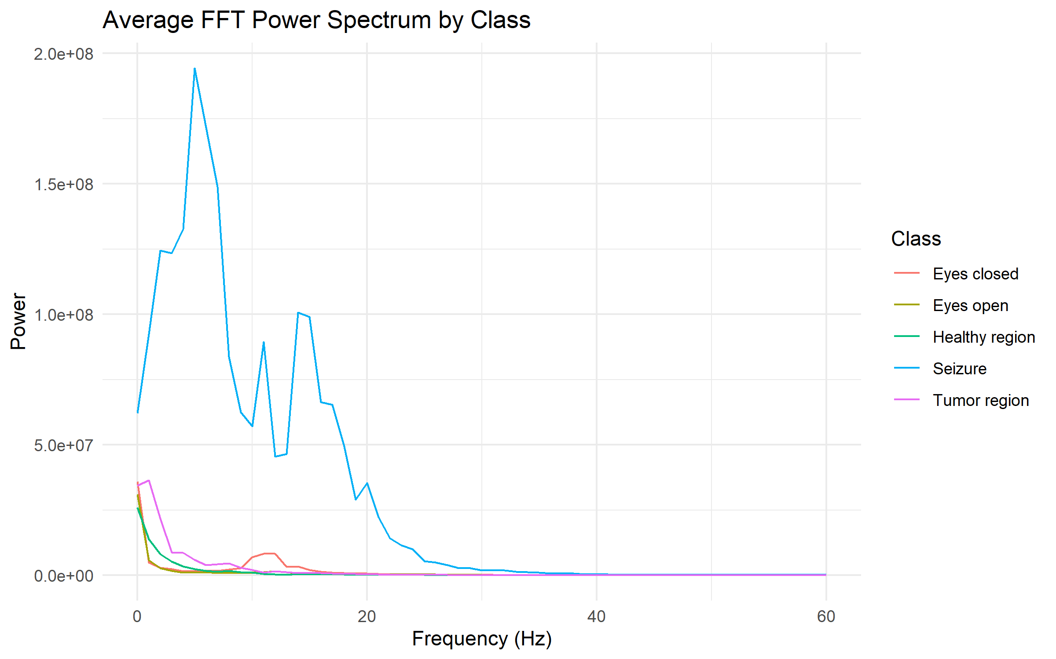


KEY INSIGHT
The entropy result that flipped an assumption
Expected
A seizure concentrates energy narrowly → should mean lower spectral entropy.
Found
Entropy is higher for seizures — median 3.36 vs. 3.01. Power is elevated AND spread across 0–20 Hz, not narrowly concentrated.
Seizure power towers over every other class across ~0–20 Hz — spread-out power means higher entropy, even with far more total energy.
11

Slide 12
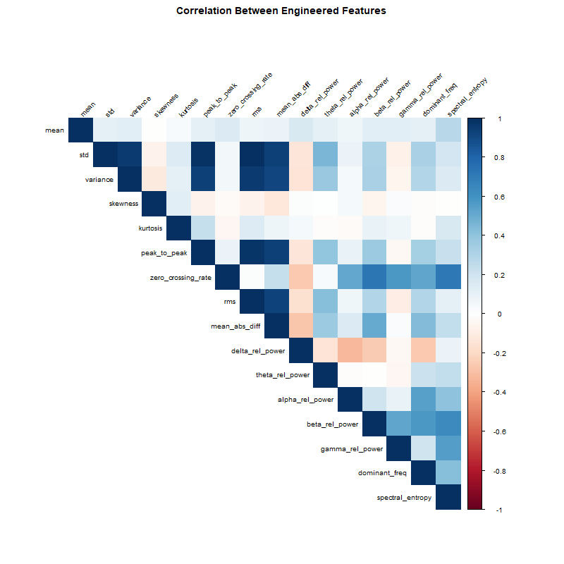
EXPLORATORY DATA ANALYSIS
Which engineered features overlap?
Magnitude features cluster
Std dev, variance, peak-to-peak, RMS move together — different summaries of the same amplitude.
Frequency-band features cluster separately
Beta, gamma, and dominant frequency form their own correlated group.
Delta power runs opposite
Relative power is a fixed budget across bands — more delta means proportionally less beta/gamma.
Correlation across 16 engineered features
Useful signal for feature selection — several magnitude features may be redundant together.
12

Slide 13


WHY IT MATTERS
Triage, not replacement
The goal isn't to replace clinical judgment — it's to flag the small fraction of a long recording that actually deserves a clinician's attention.
Consistent, real-time alerting
Removes reliance on after-the-fact review of hours of recorded EEG.
Reduces inter-rater variability
A consistent automated first pass, rather than relying on any one reviewer's judgment.
Enables wearable / outpatient use
The only realistic option when no clinician is watching the signal live.
13

Slide 14

PROGRESS SO FAR
The pipeline built end-to-end
Raw dataset
Feature extraction
Exploratory analysis
Findings documented
11,500 EEG samples sourced & validated
→
21-feature engineered dataset built in Python
→
5 visualizations built & interpreted in R
→
Write-up with verified literature grounding
14

Slide 15
WHAT'S NEXT
From analysis to a working detector
Feature selection
Narrow the engineered feature set using the redundancy patterns already found.
Database connectivity
Move the pipeline onto a proper database backend for retrieval at scale.
Model comparison
Train and compare classical ML and deep learning models side by side.
Hyperparameter tuning
Optimize the strongest candidate models for real performance gains.
Comparative evaluation
ROC curves, confusion matrices, precision-recall, and feature importance.
15

Slide 16
Thank You
Questions welcome.
Automated Epileptic Seizure Detection from EEG Signals

