Slide 1
Employee Data Analysis using Excel
STUDENT NAME: LATHIKA JAYA SREE G
REGISTER NO: 312216976(D63A271376071129C2D4327DE95301D6)
DEPARTMENT: B.Com (G)
COLLEGE: SHRI KRISHNASWAMY COLLEGE FOR WOMEN

Slide 2
PROJECT TITLE
USING PIVOT TABLES FOR EMPLOYEE TURNOVER ANALYSIS

Slide 3


AGENDA
1.Problem Statement 2.Project Overview 3.End Users 4.Our Solution and Proposition 5.Dataset Description 6.Modelling Approach 7.Results and Discussion 8.Conclusion
3/21/2024 Annual Review

Slide 4

PROBLEM STATEMENT
*Employee turnover is a critical issue for organizations,leading to increased costs and loss of productivity.
*Understanding the factors contributing to turnover can help in devising strategies to retain employees and improve organizational performance.
*This analysis aims to explore the key factors driving employee turnover within the company.

Slide 5

PROJECT OVERVIEW
*The project involves analyzing employee data to identify patterns and trends associated with turnover.
*By leveraging pivot tables, we aim to summarize and explore various dimensions of the data to gain insights into the factors influencing employee exits.

Slide 6

WHO ARE THE END USERS?
*Human Resources (HR) Team: To understand the key drivers of turnover and develop targeted retention strategies.
*Management: To make informed decisions based on data-driven insights regarding.
*Analysts: To provide deeper analysis and recommendations for minimizing turnover.
*Department Heads: They use the data to address specific issues within their departments, manage staffing levels, and implement targeted retention strategies.

Slide 7

OUR SOLUTION AND ITS VALUE PROPOSITION
*Identify high-risk groups based on various factors such as department, tenure, and performance.
*Pinpoint key reasons for turnover, such as lack of advancement opportunities or dissatisfaction with compensation.
*Develop proactive measures to reduce turnover by addressing identified issues

Slide 8
Dataset Description
*Employee ID: unique identifier for each employee.
*Department: Department where the employee
*Working role: Specific role of the employee within the organization
*Tenure: Duration of employment.
*Age: Employee’s age
*Gender: Employee’s gender. *Education Level: Highest level of education attained.
*Performance Rating: Performance evaluation score.
*Attrition: Indicator of whether the employee has left the organization (Yes/No).
*Monthly Income: Monthly salary of the employee.

Slide 9

THE "WOW" IN OUR SOLUTION
Impactful Insights: Share any surprising or particularly valuable insights uncovered by the analysis that might not have been evident with standard approaches. User Experience: Discuss how the pivot table solution enhances the user experience, enabling quicker, data-driven decisions.
3/21/2024 Annual Review
9

Slide 10
MODELLING
! Summarize turnover data by key categories such as department, tenure, and performance rating.
! Calculate turnover rates and compare them across different segments.
! Visualize patterns and trends to identify high-risk areas.
10

Slide 11
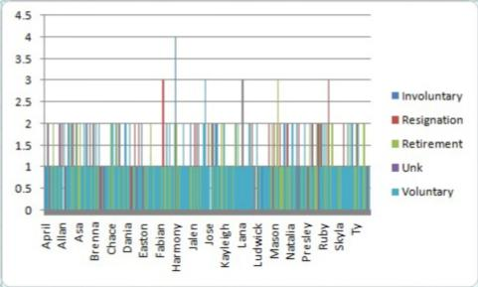
RESULTS
11

Slide 12
conclusion
*Summarize the main takeaways from the analysis, reiterating the importance of addressing the identified issues to reduce turnover.
*Suggest next steps, such as further analysis or the implementation of specific HR interventions.

