Slide 1
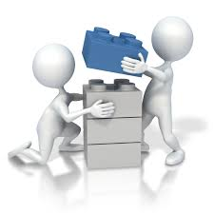
CSc Project 102
Zelalem S. Shibeshi
Adapted from Dane Brown
Together we can change the world

Slide 2
Administration (like before)
I often highlight important concepts in red
Test questions are often based on these concepts
Bold/italics emphasizes my point or improves readability
Note (on paper) anything else you deem important
The module has a section on the course page with a name Project
Notes:
Many studies show improved memory retention when writing down keypoints

Slide 3
Assessment
I hope so
Project + ???
Ask James
Will there be a project?
What will be assessed?
Some test and exam questions maybe.

Slide 4
Project: General Info
Write an app (game) – tic-tac-toe or sudoku (last year – card games- Black Jack, (Snap, poker, solitaire, crazy eights, etc)
Solo for now. Later, groups of 5 probably
Tutor will be assigned as a mentor
Must be in Java for marks to be awarded
Presentation close to the last week of semester
Grading of the code (specifics come later):
completeness
functionality
user interface
understandability
originality

Slide 5
Project Deliverables
Project proposal document ~1-2 page long
Code pushed to GitHub (plagiarism engine)
~5 min presentation
Possibly more
Try to form a group and submit members names by Thursday. The link to enter the information is on the course page.
Notes:
A template is uploaded.

Slide 6
Software Development Life Cycle (SDLC)
A framework that describes the order in which activities are performed at each stage of a software-based project.

Slide 7
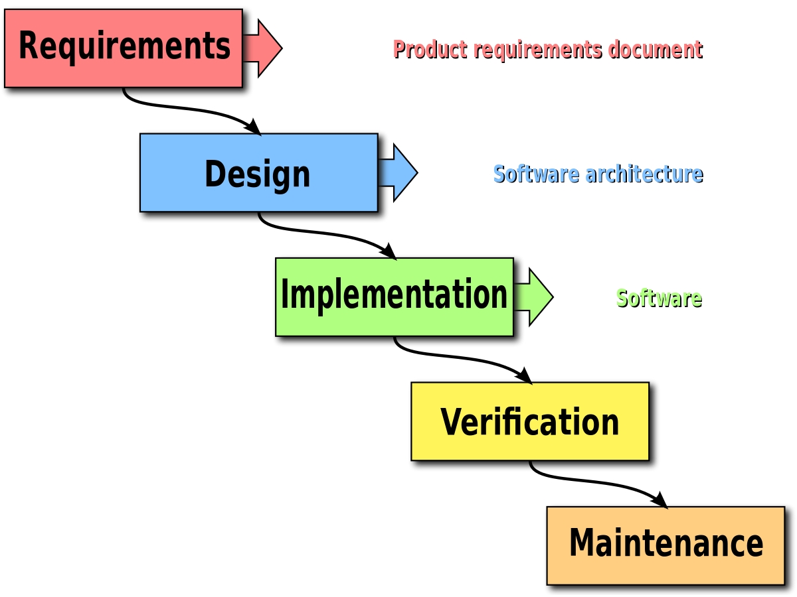
Software Development Life Cycle (SDLC)

Slide 8
Requirements (and analysis)
What are requirements?
Requirements include:
functionality
behaviour
performance
And we get information from different sources.
Customer
Users
System manuals and reports
Other similar system

Slide 9
Requirements (and analysis)
What needs to be analyzed?
Discover the boundaries of the new system (or software) and how it must interact with its environment within the new problem domain
Detect and resolve conflicts between (user) requirements
Negotiate priorities of stakeholders
Prioritize and triage requirements
Classify requirements information into various categories and allocate requirements to sub-systems
Evaluate requirements for desirable qualities

Slide 10
Design
The design of a software project includes specifying all:
risks
technologies:
data structures -- is it numerical? is it visual? etc.
software architecture -- everything about the software
interface representations -- storyboards
algorithmic details -- object diagram (UML)
review and select best design approach
Abstract until you can easily understand/represent the problem

Slide 11
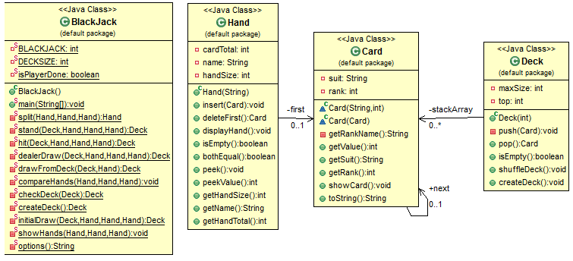
Design -- Example UML
Classes specify the various object that represent things in the system.
Types of objects: entity (e.g players), control (controlling other objects e.g game master), interface (for GUI)
Notes:
One output of the design phase is Class Diagram

Slide 12
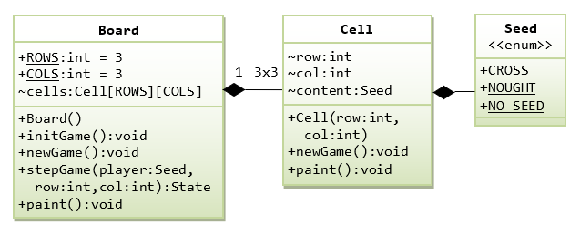
Design -- Example UML
Notes:
One output of the design phase is Class Diagram

Slide 13
Implementation
Implementation usually includes:
Algorithm development
Source code writing
Compilation
Testing and debugging

Slide 14
SDLC Frameworks
Waterfall
Incremental
Spiral
Agile

Slide 15
Good Model for a Card Game?
The waterfall model will work well for this purpose since the requirements are very well known with a clear and stable product definition. Technology involved includes Java and a pc or laptop and allows for portability. An example of a card game will usually be an existing popular one and thus it is straightforward to implement.
Other models can also work but you need to motivate why

Slide 16
Waterfall model
Waterfall is the oldest and easiest of the structured SDLC methodologies.
There are strict stages and each stage needs to be completed first before going to the next stage. There is no going back.
Each stage relies on information from the previous stage and has its own project plan.

Slide 17
What does this mean?
Prone to delays as each stage needs to be reviewed and fully signed off before the next stage can begin
Once a stage is completed, problems can’t be fixed until you get to the maintenance stage.
If a requirement is wrong or missing, it won’t become apparent until the late stages (phases) of the life cycle.
Notes:
Waterfall is easy to understand and simple to manage. However, it is usually

Slide 18
Waterfall Strengths
Easy to understand/use
Provides structure to inexperienced staff (newbies)
Milestones are normally well understood
Requirements are stable/static
Good for management control (plan, staff, track)
Works well when quality is more important than cost or schedule

Slide 19
Waterfall Weaknesses
All requirements must be known upfront
Deliverables created for each stage are considered frozen – inhibits flexibility
Can give a false impression of progress
Does not reflect problem-solving nature of software development – iterations of stages
Integration is one big bang at the end
Little opportunity for customer to preview the system (until it may be too late)

Slide 20
When to use Waterfall?
Requirements are very well known
Product definition is stable
Technology is understood
New version of an existing product
Porting an existing product to a new platform
Works well for smaller straightforward projects
A first year card game project 😃

Slide 21
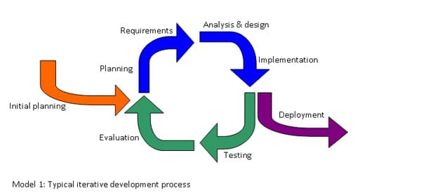
Incremental model
Just like iterative Waterfalls?
No, it is more like breaking down tasks into milestones
With each cycle, the next group of milestones are tackled

Slide 22
Incremental Strengths
Group and develop high-risk or major functions first
Each cycle delivers a working (part of) system
Customer can respond to each build
Lowers initial delivery cost
Initial product delivery is faster
Customers get important functionality early
Risk of changing requirements is reduced

Slide 23
Incremental Weaknesses
Requires good planning and design (abstraction)
Some customers would still want to see the full product/program upon the first cycle
Requires early definition of a complete and fully functional system to allow for the definition of cycles
Well-defined module interfaces are required (some will be developed long before others)

Slide 24
When to use Incremental?
Customers need early realization of benefits
Most of the requirements are known upfront but are expected to evolve over time
A need to get basic functionality to the market early
Remember: Difficult milestones first (for realistic goals)
On projects which have lengthy development schedules
On a project with new technology (impatience)
A first year card game project 😃

Slide 25
Iterative vs. Incremental?
Iterative model is an approach where the focus is to rapidly develop a working prototype first but often not good quality or incomplete. e.g. write parts of chapter 1,2,3,4,5 and significantly change them during each (next) cycle, often making it better
Whereas features are added during each cycle of the incremental model. e.g. write chapter 1 then 2 then 3.
Notes:
I write loads of stuff that's a complete mess
I go through it throwing out the irrelevant drivel, expanding on the important bits, and sorting out the structure
I go through it again now I can start to see the shape of it, sorting it some more
I go through it yet again, etc, until it's GoodEnough
IncrementalDevelopment means:
I write part one
I write part two
I write part three, etc, until the book is finished

Slide 26
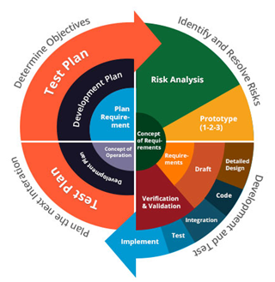
Spiral model
Notes:
The spiral model is a risk-driven software development process model. Based on the unique risk patterns of a given project, the spiral model guides a team to adopt elements of one or more process models, such as incremental, waterfall, or evolutionary prototyping.

Slide 27
Spiral Strengths
Provides early indication of insurmountable risks
Users see the system early because of rapid prototyping tools
Critical high-risk functions are developed first
The design does not have to be perfect
Users can be closely tied to all lifecycle steps
Early and frequent feedback from users
Cumulative costs assessed frequently
(Reminds me of a complex version of incremental model)

Slide 28
Spiral Weaknesses
Time spent evaluating risks too long/expensive for small or low-risk projects
Therefore, does not work well for smaller projects
The model is complex
Cost: Risk analysis requires highly specific expertise.

Slide 29
When to use Spiral?
When rapid creation of a prototype is appropriate
When costs and risk evaluation is important
For medium to high-risk projects
Even more control between cycles are required than incremental -- shorter increments
The US military has adopted the spiral model for its Future Combat Systems program.

Slide 30
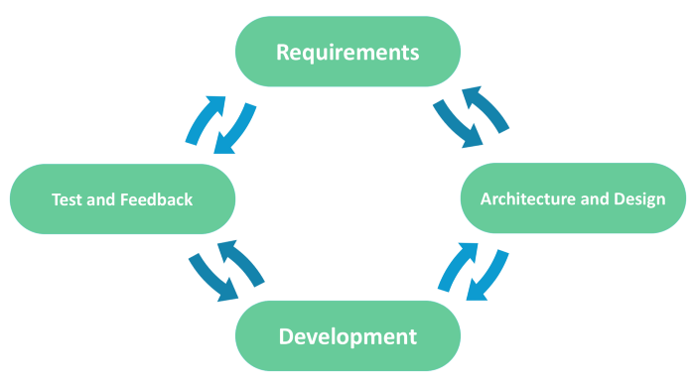
Agile model
Notes:
Agile approaches development requirements and solutions through the collaborative effort of self-organizing and cross-functional teams and their customer(s)/end user(s). They are principles, not methods as such.

Slide 31
Agile models
Scrum
Rapid Application Development (RAD)
Extreme Programming (XP)
Adaptive Software Development (ASD)
Feature Driven Development (FDD)
Crystal Clear
Dynamic Software Development Method (DSDM)
Rational Unified Process (RUP)

Slide 32
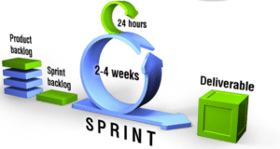
Scrum
Scrum, like all of the agile models, is both iterative and incremental.
Scrum encourages teams to learn through experiences, self-organizing while working on a problem, and reflect on their wins and losses to continuously improve.

Slide 33
Scrum
Prioritized wish list called a product backlog -- a placeholder for all the future development
During planning stage, decides how to implement the top chunk called a sprint backlog
The team is given a certain amount of time, called a sprint, to complete its work
The team meets each day to assess the progress
2-4 weeks work is ready to hand to a customer
The sprint ends with a sprint review
The next sprint then begins (based on customer input)

Slide 34
When to use Agile?
Dynamic users -- continuous changes
Can afford to have team and client meetings often
When many changes are sure to be implemented because of the many iterations
Unlike the Waterfall model, it requires only initial planning to start a project
A crazy first year card game project 😃

Slide 35
Investigate the rest yourself
Rapid Application Development (RAD)
Extreme Programming (XP)
Adaptive Software Development (ASD)
Feature Driven Development (FDD)
Crystal Clear
Dynamic Software Development Method (DSDM)
Rational Unify Process (RUP)

