Slide 1
TicTacToe
An overview of Tic Tac Toe basics.

Slide 2
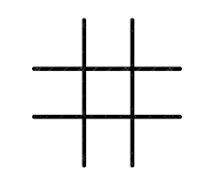
Possible solutions
Tic Tac Toe has 8 possible solution :
[ 0 1 2 ] - Row
[ 3 4 5 ] - Row
[ 6 7 8 ] - Row
[ 0 3 6 ] - Column
[ 1 4 7 ] - Column
[ 2 5 8 ] - Column
[ 0 4 8 ] - Diagonal
[ 2 4 6 ] - Diagonal
0
1
2
3
4
5
6
7
8

Slide 3
The program should only check for possible solution after the 4th turn. No game can be won before the 5th move.
X
O
X
O

Slide 4
Optimal solution
The program should not check for answers that are impossible.e.g
The top row[ 0 1 2] should not be checked because there are two different values in the possible solutions.
1st column[0 3 6] should be checked because the 1st two values in the possible solution are the same.
The diagonal [ 0 4 8] should not be checked because there is an invalid solution.
The above solutions must be ignored on the following turn.
X
O
X
X
O

Slide 5
Lazy solution
The lazy solution would be to check for all the possible solutions after each turn.the pitfall of this method is that the program will check invalid answers over and over again. The advantage is that it is an easier solution to implement.e.g
The image on the right depicts a position that is a draw. This algorithm would check through 8 possible solution although there is no winning solution.
X
O
X
X
O
X
O

