Slide 1
Medical Inventory Optimization Dataset
Using only SQL queries

Slide 2
EDA / Descriptive Statistics
Medical inventory optimization is a vital component of efficient healthcare management. Within the healthcare industry, the management of supplies, medications, and equipment generates a vast pool of data.
The effective utilization of SQL queries plays a pivotal role in analyzing this data, allowing for comprehensive insights into inventory levels, usage patterns, and supply chain efficiency over time.
Our inventory optimization project revolves around leveraging SQL queries to delve deep into the data, enabling healthcare providers to make informed decisions. By scrutinizing inventory databases and transaction records, we aim to streamline inventory management, minimize waste, and ensure adequate supplies are available when required, ultimately enhancing patient care and operational efficiency within healthcare facilities.

Slide 3
Overall design strategy
The total count of this medical inventory optimization dataset is about 14219
The idea is to derive insights from this vast dataset so we can do further analysis.
The plan is to remove all the outlier values and get a data that will be much useful
This dataset is about all the sales and return happened in a pharmacy in the year 2022
USERS –The ones who use this visuals
The OWNER of the drug store : To get a idea on how he should buy the drugs in way there is
No wastage of drugs
Finding the pattern of the drug sales
To find the pattern of his buyers
To plan his next drug delivery to his store

Slide 4
Questions:
Just a overview of the data
How many unique drugs are there in the store?
Top 2 “sub-category ” of the drugs that are popular based of the Total count of every specific drug
how many count of drug was returned back to the drug store
Total revenue generated on the year 2022
Total Net worth of the drugs that was returned
PROCESS OF DATA DUMPING
Creating a database from freedatabasesql.com
Generating the key and password to access the database
Importing the csv format of the dataset into the database and accessing them using SQL queries
Following slides contains the respective questions and their output.

Slide 5
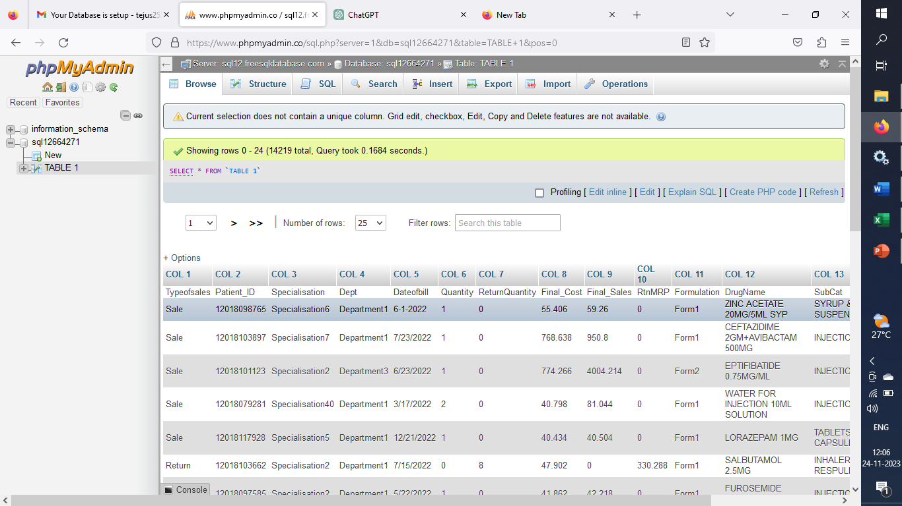
1. To get a overview on the dataset
SELECT * FROM TABLE 1

Slide 6
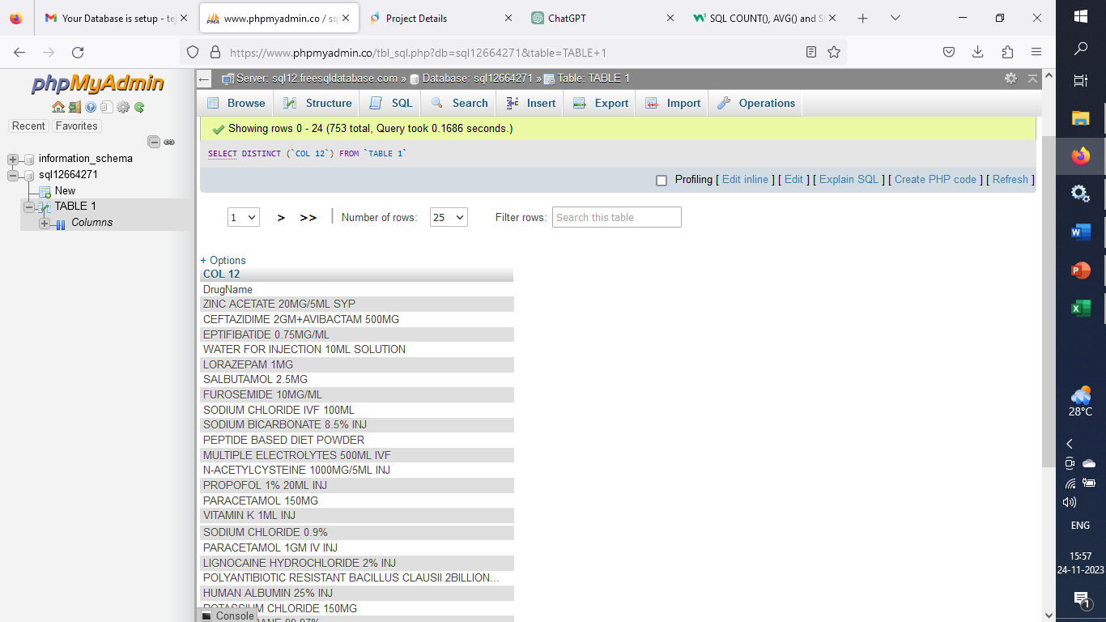
2.How many unique drugs are there?
SELECT DISTINCT (`COL 12`)
FROM `TABLE 1`
23 UNIQUE DRUG NAMES

Slide 7
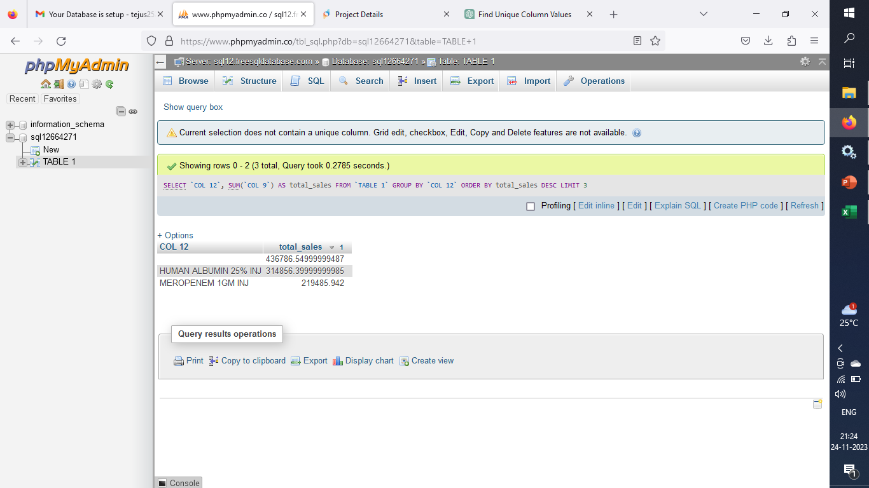
3. Top 2 “sub-category ” of the drugs that are popular based of the Total count of every specific drug
SELECT `COL 12`,
SUM (`COL 9`) AS total_sales FROM `TABLE 1`
GROUP BY `COL 12`
ORDER BY total_sales DESC LIMIT 3;

Slide 8
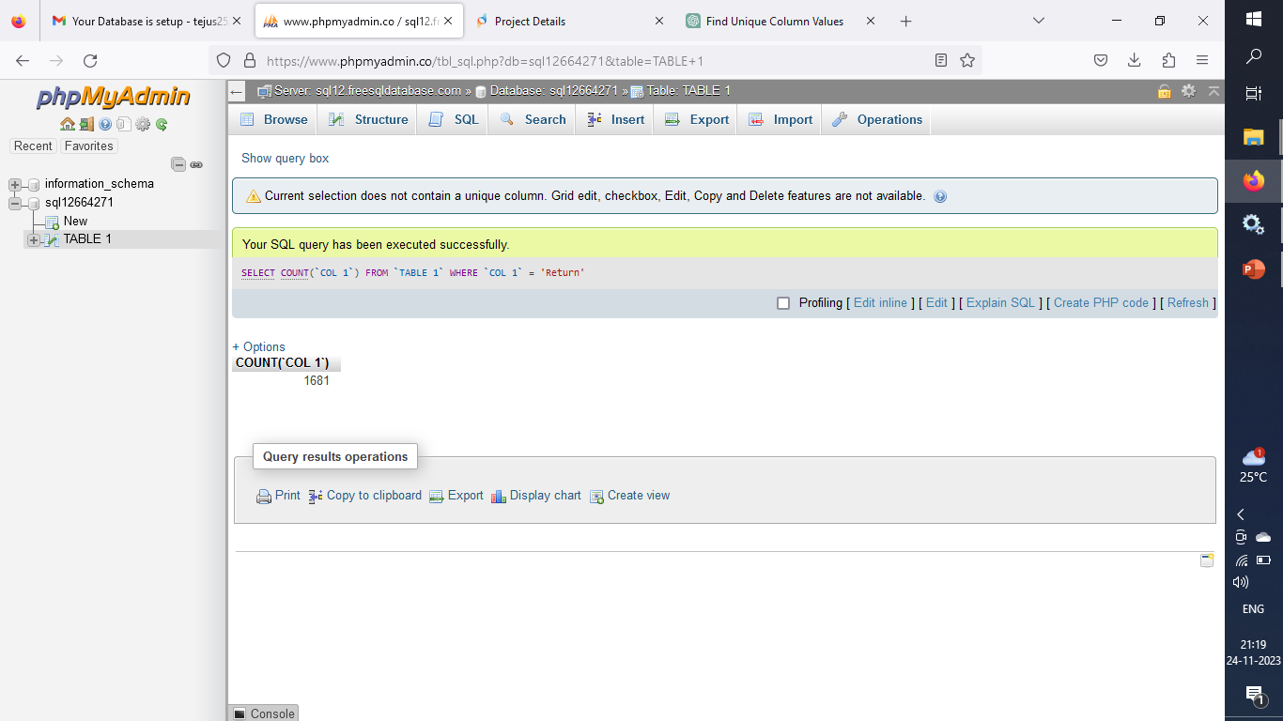
SELECT COUNT(`COL 1`)
FROM `TABLE 1`
WHERE `COL 1` = 'Return'
1681
1681 Is the number of “returns” from the data set
4.Total count of Drug that was returned to the Drug store

Slide 9
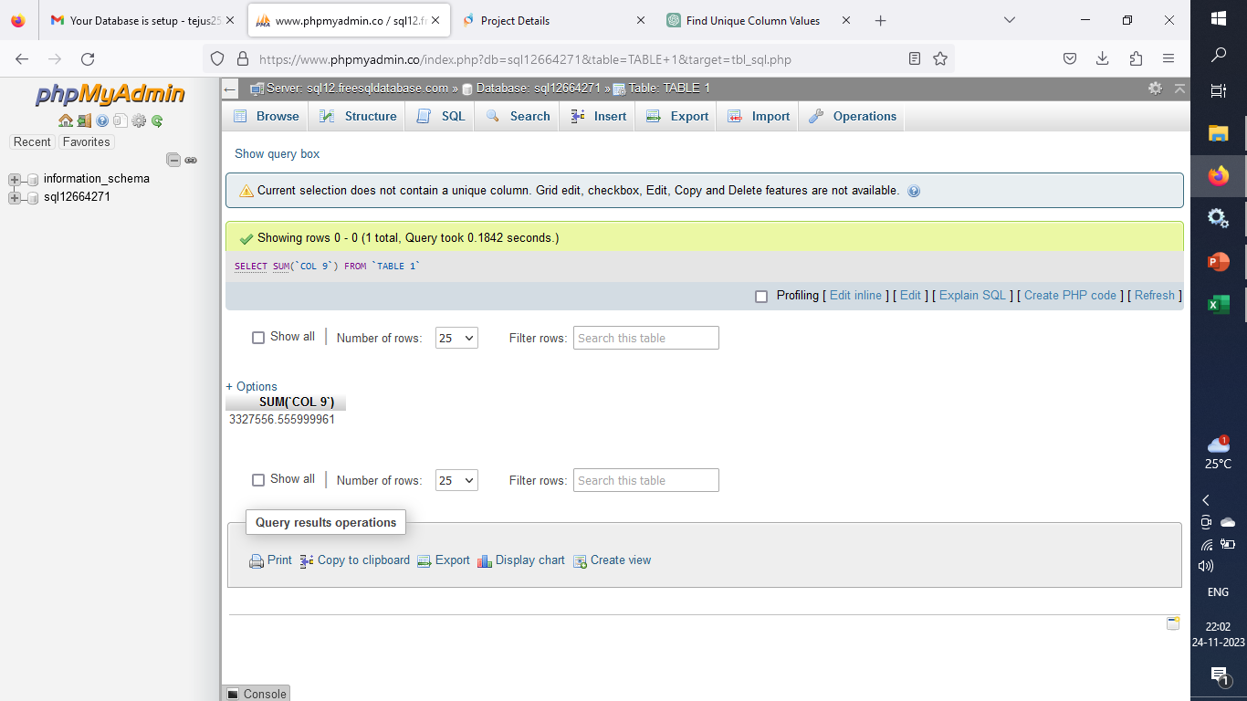
5.Total revenue generated on the year 2022
SELECT SUM(`COL 9`) FROM `TABLE 1
3327556 is the total revenue generated from all the sales in 2022

Slide 10
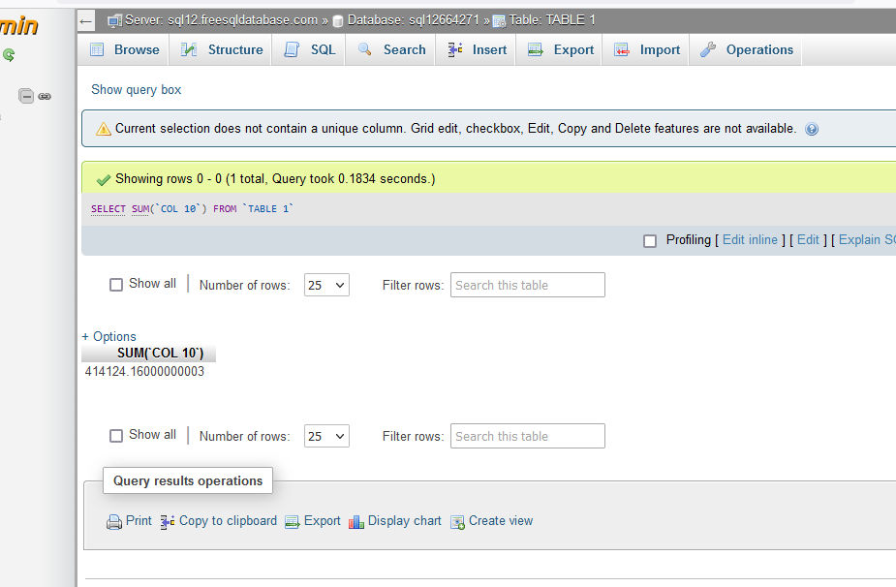
6.Total Net worth of the drugs that was returned
SELECT SUM (`COL 10`) FROM `TABLE 1`;
414124 Is the total amount of revenue generated from all the return items

