Slide 1

LocalFixers
Project guide : Ms. Farha
Submitted by : Vivek Kumar
Batch : 2022-24
Enrollment number : U2249033

Slide 2

Table of contents
Introduction
Problem definition
Motivation
Objectives
Requirements
Data flow diagram
Modules
Diagrams
Testing strategy
Conclusion

Slide 3
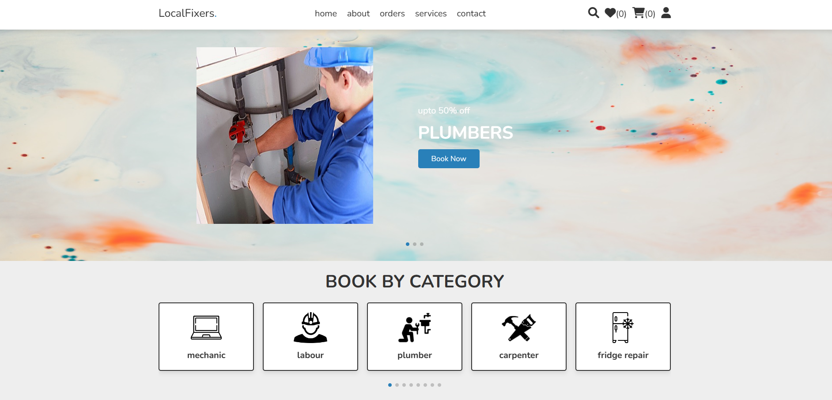
Introduction
LocalFixers is your one-stop destination for finding reliable and trusted local service providers in your community. Whether you’re looking for home improvement professionals, health and wellness experts, technicians, plumbers, etc. LocalFixers makes it effortless to connect with local business that meets everyone’s needs.

Slide 4
Problem definition
Many individuals and businesses in our community require various services, ranging from plumbing and electrical work to landscaping and home cleaning. However, finding trustworthy and reliable local service providers can be a challenging and time consuming task.
In today's digital age, there is a clear need for a dedicated local service provider website to connect consumers with qualified professionals in their area.
The problem at hand revolves around the inefficiency and lack of transparency in the process of finding and hiring local service providers. The existing methods such as word-of-mouth recommendations, random internet searches, or reliance on traditional phone directories often lead to frustrating experiences for both service seekers and providers.

Slide 5
Motivation
Everything is online, and people continuously search for information, whether buying something or communicating with someone. In this instance, having a solid internet presence is critical. As a result, every business has an online presence on numerous social media platforms so that as many people as possible can contact them.
In creating a local service provider website, it aspires to bridge the gap between service seekers and providers, fostering stronger, more vibrant communities while making the process of finding and hiring local services a breeze.

Slide 6
Objective
The objective of creating a local service provider website project is to establish a centralized platform that seamlessly connects residents and businesses with a diverse range of reliable and professional services in their local community.

Slide 7
Features
01
02
03
04
05
06
Comprehensive direcory
Search and filter
User verification
Implement a robust search engine that will allow users to search for service providers by location, service type, ratings, and availability.
Establish a user verification process to verify the authenticity of service providers and seekers, enhancing websites credibility.
Create an extensive database of local service providers, categorizing them by type, location, and specialty to ensure users have access to a wide range of options.
Rating and review
Ensure privacy and security
Monitor and improve
Allow users to submit reviews and ratings for service providers, and display service provider ratings and reviews prominently on their profile.
Prioritize the privacy and security of user data including personal details.
Regularly monitor platform, gather user feedback and make data driven improvements to enhance overaall user experience.

Slide 8
Requirements
Hardware
Software
Processor : Intel Pentium 4 and above
Ram : 1GB or more
Hard disk : 100 MB or more
OS : Windows 7 and above
Server : Django server
Database : Sqlite
Others
Web browser : Google chrome, Microsoft edge

Slide 9
Modules
Services
Admin
Service providers
Service seekers

Slide 10
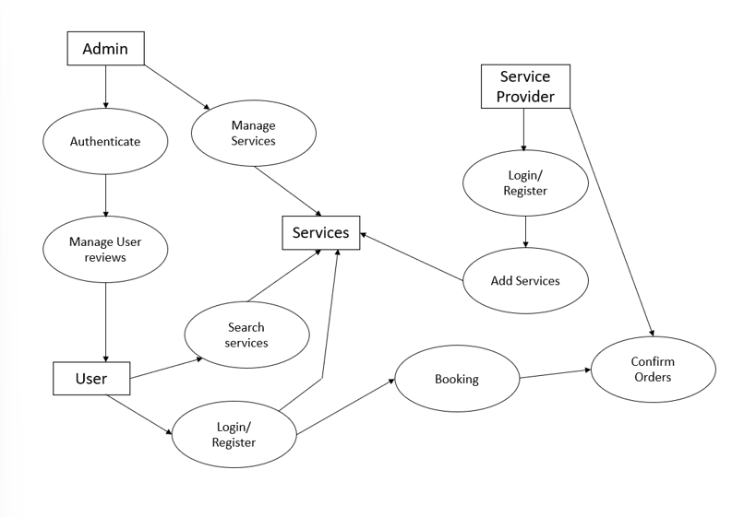
Data flow diagram

Slide 11
Testing strategy
Manual Testing | Manually execute test cases to validate the functionality, usability, and user experience of the website.
Compatibilty testing | Test the website on multiple browsers, devices, and operating systems to ensure consistent performance and appearance.
User acceptance testing | Involve actual users in UAT to validate that the website meets their needs and expectations.
Continuous monitoring | After the website goes live, implement continuous monitoring to detect and address any issues that arise in the production environment.

Slide 12
Conclusion
LocalFixers website represents a significant step forward in enhancing convenience and accessibility for users seeking services in their local areas. This website not only bridges the gap between service providers and users but also fosters local businesses and economic growth within communities.
By implementing a clean and intuitive design, robust functionality, and mobile responsiveness this website will serve as a valuable tool for connecting with current and prospective clients, improving our service delivery, and ultimately achieving business goals.

