Slide 1
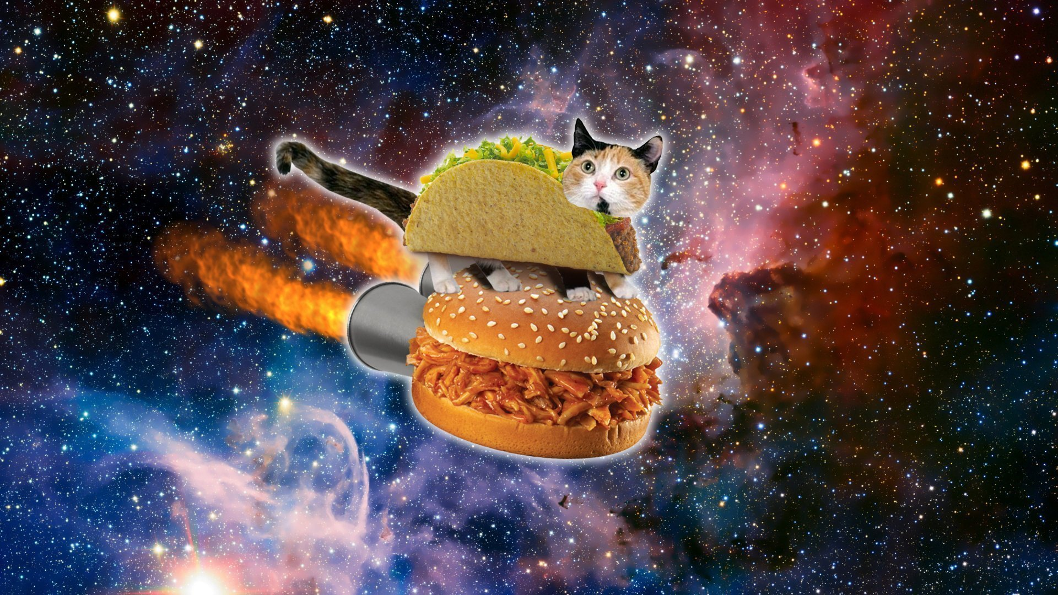

THE BOTLER
The Prime Meridians
[Lat, Kimmi, Kelly, Rene, Dominic]
CPS 298 – Winter 2021
05-03-2021

Slide 2
SCOPE
Discord is a highly dynamic social media platform designed to enhance the user’s experience beyond text conversation. Discord servers host several mechanisms which allow users to interact with each other. As such, it’s necessary for each server to employ the use of an admin team to moderate the chat environment.
Bots are Discord-compatible systems that can automate several administrative and entertainment functions. The Botler will allow admins to automate common moderation tasks and manage tiers of leadership roles. The Botler will also allow users and admins to enjoy various entertainment functions such as trivia games, music streaming services, and random cat pictures.
The Botler is an open source system which can function as a standalone system or be enhanced with additional functionality. It can be determined by the Discord server’s admin team which, if any, additional functions should be added.

Slide 3
FEATURES Music Streaming
FEATURES
Plays music from YouTube and SoundCloud
Songs can be queued, shuffled, or skipped
Can play playlists from YouTube
Can view lyrics while listening to music
Includes cat puns (meowvelous!)
Includes volume controls
MusicSheen can help you invite The Botler to the server
CONSTRAINTS
If you don’t add additional songs to the queue, once the queue is exhausted, the bot will leave the voice channel
Cannot play from other streaming services such as Spotify
Playlist command can only accept playlist URLs from YouTube
Can’t be pet; is a service animal, thank you

Slide 4
FEATURES Random Cat Pictures
FEATURES
Posts random cat pic to server upon user request
What more could we ask for? ☺
CONSTRAINTS
If CatAPI platform is unavailable, The Botler will be unable to post random cat pics
This would be a very sad day ☹

Slide 5
FEATURES Admin Menu
FEATURES
Web-based GUI that allows admins to customize various Botler functions
Links to GitHub repo for The Botler and an “Easter Egg” link to pictures of the developers’ cats
Can enable/disable music streaming, cat pictures, trivia, and auto-ban functions at any time
Can set how many warnings must be issued before a user is automatically banned from the server
Displays custom Discord widget showing who is online in the server
Can manage the list of banned word The Botler monitors the server for
CONSTRAINTS
Other settings cannot be modified via this menu; admins should try to utilize other menus within Discord to make other modifications
The Botler will not provide a link to the Admin Menu; there are instructions on GitHub admins can use to generate the link manually

Slide 6
FEATURES Trivia
FEATURES
Utilizes repository of questions used in the popular game show Jeopardy!
The winner of a game of trivia can enter the !prize command to receive an Easter Egg, which is one picture of a developer’s cat
A help command is available for new users to learn how to play a trivia game
CONSTRAINTS
Players have 30 seconds to respond to a question
Players are responsible for tracking their own scores and deciding when the game ends
Prize command must be manually issued by user; this command can be issued by any user, so the winner is not tracked by The Botler

Slide 7
FEATURES Banned Words / Auto Ban
FEATURES
Allows admins to automatically enforce “clean” or user-friendly language in the server
Can automatically ban users from server if too many banned words are used
CONSTRAINTS
Banned words/phrases must be entered one at a time in the GUI
The Botler does not parse every character in a string, so users could hide banned words by adding characters other than a space to the word

Slide 8
FEATURES Audit Logs
FEATURES
Admins can log deleted messages and edited messages, and it allows admins to view the old and new messages when editing occurs
Admins can log who joins and leaves the server
Admins can log when roles are assigned/unassigned
CONSTRAINTS
When a user leaves the server, the audit logs will not show if this was due to a kick or ban
Does not log when embedded messages are deleted

Slide 9
FEATURES Auto Roles
FEATURES
Automatically assigns roles whenever user joins server
Admins can specify roles to assign as well
CONSTRAINTS
Only one kind of role can be auto-assigned

Slide 10
THE BOTLER DEMO
THIS WILL BE A VIDEO EDITED BY DOMINIC

Slide 11
TECH
Here are the technologies we used for this project:
SHELL: Ubuntu Server via Vultr
LANGUAGES: HTML, CSS, JSON, JavaScript, MySQL, and PHP
PACKAGES: discord.js, node.js, NPM, and PM2
PLATFORMS: Discord

Slide 12
TEAM STRATEGY
All team members had different roles.
Workloads were distributed mostly on a volunteer basis.
WORKFLOW: We collaborated every Monday to update our existing workload, identify new action items, and review existing tasks. During each week, we worked individually or together to work on or complete tasks.
Decisions were made primarily via discussion and vote.
We found that our understanding of functional and nonfunctional requirements, as well as our understanding and use of a Use Case Diagram, helped us immensely during the semester. Studying software development methods and architectural designs was very interesting, but we found these concepts weren't immediately useful for this project. We feel these concepts would be very useful for projects of a larger scope.

Slide 13
TEAM REFLECTION
How were the team dynamics?
We were an organized group, not always the most rigidly or seriously structured, but with lots of time to break the ice and have fun, the environment made us more productive and collaborative. Lat suggested the idea of creating The Botler, which we all liked and enjoyed.
What worked well?
Fun environment, Lat’s soft deadlines, Kimmi’s flow chart and other visual aids, splitting The Botler into manageable, evenly distributed tasks; in general, we had great, professional communication.
What team problems did you encounter and how did you resolve them?
We experienced difficulty debugging individually; resolved errors via partner programming.
What were any lessons learned?
Google is a good friend; having a relaxed environment makes it easier to learn coding; picking up a new language to code something is easier than we realized; version control, in retrospect, is very important and makes the software development process so much more efficient; good leadership structure and energy makes the software development process efficient with momentum

