Slide 1

VLSI Project
Title : Direct Mapped Cache
Group Members:
Guang Yang (260510361) Viola Fang (260498315) Hassan Anwar (260649464) Chao Chen (260649469)
Yan Li (260613055)

Slide 2
Agenda
Design
Main Components
Design Approach
Final Product
Future work

Slide 3
Design
Cache cells are implemented using srams with read and write enable signals.
Each memory line consists of 8 bits of data, a 4-bit tag-memory with valid in and valid out signal.
The address space is 4 bit.
This means the Cache stores data in 16 to 8-bit caches sets, capable of storing 4 machine instructions for a CPU in total.

Slide 4
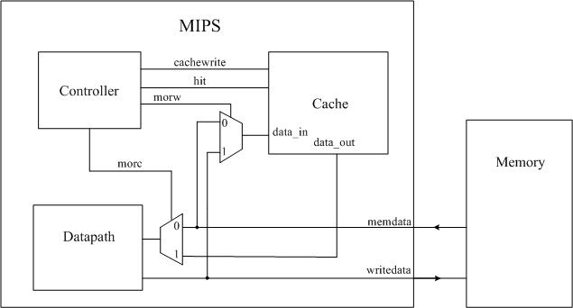
Design

Slide 5
Main components
4-16 bit decoder for cache line selection
Comparator used for tag comparison
AND Gate used to generate for HIT signal generation

Slide 6
Design Approach
Simulation Verification of each component.
        Cache
        Comparator
        controller_pla
        Decoder
        MIPS
        SRAM
Schematic and layout Verification
Spice Verification

Slide 7
Final Product
We have successfully implemented and tested the cache

