Slide 1
ENSC 450: Assignment 2
Barry Yim byim@sfu.ca
Cheng Jie (Jadan) Ou jou@sfu.ca
Bonnie Ha bha20@sfu.ca

Slide 2
Outline
Scope of Presentation:
Perform CMOS logic cell analysis, using HSPICE circuit simulator
Determine the size of internal transistors to yield raise/fall Output Transition Time <100ps
Evaluate the setup and hold time of the Flip-Flop designed considering clock transition time of 100ps.
Methodology Used
Results
Conclusion

Slide 3
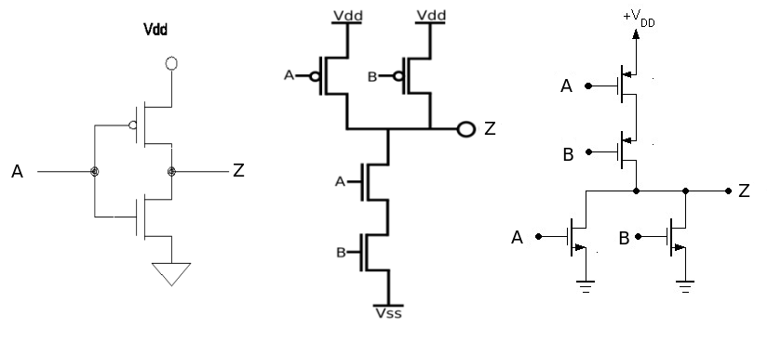
Methodology (1)
Designed simple logic gates using HSPICE
INVERTER
NAND
NOR
Logic of AND gate
Logic of OR gate
Xnand a b d vdd gnd vdds gnds NAND Wn=Wm#
Xinv d z vdd gnd vdds gnds INV Wn=Wm#
Xnor a b d vdd gnd vdds gnds NOR Wn=Wm#
Xinv d z vdd gnd vdds gnds INV Wn=Wm#

Slide 4
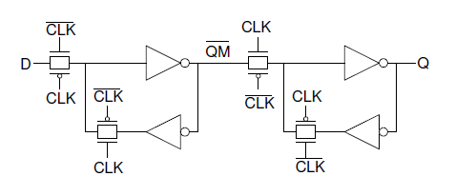
Methodology (2)
Designed a Flip-Flop using logic gates from Methodology 1
Varied size ratio between PMOS and NMOS transistors in order to decrease rise and fall times to below 100ps
Determined the setup time of FF by continuously decreasing the time frame between input transition (D) and clock transition until output (Q) becomes distorted
Pin pointed the hold time of FF by changing the input (D) soon after clock begins to rise, and viewing output to see if desired waveform is produced
Reduced setup time until greater rise/fall transition times were observed
Flip Flop

Slide 5
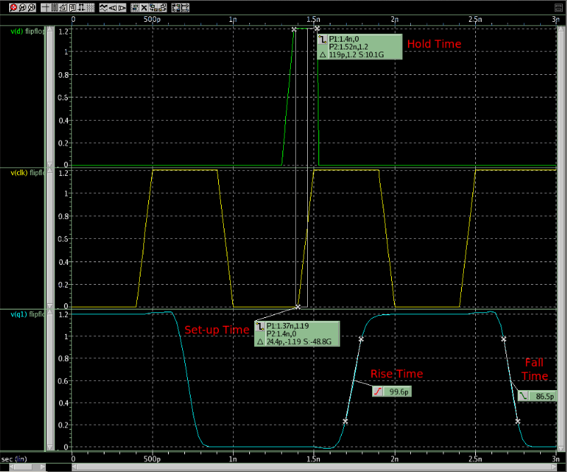
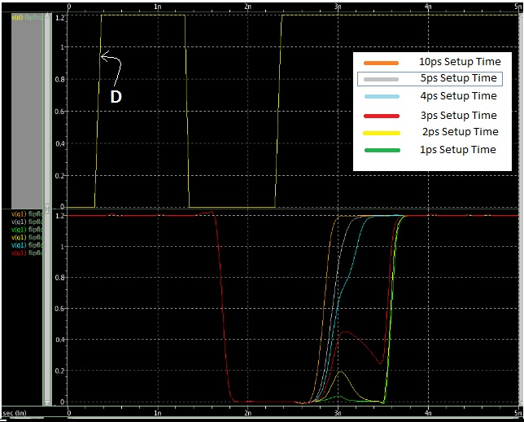
Results
Logic Operation | Number of Transistors
AND | 6
NAND | 4
NOR | 4
OR | 6
INVERTER | 2
Final Results:
Setup Time Waveforms
with Greater Rise Times

Slide 6
Conclusion
Width Ratios of PMOS/NMOS:
30/3
24/6
13/3
13/3
2/1
2/1
2/1
2/1
Rise Time: 99.6ps
Fall Time: 86.5ps
Set-up Time: 25ps
If <25ps, then rise time would increase >100ps
Hold Time: 120ps
If <120ps, then output is distorted

