Slide 1
ENSC 450: Assignment 3
Barry Yim byim@sfu.ca
Cheng Jie (Jadan) Ou jou@sfu.ca
Bonnie Ha bha20@sfu.ca

Slide 2
Outline
Scope of Presentation:
Designed schematics and layouts of an Inverter cell
DRC/LVS Checks operated over layout design
Simulated extracted schematic from layout design
Modified schematic and layout design to have equal rise and fall output transition times
Methodology Used
Results
Conclusion

Slide 3
Methodology
By following the provided Layout Tutorial:
Designed and simulated schematic of Inverter cell with Width(PMOS) = Width(NMOS)
Designed and simulated a DRC-&-LVS-free layout of Inverter cell with Width(PMOS) = Width(NMOS)
Simulated net-lists of schematic and extracted circuits by HSPICE
Since schematic and extract circuits match, modify the PMOS width of one net-list such that rise and fall output transition times are equal
Implemented corresponding changes to schematic and DRC-&-LVS-free layout designs
Simulated new designs
Notes:
Description of the modifications you performed on the layout resulting from Task (1) to meet
Task(2) requirements and (brief) theoretical explanation for such modifications

Slide 4
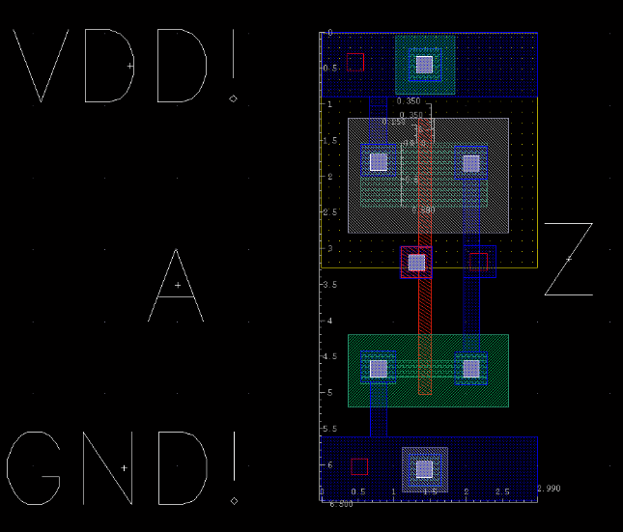
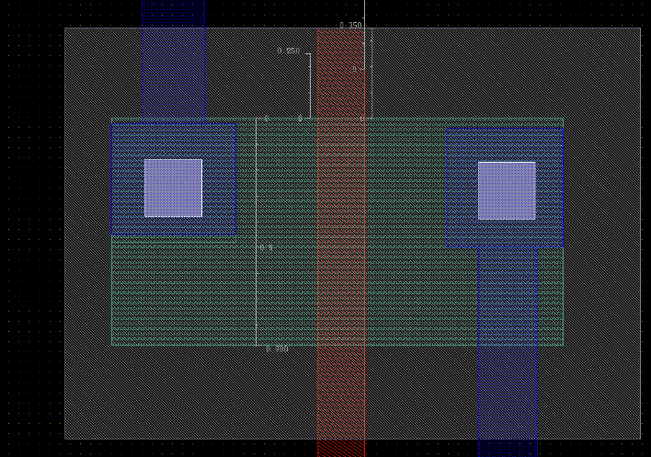
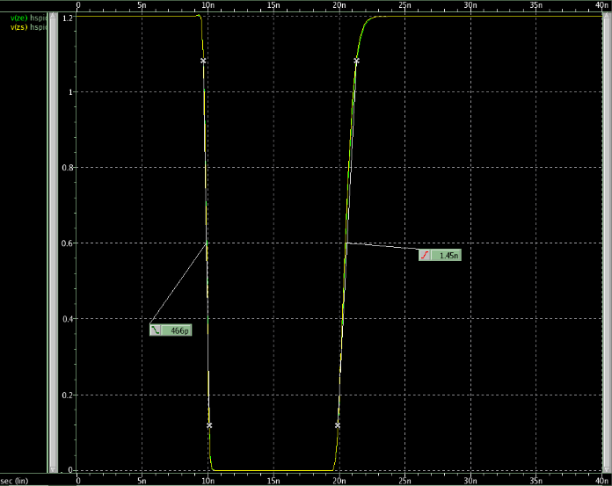
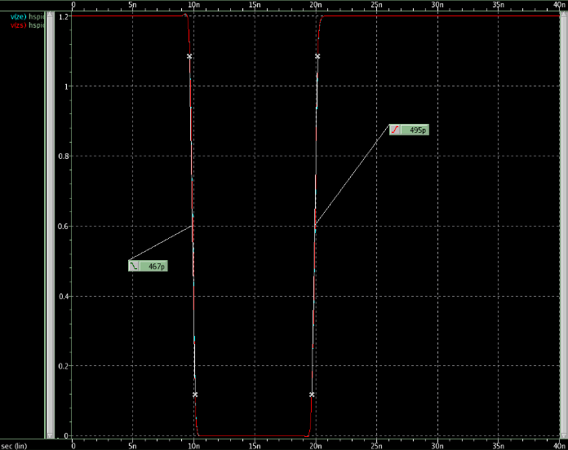
Results
Screen capture of final layout
Final layout showing modifications made
Spice Simulations Waveform (post layout) Task 1 | Spice Simulations Waveform (post layout) Task 2
Notes:
Screen capture of the final layout picture (Clearly showing the modifications described above)
Add two spice simulation waveforms (post layout) for task 1 and task 2
Possibly showing the two V(z) on the same panel

Slide 5
Results (2)
 | Task 1 |  | Task 2
 | Simulated | Extracted | Simulated | Extracted
Area | 9.0087um |  | 11.8854um
Propagation Delay of Rise Time | 0.97091ns | 0.99032ns | 0.43791ns | 0.4212ns
Propagation Delay of Fall Time | 0.40215ns | 0.40826ns | 0.41639ns | 0.42190ns
Total Rise Time | 1.3936ns | 1.4404ns | 0.48308ns | 0.48919ns
Total Fall Time | 0.45432ns | 0.46275ns | 0.45759ns | 0.46181ns
Notes:
One table showing differences between the two circuits of task (1) and (2) in terms of Area,
Propagation Delay and Output transition time for both Raise and Falling edge

Slide 6
Conclusion
Modified the PMOS width to 880nm, from task(1) design of 220nm
On schematic, adjusted PMOS properties to W=880nm
On layout, stretched active layer of PMOS to W=880nm
To not violate any design rules, stretch Pplus layer such that Pplus-Extension-Over-Channel W≥ 350ns
Since PMOS is used as a Pull-Up network, it determines the rise transition time of our inverter.
We increased the width of the PMOS in order to decrease it’s rise transition time because PMOS transistors rely on hole mobility which is slower than electron mobility.
Thus PMOS must be wider in order to provide the same current. With a width of 4 times the width of the NMOS, the difference between our fall and rise transition times from both the extracted and simulated netlists is ~6%.

