Slide 1
ENSC 450: Assignment 5
Barry Yim byim@sfu.ca
Cheng Jie (Jadan) Ou jou@sfu.ca
Bonnie Ha bha20@sfu.ca

Slide 2
Outline
Scope of Presentation:
Built 6TSRAM subcircuit
Instantiate 2 cells: cell 0 and cell 1
Want to write one into cell 0, zero into cell 1, read from cell 0, and read from cell 1
Optimization of criteria for transistor balancing
Methodology
Results
Conclusion

Slide 3
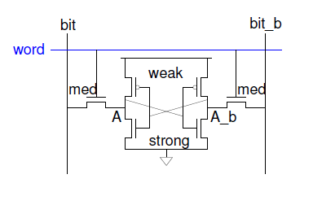
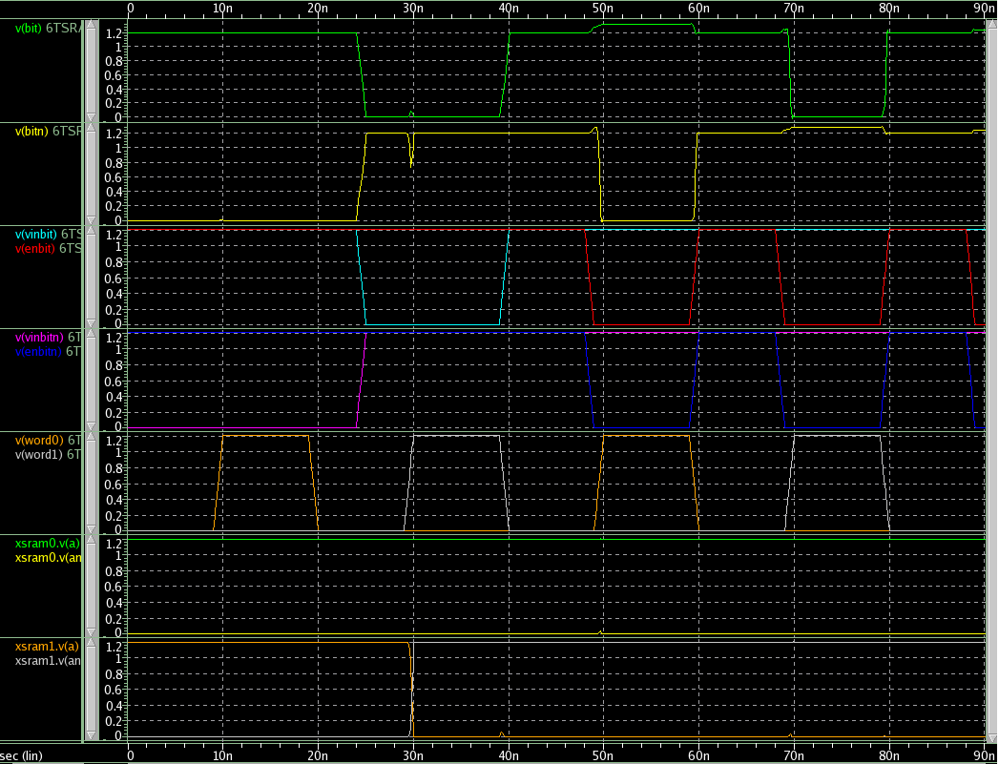
Methodology
Built SRAM using 6 transistors with PMOS having width 2*Wm and NMOS having width Wm
Instantiated 2 SRAM subcircuit: cell 0 and cell 1
Want to write one into cell 0, zero into cell 1, read from cell 0, and read from cell 1
Added transmission gates for bitlines in order to control when bitline is an input and when it's an output
Write:
1. Force desired value onto bitline by enabling transmission gate
2. Raise wordline
Read:
1. Pre-charge bitline and bit_b to 1
2. Disable transmission gates
3. Raise wordline
Once the SRAM was able to be correctly written into and read out from (above waveform
diagram) we determined the minimal widths of the transistors.
After the minimal width was determined we moved on to building an extra 6 SRAM cells

Slide 4
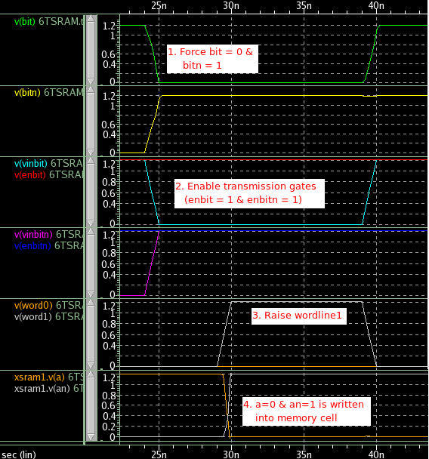
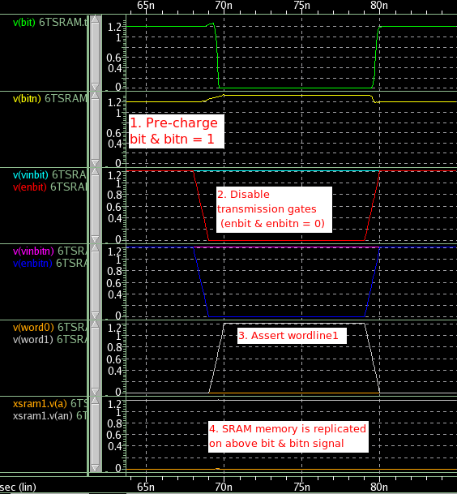
Results
Write 0 into cell 1
Read 0 from cell 1

Slide 5
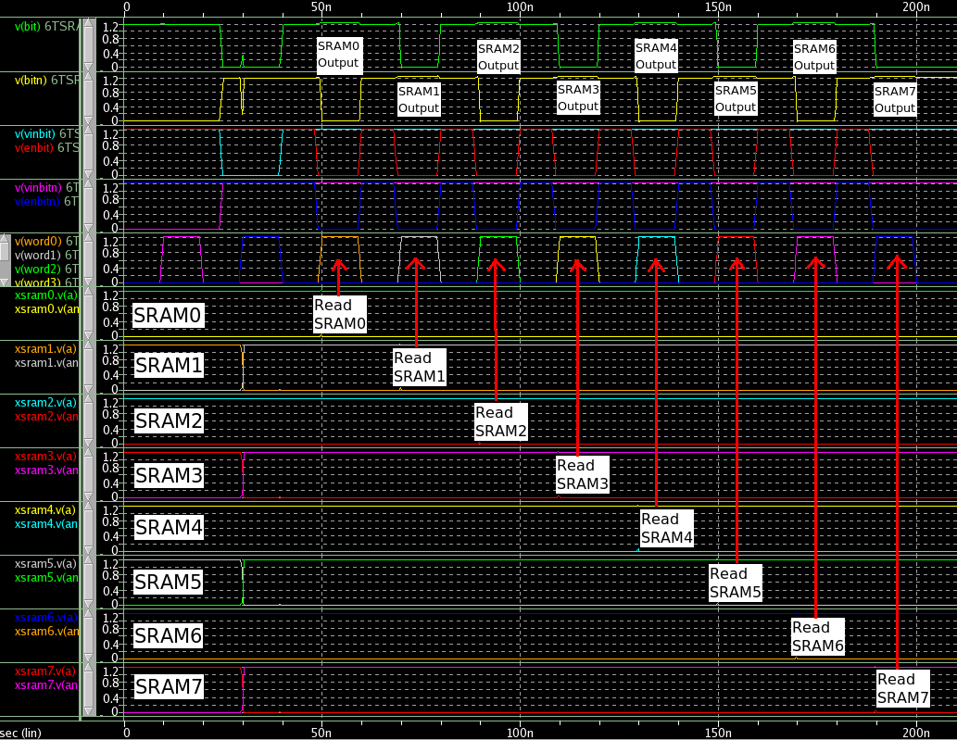
Results (2)

Slide 6
Conclusion
Final area of 8 SRAM cells is 6*8*1 = 48um^2
We decided leave all PMOS and NMOS transistor widths to just Wm
From the diagram below it is evident that this balancing works
With such small areas we can have higher density and lower power consumption in a cell

