Slide 1
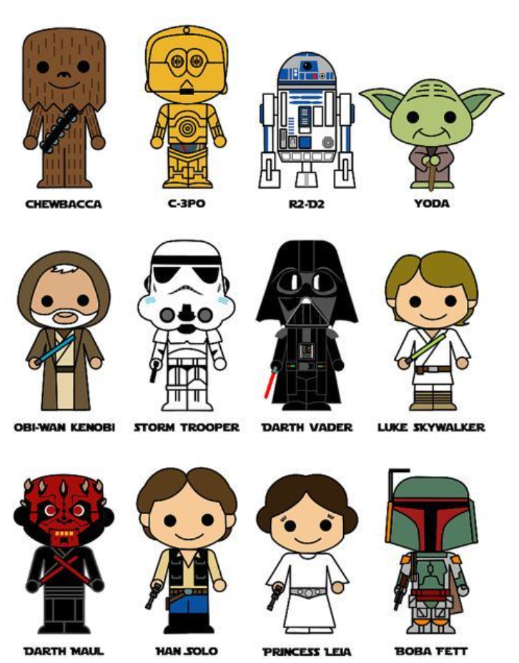
Java Graphics

Slide 2

Drawing Methods
Java has many drawing methods.
  Lines
  Rectangles
  Ovals
  Arcs
  Polygons

Slide 3
The Graphics Screen
0,0
X goes across
800,0
Y
goes
down
0,600
800,600
Notes:
Notice the Graphics screen being used with Graphics class does not use Cartesian coordinates. X goes across and Y goes down. X starts at 0 and goes to MAXX which in this case is 640. Y starts at 0 and goes down to MAXY which in this case is 479.

Slide 4
The Graphics Screen
X goes across
0,0
X=100 y=100
Y
goes
down
width=50 height=50
window.fillOval(100,100,50,50);

Slide 5
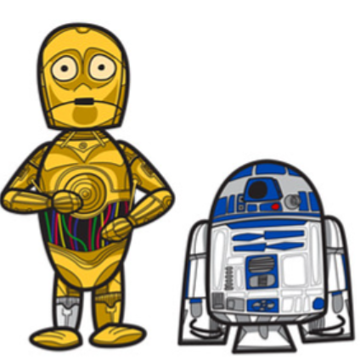
Line
drawLine( x1, y1, x2, y2)
window.drawLine(50,475,150,450);

Slide 6
Rectangle
drawRect(x, y, width, height)
window.drawRect(100,100,150,50);
100,100
250,150

Slide 7
Rectangle
fillRect(x, y, width, height)
window.fillRect(200,400,150,50);

Slide 8

Rounded Rectangle
drawRoundRect(x, y, wd, ht, arw, arh)
window.drawRoundRect(200,200,50,50,20,20);

Slide 9

Rounded Rectangle
fillRoundRect(x, y, wd, ht, arw, arh)
window.fillRoundRect(200,200,50,50,10,10);

Slide 10
Ovals
drawOval( x, y, width, height)
window.drawOval(150,50,75,35);

Slide 11
Ovals
fillOval( x, y, width, height)
window.fillOval(150,50,50,50);
The oval is draw inside of an invisible rectangle.

Slide 12

Arcs
drawArc(x, y, wid, ht, start, length)
window.drawArc(150,300,50,50,0,180);
start states where to start on the unit circle.
The length states how many degrees to go around.
Positive length goes left on the unit circle.

Slide 13

Arcs
drawArc(x, y, wid, ht, start, length)
window.fillArc(150,300,50,50,0,-180);
start states where to start on the unit circle.
The length states how many degrees to go around.
Negative length goes right on the unit circle.

Slide 14
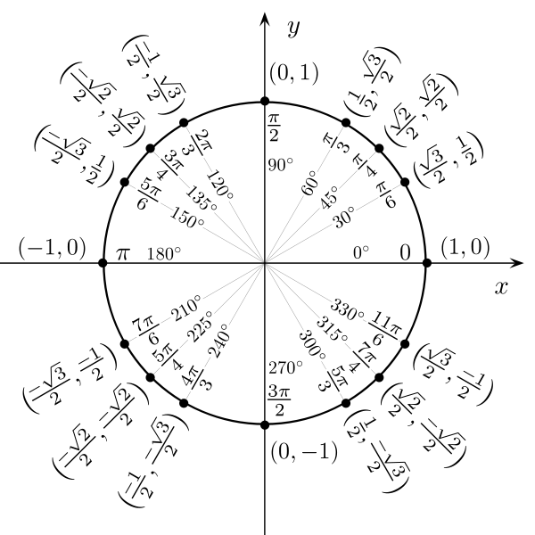
Unit
Circle

Slide 15
Polygon
//pt1 pt2 pt3
int[] xPoints = {200, 300, 100};
int[] yPoints = {100, 200, 200};
Polygon pol;
pol = new Polygon( xPoints, yPoints, 3);
window.drawPolygon( pol );
There is no limit on the number of points.

Slide 16

Polygon
//pt1 pt2 pt3
int[] xPoints = {200, 300, 100};
int[] yPoints = {100, 200, 200};
Polygon pol;
pol = new Polygon( xPoints, yPoints, 3);
window.fillPolygon( pol );

Slide 17

Polygon
new Polygon( xPoints, yPoints, 3);
The 3rd parameter states how many of the points you want to use.

Slide 18

Color
A color is a 3 part parameter
(red, green, blue) - (0-255, 0-255, 0-255)
Red = (255,0,0)
Green = (0,255,0)
Blue = (0,0,255)
White = (255,255,255)
Black = (0,0,0)
Color col = new Color(40,60,100);

Slide 19
Math.random()
//a would be (0 to 9)
int a = (int)(Math.random()*10);
//b would be (20 to 29)
int b = (int)(Math.random()*10)+20;
//c would be (50 to 80)
int c = (int)(Math.random()*51)+30;

Slide 20
Random Colors
int r = (int)(Math.random()*256);
int g = (int)(Math.random()*256);
int b = (int)(Math.random()*256);
Color fred = new Color(r, g, b);
window.setColor(fred);
window.fillRect(50,250,50,50);
Colors require R,G,B values.

Slide 21
Fonts
Font r;
r = new Font("Arial", Font.BOLD, 18);
window.setFont( r );
There are lots of fonts you can use.

Slide 22
Canvas
public class DrawingLines extends Canvas
{
public DrawingLines ()
{
setBackground(Color.WHITE);
}
public void paint( Graphics window )
{
window.drawString("Drawing Lines ", 50, 40);
window.setColor( Color.GREEN);
window.drawLine(50,175,150,250);
window.setColor( Color.RED);
window.drawLine(250,275,450,300);
}
}
Canvas is where you draw stuff.
All of your drawing code goes in the paint method.

Slide 23
JFrame
public class RunThis extends JFrame
{
private static final int WIDTH = 800;
private static final int HEIGHT = 600;
public RunThis()
{
super("Main Graphics Runner");
setSize(WIDTH,HEIGHT);
getContentPane().add(new DrawingLines() );
setVisible(true);
setDefaultCloseOperation(JFrame.EXIT_ON_CLOSE);
}
public static void main( String args[] )
{
RunThis run = new RunThis();
}
}
JFrame is where you hang each Canvas.
You will always run the RunThis class.

Slide 24
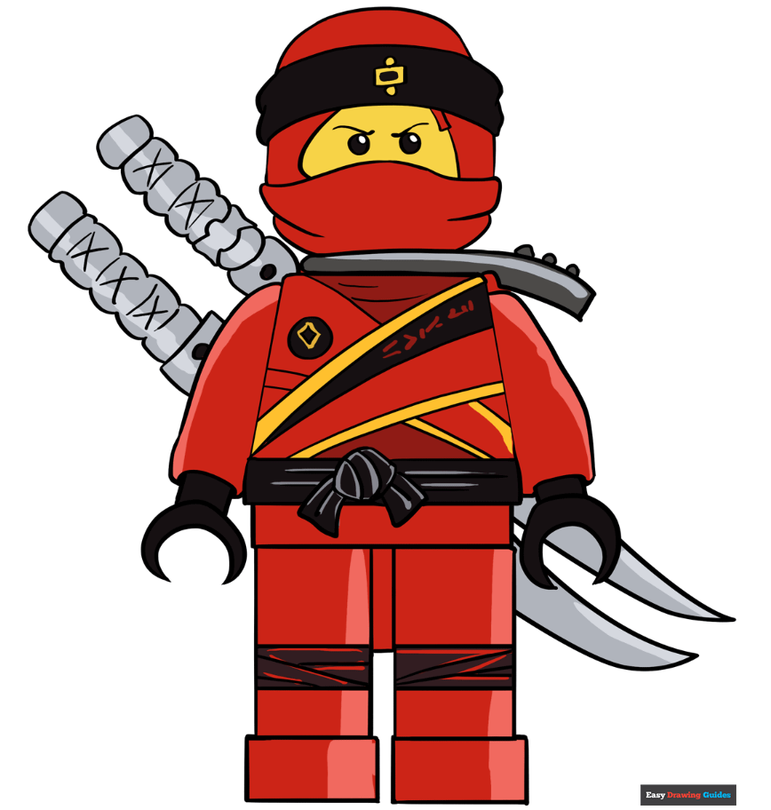
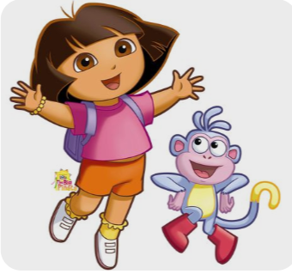
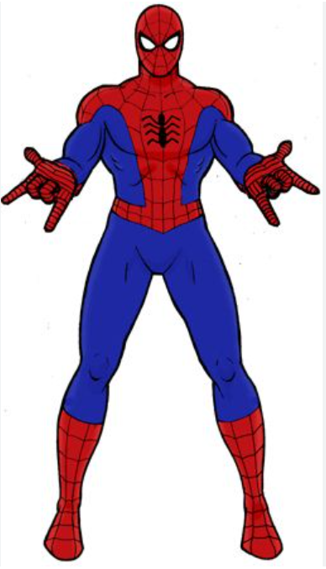


Start
Drawing
Stuff
Draw your picture in Picture.java

Slide 25

Spooky Scene
Draw your Spooky Scene in SpookyScene.java

Slide 26
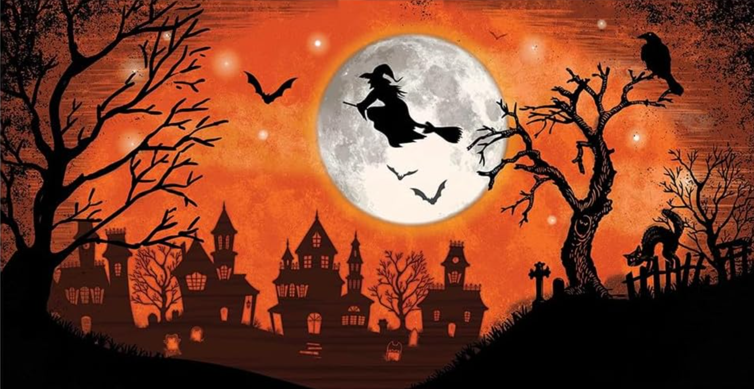
Spooky Scene
Draw your Spooky Scene in SpookyScene.java

Slide 27
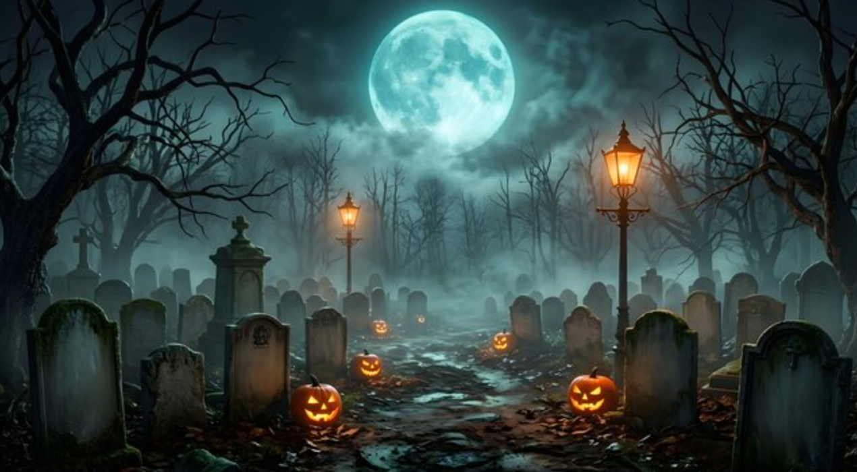
Spooky Scene
Draw your Spooky Scene in SpookyScene.java

