Slide 1
ADAPTIVECACHE
Compacting an AI agent's
working memory:
12 ways to drop old data
What we learned from running 12 strategies on real coding and customer-service tasks.
Vlad Cainamisir · Harvard · AdaptiveCache project

Slide 2
WHAT WE RAN
Six months of compaction experiments, in numbers.
500+
12
15K+
3
agent trajectories
compaction strategies
agent steps recorded
benchmarks
500M+
25+
$200+
100+
input tokens
experimental phases
Anthropic API spend
GPU hours (Blackwell + SEAS + Modal)
Compute · Anthropic Claude Haiku 4.5 (API) · Qwen3-30B-A3B on Blackwell + SEAS cluster + Modal
AdaptiveCache · Vlad Cainamisir · Harvard
2 / 17

Slide 3
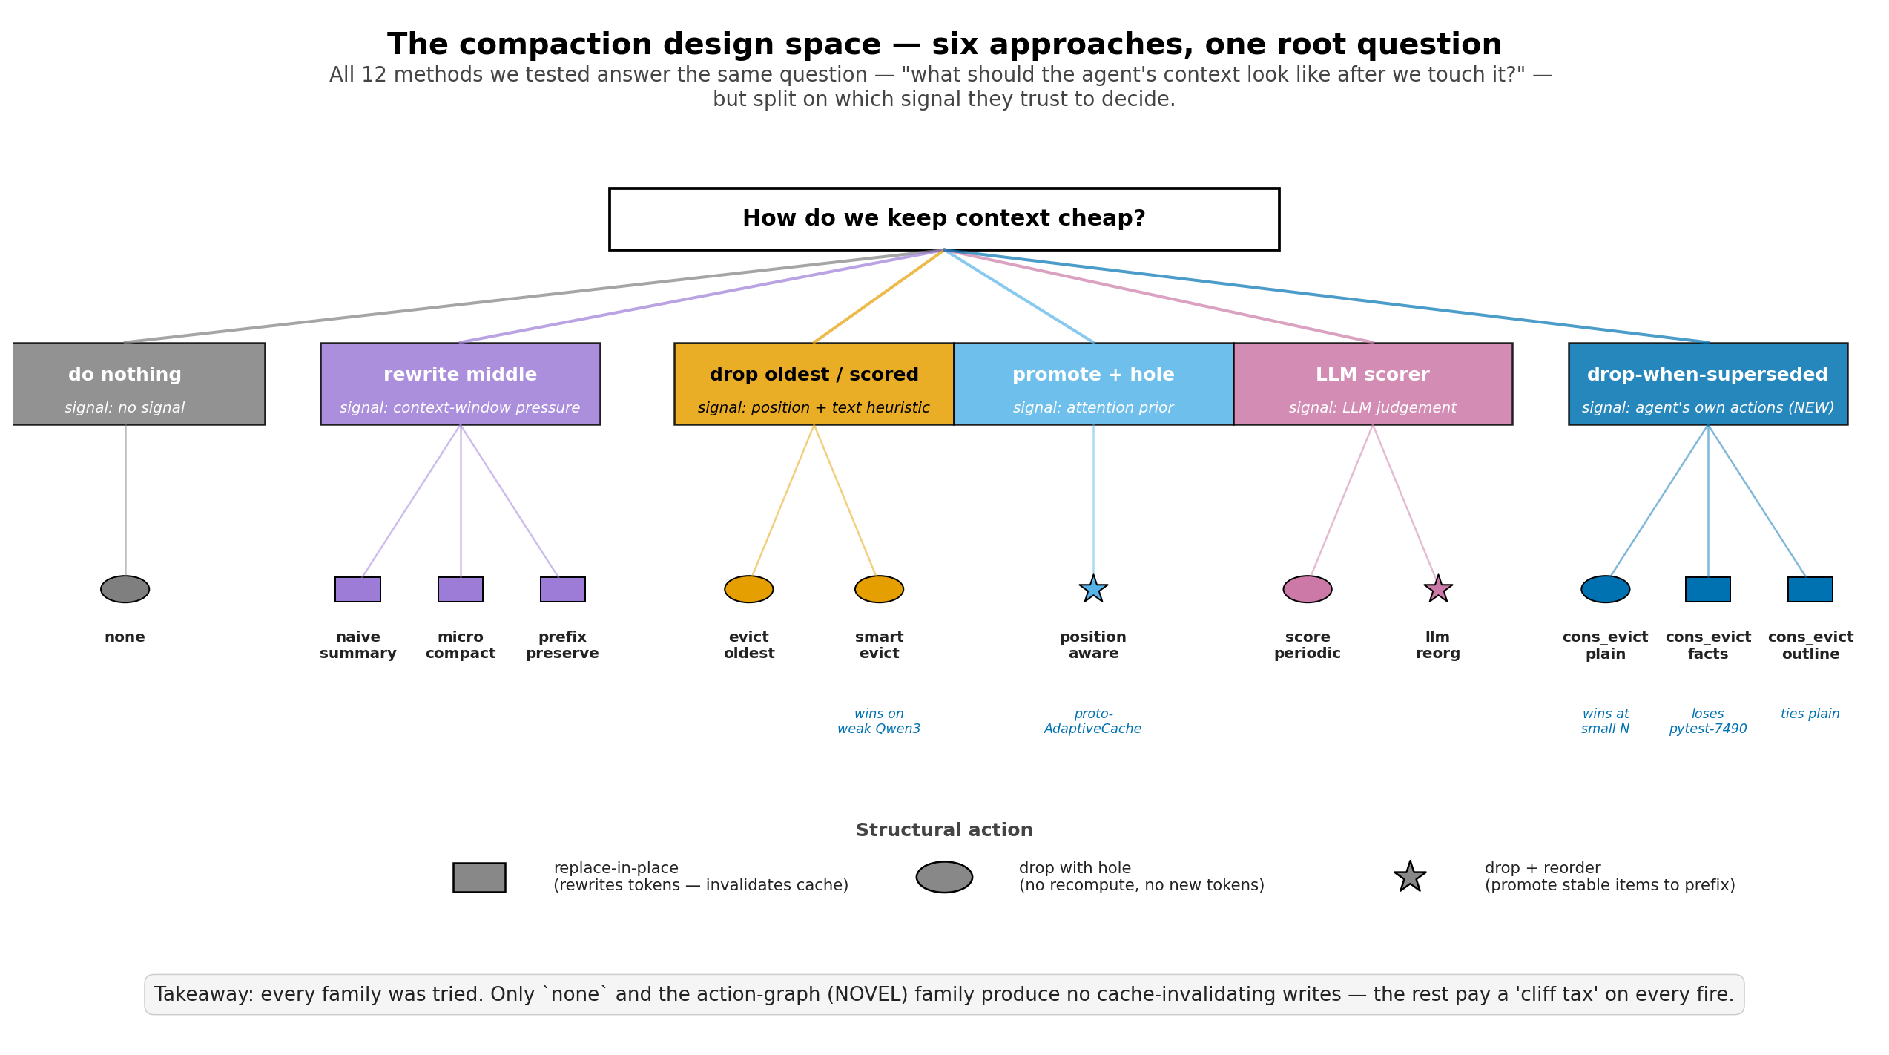
The problem: agent memory grows step by step.
Each tool call (read file, run test, search) adds 100s–1000s of tokens. Eventually we hit the model's limit.
1
Drop old observations
2
Leave a placeholder
3
Pay for the change
Pick which past tool outputs to evict from the running context.
Replace the dropped content with a short marker the agent can still see.
Every rewrite invalidates the prefix cache → input bills uncached at 10× cost.
We tested 12 ways of doing steps 1 + 2. The cost of step 3 decides whether they win.
AdaptiveCache · Vlad Cainamisir · Harvard
3 / 17

Slide 4
The 12 strategies, grouped by family
Six families. They differ on what signal they use to decide which observations to compact.
AdaptiveCache · Vlad Cainamisir · Harvard
4 / 17

Slide 5
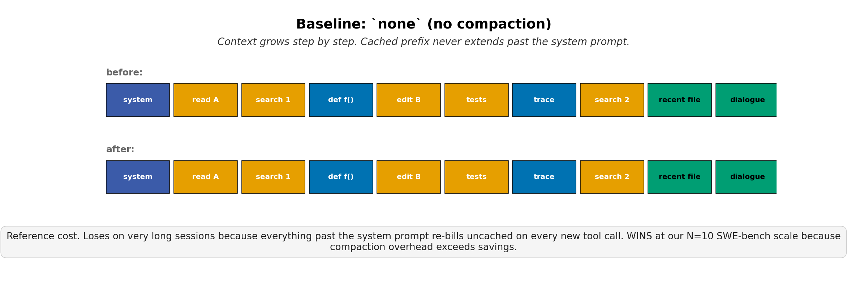
BASELINE
none
Pareto-dominates on N=10 SWE-bench Lite (Haiku 4.5)
84+ trajectories · 20 phases
AdaptiveCache · Vlad Cainamisir · Harvard
5 / 17

Slide 6
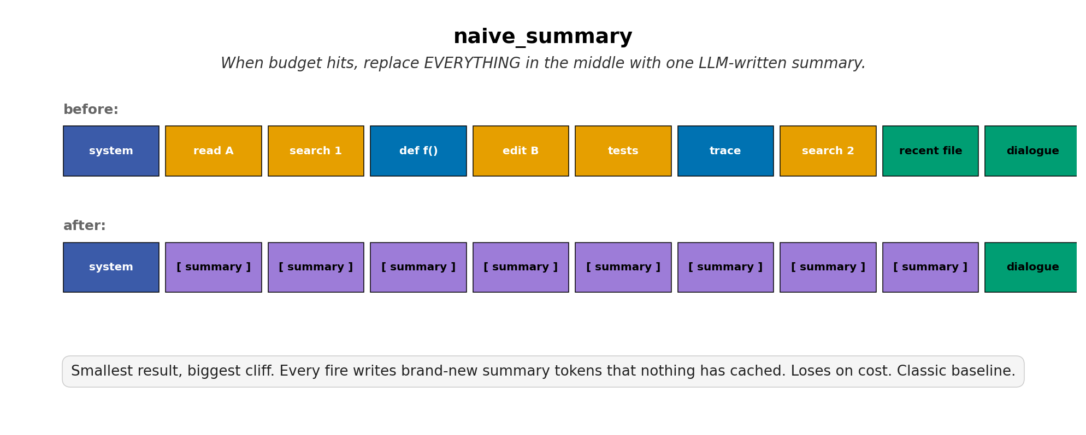
SUMMARIZE
naive_summary
Always loses on cost — every fire writes uncached tokens
tested on τ-bench airline + SWE-bench Lite
AdaptiveCache · Vlad Cainamisir · Harvard
6 / 17

Slide 7
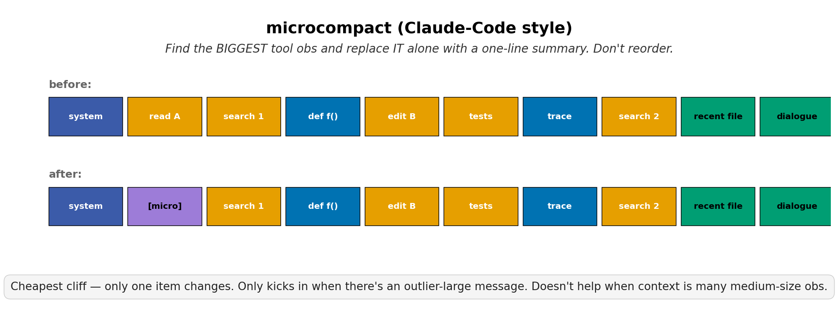
SUMMARIZE
microcompact
Rarely fires — needs an outlier-large observation
10 trajectories · Phase B + C
AdaptiveCache · Vlad Cainamisir · Harvard
7 / 17

Slide 8
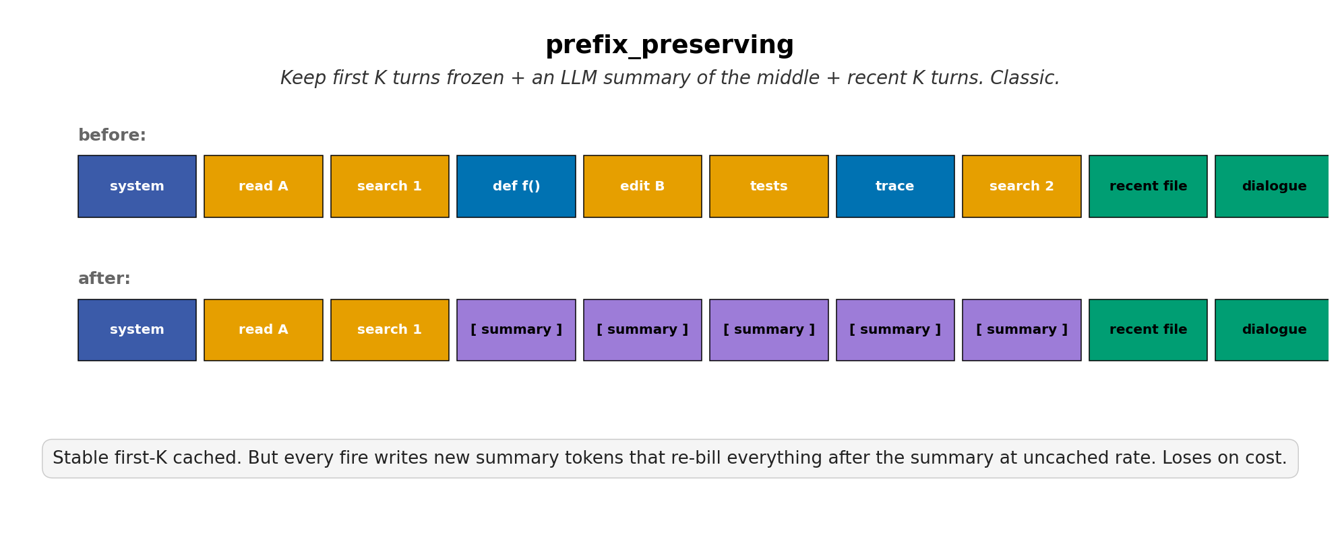
SUMMARIZE
prefix_preserving
Stable cliff cost; loses ~30% on cost vs none
28 trajectories · 7 phases
AdaptiveCache · Vlad Cainamisir · Harvard
8 / 17

Slide 9
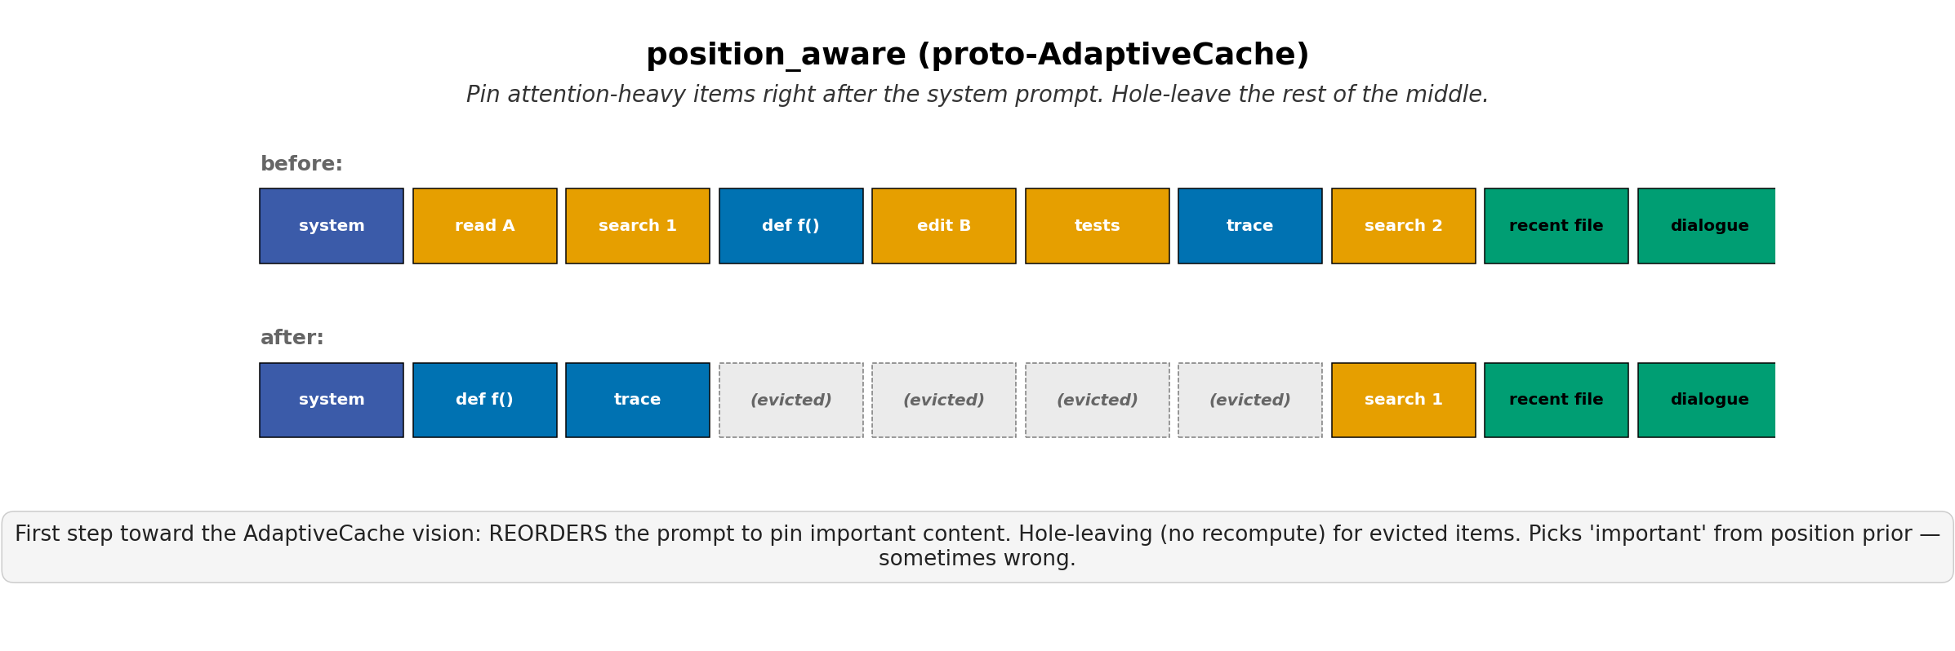
REORDER
position_aware
Proto-AdaptiveCache layout; no cost win at our scale
12 trajectories · Phase A + C
AdaptiveCache · Vlad Cainamisir · Harvard
9 / 17

Slide 10
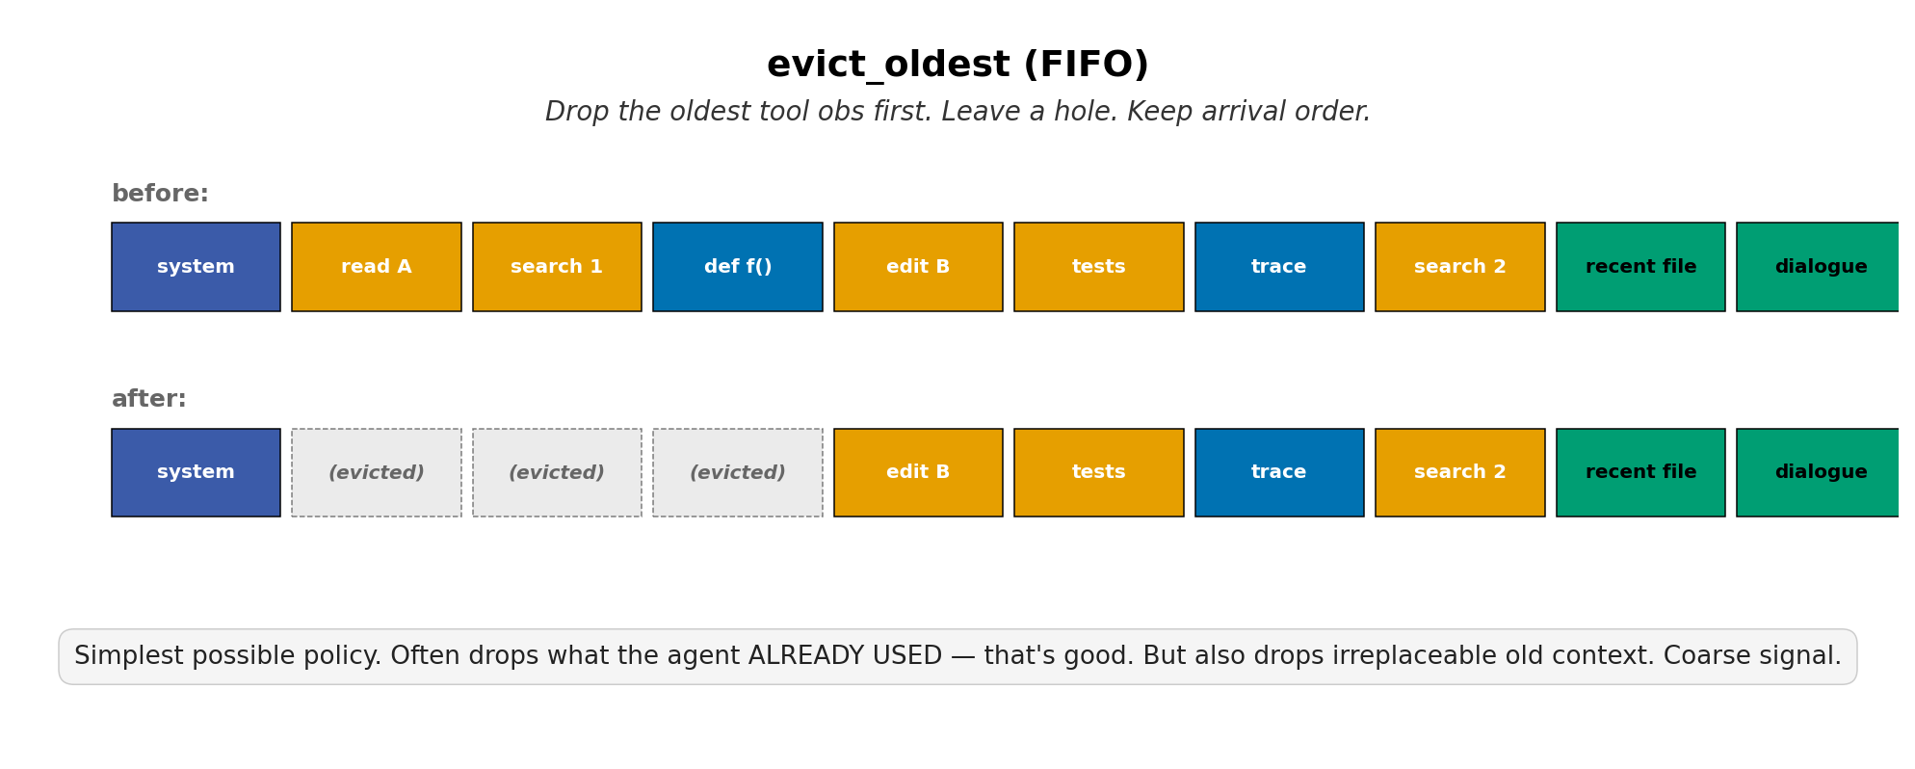
HEURISTIC
evict_oldest
FIFO baseline — drops irreplaceable old context too
6 trajectories · Phase C
AdaptiveCache · Vlad Cainamisir · Harvard
10 / 17

Slide 11
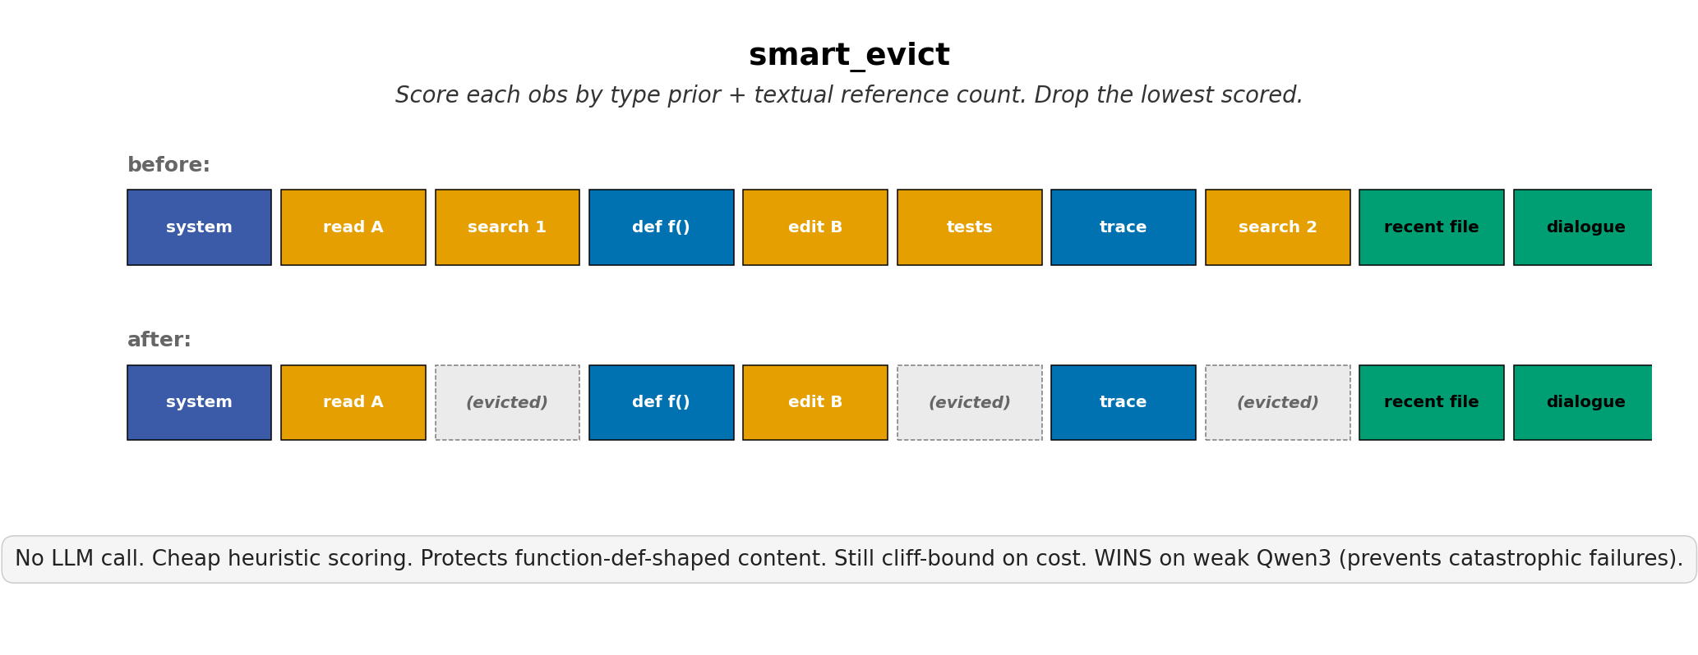
HEURISTIC
smart_evict
WINS on weak Qwen3 — prevents catastrophic OOC failures
59 trajectories · 14 phases
AdaptiveCache · Vlad Cainamisir · Harvard
11 / 17

Slide 12
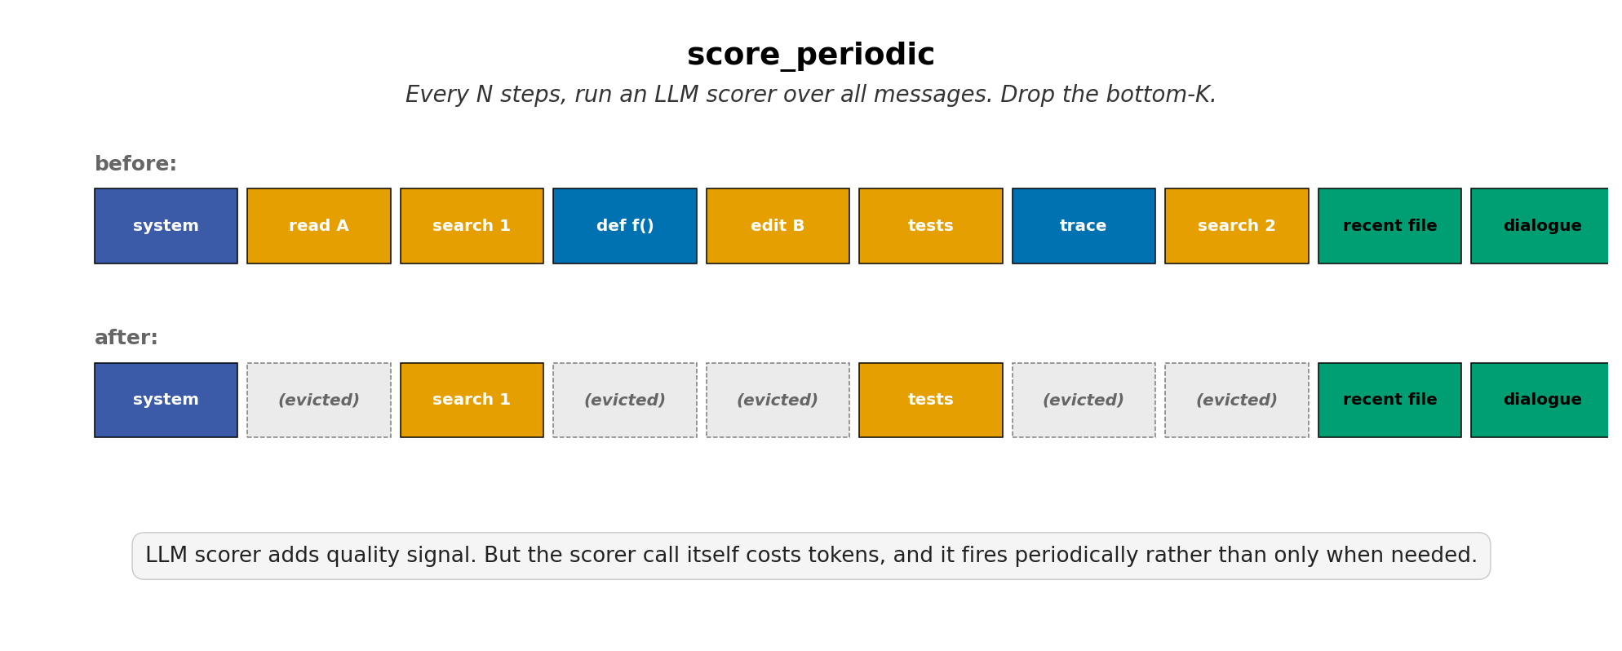
LLM-SCORED
score_periodic
LLM scorer overhead exceeds bytes saved
limited tests · Phase C v8
AdaptiveCache · Vlad Cainamisir · Harvard
12 / 17

Slide 13
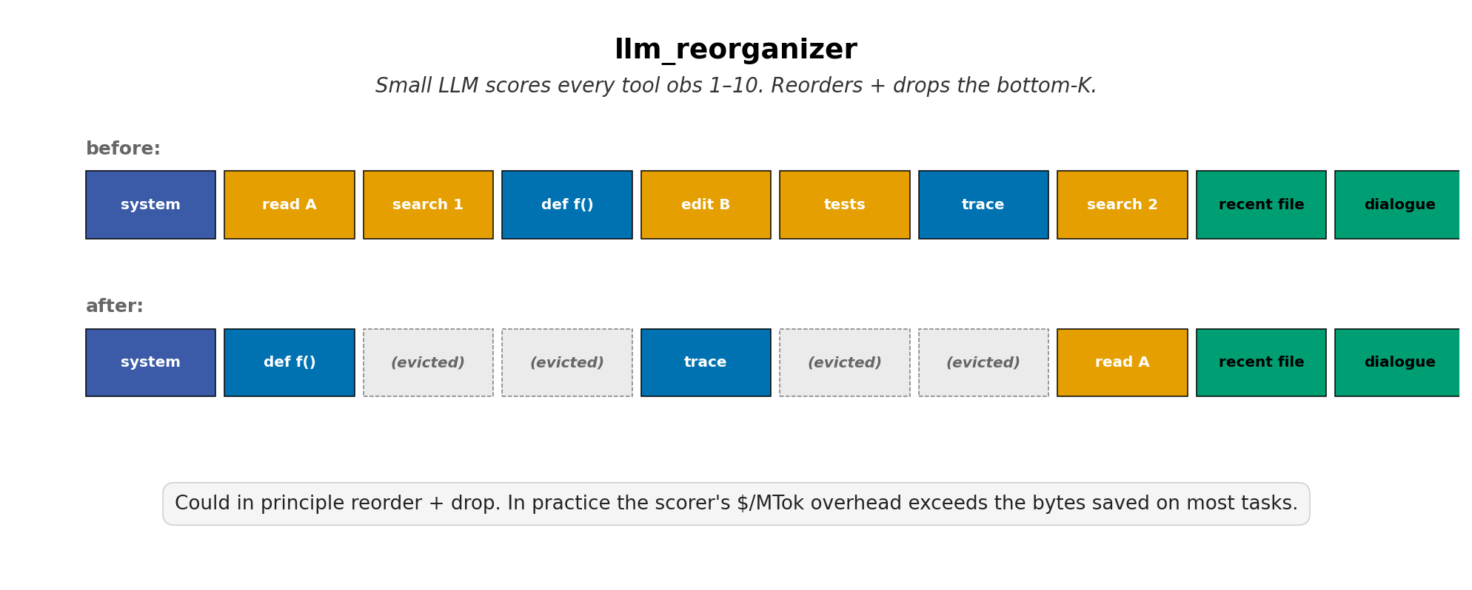
LLM-SCORED
llm_reorganizer
Reorder + score — same overhead problem
30 trajectories · 9 phases
AdaptiveCache · Vlad Cainamisir · Harvard
13 / 17

Slide 14
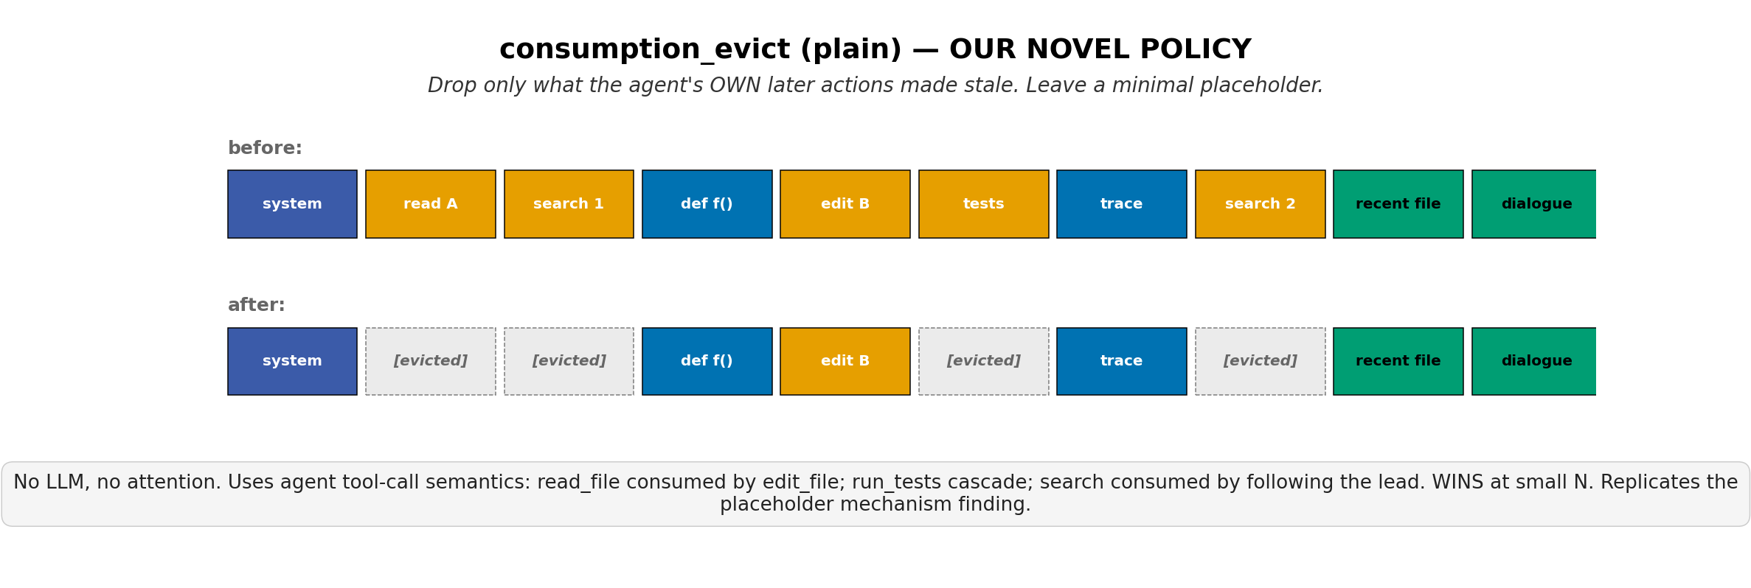
ACTION-GRAPH
consumption_evict_plain
WINS pytest-7490 in 4 edits · ties on retail chain (5/10)
Phase D 2× + Phase E (10 customers)
AdaptiveCache · Vlad Cainamisir · Harvard
14 / 17

Slide 15
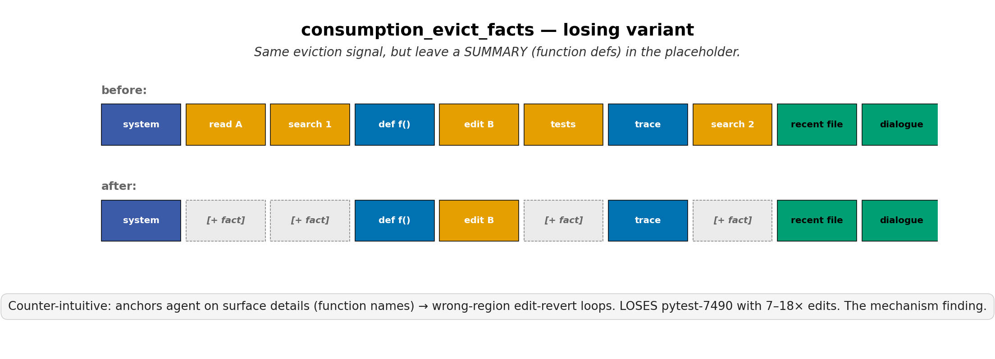
ACTION-GRAPH
consumption_evict_facts
LOSES pytest-7490 — 18 edits, 0/2 success (mechanism finding)
Phase D 2×
AdaptiveCache · Vlad Cainamisir · Harvard
15 / 17

Slide 16
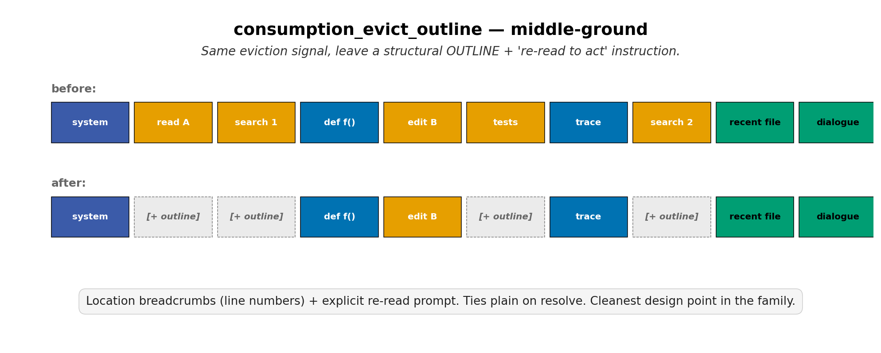
ACTION-GRAPH
consumption_evict_outline
Ties plain on retail chain (5/10) — cleanest design point
Phase E (10 customers)
AdaptiveCache · Vlad Cainamisir · Harvard
16 / 17

Slide 17
WHAT WE LEARNED
What you leave behind
matters more than what you remove.
1. On strong agents, no compaction beats every heuristic — the cliff tax dominates.
2. Drop-with-hole (no rewrite) is the only family that avoids the tax.
3. Placeholder design dominates: minimal markers win, summaries anchor.
4. Compaction wins on weak agents (Qwen3) — preventing context overflow.
Thank you. · github.com/vladcainamisir/adaptivecache
AdaptiveCache · Vlad Cainamisir · Harvard
17 / 17

