Slide 1
Decentralized federated learning through proxy model sharing
Shivam Kalra , Junfeng Wen, Jesse C. Cresswell, Maksims Volkovs,H. R. Tizhoosh
Published on Nature Communications

Slide 2
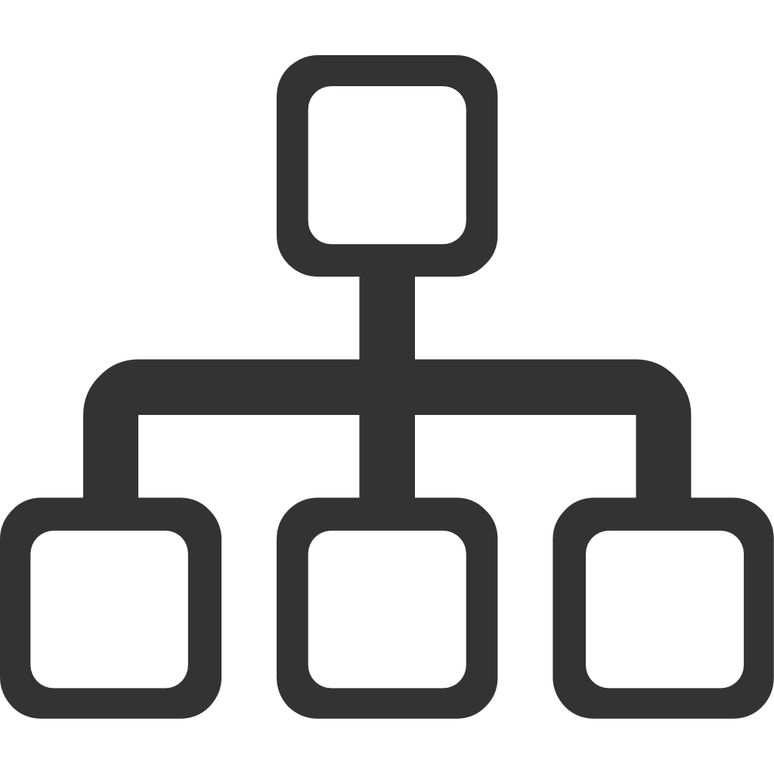
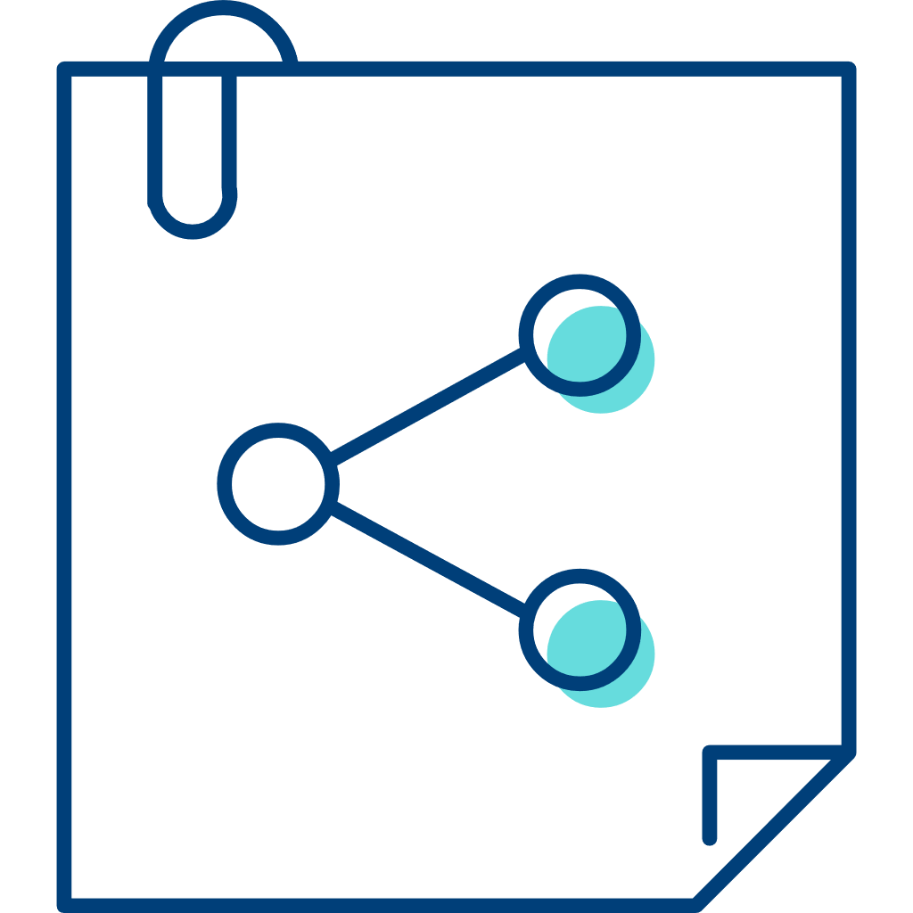




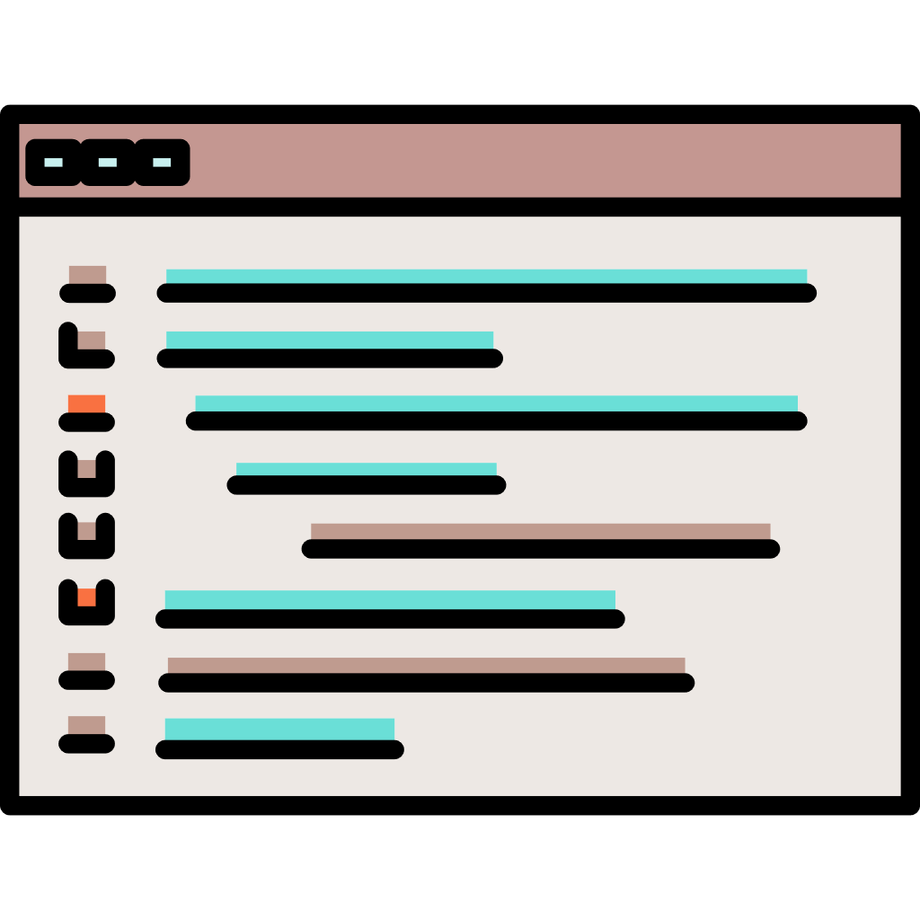

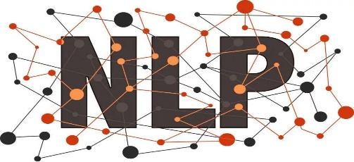


Background
Image classification
Input
Output
Cat
Dog
Natural Language Processing
Large-scale Datasets
Machine Learning
Privacy
The ability to share information between institutions while respecting the data privacy of individuals would need to more secure and accurate models.

Slide 3
In the Healthcare Domain
Because of specializations at institutions and variability across local populations the integration of medical data across multiple institutions is essential.
Data privacy & Regulatory obstacles
Limitations
Centralized machine learning method
Technical challenges including managing
and distributing the data
Secure and Distributed Machine Learning Algorithm
Federated learning (FL) is a distributed learning framework designed to train a model on data that cannot be centralized, without sharing raw data.

Slide 4

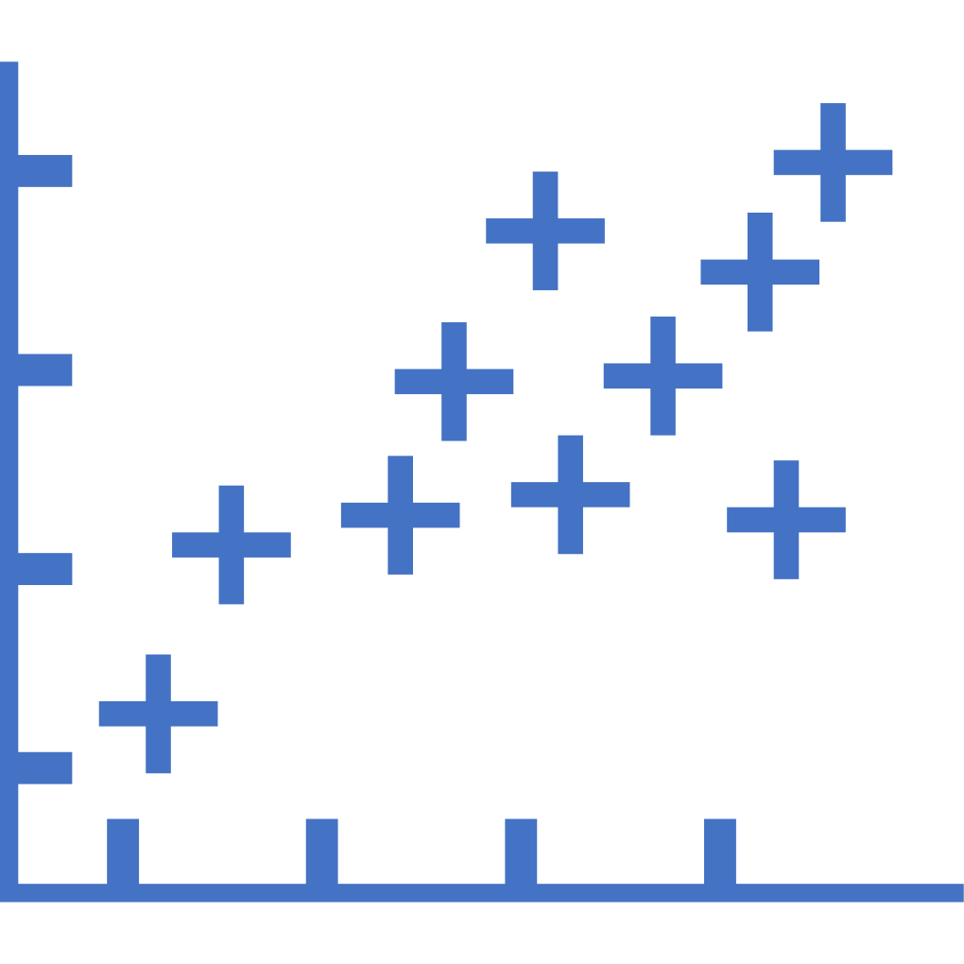


The Challenges of Fedrated Learning
Challenge 1：No Trusted Third-Party
Traditional FL
The centralized FL setting is not suited to the multi-institutional collaboration problem.
Centralized Server
Each hospital may seek autonomy over its own model for regulatory compliance and tailoring to its own specialty.
Aggregated ML Model
updated global gradient
updated global gradient
updated gradient
The decentralized FL frameworks are preferred under such settings.
updated gradient
updated global gradient
updated gradient
Challenge 2：Insufficient Privacy
Institution 1
Institution 2
Institution 3
The centralized server may infer sensitive client data from the updated gradient information.
On the basis of the Federated Learning framework, an enhanced privacy protection mechanism is also needed.

Slide 5
The State-of-the-Art Solution
Solution | Limitation
In Cyclical Weight Transfer (CWT)^{[1]} each client trains a model on local data, then passes that model to the next client in a cyclical fashion. | CWT does not meet strict privacy requirements.
Split learning^{[2]} enables multiple parties to jointly train a single model with a server such that no party controls the entire model. | The additional reliance on a central party for inference is undesirable.
swarm learning^{[3]} applies blockchain technology to promote a decentralized, secure network for collaborative training. | Swarm learning inherits relatively poor model performance when strict privacy measures are applied, and requires homogeneous model architectures.
Federated Mutual Learning (FML)^{[4]} introduces a meme model, which is also trained mutually with each client’s private model. | However, FML is not well-suited to the multi-institutional collaboration setting as it is centralized and provides no privacy guarantee to clients.
[1]Chang, K. et al. Distributed deep learning networks among institu_x0002_tions for medical imaging. J. Am. Med. Inform. Assoc. 25, 945–954 (2018).
[2]Gupta, O. & Raskar, R. Distributed learning of deep neural network over multiple agents. J. Netw. Comput. Appl. 116, 1–8 (2018).
[3]Warnat-Herresthal, S. et al. Swarm learning for decentralized and confidential clinical machine learning. Nature 594, 265–270 (2021).
[4] Shen, T. et al. Federated mutual learning. arXiv https://arxiv.org/abs/2006.16765 (2020).

Slide 6
The Contributions of the ProxyFL
How to solve centralized FL problems and reduce communication costs?
The ProxyFL uses the exponential communication protocol based on Gossip, and uses a scheme called "PushSum" to exchange proxy information between clients, thus effectively reducing the communication overhead.
How to solve the limitation of homogeneous model architectures during the federated learning process?
The ProxyFL using Deep Mutual Learning(DML) which is an approach for mutual knowledge transfer to train a publicly shared proxy model.
How to solve the privacy leakage problem in the federated learning process?
Each participant in ProxyFL maintains two models, a private model, and a publicly shared proxy model designed to protect the participant’s privacy.
The ProxyFL for communication by proxy leads to stronger privacy guarantees using differential privacy analysis.

Slide 7
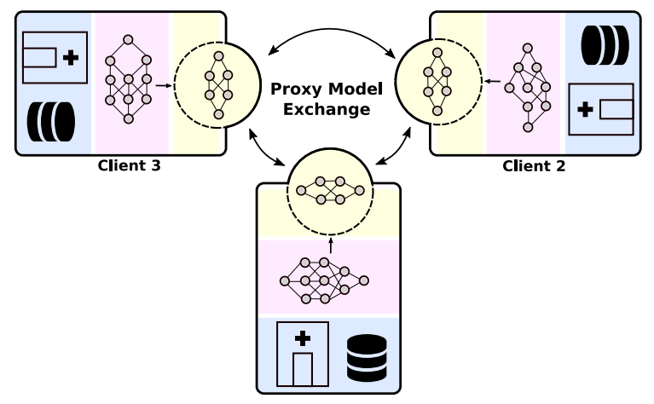
the ProxyFL Method
In this work, the authors propose proxy-based federated learning, or ProxyFL, for decentralized collaboration between institutions which enables training of high-performance and robust models, without sacrificing data privacy or communication efficiency.
Overall view of the proposed ProxyFL
The Workflow of The ProxyFL
In every round of ProxyFL, each client trains its private and proxy models jointly.
The proxy can extract useful information from private data, ready to be shared with other clients based on differential privacy protection.
public shared proxy model
Each client sends its proxy to its out-neighbors and receives new proxies from its in-neighbors according to a communication scheme.
private model
private data
Each client aggregates the proxies they received, and replaces their current proxy.
During distributed training, the client communicates with others only by exchanging their proxy model which enables data and model autonomy. After training, a client’s private model can be used for inference.
The goal is to train the private models collectively so that each generalizes well on the joint data distribution.

Slide 8
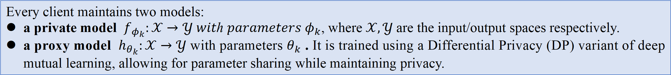
The Private and Proxy Model
Private Model
Proxy Model
The privacy model of each client can be trained by different neural network architectures.
Since Differential Privacy (DP) incurs a loss of utility, the private model to be trained without DP, which is ultimately used for inference by the client locally, tends to have much higher accuracy than otherwise.
The proxy model is trained using a Differential Privacy (DP) variant of Deep Mutual Learning, allowing for parameter sharing while maintaining privacy.
The proxy model is generally smaller than the private model thus reducing communication overhead among clients.

Slide 9
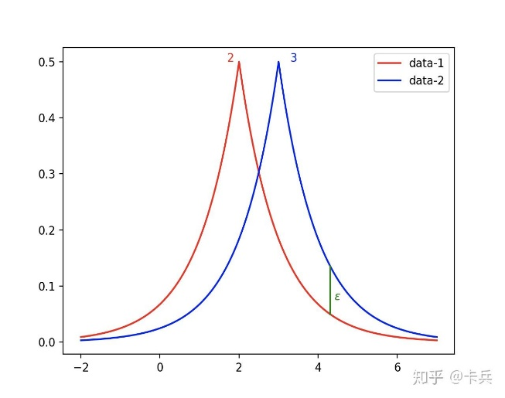
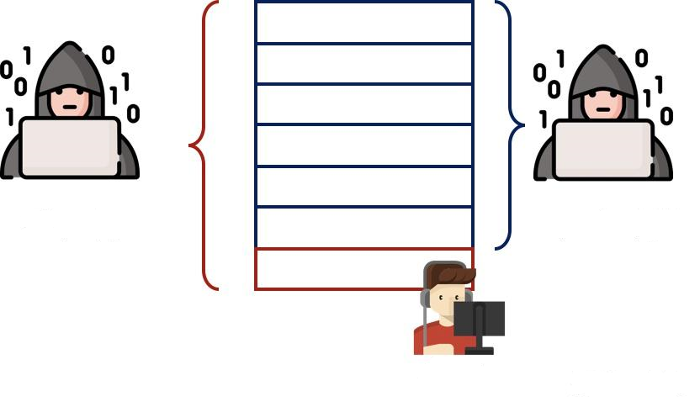
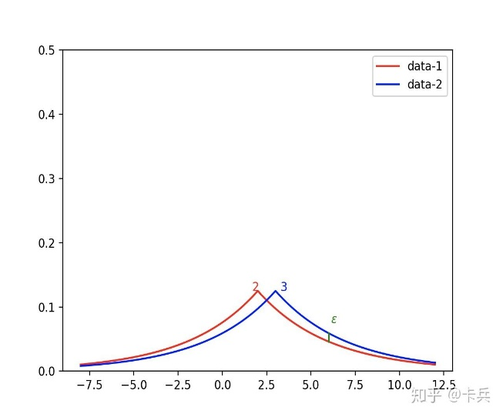

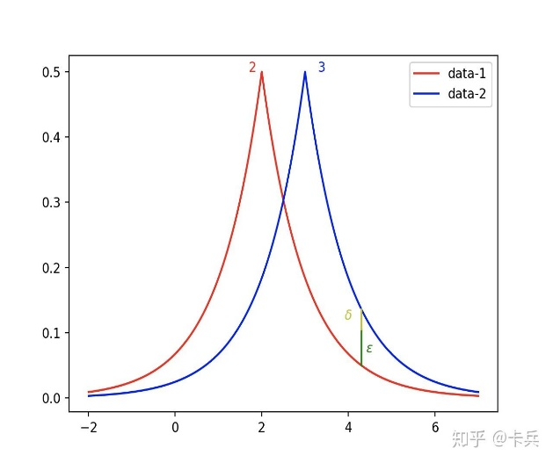
Differential Privacy
Strictly Differential Privacy
Relaxed Differential Privacy (Dwork^{[1]})
3 Singles
2 Singles
In addition to the relaxed Differential Privacy defined here by Dwork, a lot of subsequent work is focused on how to define relaxed differential privacy, such as using Rényi Differential Privacy^{[2]}. The overall goal is to achieve the same level of noise with a smaller privacy budget.
Single
[1]Dwork, C., McSherry, F., Nissim, K., and Smith, A. Calibrating noise to sensitivity in private data analysis. In: Theory of Cryptography,
265–284, Berlin, Heidelberg (2006).
[2]Mironov, I. Rényi differential privacy. 2017 IEEE 30th Computer Security Foundations Symposium (CSF) (2017). https://doi.org/10.1109/csf.2017.11.

Slide 10






Deep Mutual Learning
For concreteness, the paper considers classification tasks. To train the private and proxy models at the start of each round of training, the ProxyFL applys a variant of Deep Mutual Learning (DML). Specifically, when training the private model for client K, in addition to the cross-entropy loss (CE)
DML adds a KL divergence loss (KL)
the private model can also learn from the current proxy model.The objective for learning the private model is given by
where α ∈ (0, 1) balances between the two losses. The objective for the proxy model is similarly defined as

Slide 11
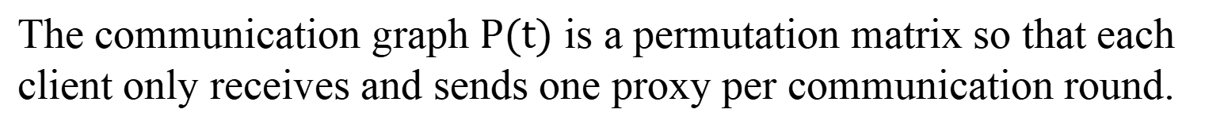
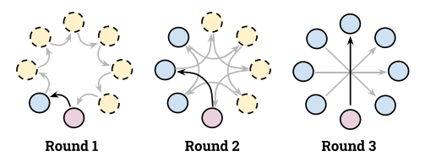
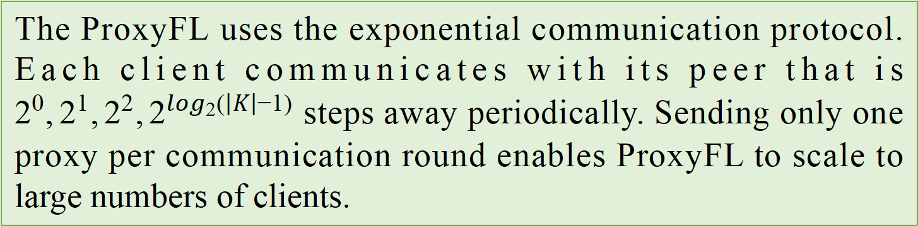
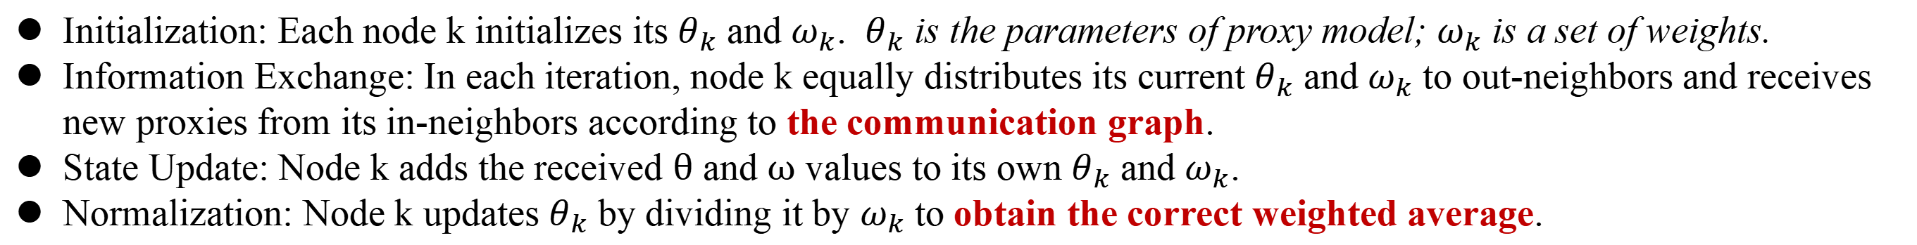
The Communication Scheme
Communication Topology^{[1]}
PushSum Scheme^{[2]}
ProxyFL的通信机制主要利用了一种名为“PushSum”的方案来在客户端之间交换代理信息，从而有效地减少了通信开销。
The ProxyFL's communication mechanism mainly uses a scheme called "PushSum" to exchange proxy information between clients, thus effectively reducing the communication overhead.The detailed steps are as follows:
[1]Assran, M., Loizou, N., Ballas, N., and Rabbat, M. Stochastic gradient push for distributed deep learning. In: International Conference on Machine Learning, 344–353. PMLR (2019).
[2]Nedić, A., Olshevsky, A. & Rabbat, M. G. Network topology and communication-computation tradeoffs in decentralized optimiza_x0002_tion. Proc. IEEE 106, 953–976 (2018).

Slide 12
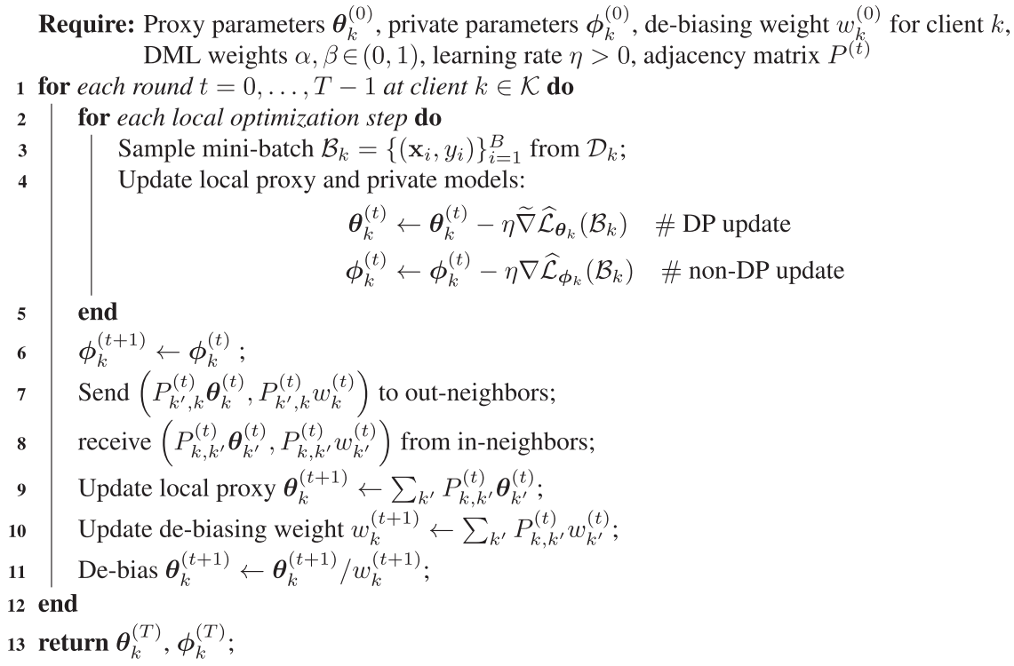
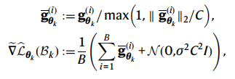
The ProxyFL Algorithm
the per-example gradient is clipped
Gaussian noise is added
The gradient is solved by DP-SGD optimization method
The gradient is solved by SGD optimization method
The aggregated proxy model parameters

Slide 13
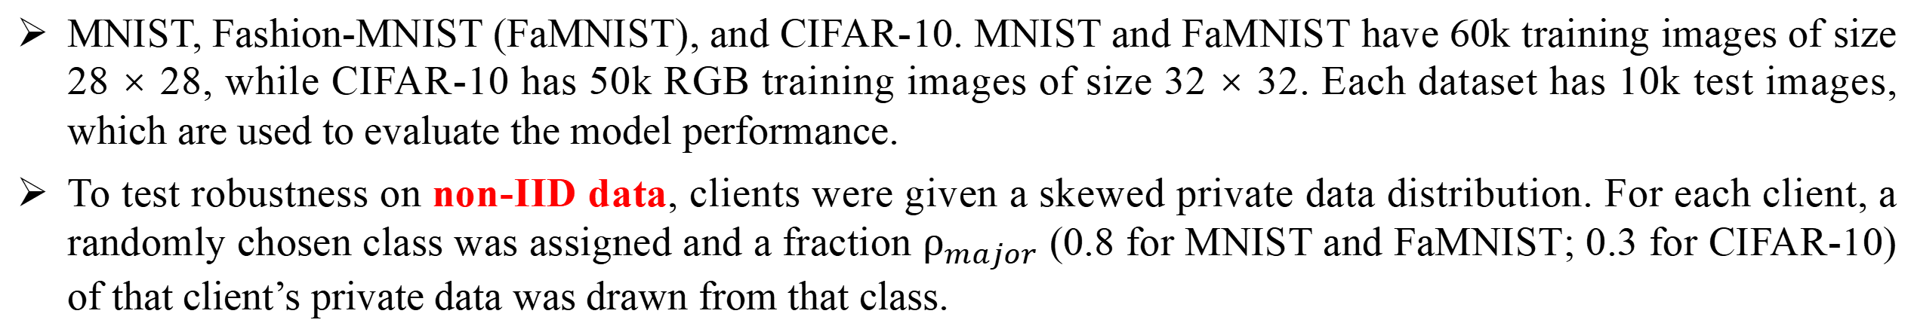
Simulation Testing
Dataset
Baseline
Method | Description
FedAvg | FedAvg is centralized schemes that average models with identical structure.
AvgPush | AvgPush is a decentralized version of FedAvg using PushSum for aggregation.
CWT | CWT is similar to AvgPush, but uses cyclical model passing instead of aggregation.
FML | FML is similar to ProxyFL in that every client has two models, except FML does centralized averaging and originally did not incorporate DP training.
Regular | Regular training uses the local private datasets without any collaboration
Joint training | Joint training mimics a scenario without constraints on data centralization by combining data from all clients and training a single model.

Slide 14
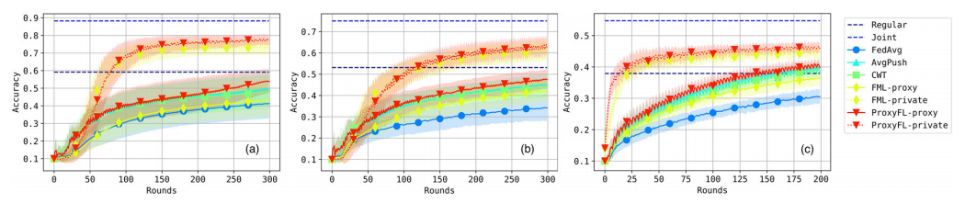
Experiment Results and discussions
Test performance with differential privacy (DP) training
(i) The private models of ProxyFL achieve the best overall performance on all datasets, even better than the centralized counterpart FML.
(ii) Note that the Joint method serves as an upper bound of the problem when private datasets are combined.
Datasets are a MNIST, b Fashion-MNIST, and c CIFAR-10. Each figure reports mean and standard deviation over eight clients for each of five independent runs.

Slide 15
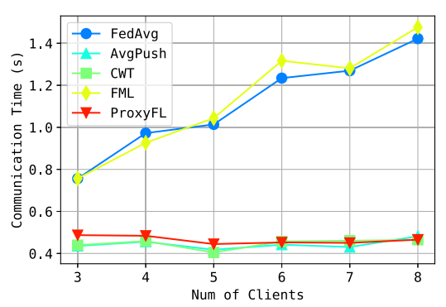
Experiment Results and discussions
Communication time required as number of clients increases
As a decentralized scheme, ProxyFL has a much lower communication cost compared to FML, as shown in Figure. The exponential protocol has a constant time complexity per round regardless of the number of clients, which makes ProxyFL much more scalable.
Decentralized schemes seem to be more robust to DP training, as AvgPush outperforms FedAvg and ProxyFL outperforms FML consistently.

Slide 16
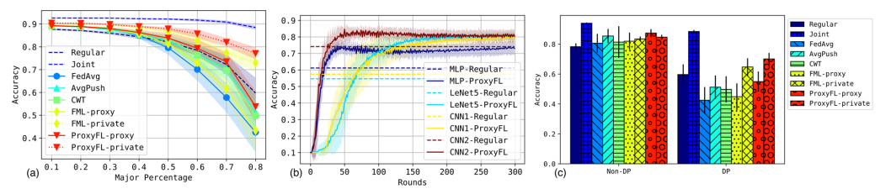
Experiment Results and discussions
Ablations of the ProxyFL
The experiment ablated ProxyFL to see how different factors affect its performance on the MNIST dataset. Unless specified otherwise, all models, including the private ones in FML and ProxyFL, have the same Multi-Layer Perceptron (MLP) structure.
(a) IID VS non-IID: We can see that as the setting deviates from IID, the private model of ProxyFL is the most robust to the degree of non-IID dataset skew. The proxy model of ProxyFL achieves similar performance to the private model of FML, which is trained without DP guarantees.
(b) Different private architectures: The different models can achieve very diverse and sub-optimal performances with individual Regular training, while ProxyFL can improve all architectures’ performance. The improvements for weaker models are more significant than for stronger models.
(c) DP VS non-DP: All methods can outperform Regular training when there is no privacy constraint. With DP, ProxyFL-private shows the smallest decrease in performance and remains closest to the upper bound of Joint training.
a Accuracy as the non-IID skew of the dataset increases. b Accuracy when clients have heterogeneous model architectures, and c accuracy with and without differentially private training.

Slide 17
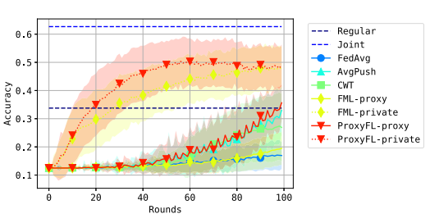
Real-World Testing-Gastrointestinal Disease Detection
Dataset
The Kvasir dataset is a multi-class image dataset for gastrointestinal disease detection. It consists of 8000 endoscopic images from eight classes such as anatomical landmarks or pathological findings.
the dataset is partitioned into 6000 training and 2000 test images in each run, and the training set is further distributed into 8 clients.
Accuracy
The centralized schemes like FedAvg and FML-proxy do not learn much during the process, as opposed to their decentralized counterparts AvgPush and ProxyFL-proxy.
ProxyFL-private consistently outperforms FML-private during training.

Slide 18
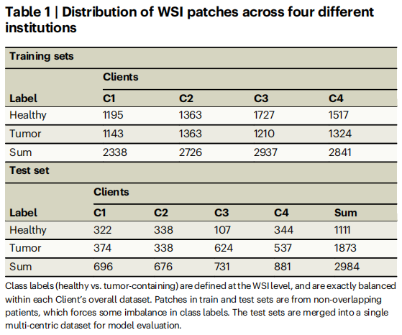
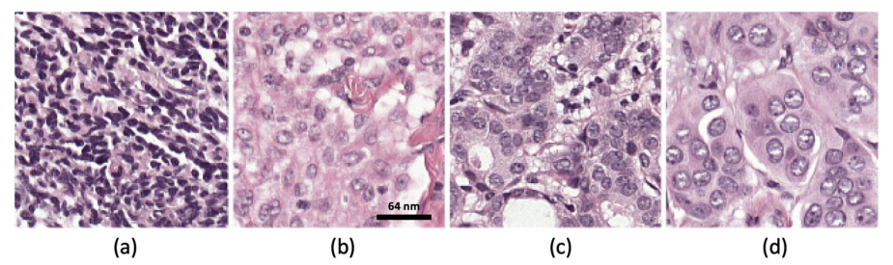
Real-World Testing-Histopathology image analysis
The experiment evaluated ProxyFL for classifying the presence of lymph node metastases in a tissue sample.
Dataset
Binary Classification Problem
The experiment considered a large public archive of whole-slide images (WSIs), namely the Camelyon-17 challenge dataset, which is derived from 1399 annotated whole-slide images of lymph nodes, both with and without metastases.
The client data for this study was created from Camelyon-17 by choosing WSIs out of these 209 annotated WSIs from four of the institutions, with balanced labels.

Slide 19
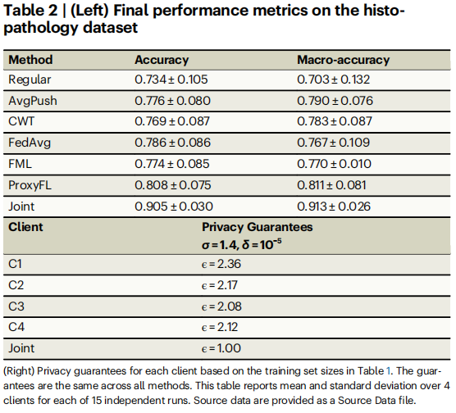
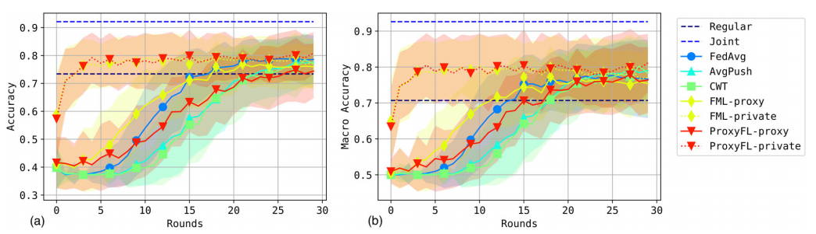
Real-World Testing-Histopathology image analysis
ProxyFL and FML achieve overall higher accuracy throughout training compared to other approaches, due to their private model’s ability to focus on local data while extracting useful information about other institutions through proxy models.
FML’s performance peaks early and begins to degrade, while ProxyFL continues to improve marginally to the end of training.

Slide 20
Conclusion
The pros of the ProxyFL
The ProxyFL allows efficient information exchange among participants based on PushSum scheme without the need of a centralized server.
The proposed method eliminates a significant limitation of canonical federated learning by allowing model heterogeneity.
The ProxyFL for communication by proxy leads to stronger privacy guarantees using differential privacy analysis.
The cons of the ProxyFL
Choice of privacy parameters: It is difficult to find a suitable privacy parameter to balance privacy and precision.
Data availability: In addition, after parameter aggregation, noise will also accumulate, resulting in further reduction of accuracy.
Limitations of application: Designing effective differential privacy mechanisms can be more difficult and complex when dealing with continuous data or complex data structures.

Slide 21
Thank you for your attention

