Slide 1






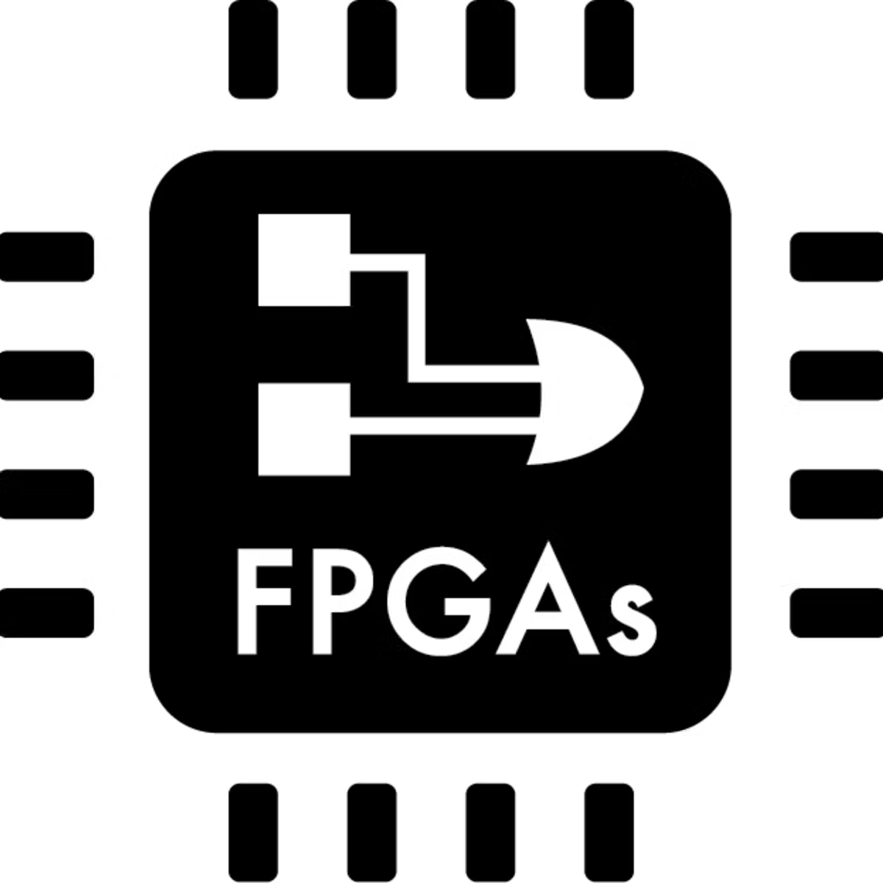
Novel Stream Processing Applications
Frameworks and Libraries
Transactional Stream Processing (ICDE’20, SIGMOD’23, VLDBJ’23)
Stateful Stream Compression (ICDE’23 x2, DEBS’23)
Data Stream Mining (SIGMOD’23)
Continual Learning (EMNLP’23)
Omni-Stream Processing:
High Performance Stream Processing in All Ways
Supports
Demands
System Infrastructure
HW-aware Stream Operations
(SIGMOD’21, ICDE’23)
Stream Query Optimization
(ICDE’17, TPDS’21)
Deployment on NUMA, GPU (ICDE’17, SIGMOD’19, ATC’20)
Divergent Parallel Hardware Architectures

