Slide 1
Transaction Scheduling: From Conflicts to Runtime Conflicts
SIGMOD’23

Slide 2
Background on OLTP
There has been increasing demand on high volume of concurrent transactions from modern apps.
e.g., e-commerce, FinTech and cloud applications
Online Transaction Processing (OLTP) systems have been proven to guard against concurrency issues.

Slide 3
Two Common Approaches
Partitioning based
Decide transaction-to-thread assignment for batch of transactions prior to execution
Eliminate concurrency overhead
Concurrency-Control (CC) based
Use CC protocols to ensure concurrency correctness for transactions on-the-fly

Slide 4
More Details
Partitioning based
Try to reduce synchronization among threads
Require prior knowledge to transaction structure and access set (table keys used during txn)
Concurrency-Control (CC) based
Aims to resolve synchronization conflicts for currently executing transactions
Do not require prior knowledges
CC can be costly!
Trade-off: CC overhead vs. synchronization conflict penalties

Slide 5
Motivation
Partition achieves serializability, yet requires prior knowledge
CC guarantees correctness without prior knowledge, yet could bring high CC overhead
Question: How to combine their advantages?
Answer: Try-their-best to utilize the serializability provided by partitioning, fix the other cases with various techniques.

Slide 6
Definitions of Txn Conflicts
Conflicts
Txn A and B accessing the same key & least one of them is updating it (assume A and B are executed by different threads)
Txn A = R[x1] W[x1] R[x2], Txn B = W[x1] R[x3]
Requires concurrency control
Runtime conflicts
Txn A and B have conflict & their execution time overlaps
Otherwise, Txn A and B have no runtime conflicts, hence does not require concurrency control
Potential: Predicting runtime conflicts by estimating txn execution time

Slide 7
Solution
For bundled txns: Estimate txn execution time, schedule txns within thread to avoid concurrency conflicts
For unbundled txns: Use txn analysis to determine runtime conflicts and perform txn deferment
If both scheduling and deferment are not feasible, rely on CC protocol

Slide 8
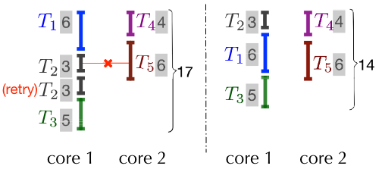
Transaction Scheduling
Purpose: Try to stay in the partition-mode, only re-schedule thread local transactions to avoid cross-thread runtime conflicts
Rely on txn execution time estimation
Not actual execution time, but relative txn length
If transaction T has the same structure as T’ (in history) and has the same parameters, use the cost of T’ to estimate T
Otherwise, use dry-run to generate estimates
For missing estimates, use CC as a backup to ensure correctness

Slide 9
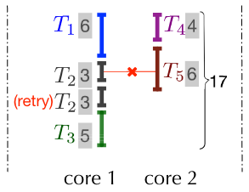
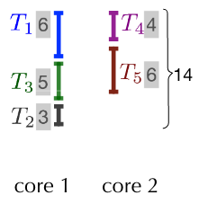
Transaction Deferment
Purpose: For txns whose execution time is not predictable, reduce conflicts at runtime
Before sending new txn A to thread, check if any currently executing txn N has conflict with A
If yes, defer A’s execution by postponing it in thread local queue
If not, execute A directly

Slide 10
Transaction Deferment
How to check txn conflicts at runtime?
User can tune the ratio of threads to be checked before executing new txn (E.g., only check for 50% of existing threads)
Again, missing checks are handled by CC protocol.

Slide 11
Experiments
Throughput improvement over existing partitioning and CC protocols by 131% and 109%, up to 294% and 152%

