Slide 1
Fine-Grained Re-Execution for Efficient Batched Commit of Distributed Transactions
Proceedings of VLDB Endowment, 2023

Slide 2
Distributed Transaction Systems
Distributed support for Online Transaction Processing (OLTP) is crucial in cloud’s storage infrastructure
Data and executors are partitioned across multiple nodes
Requirements:
Serializable OLTP processing
Fault tolerance
Scalability
etc

Slide 3
Performance Challenge in Distributed OLTP Systems
Two reasons for distributed OLTP being slow:
Executors must fetch data from remote data storage (concurrent read)
Executors must coordinate with each other to ensure serializability (concurrent write)
Consequently, executing and committing transactions require blocking communications
Only limited transactions (no conflicts) can be run concurrently
Throughput significantly reduced under contented workloads

Slide 4
Common Practices to Amortize OLTP Overhead
Caching data locally at each executor
Reduce remote reads from data storage
Batching groups of transactions together for commit & validation
Reduce communication overheads
Perform well on single-machine DB, but have seen limited use in distributed settings.

Slide 5
Existing Solutions Revised
Some (E.g., Sinfonia) performs best-effort caching
Assume data is not updated for most of the time
Incur severe recovery overhead under frequent aborts
Some (E.g., Aurora, COCO) batches transactions for validation and commits
However, per-batch validation & commit raises many concerns:
Should we permit reading uncommitted writes before batch is validated?
Does a single-transaction failure cause the entire batch to be aborted?

Slide 6
Performance Impact of Caching and Batching
Experiments on the TPC-C benchmark to quantify the performance impacts
Caching and batching increases throughput by 60% and 200% under low-conflict transactions
Each transaction only access data in one data storage node
However, the throughput drops to 30% when transaction conflicts increases

Slide 7
Proposed System: Hackwrench
Goal: Exploit caching and batching more effectively
Two-tiered commit:
Local commit: Each node executes & commit transaction locally
Global commit: Batches of local committed transactions are validated and committed
In case of global transaction validation failure
Fast transaction recovery with fine-grained re-execution

Slide 8
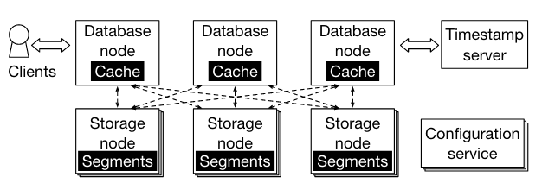
Hackwrench Architecture
Dashed lines: Communication links
Stacked boxes: Replicas

Slide 9
Tier-1: Transaction Execution & Local Commit
Transactions are represented as stored procedures
Assume transactions are deterministic
Each database node (executor) interacts with local cache
Local cache is updated during the last global commit
Ensures serializability with two-phase locking
Processed transactions are grouped into batches, submitted to timestamp server, waiting for global commit

Slide 10
Tier-2: Global Commit
Upon receiving txn-batch from executors, timestamp server configures the partial-timestamp of each batch
Used to sort transactions’ global validation & commit order
Ensuring conflicting transactions are handled in consistent order across multiple nodes

Slide 11
Partial-timestamp Assignment
Timestamp server maintains counter for each data segment (partition of DB)
Counter: <writers, readers>
Tracks the set of batches that have written / read each segment during Tier-1 local execution

Slide 12
Partial-timestamp Assignment
Once receiving a batch of transactions, timestamp server configures the partial-timestamp of the entire batch
TS[segment s] = <writers, readers>
If segment s is in readers, the batch must wait for other writer batches of s.
If segment s is in writers, the batch must wait for all reader batches that have read s.
Finally, this batch is sent to data storage node for validation
Validation
Data storage node checks the partial-timestamp of waiting-to-commit batch with its own version counter
If matches, commit successfully and update local caches
Otherwise, enter transaction recovery mode

Slide 13
Transaction Recovery
Motivation: Two-tier validation & commit is costly
During global validation, a transaction could fail due to stale (outdated) cache
Local read operations failed to fetch the latest write by other nodes
Resulting in the entire batch to be re-executed

Slide 14
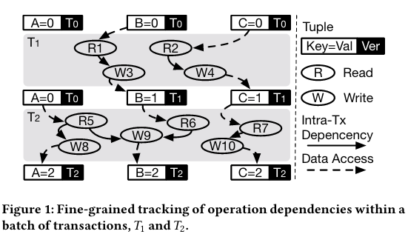
Fine-grained Dependency Resolution

Slide 15
Summary of System Mechanism
Goal: Exploit caching & batching in distributed OLTP
Caching to exploit concurrent execution locally (tier-1)
Batching to reduce communication overhead (coarse-grained, partial-timestamp)
Global commit to ensure serializability (tier-2)
Finally, amortize batched-transaction recovery cost with fine-grained dependency tracking & selective re-execution
(Experiment findings can be found in paper)

