Slide 1
Ray: A Distributed Framework for Emerging AI Applications
Philipp Moritz etc.
OSDI 2018

Slide 2
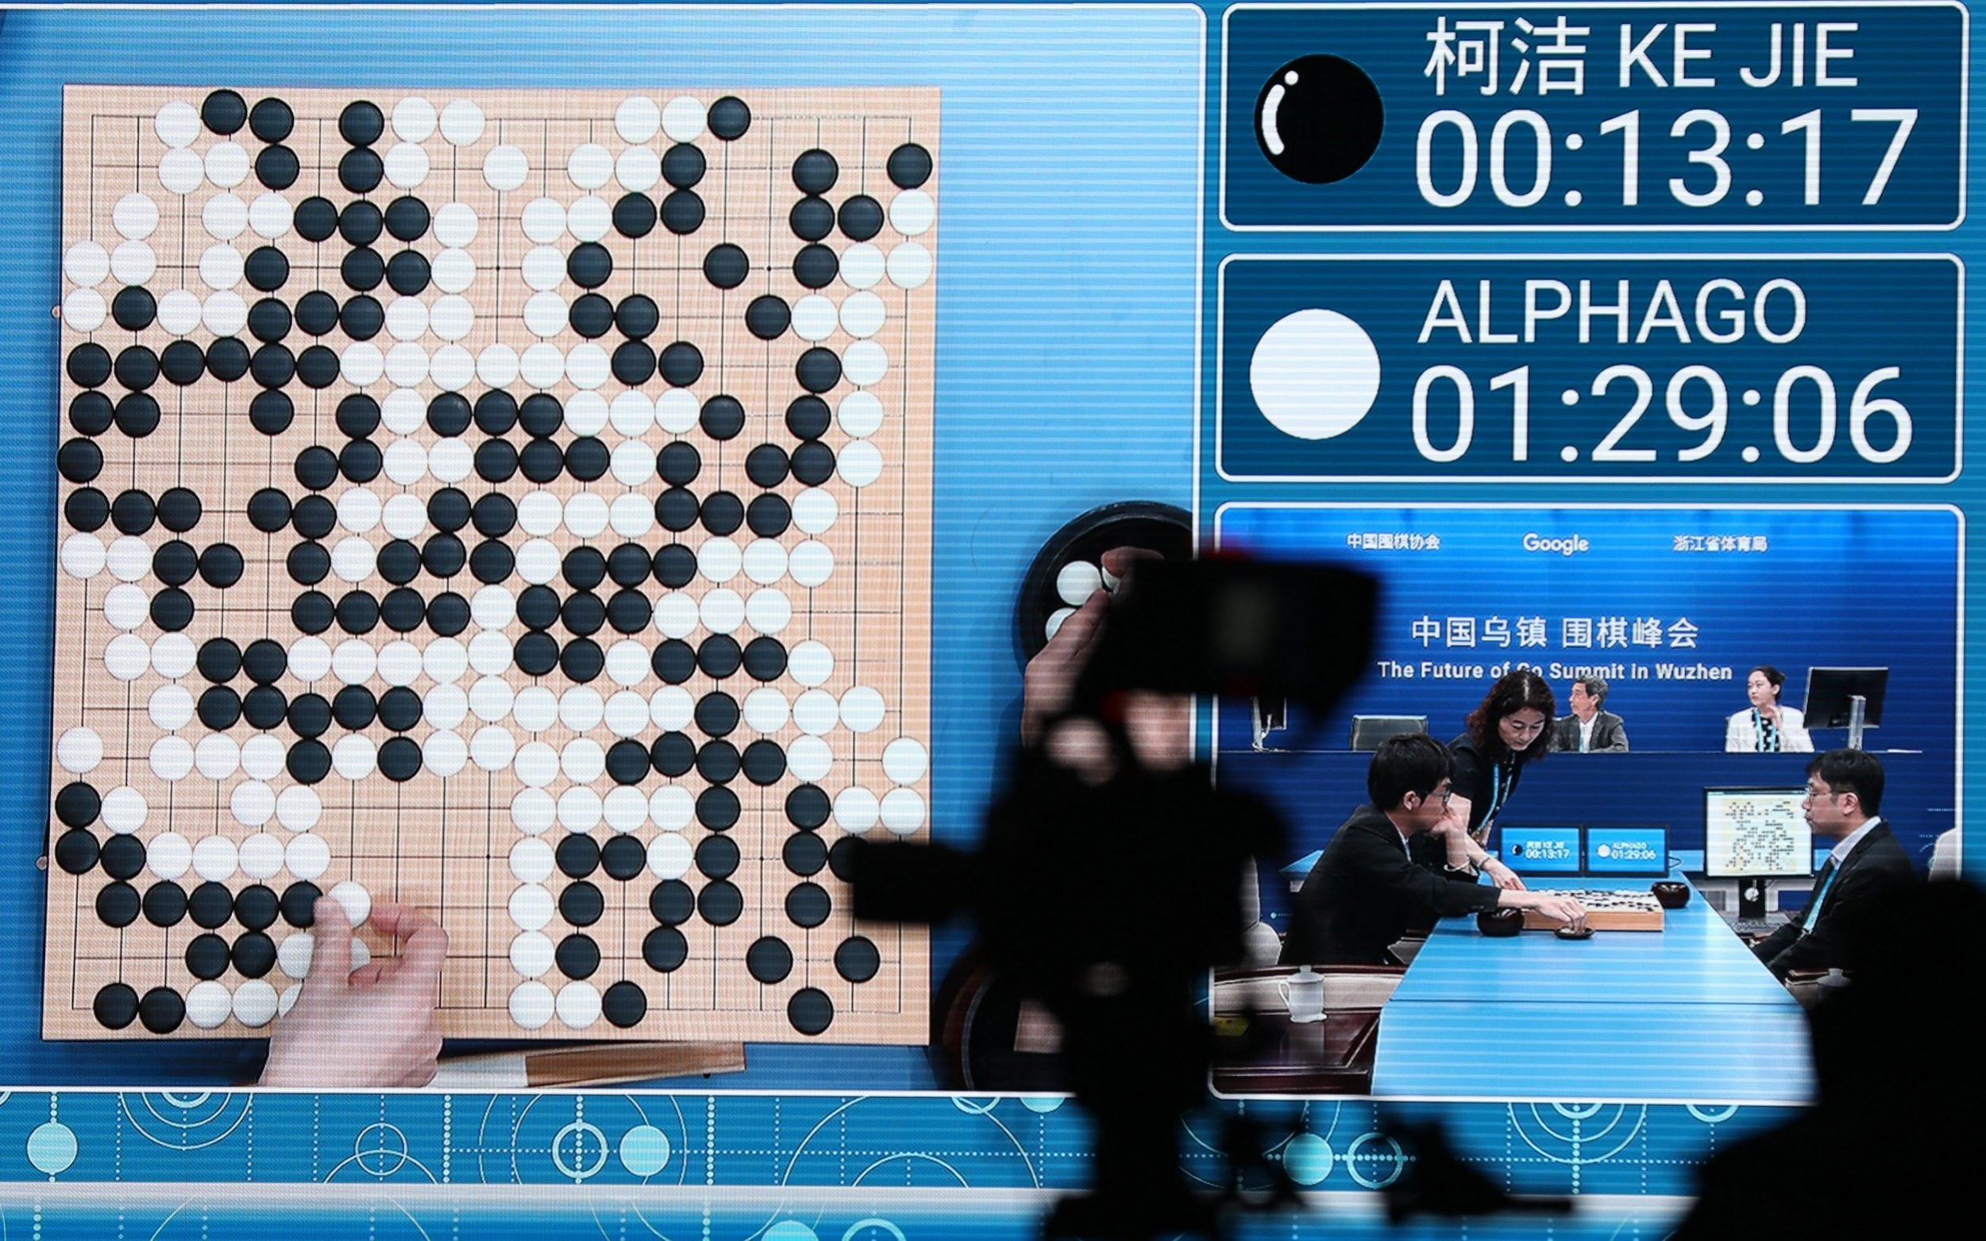
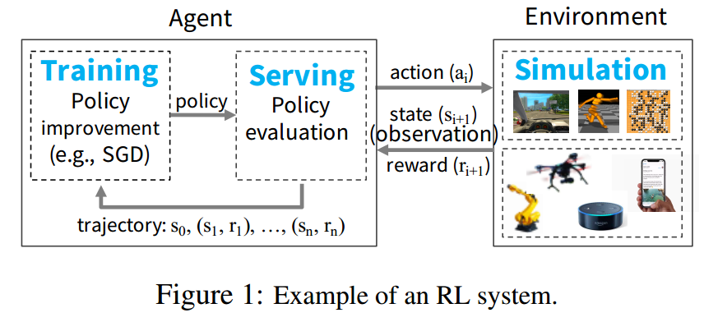
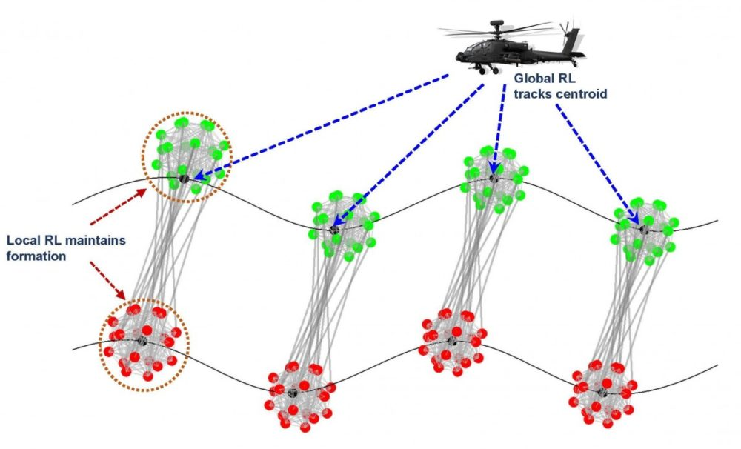
Background: Reinforcement Learning (RL)
The central goal of RL is to learn effective policies in large-scale applications
Notes:
RL-based systems
have already yielded remarkable results, such as Google’s AlphaGo beating a human world champion [54], and are beginning to find their way into dialogue systems, UAVs [42], and robotic manipulation [25, 60]
The central goal of RL is to learn effective policies in large-scale applications, which is majorly about taking a suitable action under the observered environment, such as how to move towards victory for alpha go or how to select the optimal target for the UAV.

Slide 3
Demands of RL
Diverse simulation
Explore choices and long-term rewards
Distributed training
To handle large-scale training data
Effective serving
Both closed-loop and open-loop
Notes:
To build the policy, there are three capacities demanded by RL. First, RL methods often rely on simulation to evaluate policies. Simulations make it possible to
explore many different choices of action sequences and to
learn about the long-term consequences of those choices.
Second, like their supervised learning counterparts, RL algorithms need to perform distributed training to improve
the policy based on data generated through simulations or
interactions with the physical environment. Third, policies are intended to provide solutions to control problems,
and thus it is necessary to serve the policy in interactive
closed-loop and open-loop control scenarios

Slide 4
Requirements On RL Systems
Fine-grained computations
e.g., different behaviors in compute and mem access during render action vs. simulate the environment
Support heterogeneity
e.g., GPUs for training and CPUs for simulations
Support dynamic execution
e.g., simulation results can change future computation
Notes:
These characteristics drive new systems requirements:
a system for RL must support fine-grained computations
(e.g., rendering actions in milliseconds when interacting
with the real world, and performing vast numbers of ulations), must support heterogeneity both in time (e.g.,
a simulation may take milliseconds or hours) and in resource usage (e.g., GPUs for training and CPUs for simulations), and must support dynamic execution, as results
of simulations or interactions with the environment can
change future computations.
Thus, we need a dynamic
computation framework that handles millions of heterogeneous tasks per second at millisecond-level latencies.

Slide 5
Limitations of Existing Works
Distributed systems (GP, streaming and DL): Spark, Storm, TensorFlow etc.
Can not support fine-grained simulation, training and policy serving at the same place
End-to-end RL systems: Horovod, Clipper, etc.
Tightly coupled to specific components and ad-hoc applications
Massive burden for solving standard systems challenges like scheduling, fault tolerance, and data movement onto each application
Notes:
Bulk-synchronous parallel systems such as MapReduce [20], Apache Spark [64], and Dryad [28] do not
support fine-grained simulation or policy serving. Taskparallel systems such as CIEL [40] and Dask [48] provide
little support for distributed training and serving. The
same is true for streaming systems such as Naiad [39]
and Storm [31]. Distributed deep-learning frameworks
such as TensorFlow [7] and MXNet [18] do not naturally
support simulation and serving. Finally, model-serving
systems such as TensorFlow Serving [6] and Clipper [19]
support neither training nor simulation
While in principle one could develop an end-to-end solution by stitching together several existing systems (e.g.,
Horovod [53] for distributed training, Clipper [19] for
serving, and CIEL [40] for simulation), in practice this approach is untenable due to the tight coupling of these components within applications. As a result, researchers and
practitioners today build one-off systems for specialized
RL applications [58, 41, 54, 44, 49, 5]. This approach imposes a massive systems engineering burden on the development of distributed applications by essentially pushing
standard systems challenges like scheduling, fault tolerance, and data movement onto each application

Slide 6
Their Proposal: Ray
A general-purpose cluster-computing framework that enables simulation, training, and serving for RL applications
Unified interface for stateless and stateful RL computation
Liberate from manual works of dynamical load balance, scaling up and fault tolerance
Decentralized task scheduler and metadata storage
Notes:
In this paper, we propose Ray, a general-purpose
cluster-computing framework that enables simulation,
training, and serving for RL applications. The requirements of these workloads range from lightweight and
stateless computations, such as for simulation, to longrunning and stateful computations, such as for training.
To satisfy these requirements, Ray implements a unified
interface that can express both task-parallel and actorbased computations. Tasks enable Ray to efficiently and
dynamically load balance simulations, process large inputs and state spaces (e.g., images, video), and recover
from failures. In contrast, actors enable Ray to efficiently
support stateful computations, such as model training, and
expose shared mutable state to clients, (e.g., a parameter
server). Ray implements the actor and the task abstractions on top of a single dynamic execution engine that is
highly scalable and fault tolerant.
To meet the performance requirements, Ray distributes
two components that are typically centralized in existing
frameworks [64, 28, 40]: (1) the task scheduler and (2) a metadata store which maintains the computation lineage
and a directory for data objects

Slide 7
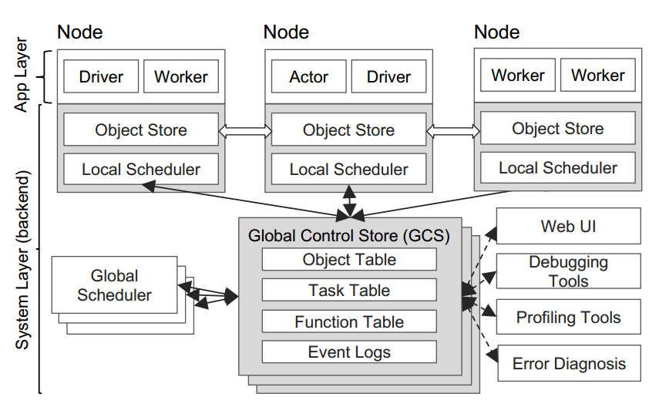
System Overview
Application Layer
To implement the API*
System layer
To achieve scalability and fault-tolerance
*Please refer to Section 3 in the paper for API and programming model details
Notes:
Ray’s architecture comprises (1) an application layer implementing the API, and (2) a system layer providing high
scalability and fault tolerance.

Slide 8
Application Layer
Driver: to execute user program
Worker: stateless functions
Automatically started and assigned
Actor: stateful 'classes' or 'objects'
Need to be explicitly instantiated
Actor = Worker + dependency check + local state*
* The local state is possible to be partially shared by using explicit function calls. But ray does not encourage global state in user applications.
Notes:
Ray’s architecture comprises (1) an application layer implementing the API, and (2) a system layer providing high
scalability and fault tolerance.

Slide 9
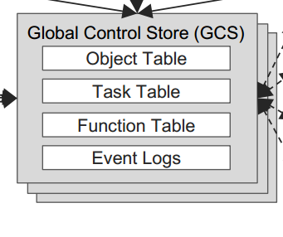
System Layer: Global Control Store
Goal: support stateless system components for both scalability and fault-tolerance
Only share necessary state by using GCS
Sharding for scalability
Shared-nothing partitions of objects, tasks, functions and logs
Per-sharding chain replication* for fault-tolerance
Restart from a halted state in a fine-grained way, e.g., at a specific matmul() function
In-memory distributed object store to further optimize latency
Sharding memory for storing IR
'Least Recently Used policy' to evict data into disk
*Chain replication for supporting high throughput and availability, OSDI 2004.
Notes:
The global control store (GCS) maintains the entire control state of the system, and it is a unique feature of our
design. At its core, GCS is a key-value store with pubsub functionality. We use sharding to achieve scale, and
per-shard chain replication [61] to provide fault tolerance.
The primary reason for the GCS and its design is to maintain fault tolerance and low latency for a system that can
dynamically spawn millions of tasks per second.

Slide 10
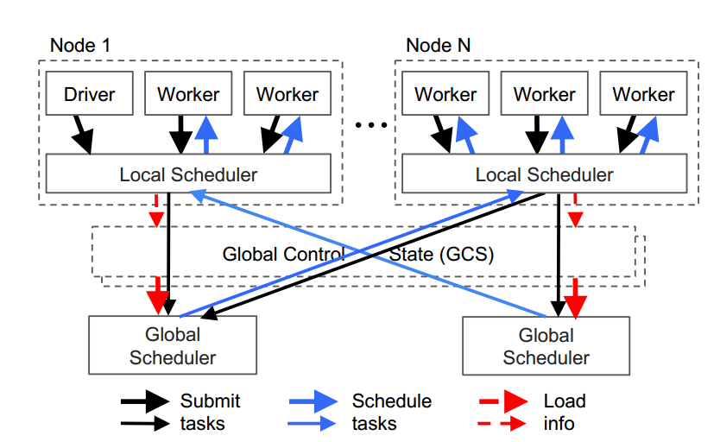
System Layer: Bottom-Up Distributed Scheduler
Local-first principle
Access global scheduler only needed
Automatic replication of global schedulers
Act when global scheduler becomes a bottleneck
Support user-specified binds to optimize resource
e.g. 1, force matmul() task to be scheduled to a SIMD node
e.g. 2, force a subsequent avg() task to be scheduled to the same node with its upstream matmul()

Slide 11
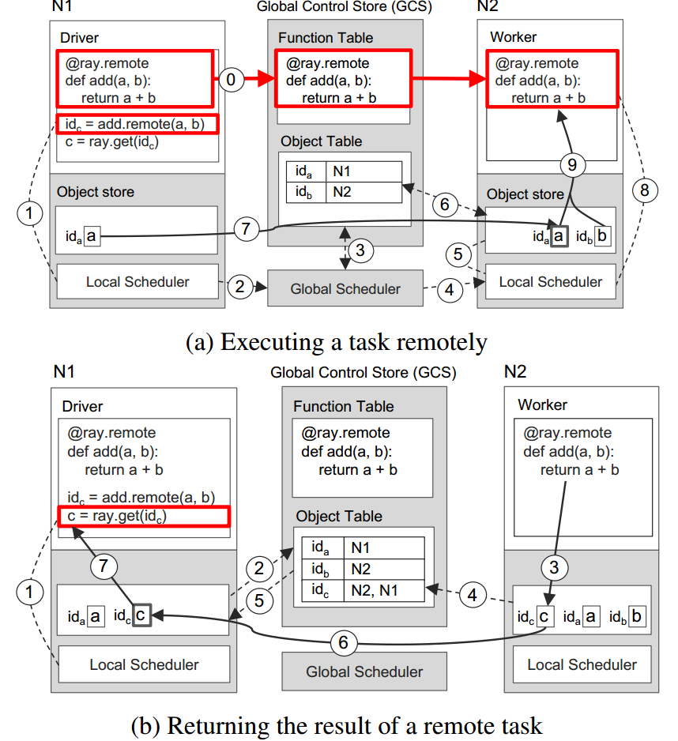
Running Examples
GCS to coordinate with nodes
Function table to record the workflow
Ray only cares about the function name and parameters
Possible for different implementation on nodes and node-specific optimizations
Object store for I/O parameters
Never execute on remote, using the copy-before-execution policy for using remote data objects
Notes:
gure 7a shows the step-by-step operations triggered
by a driver invoking add.remote(a;b), where a and b are
stored on nodes N1 and N2, respectively. The driver submits add(a, b) to the local scheduler (step 1), which forwards it to a global scheduler (step 2).z Next, the global
scheduler looks up the locations of add(a, b)’s arguments
in the GCS (step 3) and decides to schedule the task on
node N2, which stores argument b (step 4). The local
scheduler at node N2 checks whether the local object
store contains add(a, b)’s arguments (step 5). Since the
local store doesn’t have object a, it looks up a’s location
in the GCS (step 6). Learning that a is stored at N1, N2’s
object store replicates it locally (step 7). As all arguments
of add() are now stored locally, the local scheduler invokes add() at a local worker (step 8), which accesses the
arguments via shared memory (step 9).
Figure 7b shows the step-by-step operations triggered
by the execution of ray.get() at N1, and of add() at N2,
respectively. Upon ray.get(idc)’s invocation, the driver
checks the local object store for the value c, using the
future idc returned by add() (step 1). Since the local
object store doesn’t store c, it looks up its location in the
GCS. At this time, there is no entry for c, as c has not
been created yet. As a result, N1’s object store registers a
callback with the Object Table to be triggered when c’s
entry has been created (step 2). Meanwhile, at N2, add()
completes its execution, stores the result c in the local
object store (step 3), which in turn adds c’s entry to the
GCS (step 4). As a result, the GCS triggers a callback
to N1’s object store with c’s entry (step 5). Next, N1
replicates c from N2 (step 6), and returns c to ray.get()
(step 7), which finally completes the task

Slide 12
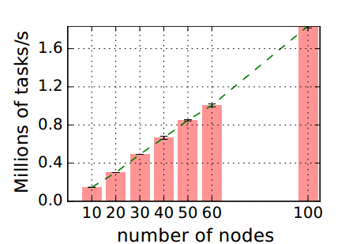
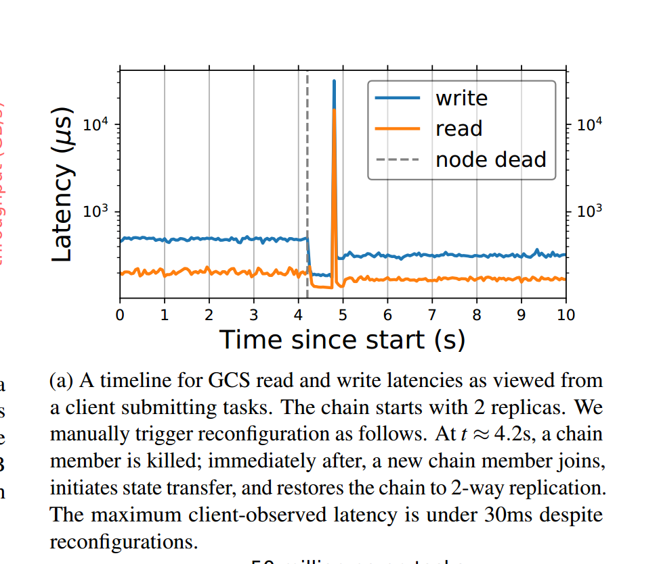
Stand-alone Evaluation
Ray achieves linear scaling to 100 nodes
Ray recovers from fault within 30ms

Slide 13
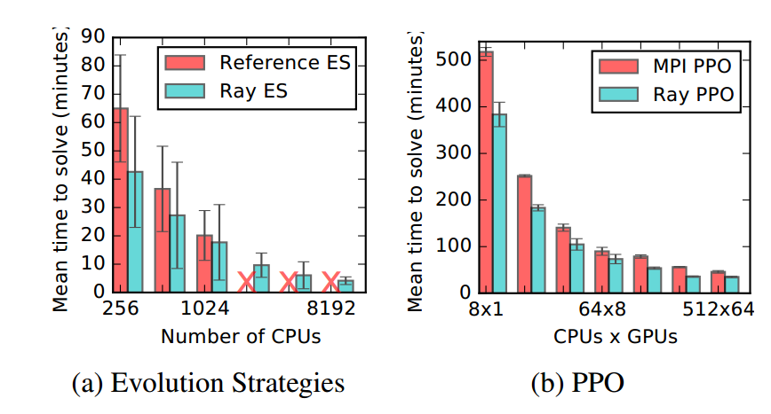
Evaluation on RL Applications
Ray outperforms SOTA Significantly in two representative reinforcement learning applications

Slide 14
More Detailed Evaluations In the Paper
Performances of critical components such as object store (e.g., Figures 9 and 10)
Breakdown evaluation on RL steps of simulation, training and serving (Section 5.2)

Slide 15
Conclusion
Ray provides a powerful combination of flexibility, performance, and ease of use for the development of future AI applications

