Slide 1
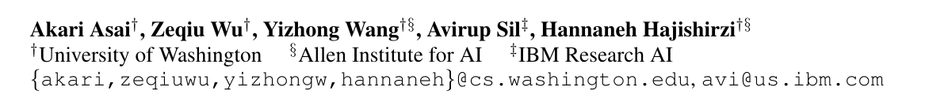
SELF-RAG: LEARNING TO RETRIEVE, GENERATE, AND CRITIQUE THROUGH SELF-REFLECTION （ Submission to ICLR‘24）

Slide 2
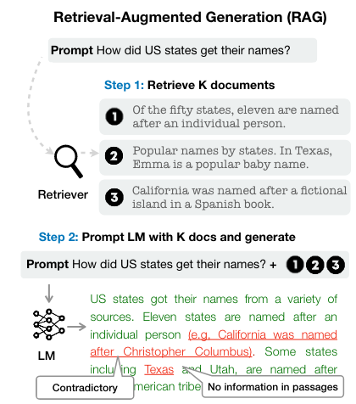
Traditionally RAG Framework
Step 1：Retriever K document
Step 2：Prompt LM with K docs and Generate
Notes:
query-retrieval –passgae retrieved reader（help LM using and understanding work） and give answer

Slide 3
Limitation
Retrieve passages indiscriminately regardless
The passage maybe is unhelpful
Low-quality generations
LMs are not explicitly trained to leverage and follow facts from provided passages
The output is not guaranteed to be consistent with retrieved relevant passages
Notes:
举个例子来说，

Slide 4
Research Goal
Goal：Perform accurate retriever and select useful passages to use and ensure consistency between output and retrieval.
Notes:
举个例子来说，

Slide 5
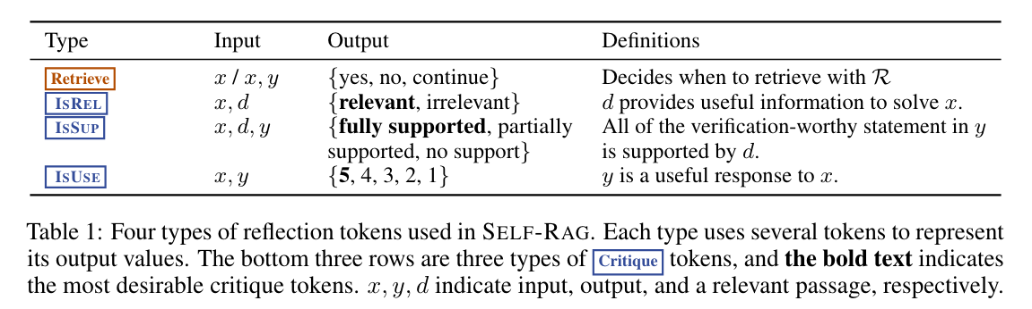
Problem Formalization
Input ： X （query）
Database ： D
Retrieve passage ：d
Output ：y=[y₁,…y_{T}], y_{t} is sequence of tokens for the t-th segment
yt include text from the original vocabulary as well as the reflection tokens
Notes:
举个例子来说，

Slide 6
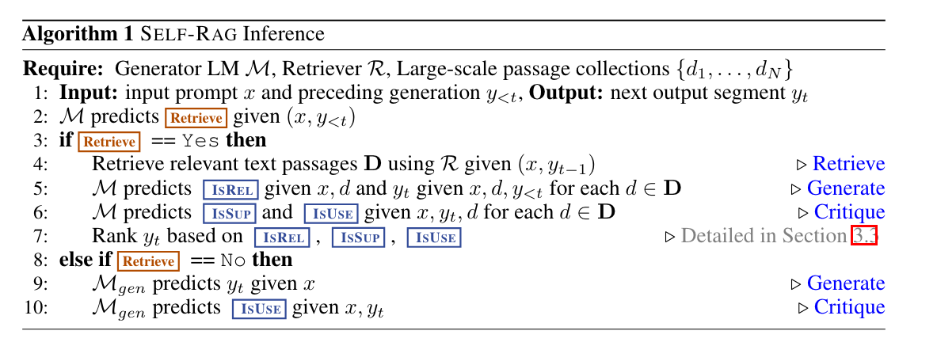
Inference Overview
Notes:
举个例子来说，

Slide 7
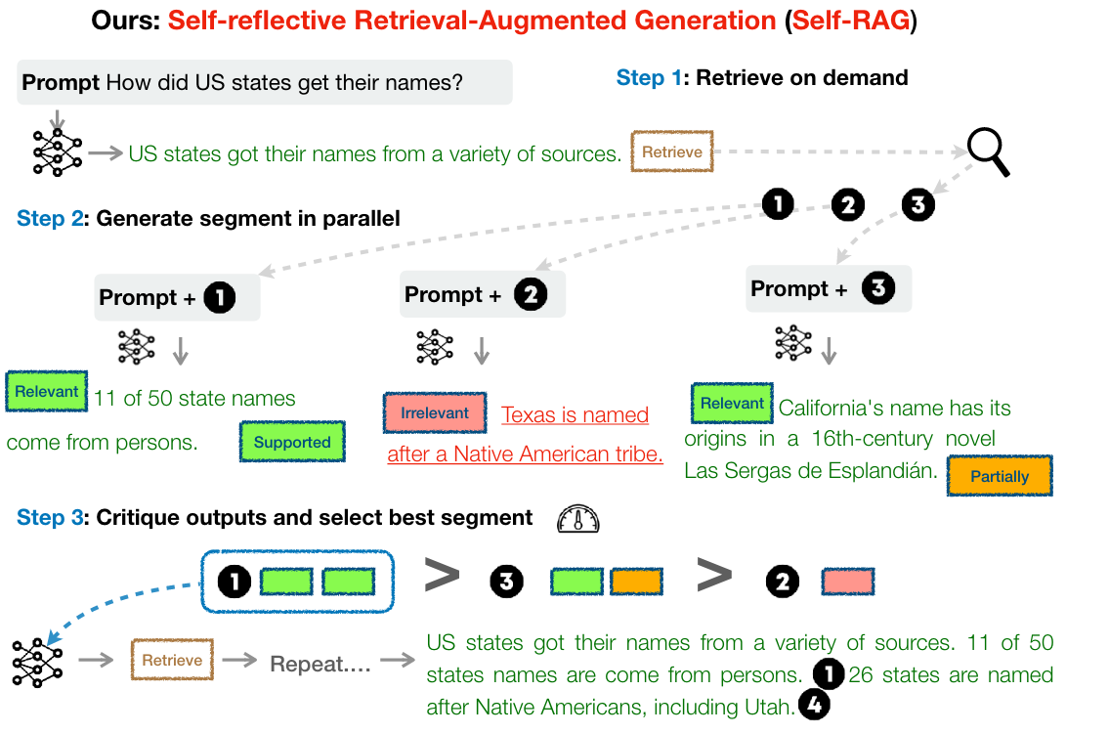
Notes:
Good afternoon everyone , today my presentation paper is

Slide 8
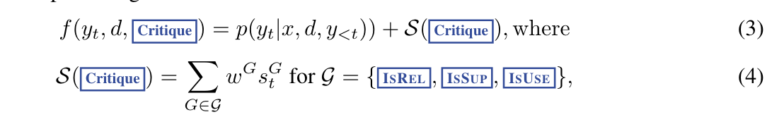
Self – RAG Inference Rank y_{t}
Notes:
举个例子来说，

Slide 9
Self – RAG Inference
The probability of Critique token
Notes:
举个例子来说，

Slide 10
Self – RAG Inference
The probability of each Critique token
hyperparameters, importance of different Critique token
Notes:
举个例子来说，

Slide 11
Self – RAG Inference
Comprehensive evaluation of whether Rel, Sup , Use
The probability of each Critique token
hyperparameters, importance of different Critique token
Notes:
举个例子来说，

Slide 12
Self – RAG Inference
Is it contextually fluent
Comprehensive evaluation of whether Rel, Sup , Use
The probability of each Critique token
hyperparameters, importance of different Critique token
Notes:
举个例子来说，

Slide 13
Self – RAG Inference
Is it contextually fluent
Comprehensive evaluation of whether Rel, Sup , Use
The probability of each Critique token
hyperparameters, importance of different Critique token
Notes:
举个例子来说，

Slide 14
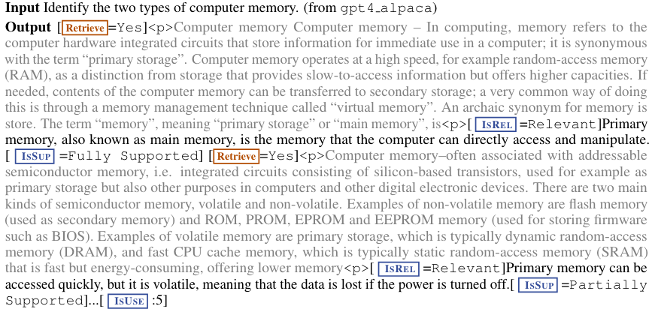
Notes:
Good afternoon everyone , today my presentation paper is

Slide 15
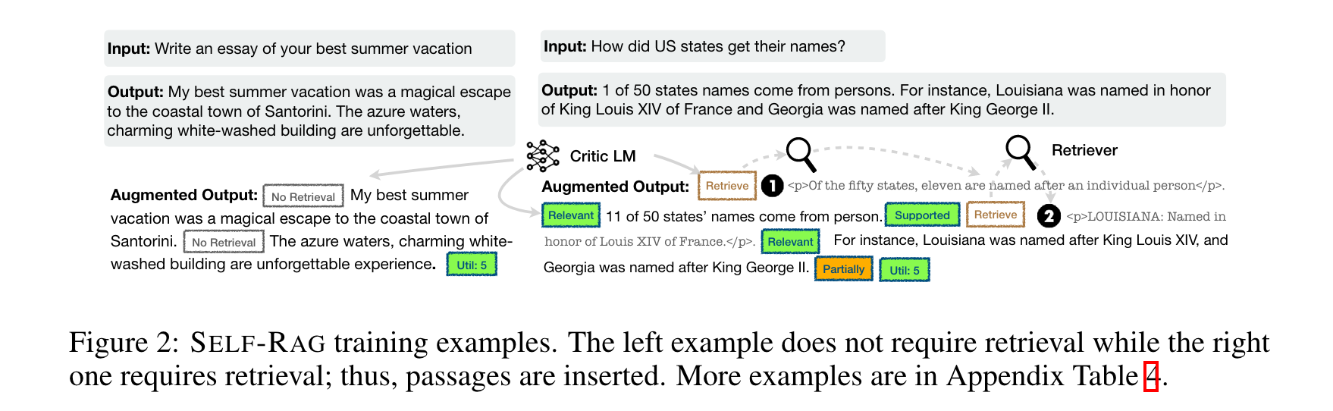
Self – RAG Training Critic Learning
Using labeled datasets(GPT4), train the critic LM.
Notes:
举个例子来说，

Slide 16
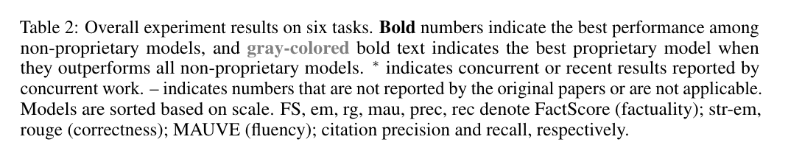
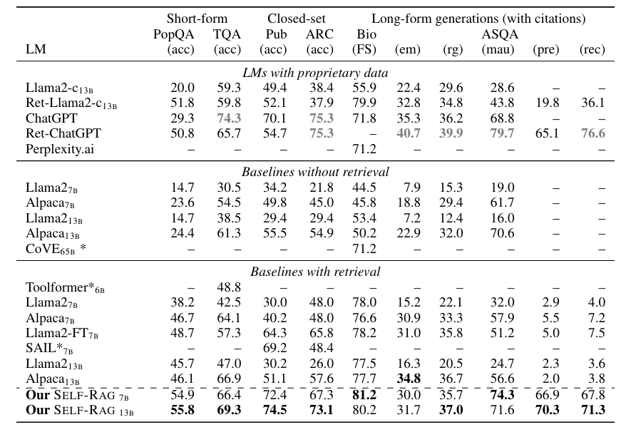
Experiment
Notes:
fact verification dataset
六项任务的总体实验结果。粗体数字表示非专有模型中的最佳性能，灰色粗体文字表示优于所有非专有模型的最佳专有模型。∗ 表示同时进行的工作或同时进行的工作所报告的最新结果。- 表示原始论文未报告或不适用的数字。模型根据规模排序。FS、em、rg、mau、prec、rec 分别表示 FactScore（事实性）；str-em、rouge（正确性）；MAUVE（流畅性）；引用精确度和召回率。

Slide 17
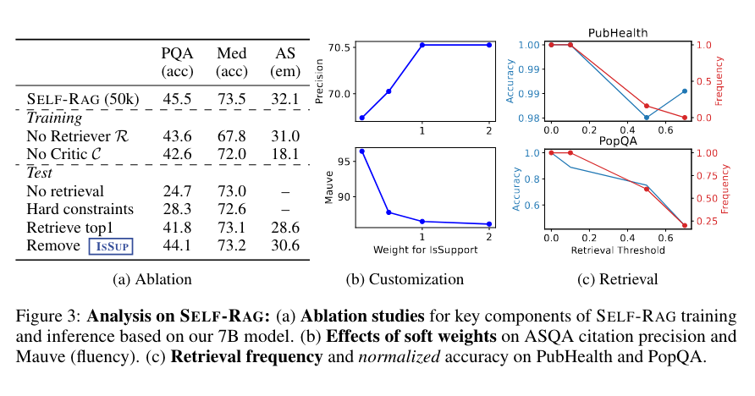
Experiment
Notes:
We show in Table 3a the ablation results. The top part of the table shows results for training ablations, and the bottom part is for inference ablations. We see that all components play important roles. We also observe a large performance gap between SELF-RAG and No Retriever or Critic baselines across tasks, indicating that training an LM with those models largely contributes to the performance gain of SELF-RAG. Using the top passages regardless of their relevance (Retrieve top 1) as in conventional RAG approaches causes a large drop in PopQA and ASQA, and removing ISSUP during the beam search results hurts performance on ASQA. This demonstrates the effectiveness of SELF-RAG’s capabilities of carefully selecting generations based fine-grained multiple criterion, instead of naively using all of the top passages from the retrieval model or solely depending on relevance scores.
表 3a 显示了消融结果。表的上半部分是训练消融的结果，下半部分是推理消融的结果。我们看到，所有组件都发挥了重要作用。我们还观察到 SELF-RAG 与无 Retriever 或 Critic 基线在各项任务中的性能差距很大，这表明使用这些模型训练 LM 在很大程度上提高了 SELF-RAG 的性能。像传统的 RAG 方法那样不考虑相关性而使用最前面的段落（检索最前面的 1 个段落）会导致 PopQA 和 ASQA 的性能大幅下降，而在波束搜索结果中移除 ISSUP 会降低 ASQA 的性能。这表明，SELF-RAG 能够根据细粒度的多重标准仔细选择世代，而不是天真地使用检索模型中的所有顶级段落或仅仅依赖于相关性得分。

Slide 18
Think
Good reflections on the current RAG
Similarity! = Contribution - Consistency of key ideas
Implications for misinformation detection, what parts of the retrieval need to be performed, how to evaluate the results of the retrieval
Notes:
query-retrieval –passgae retrieved reader（help LM using and understanding work） and give answer

