Slide 1
Dataset Quantization

Slide 2
Background
State-of-the-art deep neural networks are trained with large amounts (millions or even billions) of data:
Expensive computation
Memory costs
→ Make it difficult to train them on limited hardware resources, especially for recent popular large language models (LLM) and computer vision models (CV).
Data distillation and coreset selection are thus developed, aiming to reduce the number of training samples.

Slide 3
Challenges
Dataset Distillation (DD) → Synthesizing a small new set:
Poor generalization capability:
Gradient calculation is coupled with the specific network architectures
Low scalability to larger datasets:
The computational cost is quadratically proportional to the size of the synthetic set
Coreset Selection (CS) → Selecting a small subset:
Lack of sample diversity:
As the data keep ratio is small, the selected samples tend to lose the diversity, leading to a low performance for model training.

Slide 4
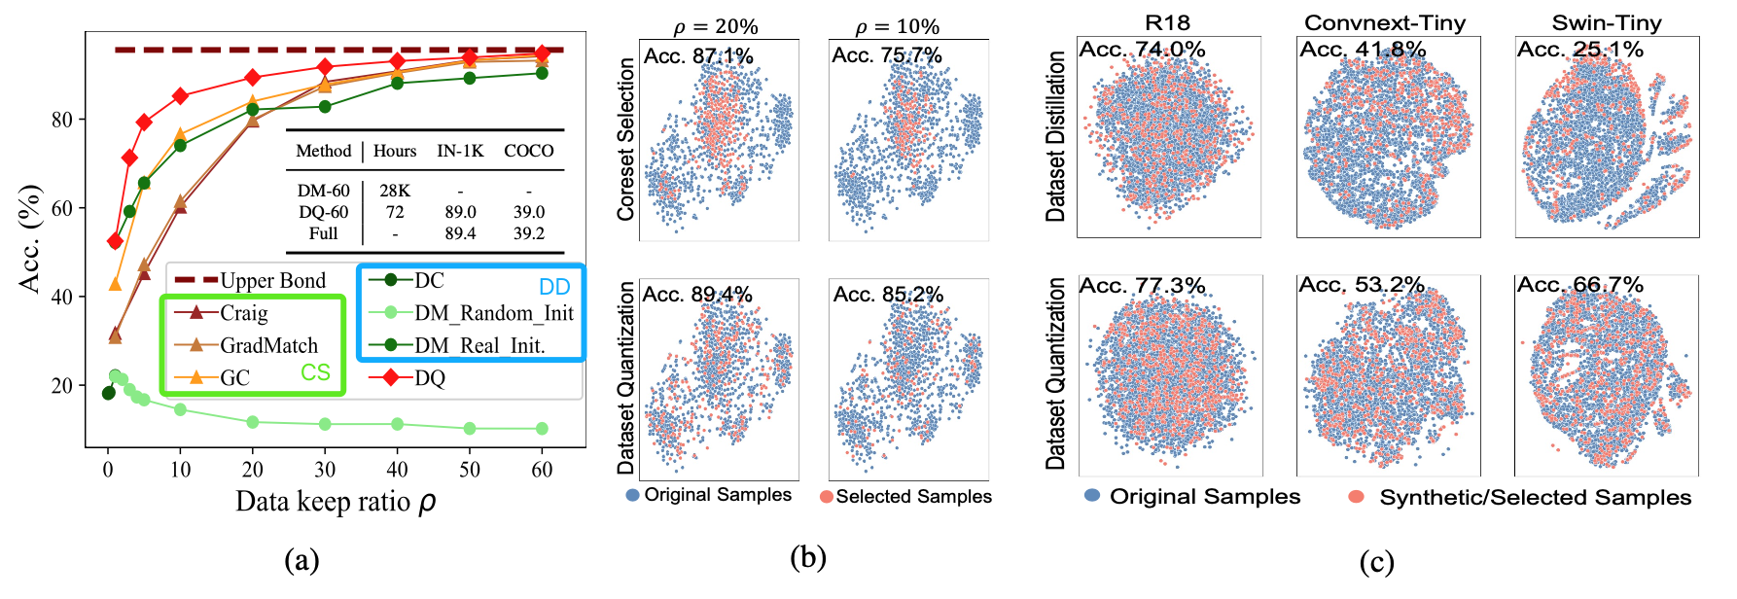
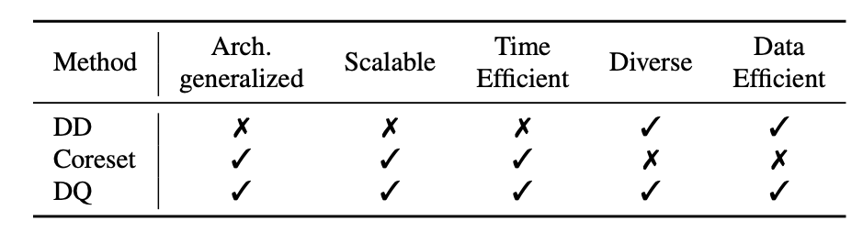
Challenges

Slide 5
Introduction
This paper combines the advantages of Dataset Distillation methods and the Coreset methods: a unified dataset compression method that generates compact datasets useful for training various network architectures.
Compared with DD methods, DQ only takes 72 GPU hours to quantize ImageNet data with 60% keep ratio, which is 388× (28, 000 vs 72 GPU hours) faster
For vision tasks, on CIFAR-10 and ImageNet-1K, only 60% of the data are used to train the models to achieve a comparable model performance as those trained with full datasets.
For language tasks, on BBH and DROP benchmarks, only 2% of instruction data are needed to achieve comparable model performance as those trained with full datasets.

Slide 6
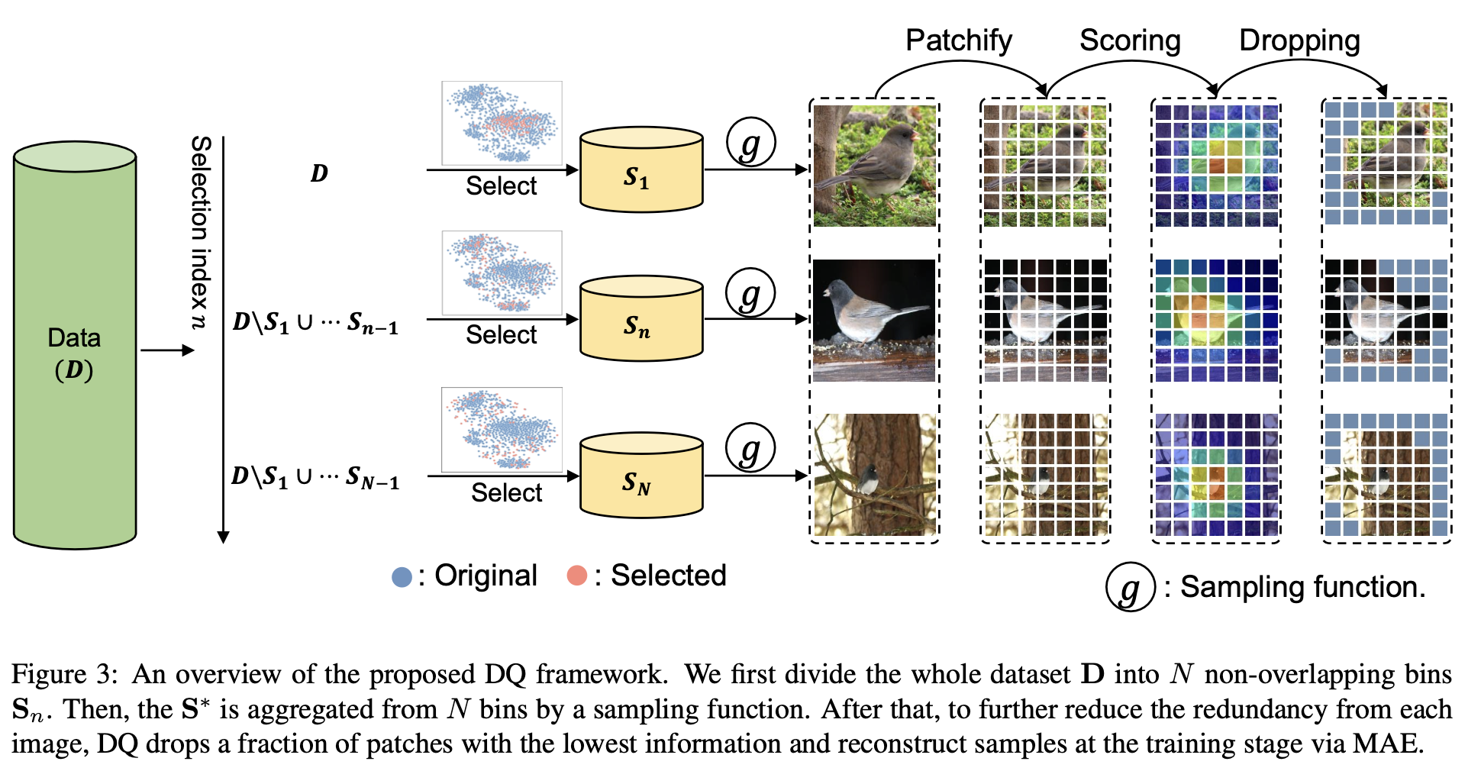
Method

Slide 7
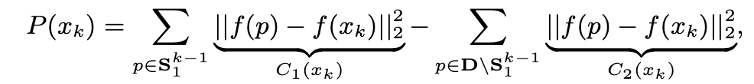
Method – Why does DQ need more bins?
Take GraphCut (SOTA Coreset method) as an example:
C2 is the sample redundance of the remained set
C1 is the sample difference within a selected corset

Slide 8
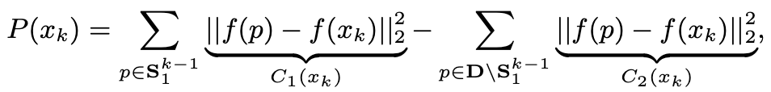
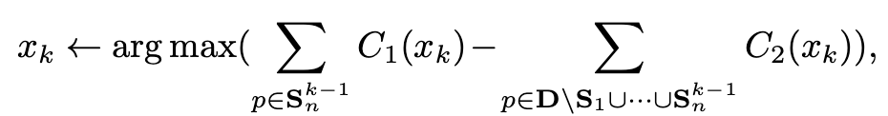
Method – Why does DQ need more bins?
As the coreset ratio becomes small:
Solution: divide the dataset into several bins with different diversity levels

Slide 9
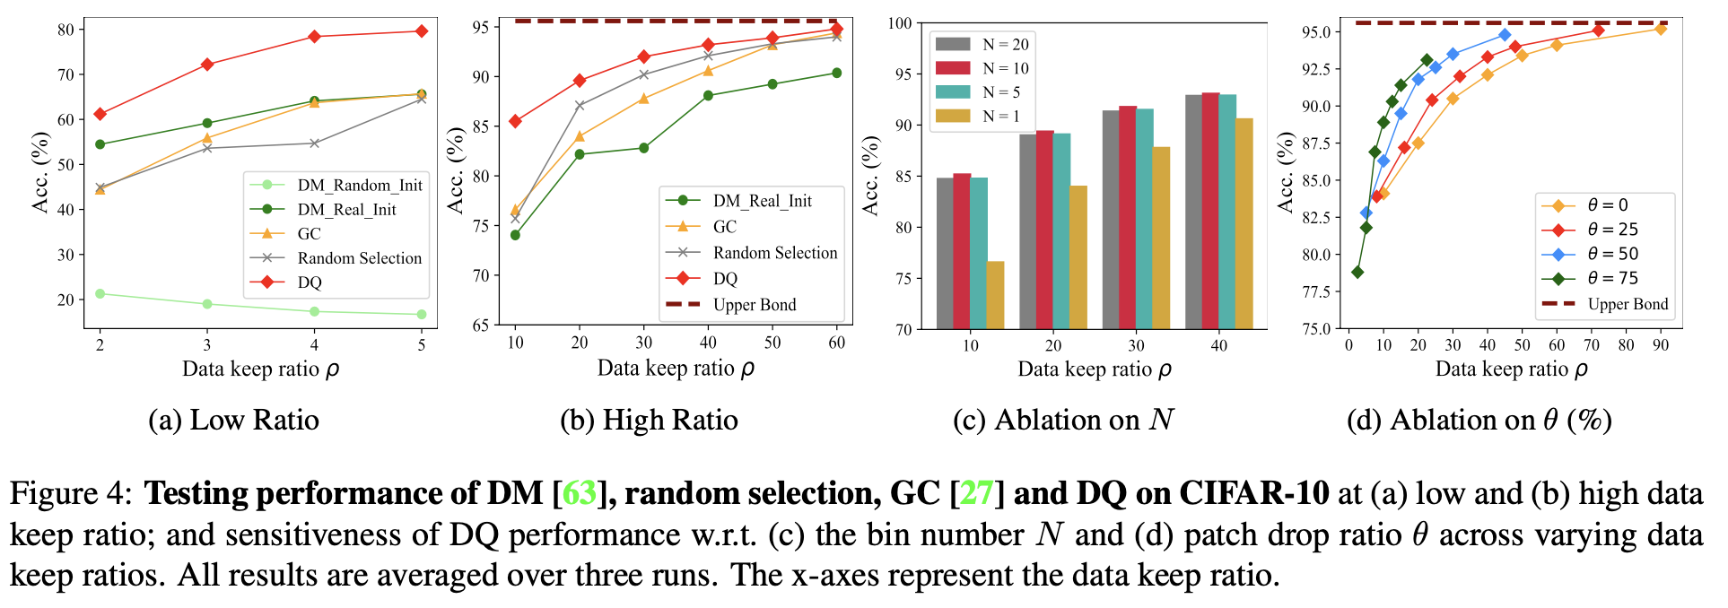
Experiment Results – Sensitive study
*DM -- SOTA DD method

Slide 10
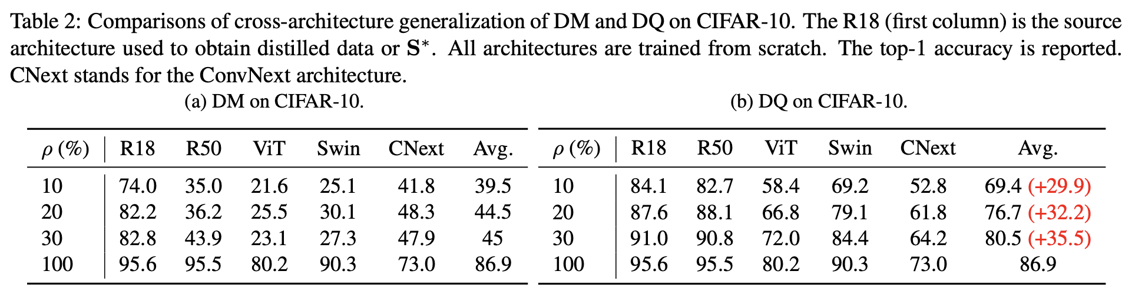
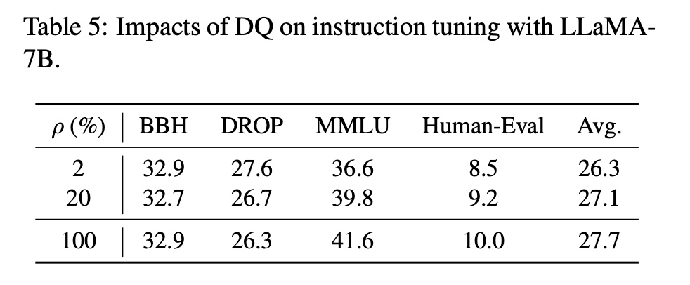
Experiment Results – For CV and NLP

Slide 11
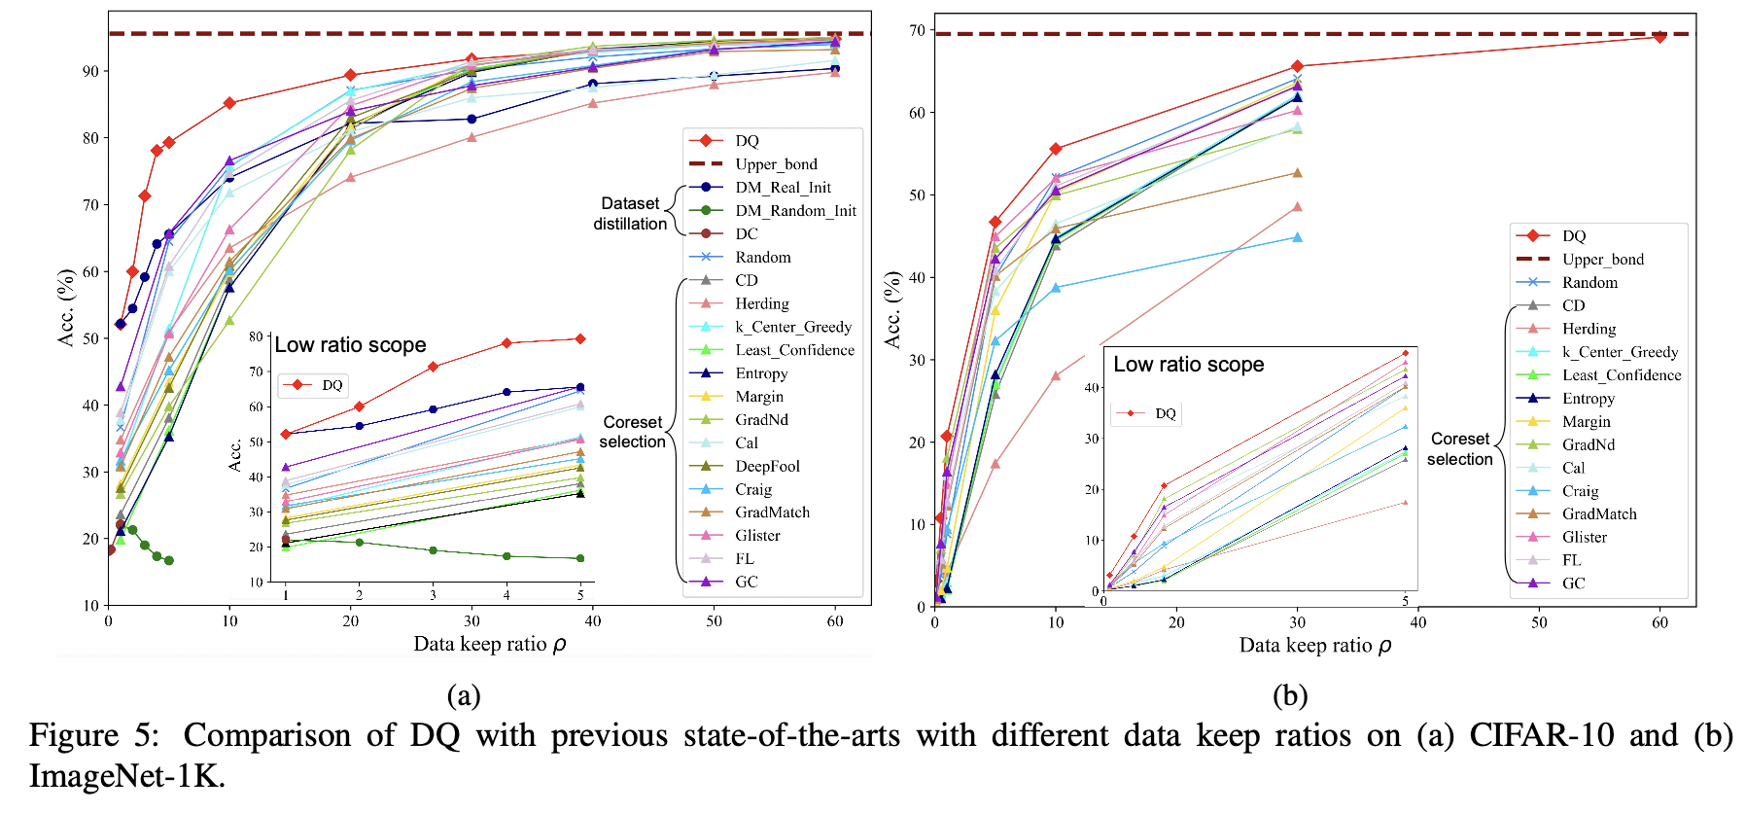
Experiment Results – For the scalability

Slide 12
Q & A?

