Slide 1
M_{add ,}M_{int}
~
Normal[μ_{AA ,}σ_{AA} ]
P_{add ,}P_{int}
~
Normal[μ_{P ,}σ_{P} ]
AA matrix elements
Residue-wise weights
μ_{AA} ~ Normal
σ_{AA} ~ Exponential
STING protein
~
Normal[μ_{STING ,}σ_{data} ]
μ_{P} ~ Normal
σ_{P} ~ Exponential
σ_{data} ~ Exponential
SatSeq data
μ_{STING} [Residue, Mutant AA] =
P_{add} [Residue] + M_{add} [WT AA, Mutant AA] +
P_{int} [Residue] * M_{int} [WT AA, Mutant AA]

Slide 2
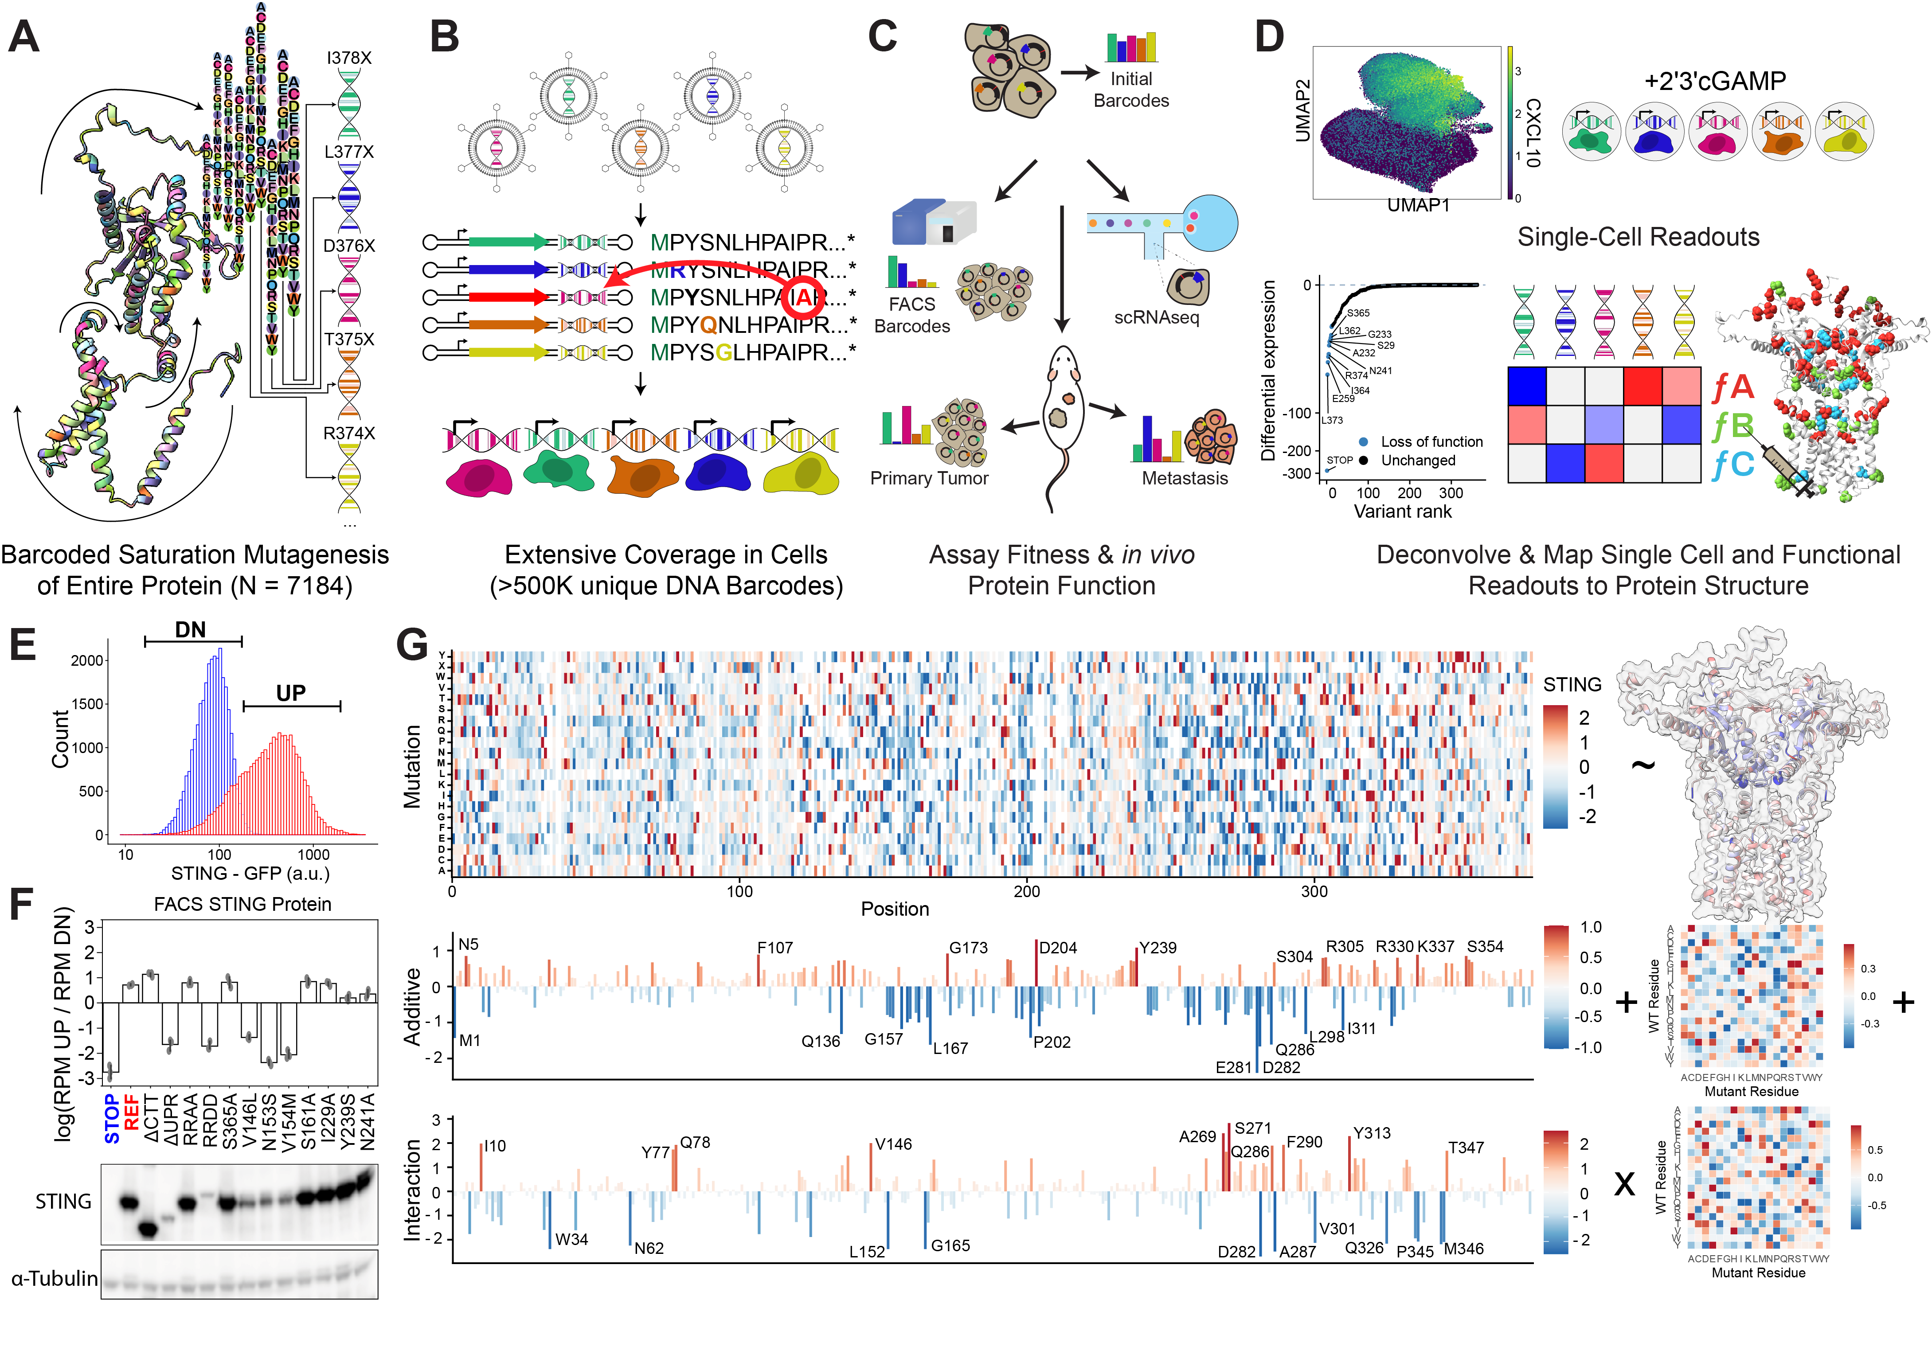
STING protein [Residue, Mutant AA]
μ_{STING} [Residue, Mutant AA] = P_{add} [Residue] + M_{add} [WT AA, Mutant AA] + P_{int} [Residue] * M_{int} [WT AA, Mutant AA]
P_{add} [Residue] M_{add} [WT AA, Mutant AA]
W_{int} [Residue] M_{int} [WT AA, Mutant AA]

Slide 3
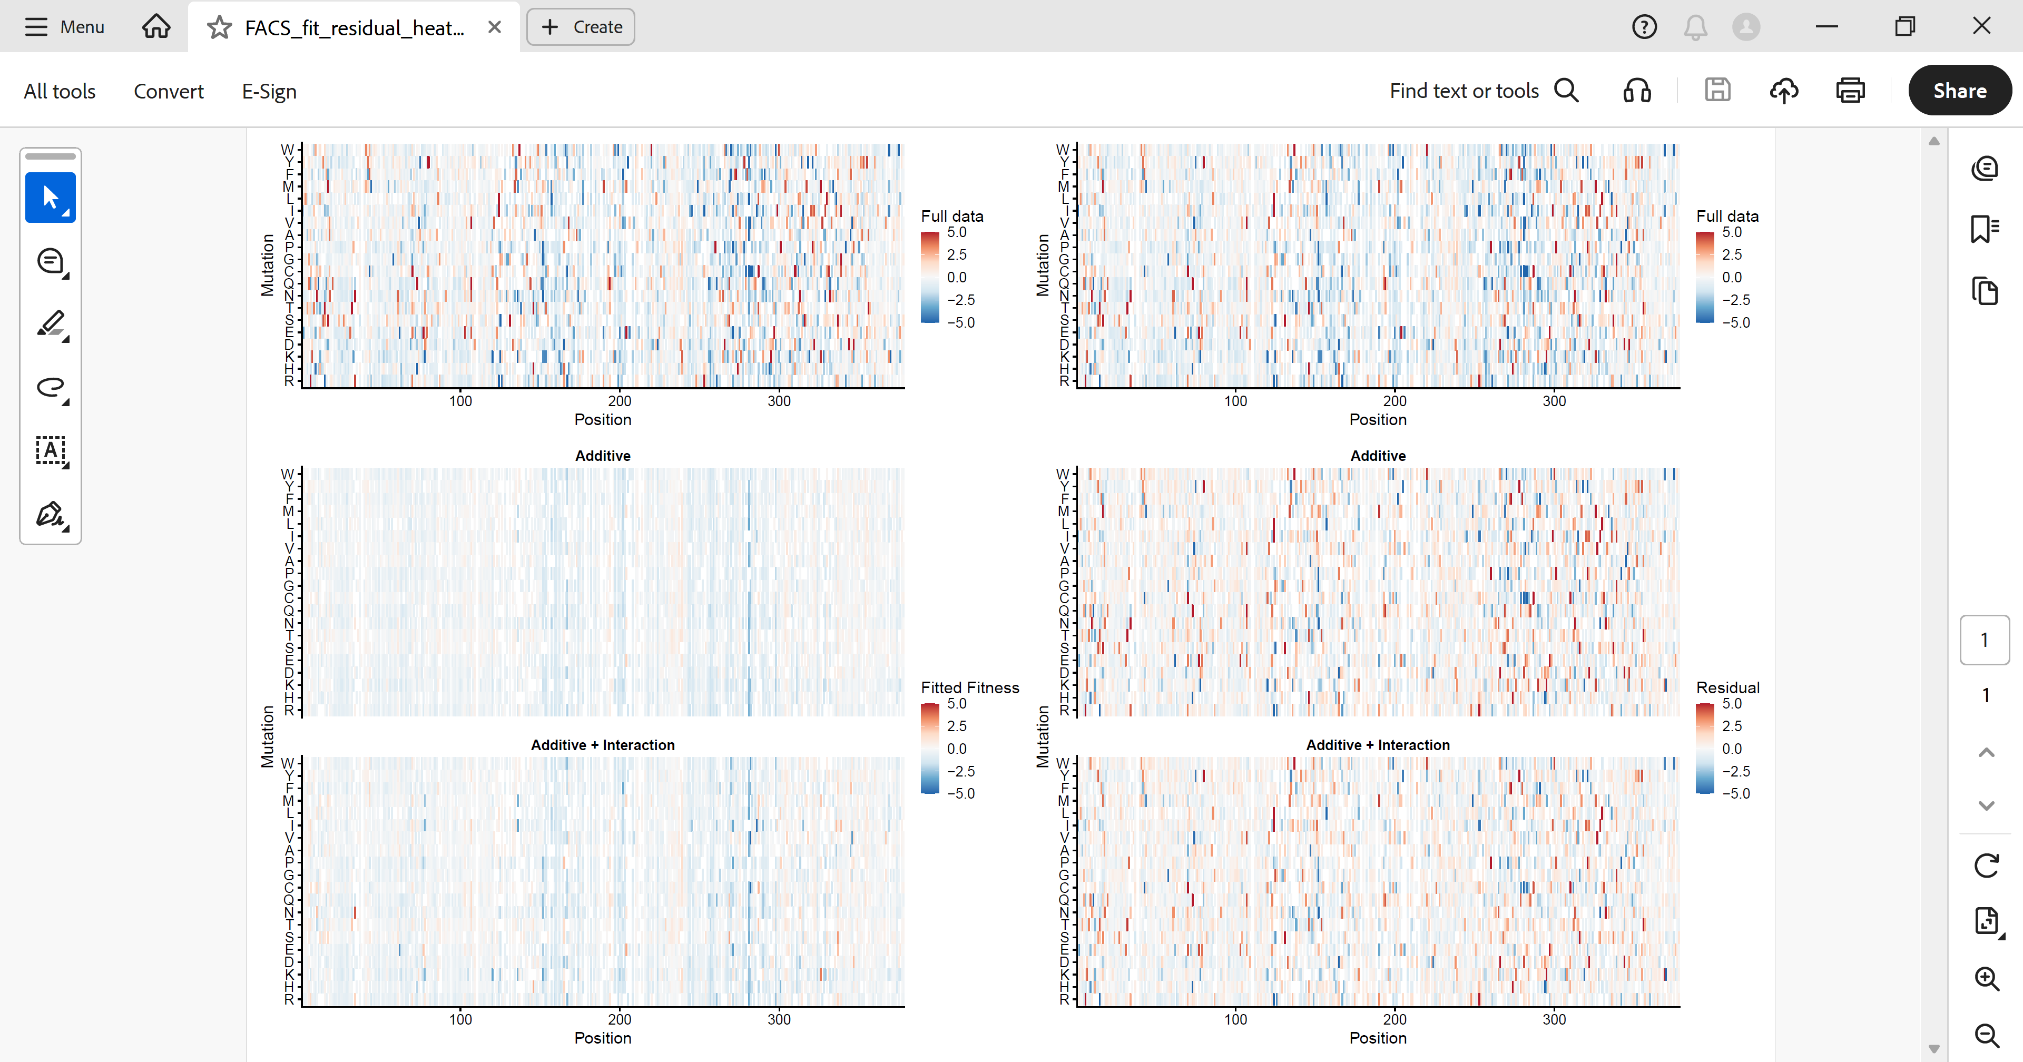
STING protein [Residue, Mutant AA] (duplicated left and right for easy visual comparison
P_{add} [Residue] + M_{add} [WT AA, Mutant AA]
STING protein [Residue, Mutant AA] - (P_{add} [Residue] + M_{add} [WT AA, Mutant AA])
P_{add} [Residue] + M_{add} [WT AA, Mutant AA] + P_{int} [Residue] * M_{int} [WT AA, Mutant AA]
STING protein [Residue, Mutant AA] -
( P_{add} [Residue] + M_{add} [WT AA, Mutant AA] + P_{int} [Residue] * M_{int} [WT AA, Mutant AA])

Slide 4
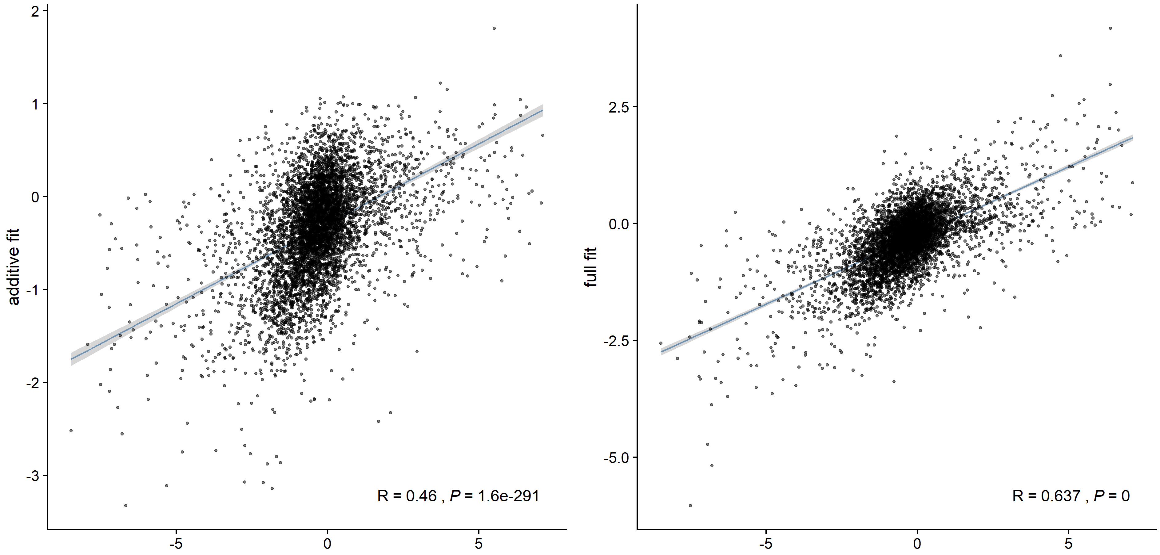
P_{add} [Residue] + M_{add} [WT AA, Mutant AA]
P_{add} [Residue] + M_{add} [WT AA, Mutant AA] + P_{int} [Residue] * M_{int} [WT AA, Mutant AA]
STING protein [Residue, Mutant AA]

