Slide 1
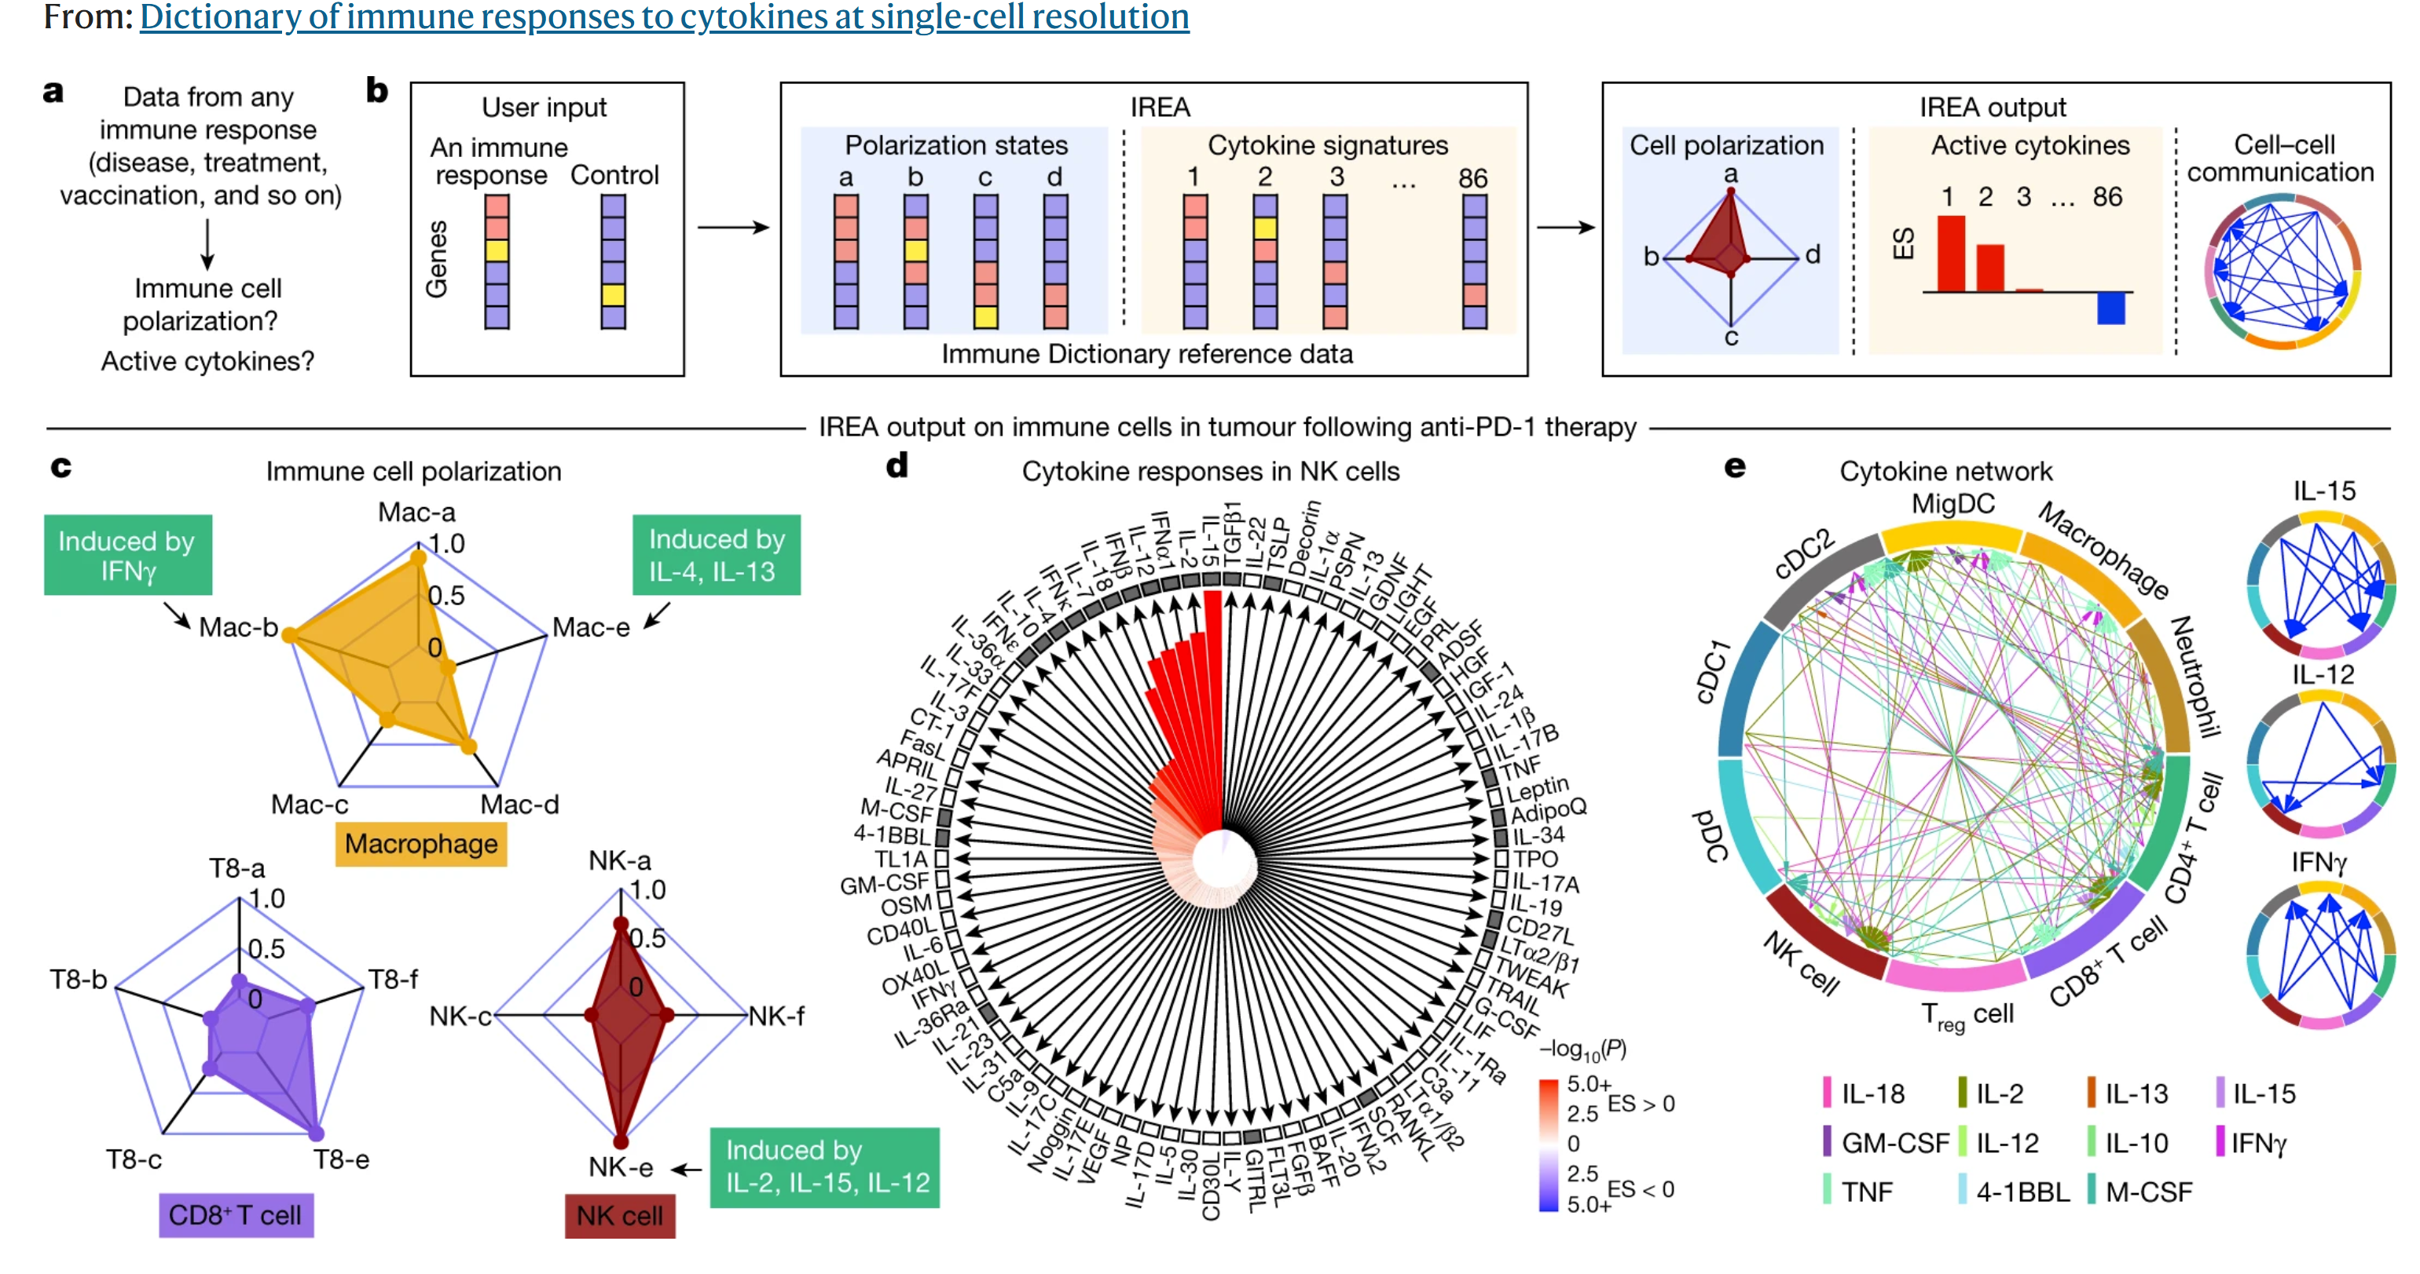

Slide 2
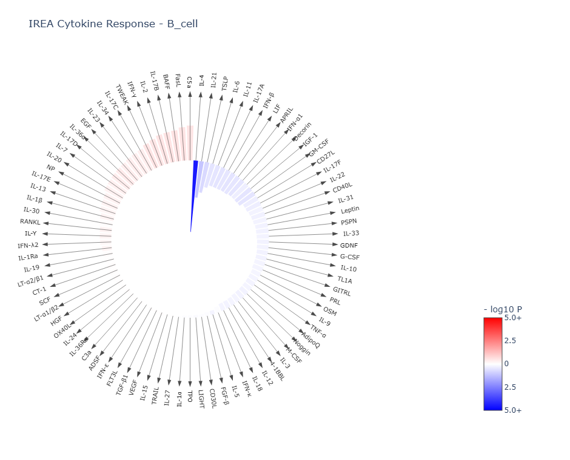
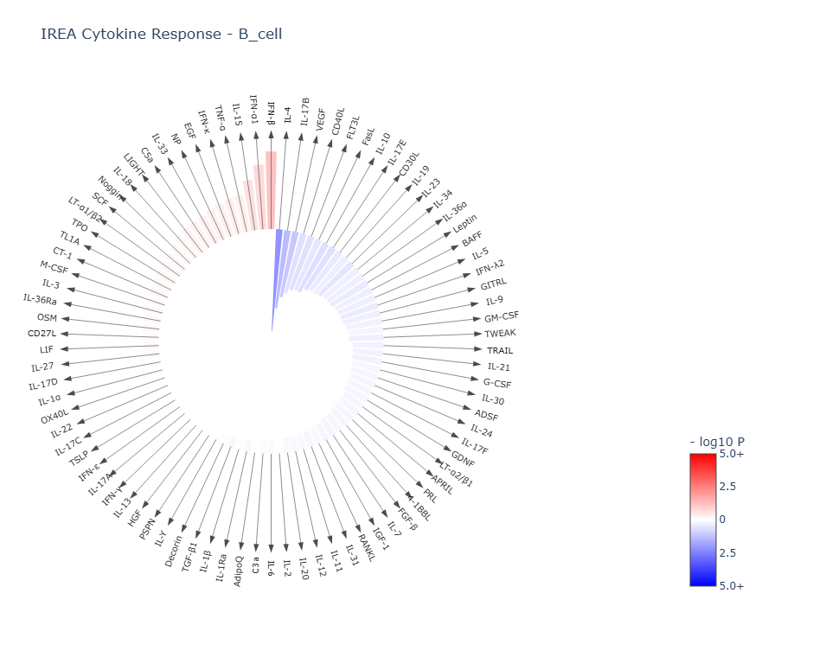
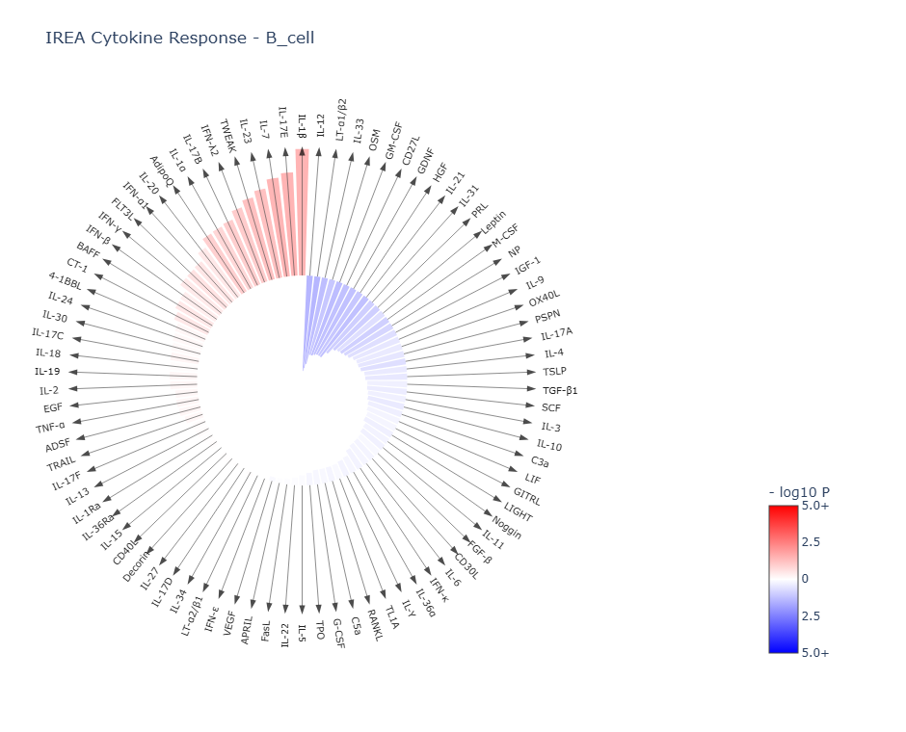
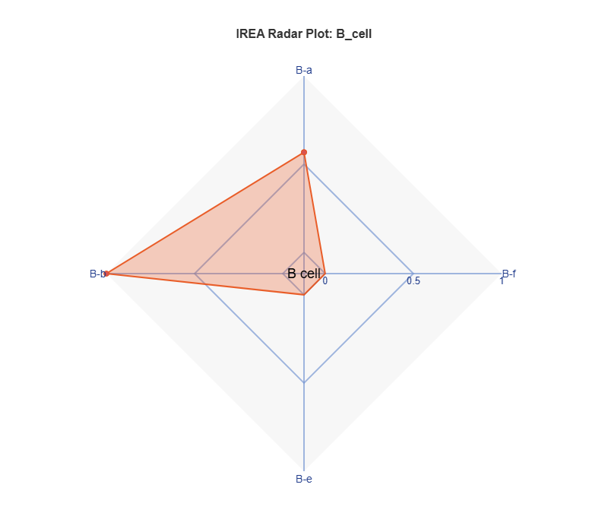
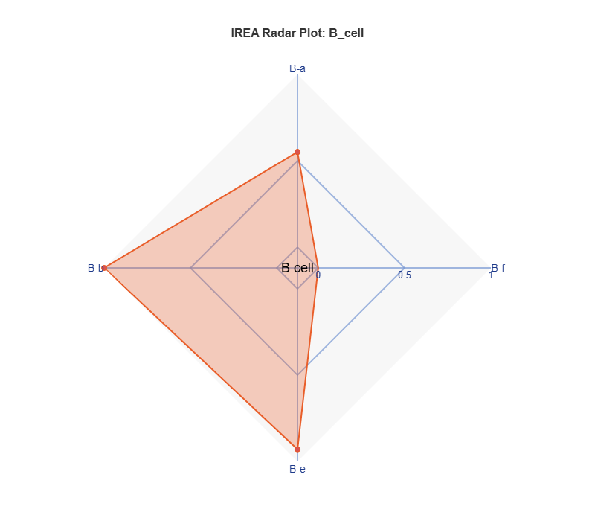
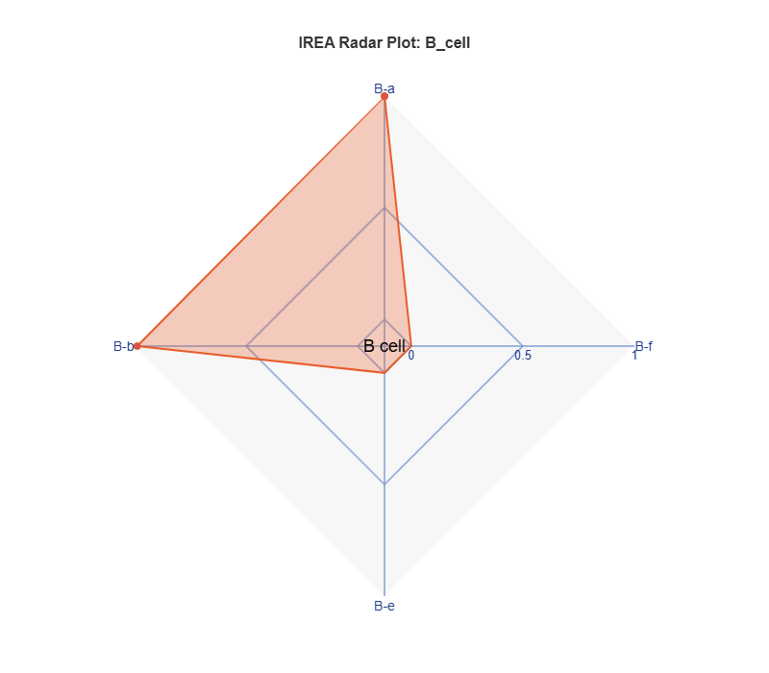
P13 K337 STOP

Slide 3
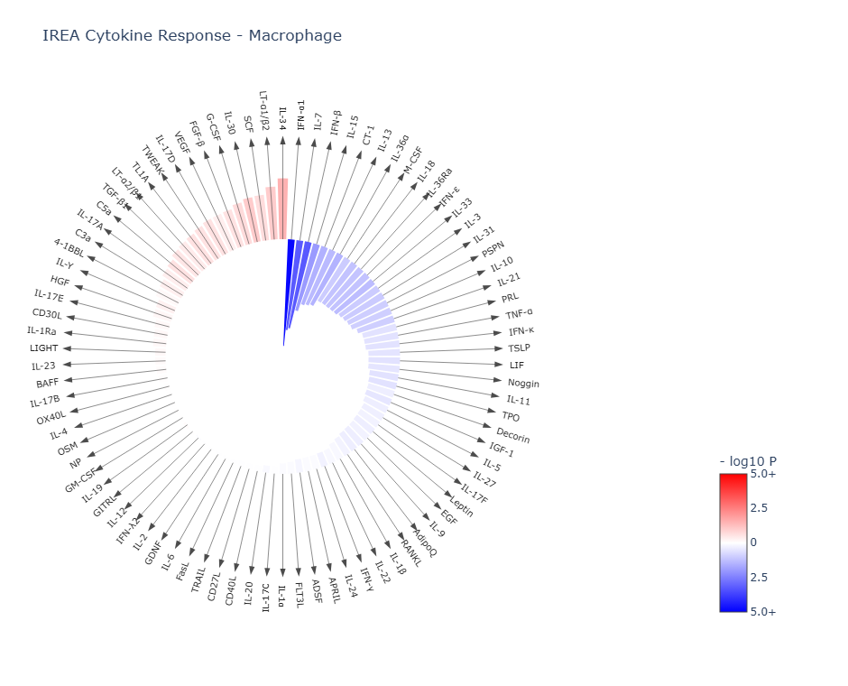
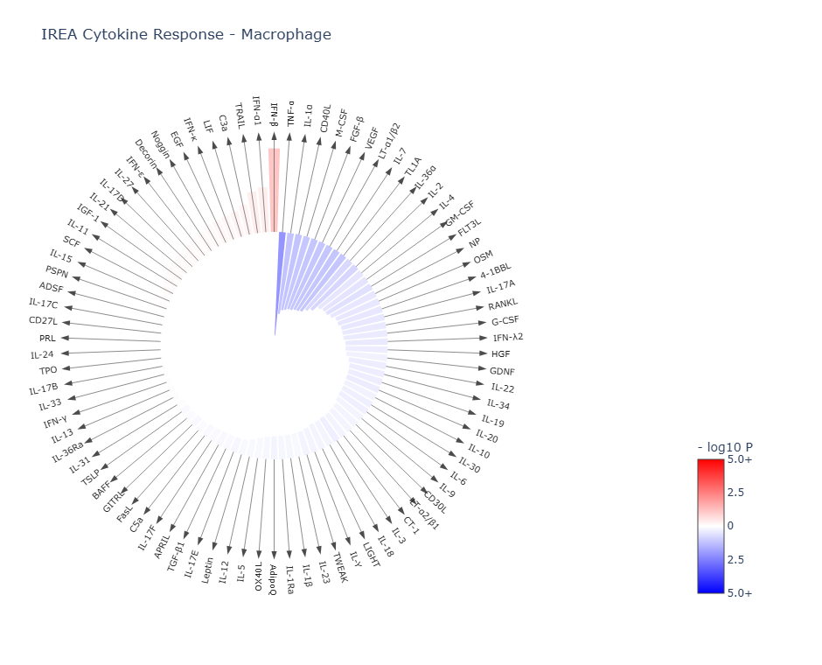
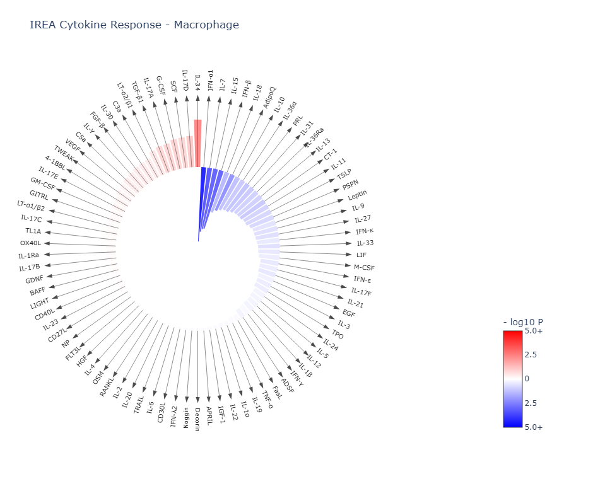
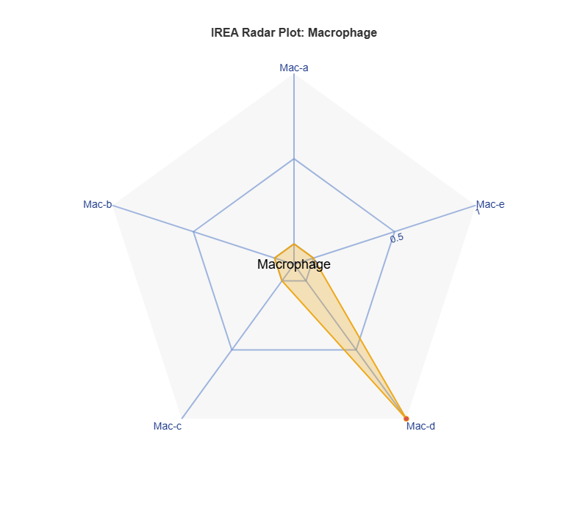
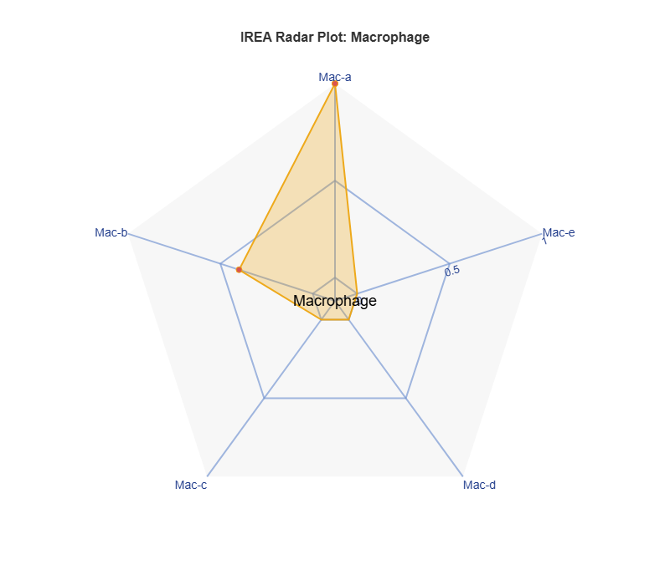
Alveolar macrophage
P13 K337 STOP

Slide 4
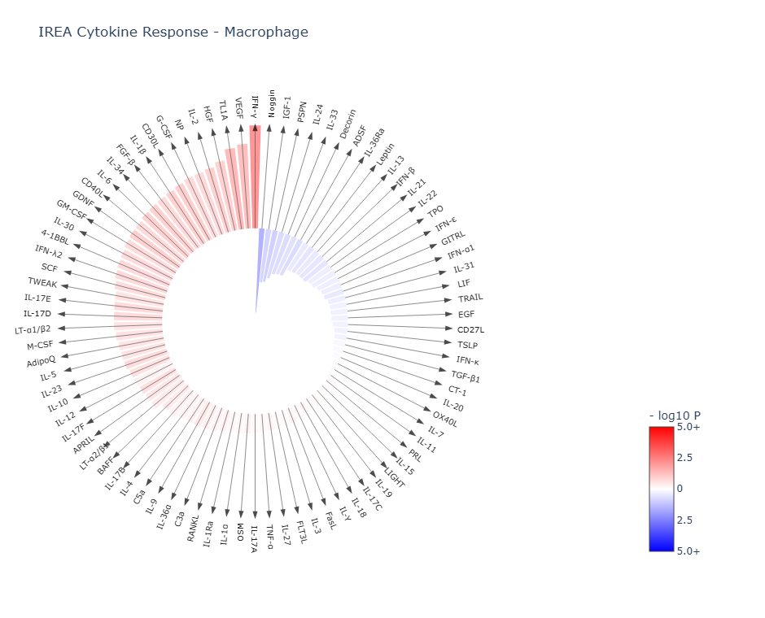
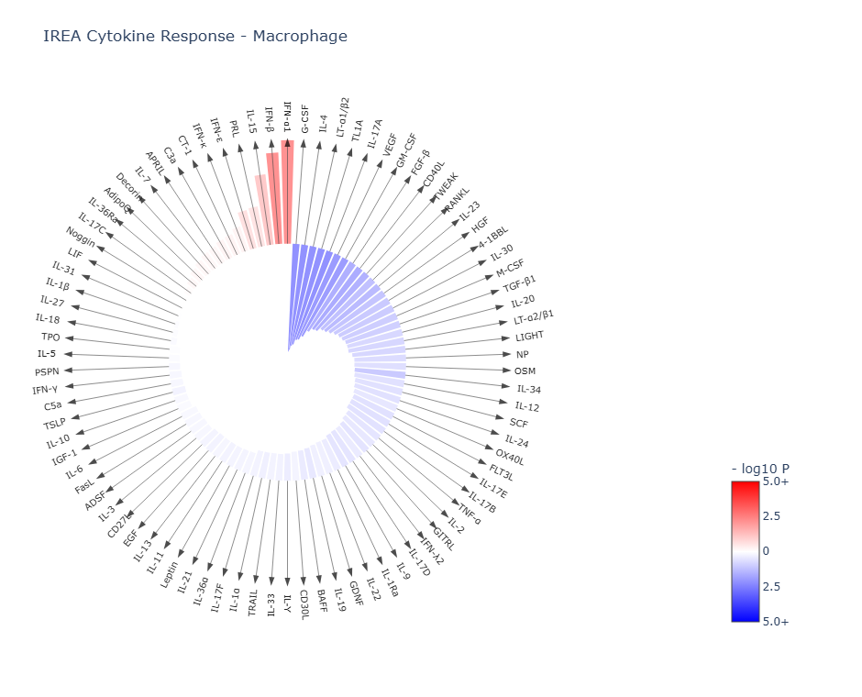
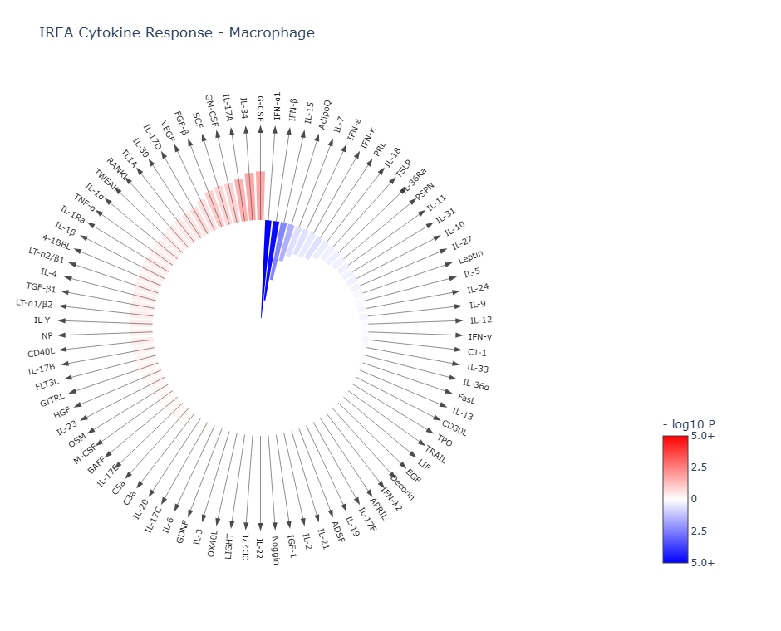
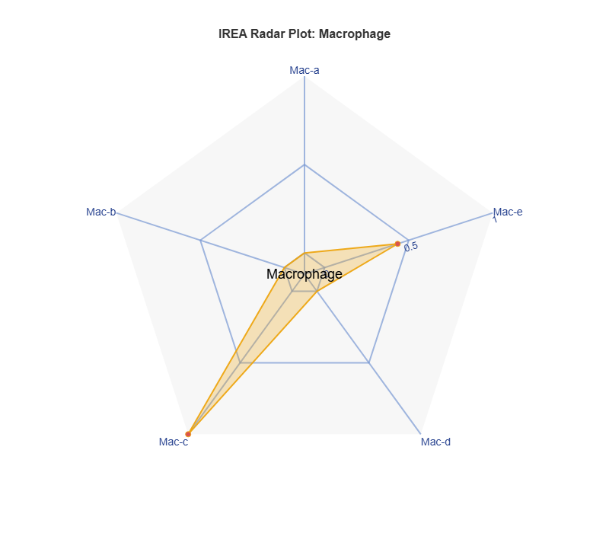
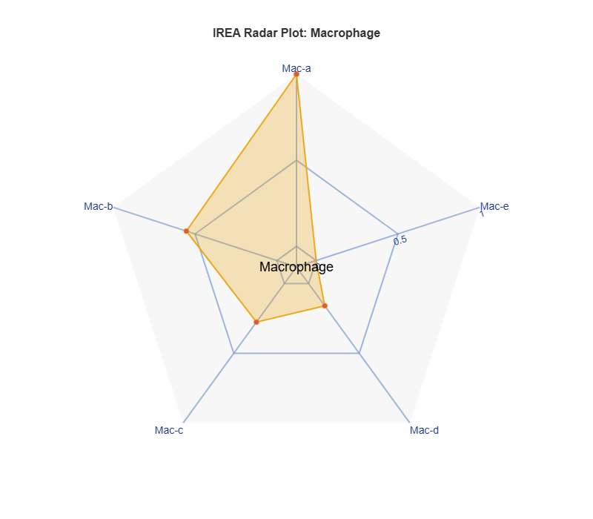
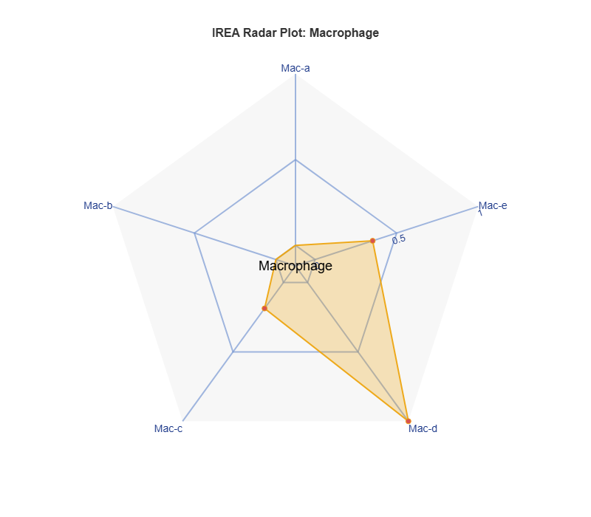
Interstitial macrophage
P13 K337 STOP

Slide 5
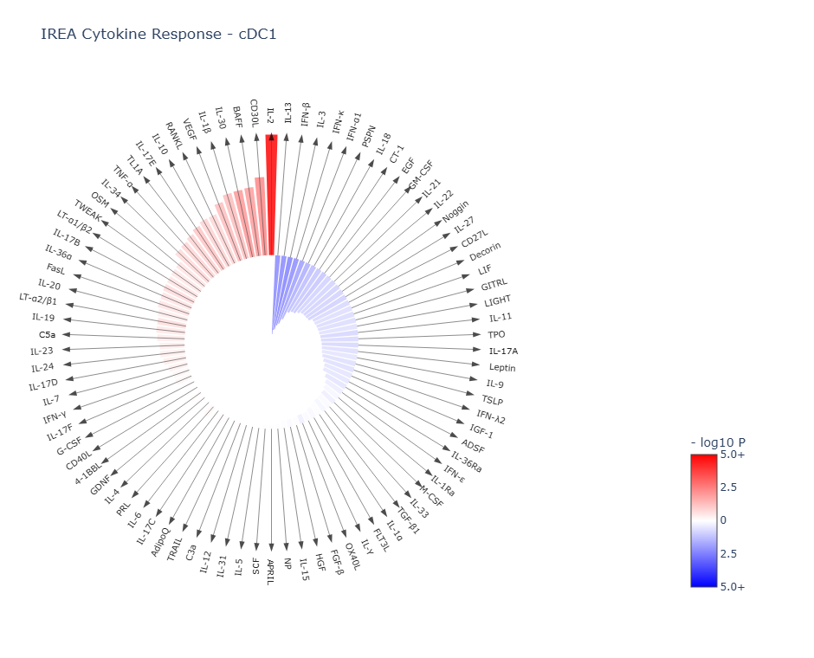
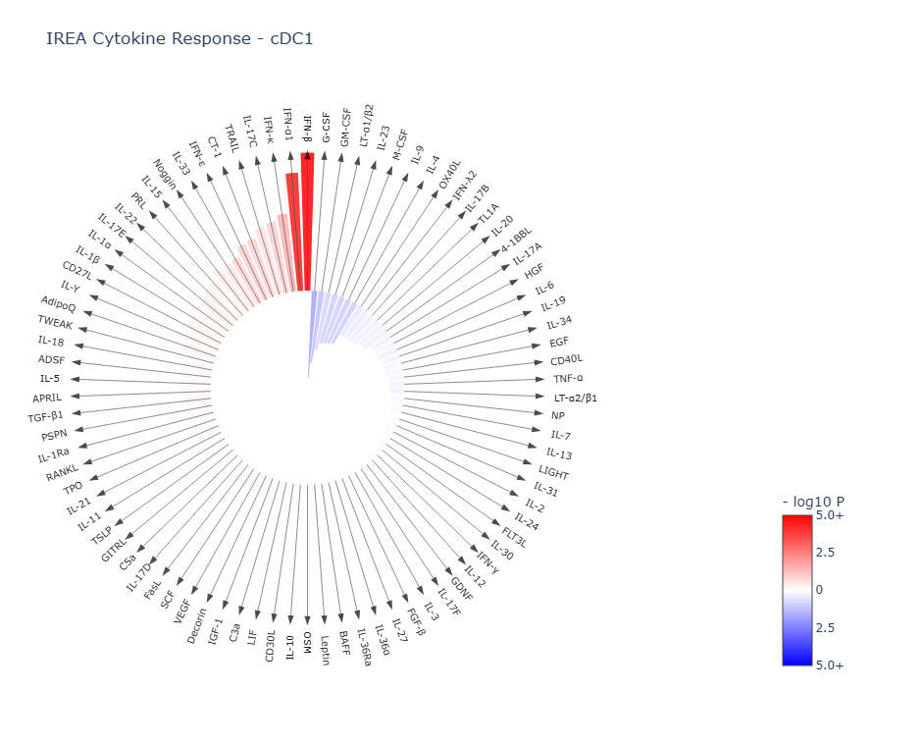
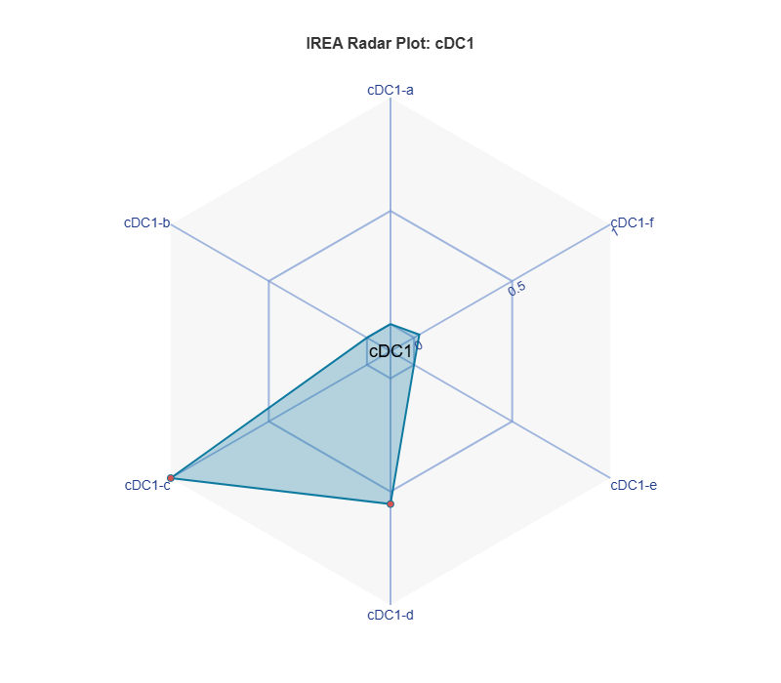
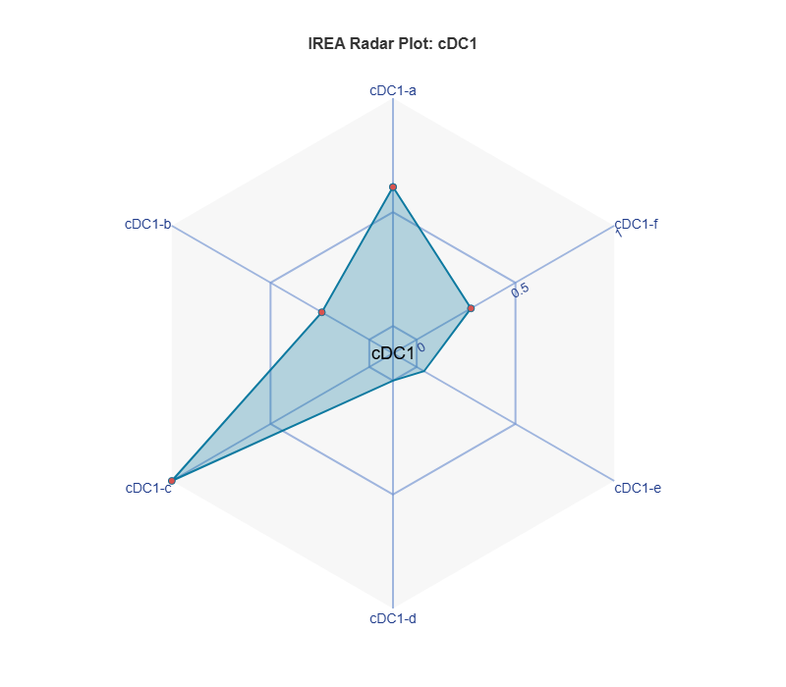
P13 K337 STOP

Slide 6
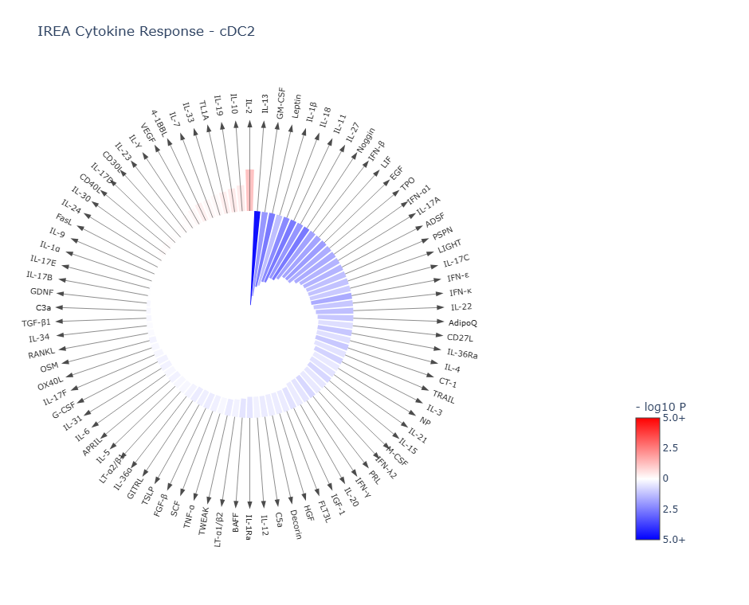
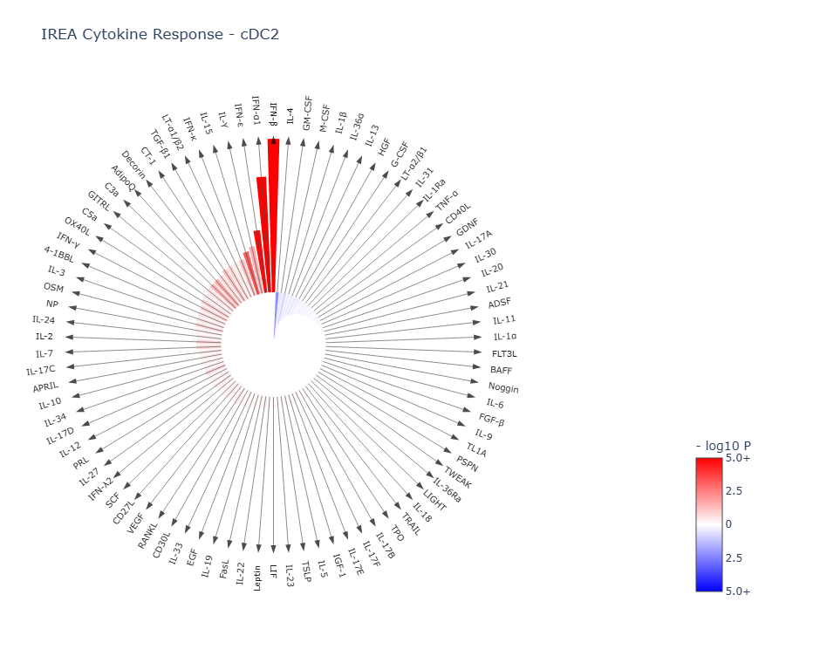
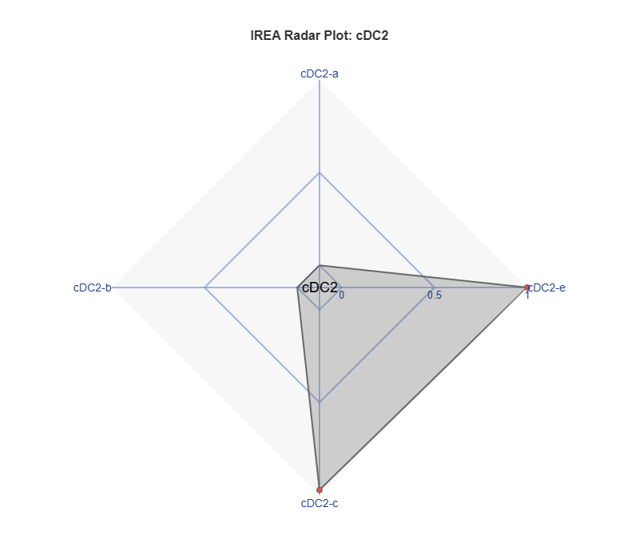
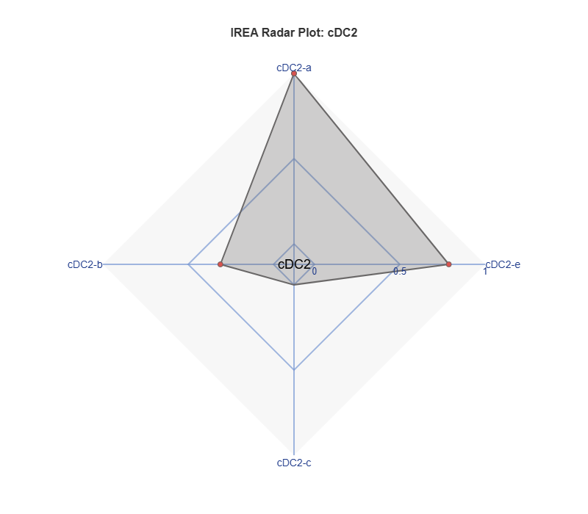
P13 K337 STOP

Slide 7
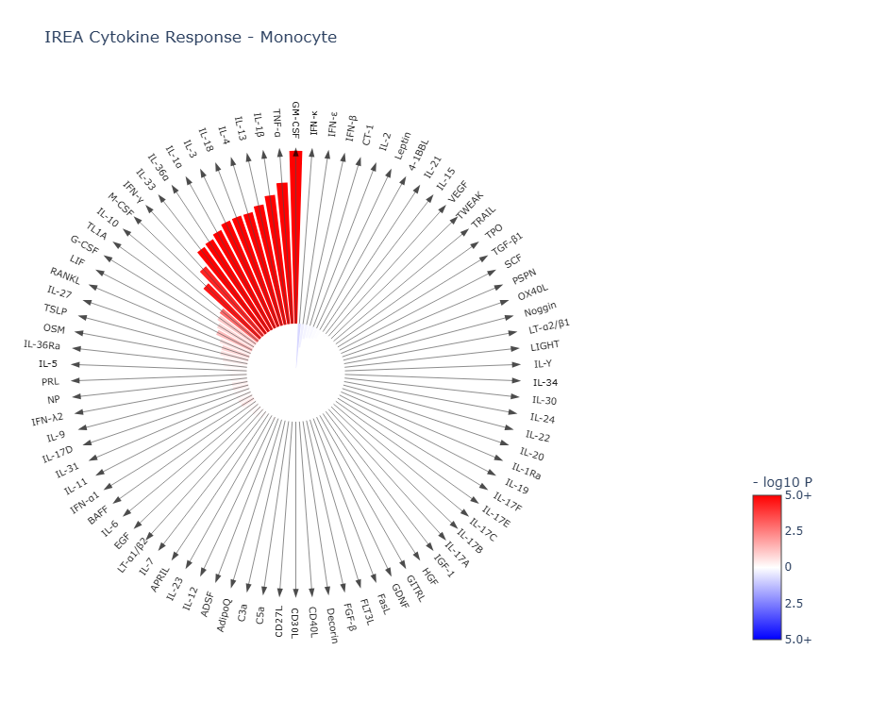
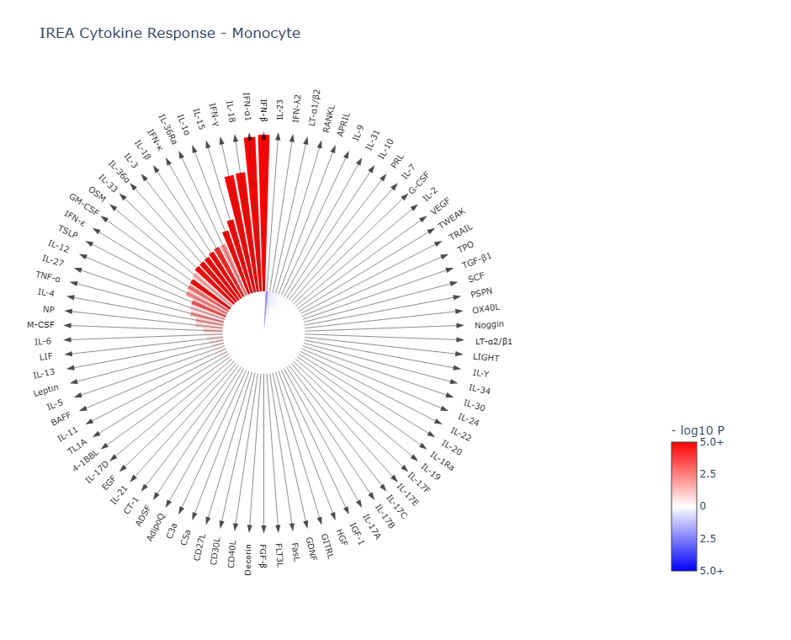
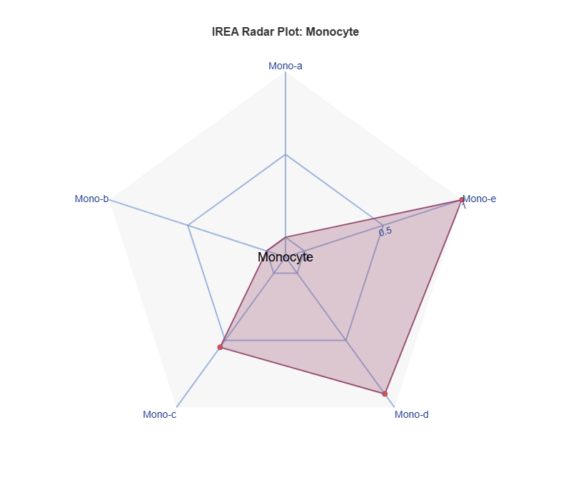
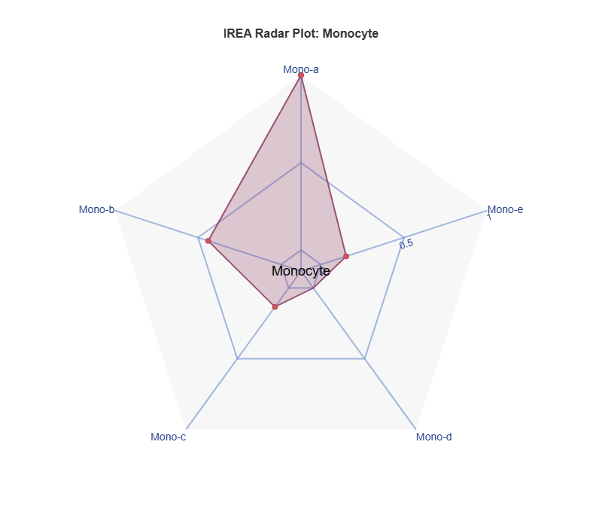
P13 K337 STOP
Notes:
Inflammatory mono

Slide 8
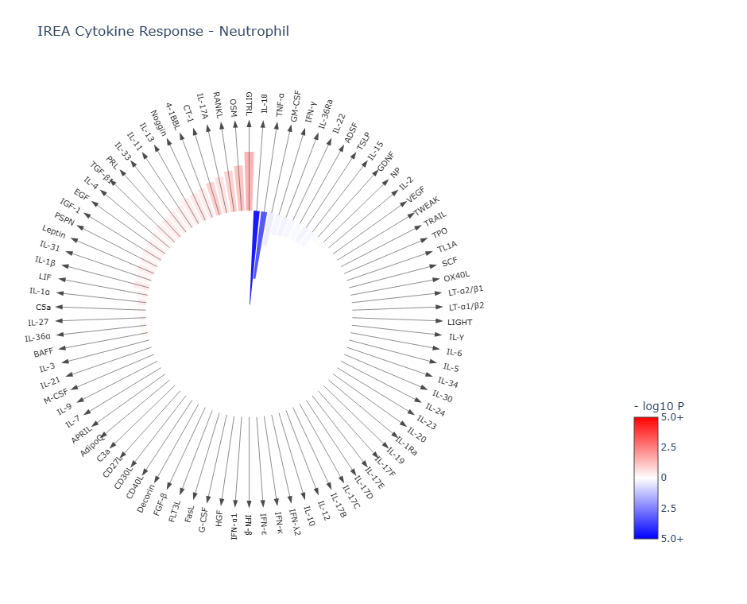
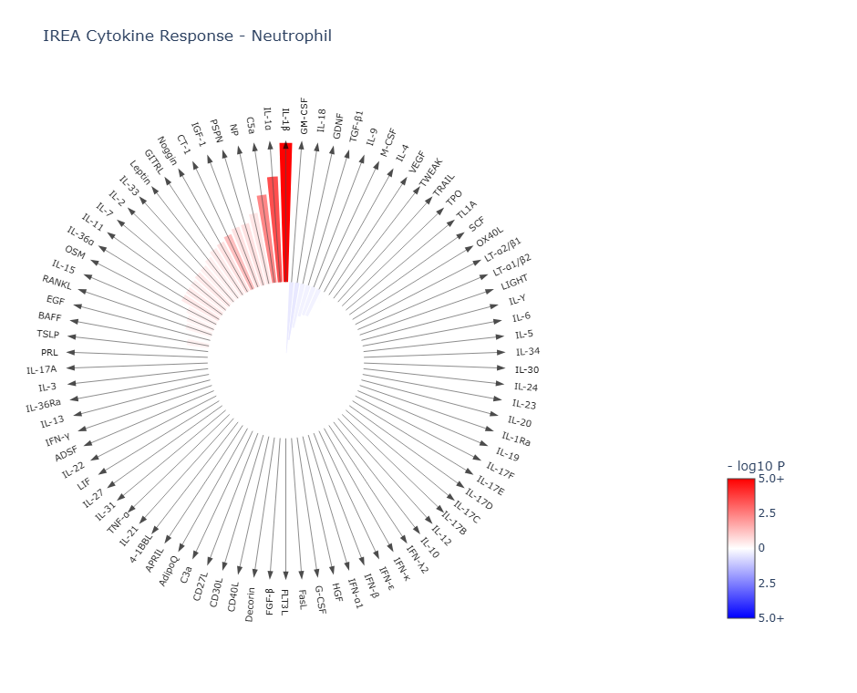
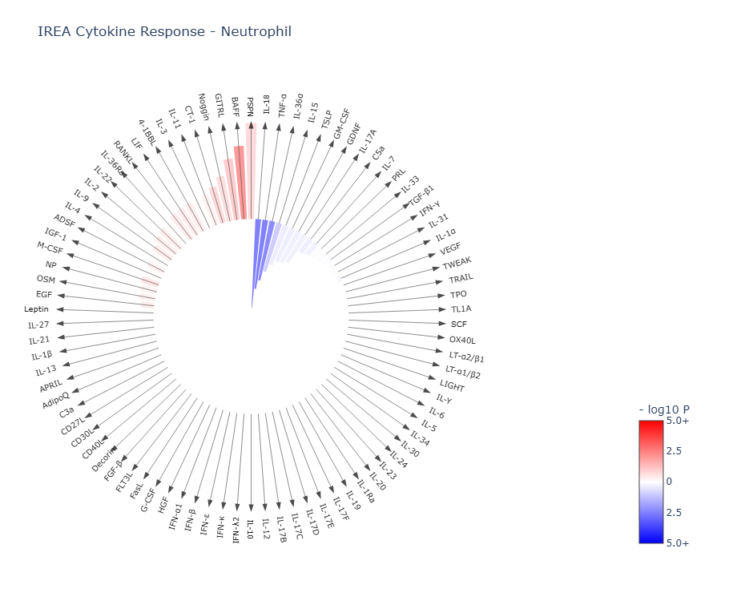
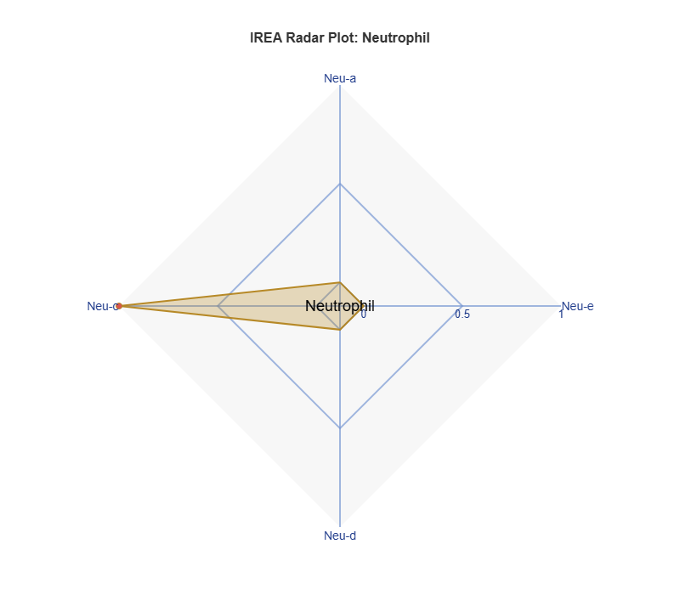
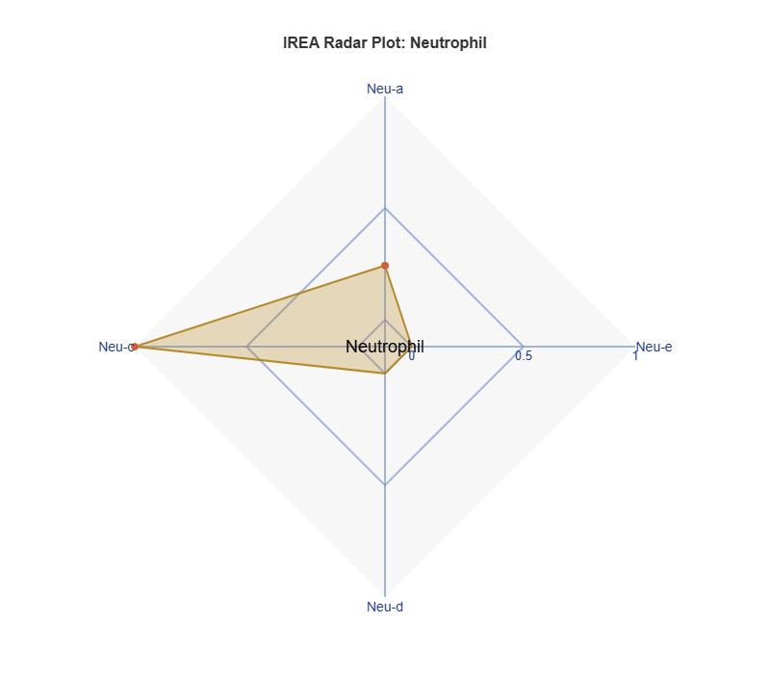
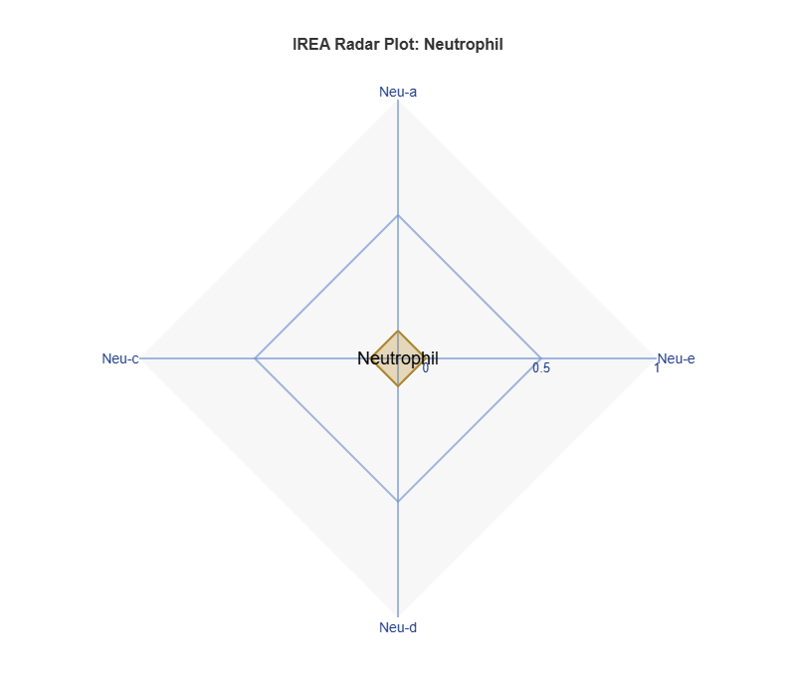
P13 K337 STOP

Slide 9
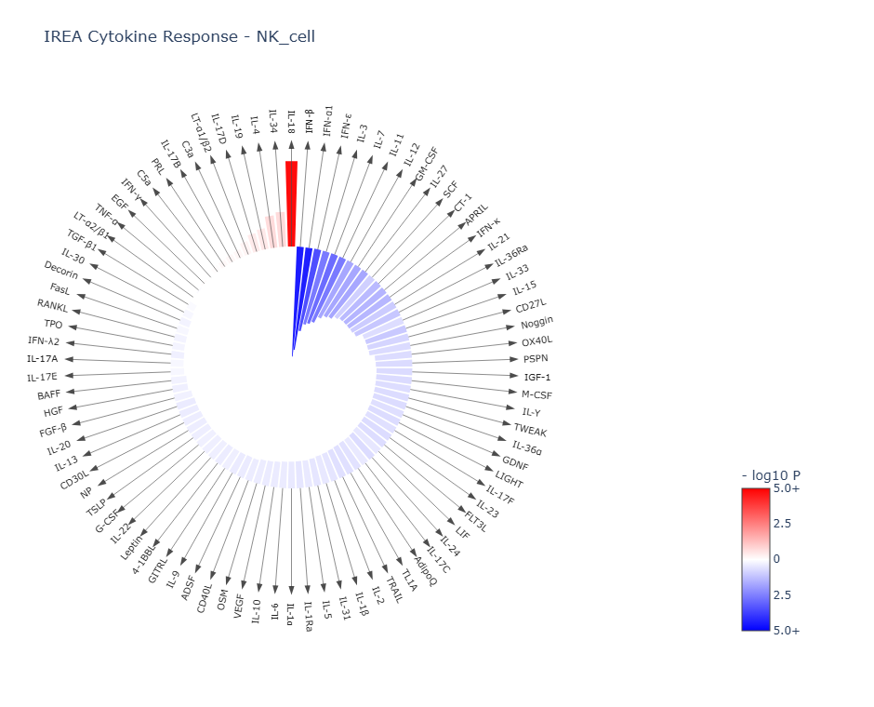
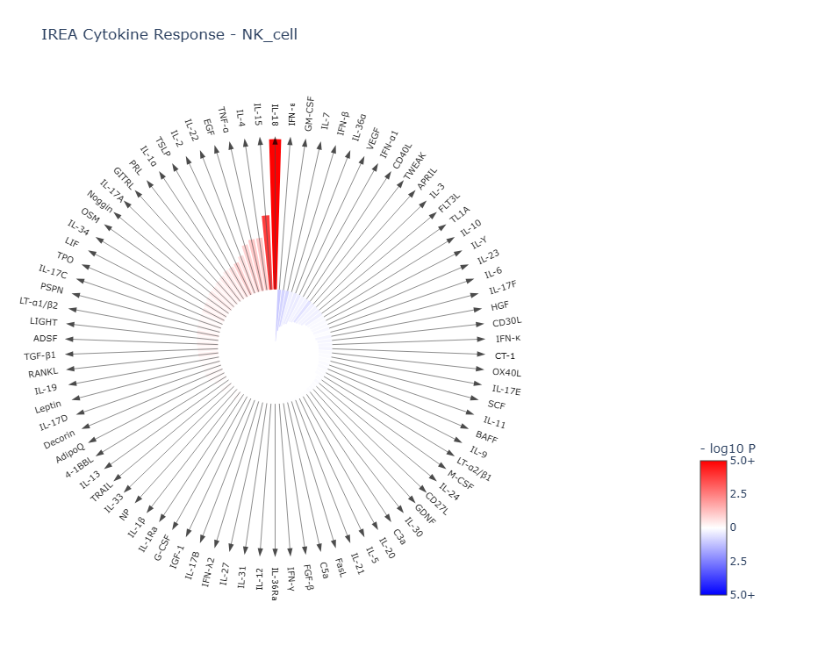
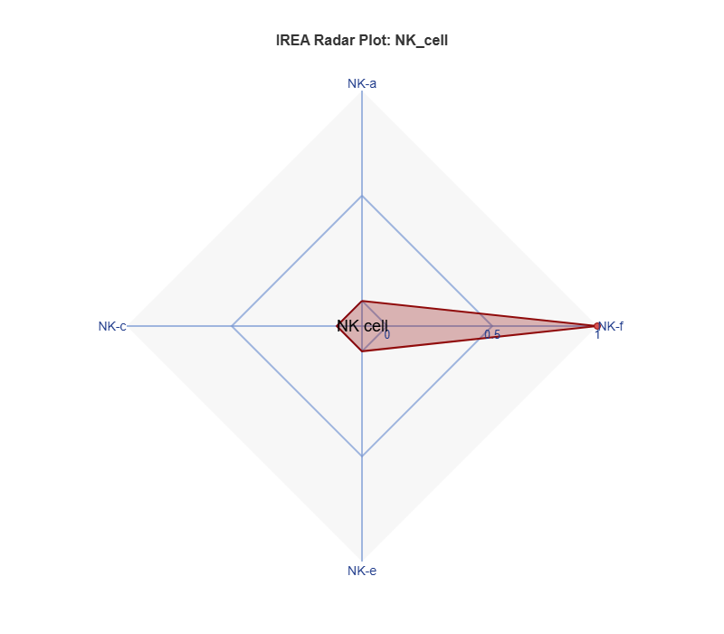
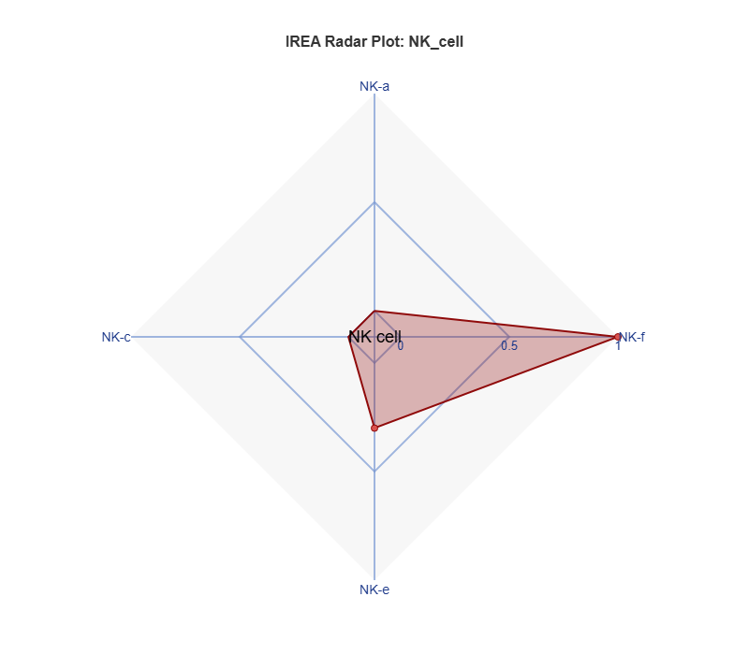
P13 K337 STOP

Slide 10
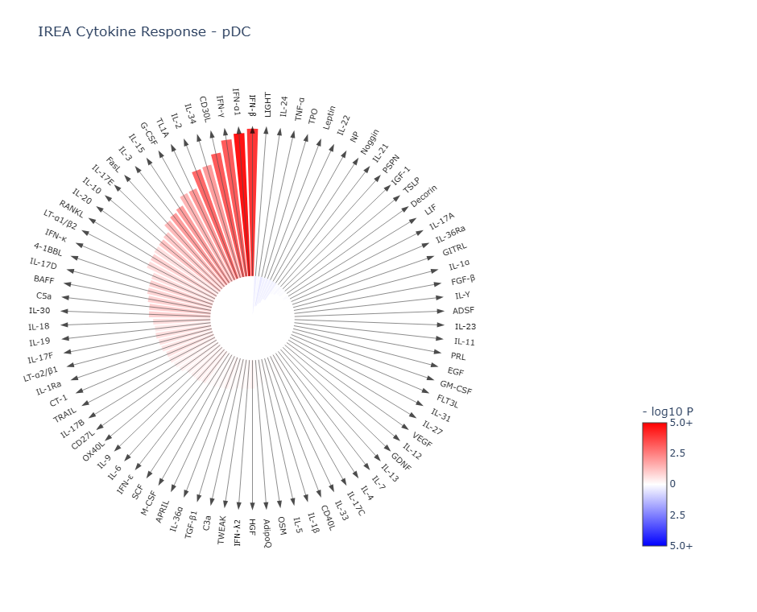
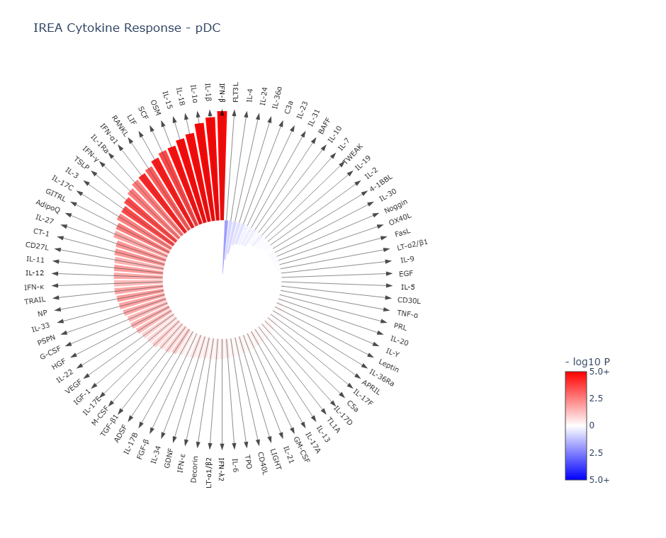
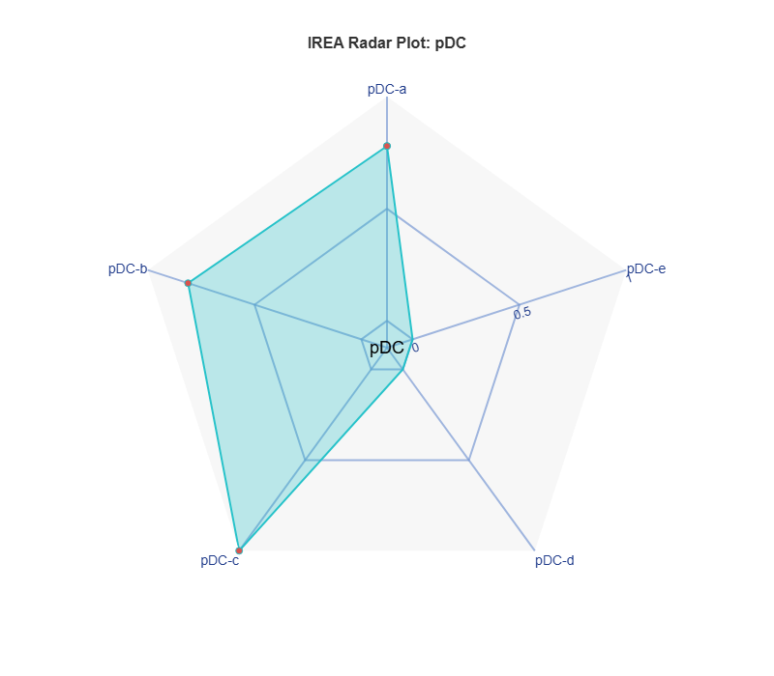
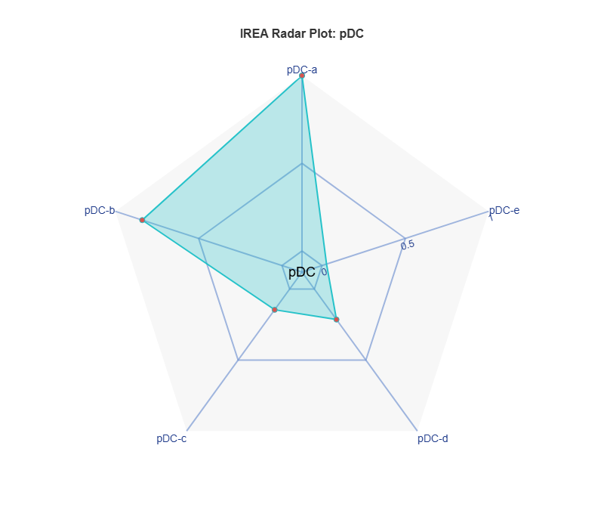
P13 K337 STOP

Slide 11
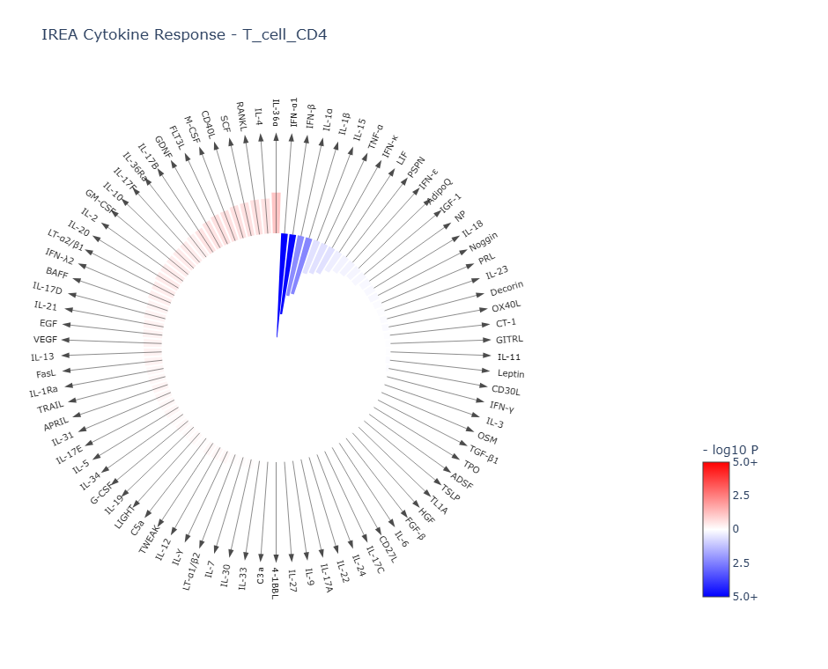
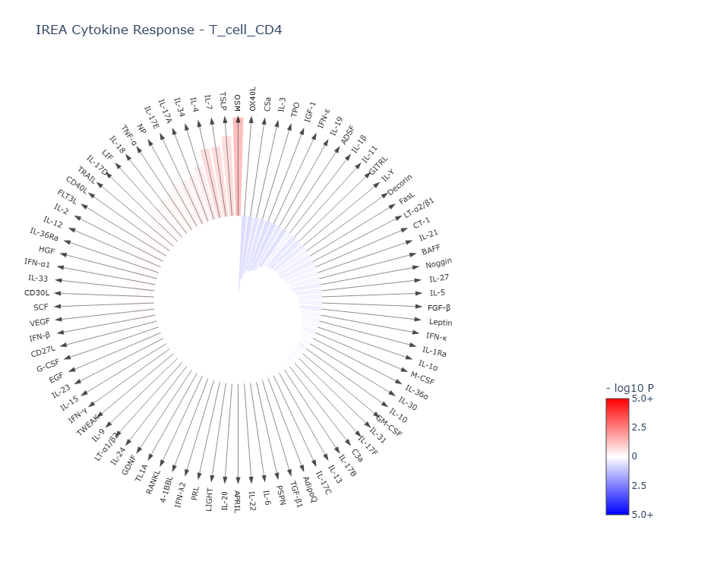
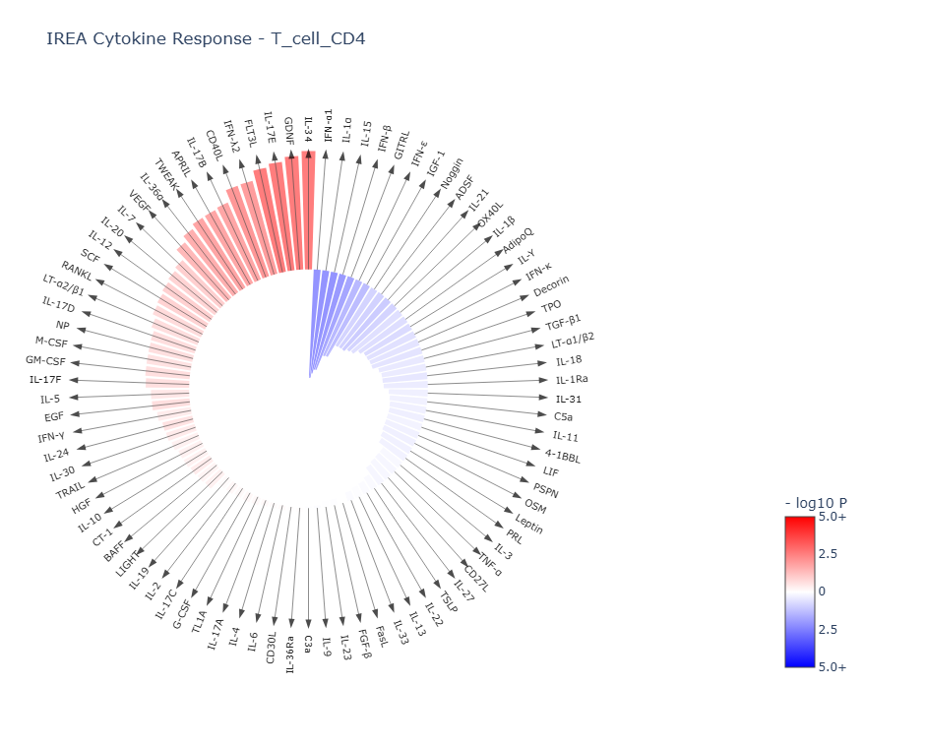
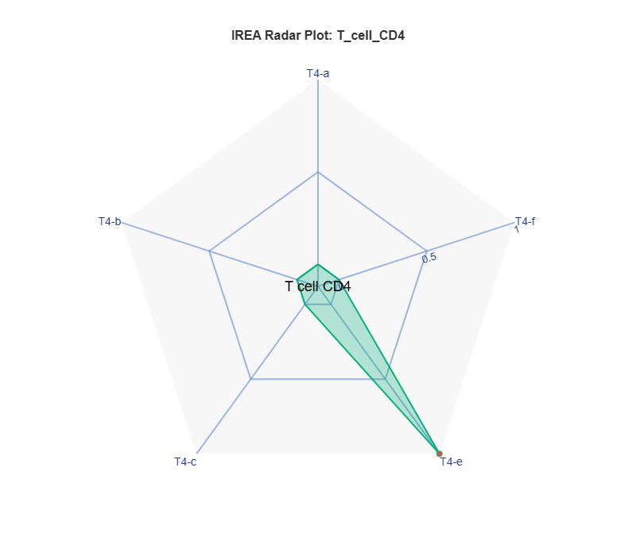
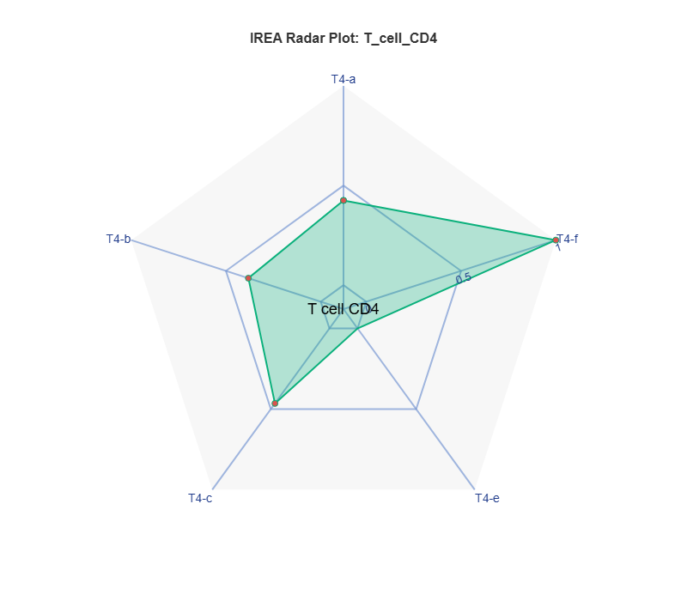
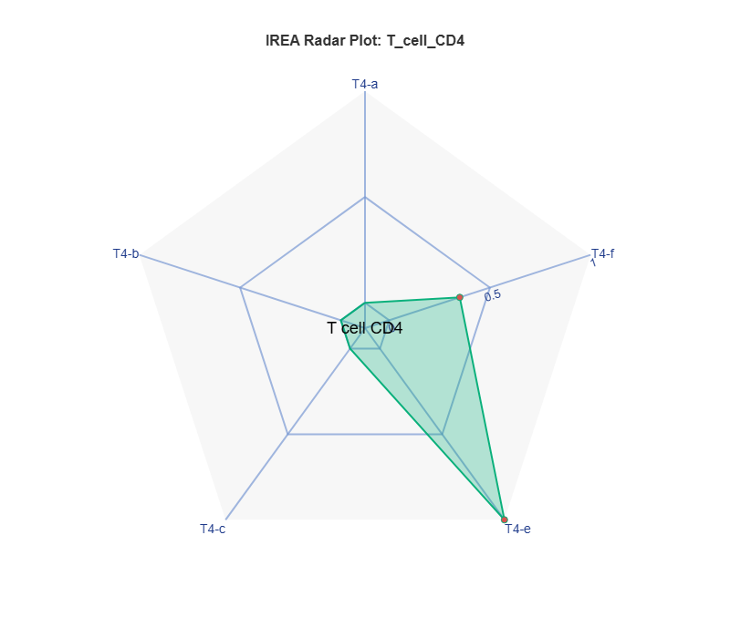
Naïve CD4
P13 K337 STOP

Slide 12




Activated CD4

Slide 13




Naïve CD8
P13 K337 STOP

Slide 14




Exhausted CD8
P13 K337 STOP

Slide 15




P13 K337 STOP

Slide 16




P13 K337 STOP

Slide 17
Overall theme: K337 drives broader and stronger immune activation than P13
Both variants shift the TME toward inflammatory states, but they do so with meaningfully different magnitudes and cell-type preferences.
Myeloid compartment
Alveolar macrophages (slide 3): P13 shows only a weak Mac-d signal with a muted cytokine circle, mostly near-null. K337 produces a strong Mac-a polarization (IFNα1/IFNβ/IFNε/IFNκ-driven, per the PDF) with a clearly dominant red arc in the cytokine wheel — a much stronger type-I interferon response.
Interstitial macrophages (slide 4): A striking contrast. P13 drives moderate Mac-c/Mac-d polarization (TNF and IL-1α/β states). K337 produces a much larger Mac-a + Mac-b polygon — a combined type-I IFN and IFNγ/IL-2/IL-12 response — suggesting K337 pushes interstitial macrophages toward both antiviral and classical activation simultaneously.
Inflammatory monocytes (slide 7): One of the most dramatic differences. P13 polarizes strongly toward Mono-d and Mono-e (TNF/GM-CSF states), with a large cytokine signal. K337 instead favors Mono-a (IFNα1/IFNβ) strongly, plus Mono-b — a sharper type-I IFN bias. The shapes are quite different, suggesting these variants activate monocytes through distinct cytokine programs.
cDC1 (slide 5): P13 produces a cDC1-c/cDC1-d dominant shape (IL-1α/β and TNF states). K337 shows a more balanced polygon shifted toward cDC1-a and cDC1-b — the IFN-I and IFNγ/IL-2/IL-12/IL-15/IL-18 states, implying K337 may better support DC cross-presentation capacity.
cDC2 (slide 6): Both variants strongly activate cDC2, but differently. P13 heavily polarizes toward cDC2-c (IL-1α/IL-1β/TNF state) with a very pronounced downward spike. K337 achieves a more balanced full-pentagon activation hitting cDC2-a (IFN-I), cDC2-b (IFNγ/IL-2 axis), and cDC2-c simultaneously — broader cDC2 activation overall.
Neutrophils (slide 8): P13 shows a Neu-d-dominant signal (TNF state). K337 shows a similar but slightly stronger Neu-a (IFNα1/IFNβ) and Neu-d combination. Both are relatively weak compared to other cell types.
pDC (slide 10): The most similar results between variants — both massively activate pDCs with near-saturating red cytokine arcs and large overlapping polygons hitting pDC-a, pDC-b, pDC-c, and pDC-d. K337 is modestly stronger in pDC-d and pDC-c (IL-1α/β and TNF states). Given pDCs are the primary IFN-I producers, this convergence makes biological sense.
Lymphoid compartment
B cells (slide 2): P13 produces a modest B-a/B-e dominant pattern (IFN-I and CD40L/IL-21 states). K337 drives a clearly stronger and broader response, particularly B-a and B-e, indicating K337 more potently engages B cell activation and potentially germinal center programs.
Naïve CD4+ T cells (slide 11): P13 shows a limited T4-c/T4-e signal (IL-1α/β and IL-36α/TL1A). K337 is substantially more activated, with a large polygon spanning T4-a (IFN-I), T4-b (IFNγ/IL-2/IL-12/IL-15/IL-18), and T4-f — suggesting K337 drives stronger priming of both IFN-responsive and classically activated Th1-like states.
Activated CD4+ T cells (slide 12): Both are strong, but K337 again fills more of the pentagon — particularly T4-a and T4-b — suggesting more robust Th1/IFN polarization. P13 is weighted more toward T4-b alone.
Naïve CD8+ T cells (slide 13): A notable difference. P13 yields a T8-c/T8-e shape (IL-1α/β and IL-2/IL-15/IL-36α), relatively modest. K337 produces a much larger activation across T8-a (IFN-I), T8-b (IFNγ/IL-2/IL-12), and T8-e — a stronger and more broadly primed CD8 response, which could mean better antitumor CD8 capacity.
Exhausted CD8+ T cells (slide 14): P13 barely registers a signal here — the polygon is nearly flat. K337 shows a meaningful T8-c/T8-e pattern. This is interesting: K337 may be more capable of reactivating or reprogramming exhausted CD8s, though the signal is still not large.
γδ T cells (slide 15): One of the most dramatic pairwise differences in the dataset. P13 produces only a narrow Tgd-a spike (IFN-I). K337 drives a very large, broad polygon spanning Tgd-a, Tgd-b, Tgd-c, and Tgd-e — engaging IFN-I, IFNγ/IL-2/IL-12/IL-15/IL-18, IL-1α/β, and IL-2/IL-7/IL-15/IL-18/IL-36α states simultaneously. K337 appears to be a potent activator of γδ T cells in particular.
Tregs (slide 16): The most striking asymmetry. P13 shows essentially no Treg polarization — a near-flat diamond. K337 produces a large symmetric Treg-a/Treg-c polygon, meaning K337 significantly activates Tregs (driven by IFN-I and IL-1α/β/IL-36α/TNF per the PDF). This is a double-edged finding: K337's broader immune activation may be partially counterbalanced by Treg induction, potentially limiting its net antitumor efficacy despite the stronger overall signals.
Summary table
The central biological interpretation is that K337 is a more potent immune activator across virtually every immune cell type, engaging type-I IFN and IFNγ/IL-2/IL-12 programs broadly. However, its simultaneous strong Treg induction — absent in P13 — raises the question of whether this immunosuppressive counterforce tempers its antitumor benefit. P13's narrower activation profile, while weaker, avoids Treg induction, which could be advantageous depending on the therapeutic context.

Slide 18


