Slide 1
Knowledge Graphs for System Integration Risk
EM 626 · AI/ML FOR SYSTEMS · PROJECT 2 · MIDTERM
Can an LLM find a system’s weakest link before it breaks? First evidences from two open-source microservice apps
Team: Sai Bhavesh Karnam, Laukik Nandkishor Pawar
Stevens Institute of Technology · November 2026
Notes:
This is Project 2, Knowledge Graphs for System Integration Risk. Our project asks a simple question: if an engineer hands an LLM the design docs for a system, can the pipeline correctly find the components whose failure would hurt the system most? Today I’ll show what is built so far and what the first results say.

Slide 2
Which component would hurt the system most if it failed, and can the pipeline find it from the docs alone?
THE QUESTION
1 · Read
2 · Map and score
3 · Learn and advise
An LLM reads a system’s design documentation and lists its components and dependencies.
The list becomes a directed graph. Each component is scored by how much of the system fails with it.
A GNN and a graph Transformer learn to predict risk. An LLM turns results into design advice.
Our angle: we use real open-source apps whose deployment configs reveal the true wiring, so every stage can be checked against an answer key instead of eyeballed.
Notes:
Most versions of this project stop at a single hand-written system description. We picked systems that come with deployment configs, which list the real connections. That lets us measure how accurate each stage is.

Slide 3
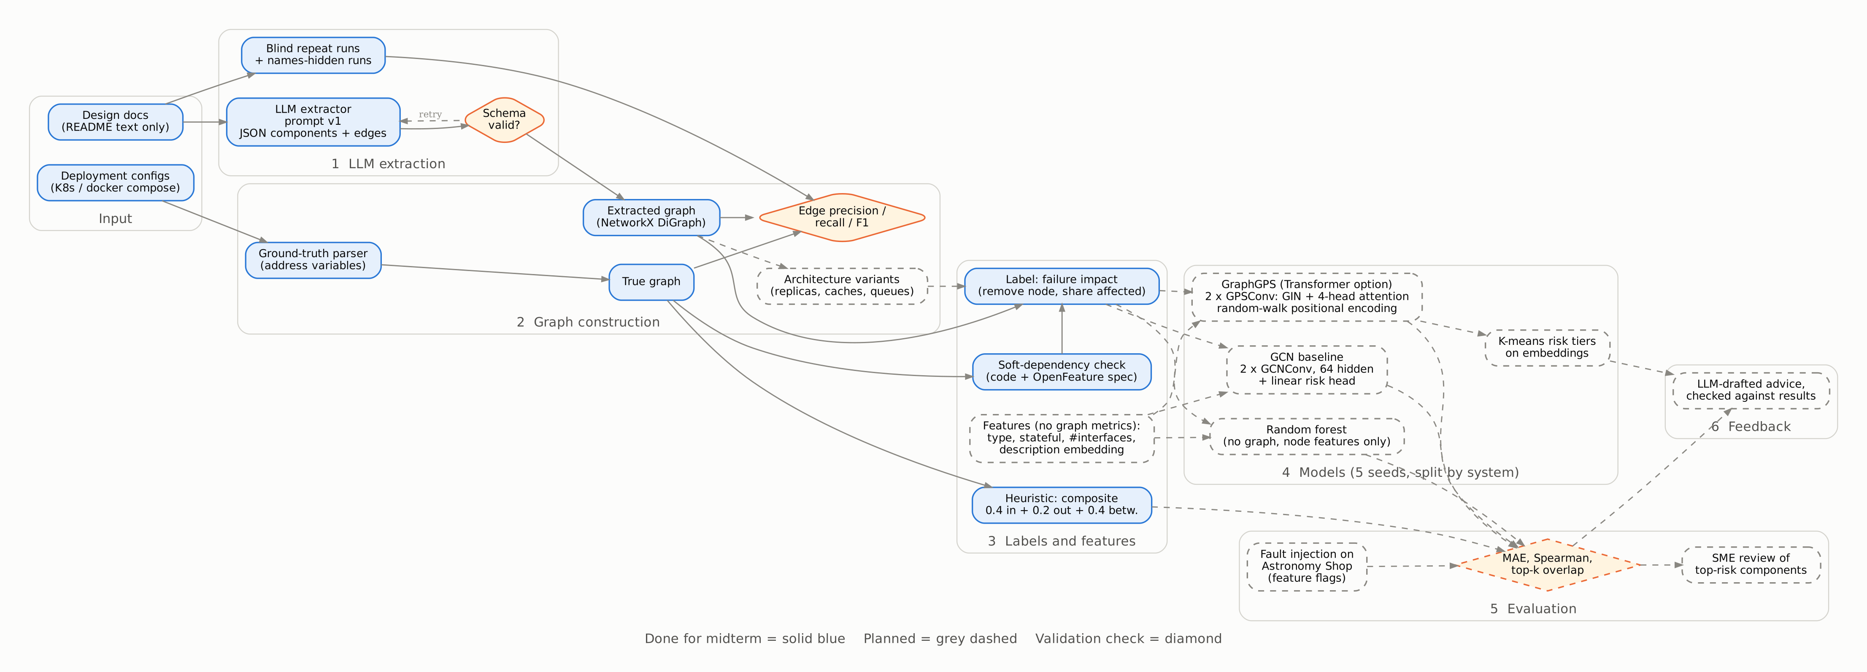
Six stages, with a validation check after each LLM step
PIPELINE DESIGN
Solid blue = built for the midterm · grey dashed = planned · diamond = validation check
Notes:
Blue boxes are built and running today. Grey dashed boxes are planned, including the chosen models: a GCN baseline with two layers, and GraphGPS as the graph Transformer, which adds global attention so it can follow long failure chains. Each diamond is a check: the JSON schema check with retry after extraction, precision and recall against the configs after graph building, and the model evaluation at the end. The soft-dependency check uses source code to mark connections that don’t actually take the caller down.

Slide 4
Two real systems, each with docs for the LLM and configs as the answer key
DATA
 | Online Boutique (Google) | OpenTelemetry Astronomy Shop
What it is | E-commerce demo, 11 services over gRPC | E-commerce demo with a Kafka queue and feature flags
LLM input | README architecture section, 352 words | Main README + 16 service READMEs, 2,090 words
Answer key | Kubernetes manifests (*_ADDR variables) | docker compose files + .env (address variables)
True graph | 12 components, 16 dependencies | 21 components, 37 dependencies
Final-stage role | Training system | Held-out test system with built-in fault injection
Scope rule, applied the same way to the LLM and the answer key: application services, datastores, queues and config services count. Telemetry infrastructure does not.
Repos: GoogleCloudPlatform/microservices-demo @ c7cb6d5 · open-telemetry/opentelemetry-demo @ e22afe5
Notes:
The two docs are very different. Online Boutique has a short, clean architecture table. The Astronomy Shop docs are scattered across per-service READMEs that mostly describe how to build each service. That gives us an easy and a realistic case.

Slide 5
Six components run end to end from one script
PRELIMINARY LLM-GENERATED COMPONENTS
Component | What it does | Tested by
Extractor | Prompt v1 → JSON parts and edges, explicit or implied | Schema check + 17 tests
Ground-truth parser | Builds the true graph from K8s and compose configs | 8 tests + spot checks
Extraction evaluator | Node and edge precision, recall, F1 vs. the truth | 4 tests
Graph builder | Stats, failure impact, composite, soft-edge check | 8 tests
Anonymizer | Replaces service names with codes for the blind test | 3 tests
Blind-run scorer | Scores 9 blind runs: mean ± sd and consistency | 3 tests
54 automated tests pass: 9 recompute every number on these slides, 3 run the real Gemini and Anthropic SDKs with a simulated network. All code: Claude Opus 5.5.
Notes:
Every component has automated tests on small inputs whose answers can be checked by hand. For example, the address valkey-cart colon 6379 must match the Valkey store, not the cart service. Three tests run the real Gemini and Anthropic SDKs with the network simulated, one of them the whole Gemini script, which checks the exact API requests without needing a key. Nine more tests recompute every number quoted on these slides from the raw data, which caught one rounding error before this talk. Checking the installed SDK also caught a bug before any live run: the current Anthropic SDK doesn’t accept a temperature setting.

Slide 6
The LLM almost never invents a dependency, but on realistic docs it misses a third
EVIDENCE 1 · EXTRACTION ACCURACY, 3 BLIND RUNS PER SYSTEM
0.96–1.00
0.69
92–93%
Edge precision. The one wrong edge comes from the doc’s own loose wording.
Astronomy Shop edge recall (± 0.04). Online Boutique: 0.96 ± 0.07.
Edge overlap between blind runs (Jaccard). The extraction is stable.
Mean ± sd, 3 blind runs | Precision | Recall | Edge F1 | v1 run F1
Online Boutique | 1.00 ± 0.00 | 0.96 ± 0.07 | 0.98 ± 0.04 | 1.00
Astronomy Shop | 0.96 ± 0.00 | 0.69 ± 0.04 | 0.80 ± 0.03 | 0.86
Blind run = fresh Claude instance that saw only the prompt and one doc. v1 had seen the repos’ folder names. Source: results/blind_runs.json
Notes:
These numbers come from blind runs: fresh Claude instances that saw only the prompt and one document, never the answer key. Precision is essentially perfect. The one wrong Astronomy edge appears in every run: the doc says the load generator runs against the frontend, while the config routes it through the proxy. Recall is the problem on the realistic docs: about two thirds. My first run, v1, scored a bit higher, but it had seen the repository’s folder names first, so I treat the blind runs as the real measurement.

Slide 7
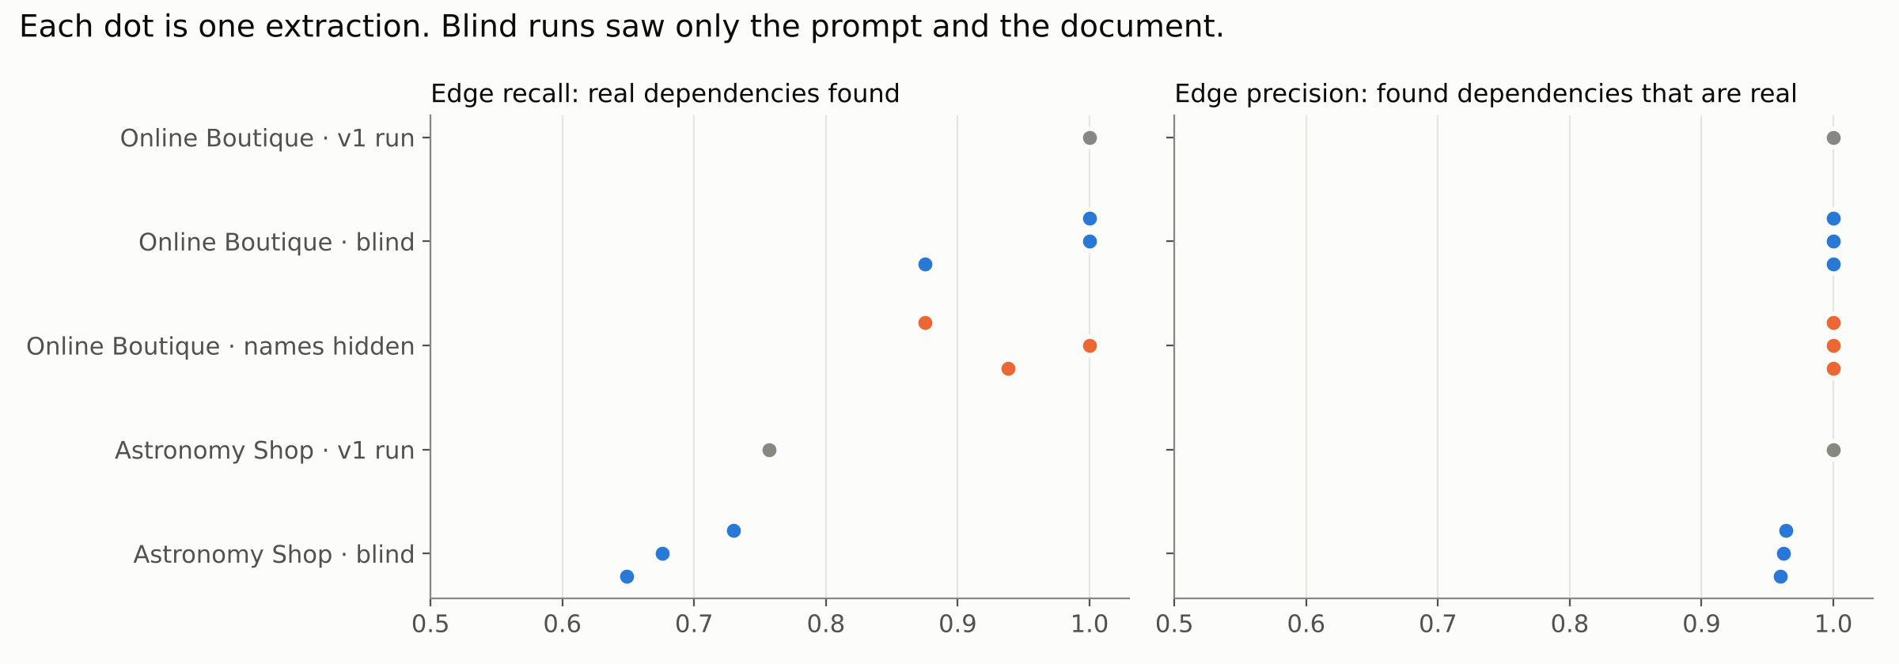
Hiding every service name barely changed the result
EVIDENCE 1B · READING OR REMEMBERING?
Online Boutique names replaced by codes (svc-01 … svc-11): recall 0.94 ± 0.06 vs. 0.96 ± 0.07 with names. Precision 1.00 in all 6 runs.
Caveat: descriptions stayed word for word, so the app could still be recognised. A second model (Gemini) is the next check.
Name-blind doc: src/anonymize.py · runs: extracted_blind/
Notes:
The worry was that the model recognises these famous apps and recalls their wiring instead of reading the document. So I replaced every service name in the Online Boutique doc with a neutral code and ran three more blind extractions. Results barely moved, which suggests the model reads the descriptions. It is not proof: the descriptions themselves are the original text, and all runs used the same model family.

Slide 8
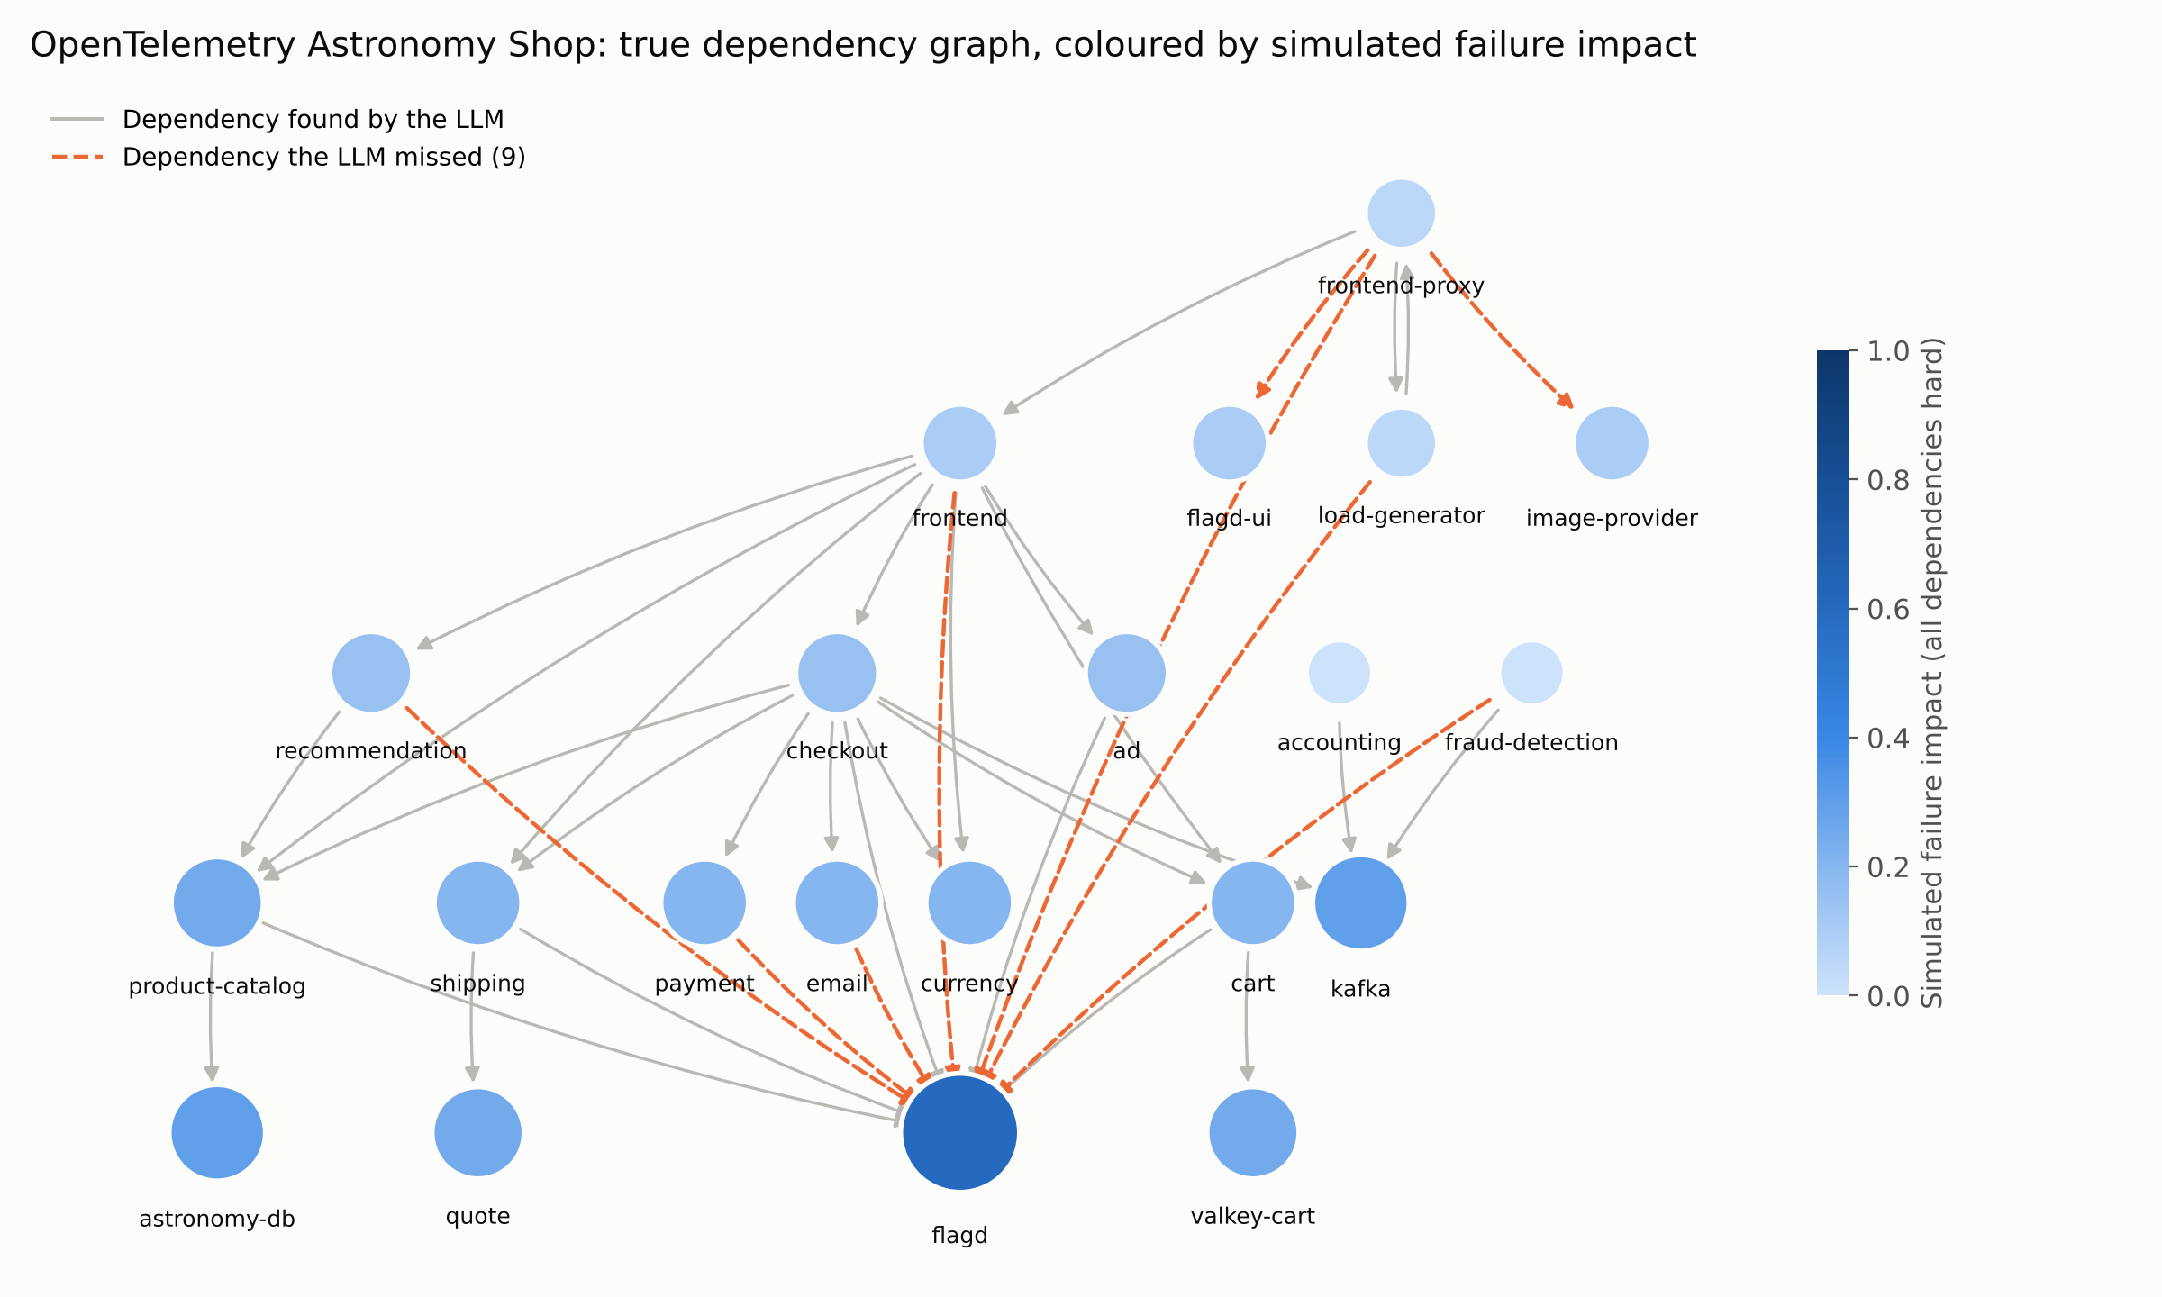
The misses are hidden configuration dependencies
EVIDENCE 2 · WHAT WAS MISSED
7 of the 9 missed edges point to flagd, the feature-flag service. All 3 blind runs missed the same 7. The configs show 12 users of flagd; the docs reveal 5.
The other 2 lead to flagd-ui (its README was not in our input) and image-provider (no README).
Dashed orange = dependency the LLM missed · node size and colour = simulated failure impact
Notes:
The LLM didn’t miss random edges. It missed configuration dependencies, because documentation rarely mentions that a service reads feature flags. This is not a one-off: all three blind runs missed exactly the same seven flagd edges, and the same two proxy edges. On paper flagd is the most depended-on component in the system. Slide 12 checks whether that actually makes it risky.

Slide 9
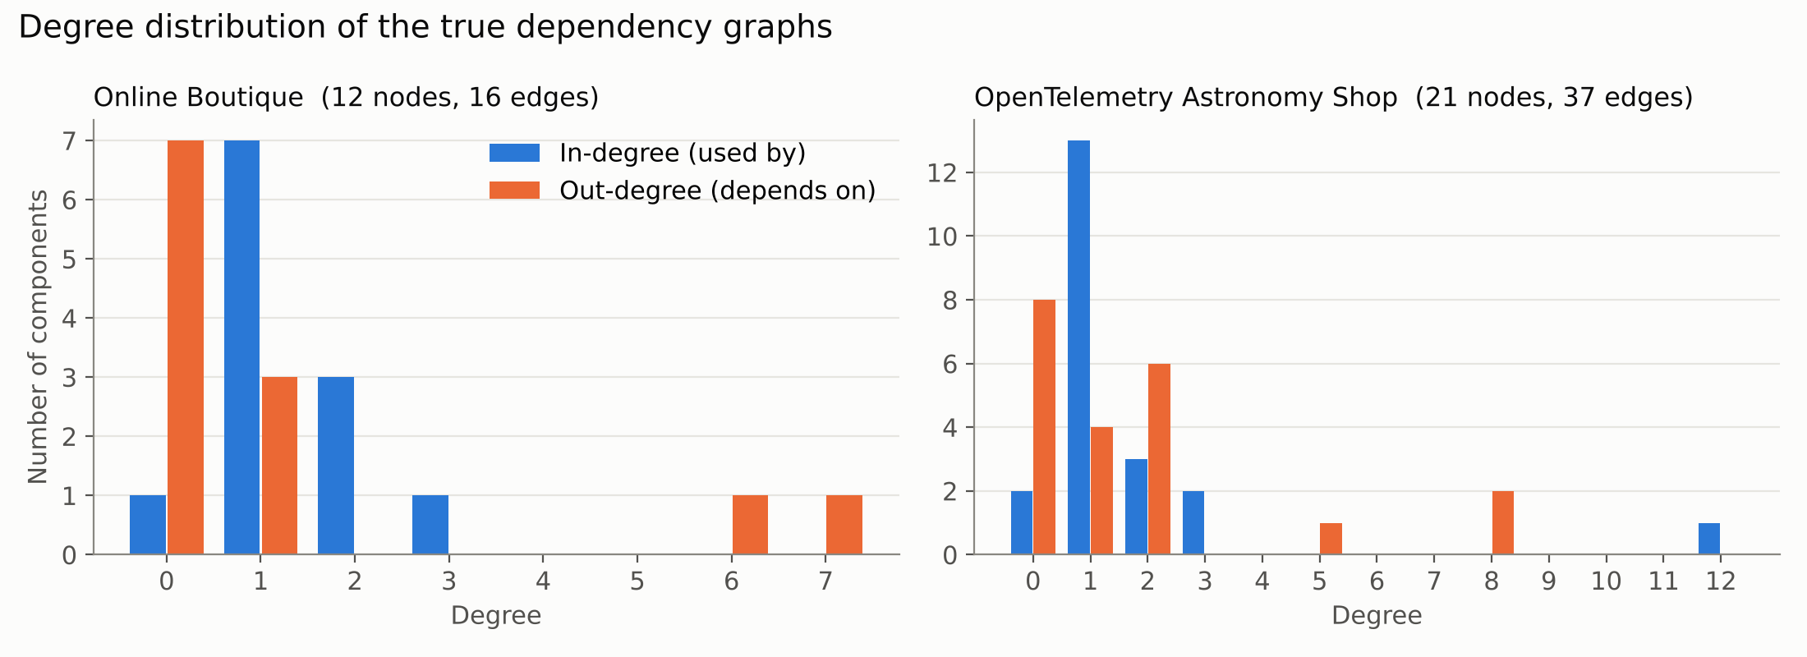
Most components are used by one other; a few hubs carry the load
FIRST GRAPHS · BASIC STATISTICS
True graph | Density | Most used (in-degree) | Longest chain | Cycles
Online Boutique | 0.12 | productcatalog (3) | 4 hops | 0
Astronomy Shop | 0.09 | flagd (12) | 4 hops | 1
Edges point consumer → provider · source: results/graph_stats.json
Notes:
These are sparse graphs with a hub structure. Chains are up to four hops long, which matters for the model choice: a two-layer GCN only sees two hops, so it may miss cascades that GraphGPS’s global attention can capture. The one cycle is real: the proxy serves the load generator’s web UI, and the load generator sends traffic through the proxy.

Slide 10
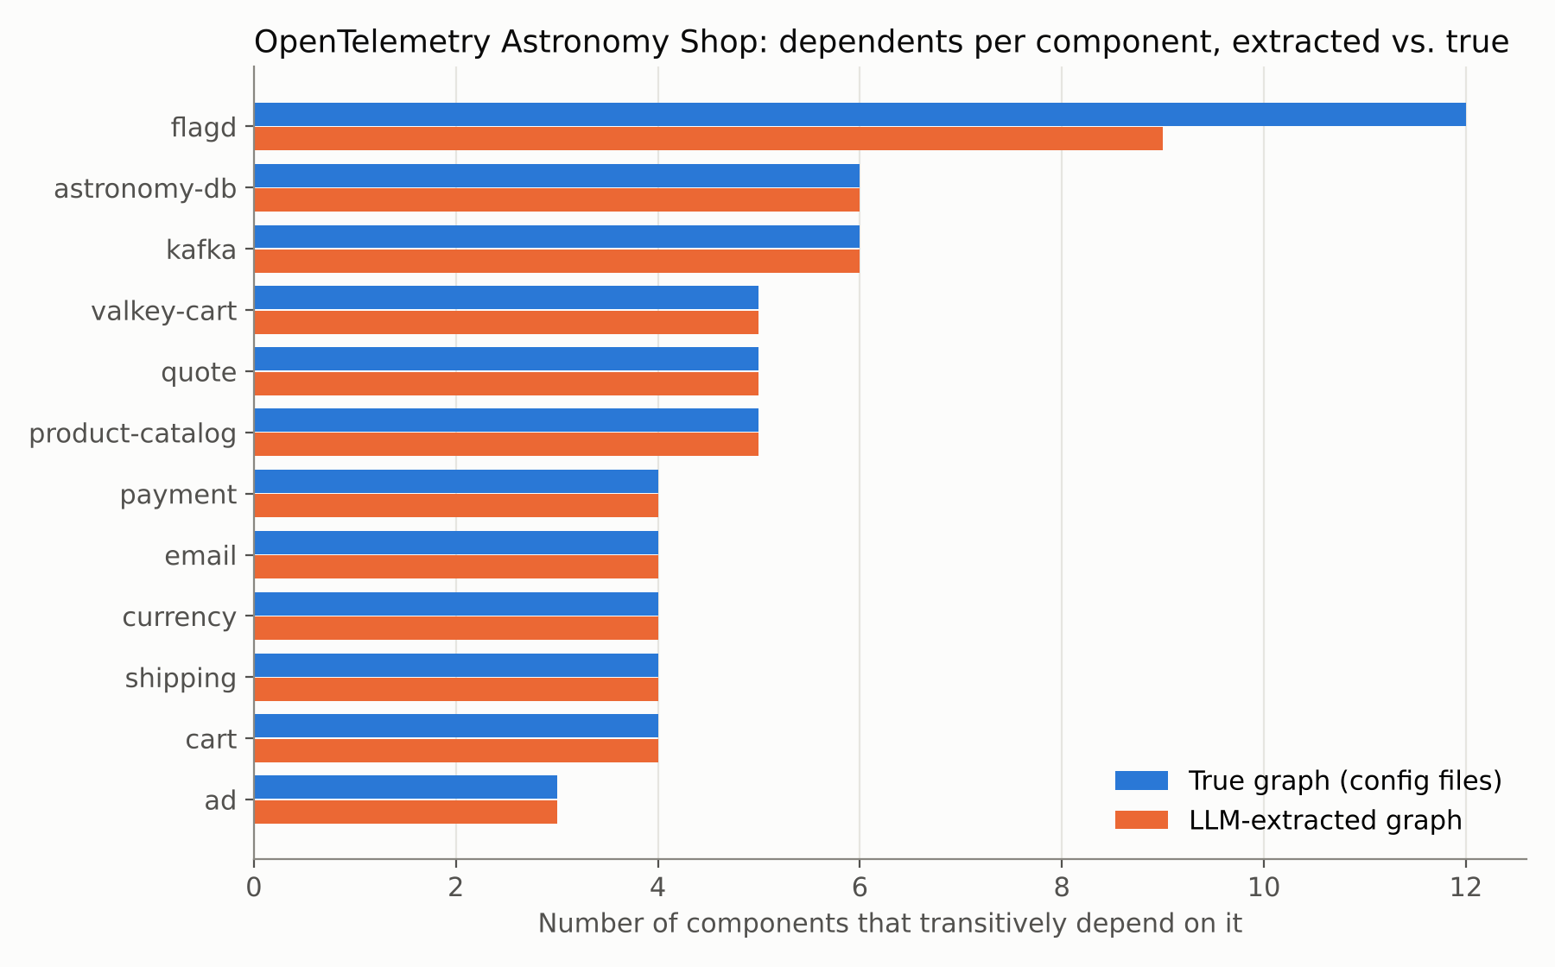
The order survived, but the top component lost dependents
EVIDENCE 3 · DO MISSES CHANGE THE RANKING?
Extracted vs. true graph: Spearman 1.00, Kendall 1.00, and the same top-5 set (6 components, with ties).
flagd drops from 12 to 9 dependents. 4 of the 7 missed consumers still reach it through other paths, so 3 are lost.
The blind runs agree: flagd has 9 dependents in all 3, and rank agreement with the truth is Spearman 0.98 ± 0.02.
Dependents = components that transitively depend on it · source: results/ranking_agreement.json
Notes:
This previews our second research question: if the LLM misreads the design, how wrong does the risk assessment get? Here the order holds, because missed services still reach flagd indirectly. But flagd’s count shrinks from 12 to 9. Ties matter: six components share the top five scores, so I report the top five as a set including ties.

Slide 11
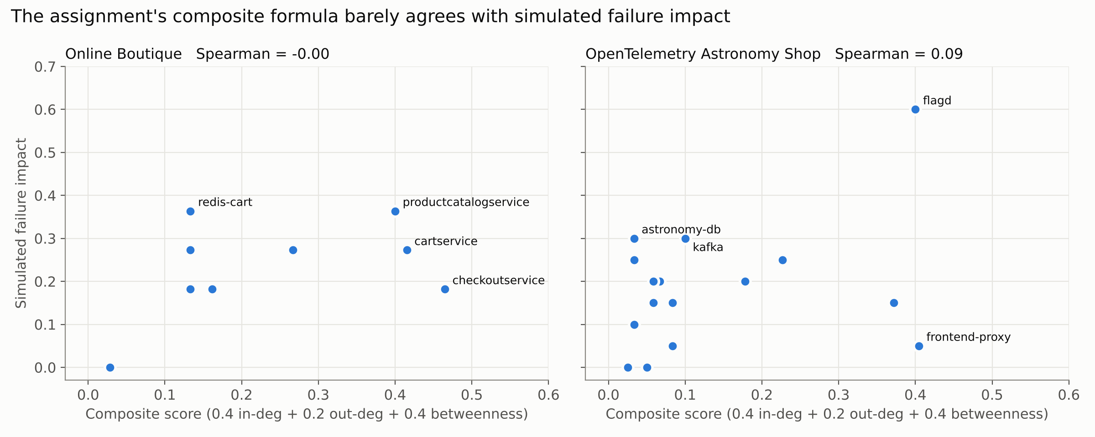
The composite formula and the failure simulation barely agree
EVIDENCE 4 · CHOOSING THE LABEL
Spearman 0.00 and 0.09.
Betweenness is zero for a datastore at the bottom of the graph, so astronomy-db scores 0.03 even though 6 components depend on it.
Decision: failure simulation is the main label. The composite score stays only as a heuristic to compare against.
Composite = 0.4 in-degree + 0.2 out-degree + 0.4 betweenness (min-max normalised)
Notes:
The assignment offers two labels. We computed both and they barely agree. Betweenness counts paths that pass through a node, and none pass through a database at the bottom of the graph, so the formula calls it safe even though everything above it needs it. This disagreement is partly built into the formula, which is exactly why it shouldn’t be the label.

Slide 12
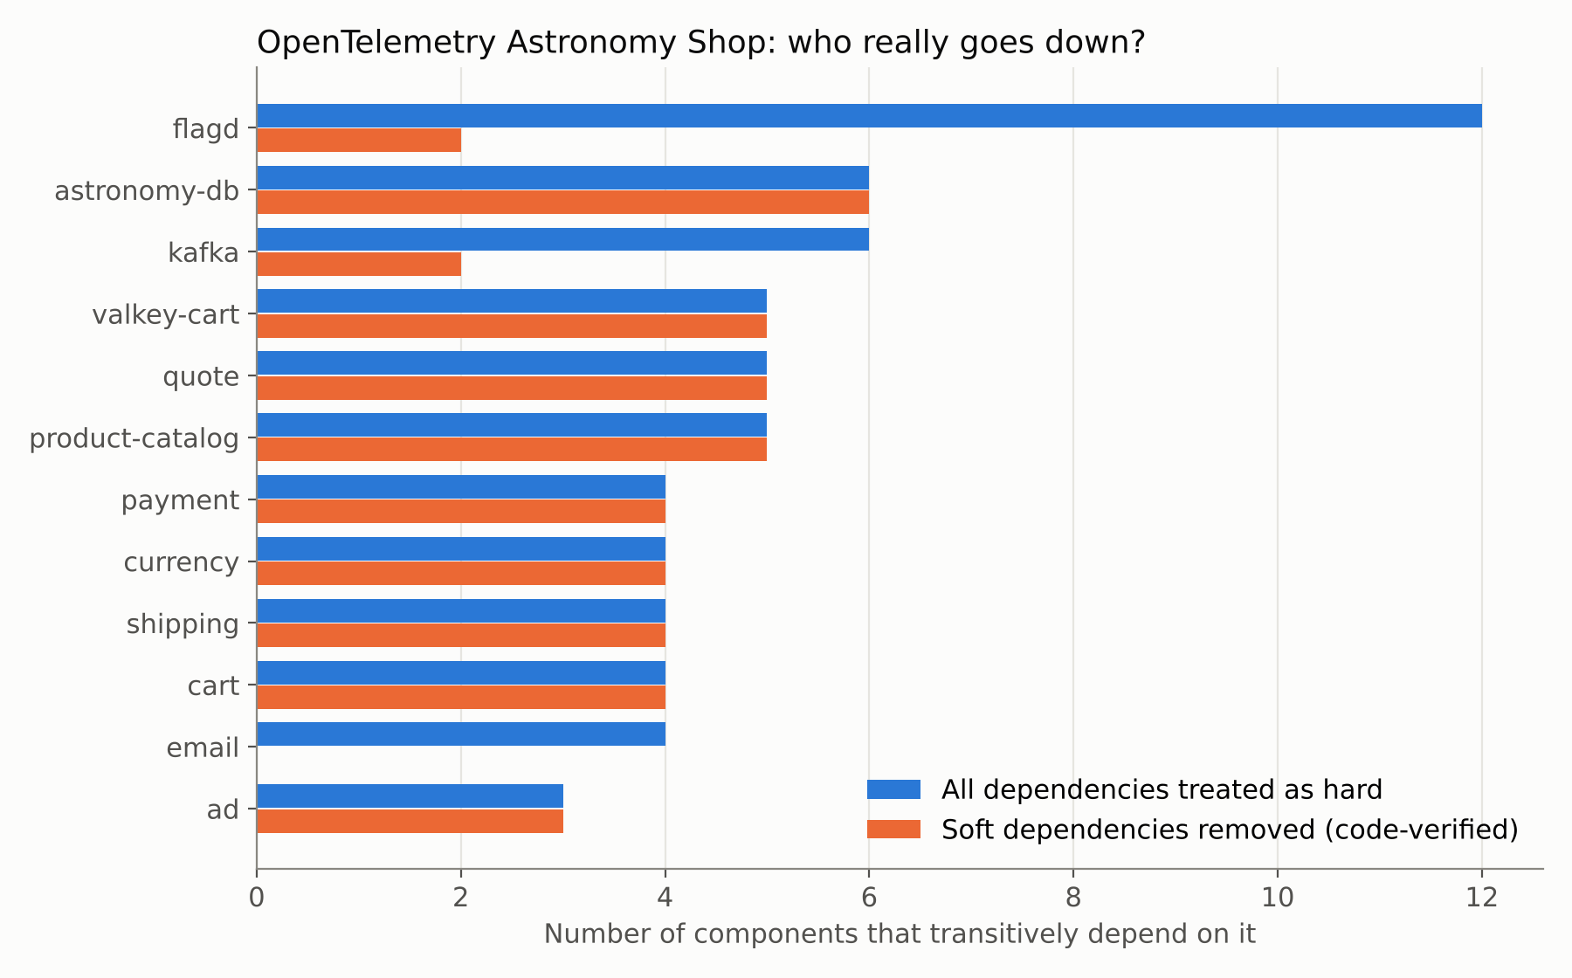
Checking the code changes who is really risky
EVIDENCE 5 · HARD VS. SOFT DEPENDENCIES
We verified 13 soft edges: flag reads fall back to defaults (OpenFeature spec 1.4.10), and checkout still completes the order if email or Kafka fails.
flagd drops from 12 to 2 dependents and Kafka from 6 to 2. astronomy-db, at 6, becomes the top risk.
Rank agreement falls to Spearman 0.66. Edge strength matters as much as edges.
Evidence for each soft edge, with file and line numbers: data/soft_dependencies.json
Notes:
The simple simulation treats every connection as a hard requirement. I checked the source code. Services read feature flags through OpenFeature, whose spec requires returning default values when the flag service is down. And checkout only logs the failure if the email or Kafka step fails, then returns the order anyway, though a Kafka outage can delay it. Removing those 13 edges, flagd falls from the top to almost nothing, and the product database becomes the real top risk. This is why the final project adds real fault injection, and why the extractor should also capture how strong each dependency is.

Slide 13
Labels, features, baselines and metrics
STATUS NOTE
Where labels come from
Model inputs, no leakage
Failure simulation using hard edges only (soft edges removed). Reality check: feature-flag fault injection on the Astronomy Shop.
Component type, stateful flag, number of interfaces and a description embedding. No degree, betweenness or centrality.
Baselines and models
Evaluation metrics
Random forest on node features (no graph), composite heuristic, 2-layer GCN, and GraphGPS. K-means on embeddings for risk tiers.
MAE, Spearman and Kendall on risk, tie-aware top-5 overlap, extraction P/R/F1. 5 seeds, mean ± std, split by system.
Notes:
Each assignment rule maps to a choice here. No leakage: graph metrics never enter the model. Non-graph baseline: the random forest sees only node features, so any gain from the GNN shows what structure adds. Small data: we train and test on different systems and repeat with five seeds. The label now uses only hard dependencies, because slide 12 showed soft ones distort the ranking.

Slide 14
What could make these results look better than they are
THREATS TO VALIDITY SO FAR
Threat | How we will handle it
LLM memory | Hiding service names barely changed recall (0.94 vs. 0.96), but descriptions stayed verbatim. Add lesser-known systems.
One model family | 9 blind runs agree (92–93% overlap), but all are Claude. Next: Gemini runs with my own API key.
Hard vs. soft edges | 13 soft edges verified so far; proxy routes and frontend calls still assumed hard. Confirm with fault injection.
Small data | 2 systems so far. Add 3–4 more apps plus realistic architecture variants.
Notes:
I want to be upfront about what could inflate these numbers. The model may already know these famous apps. Hiding the service names barely changed the result, which is encouraging, but the descriptions were the original text. And every run so far is Claude, so a Gemini run through the extractor script is the first task after the midterm.

Slide 15
From first evidences to the final report
NEXT STEPS
Step 1
Step 2
Step 3
Step 4
Gemini extraction runs (second model). Add Sock Shop, DeathStarBench and more.
Architecture variants, node features, description embeddings.
Train random forest, GCN and GraphGPS. Seeds, clustering, attention.
Fault injection on the Astronomy Shop, SME review, LLM advice, report.
Three questions the final will answer: how well an LLM reads system designs, how much its errors move the risk ranking, and whether predicted risk matches real failures.
Notes:
That’s where we are. Extraction, ground truth, graphs, labels and the soft-dependency check are working, tested, and reproducible from one script. Nine blind extraction runs back up the first results. Next come a second model, more systems, the models, and the real fault-injection test. Thank you, happy to take questions.

